Slide 1
Tools for CO2 Recovery for Breweries
and remarks to Pressure Piping
for the 2015 Ontario Technical Conference
of the Master Brewers’ Association of the Americas, District Ontario
Toronto, Ontario, 2015-Jan-28
Ueli Schrader, Beverage Engineering Inc. BEI

Slide 2
Boiler and Pressure Vessel
Registered Piping Systems in Ontario via TSSA
Do I really need to register my CO2- or Brew House Piping?

Slide 3
Boiler and Pressure Vessel
TSSA: SAFETY INFORMATION BULLETIN: SB00-7 Rev. 4
Guide for the Scope of Services Requiring Registration and Inspection of Pressure Piping Systems by Boilers and Pressure Vessels Safety Division (BPVSD) for Installations in the Province of Ontario.

Slide 4
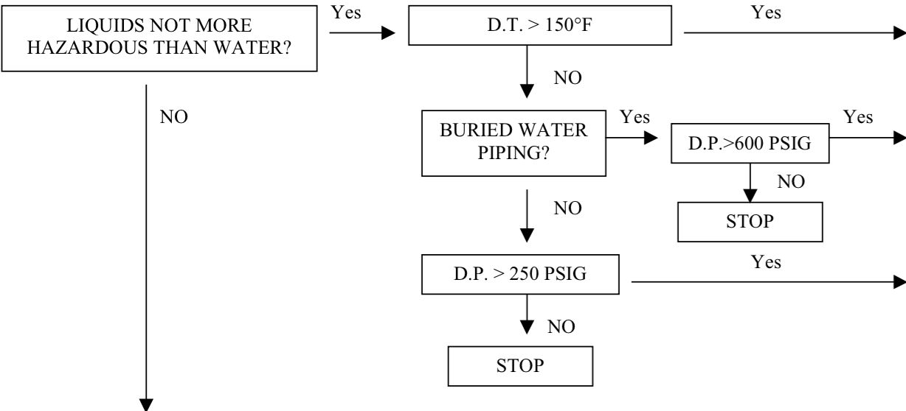
Boiler and Pressure Vessel
65.6ºC

Slide 5
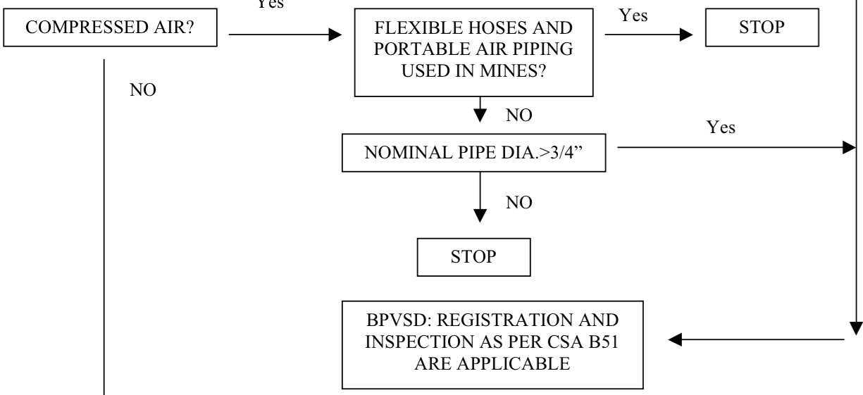
Boiler and Pressure Vessel

Slide 6
Boiler and Pressure Vessel
Summary:
Register with TSSA all new product piping
Do not register low pressure pipes and cold water, vents, small compressed air pipes
Use only CRN-registered components (valves and instruments) for all product (and …) piping projects
Ask your contractor to do the TSSA registration

Slide 7
CO2 Recovery
Why?
What is involved?

Slide 8
CO2 Recovery
Why?
Money: Make or buy
CO2 The fifth essential ingredient of beer !
Other like environmental, compliance …

Slide 9
CO2 Recovery
What is involved?
Buffer, because collection and usage do not occur at the same time.
(Superheated) Gas Buffer. Pressure / Temperature / Volume 0 psig ; 15.6ºC ; 1.84 kg/m³ gas
Liquid Buffer (boiling liquid): Pressure 250 psig / Temperature -8.4ºF = -22.5ºC; 1’042 kg/m³ liquid and 35 kg/m³ gas
Technical Installation
each machine has its price (installed) and operating costs
each machine has its limits (operating envelope).
each machine requires space and maintenance.
Notes:
apply some physical basics and common sense

Slide 10
CO2 Recovery
CO2 Collection (wet gas discharged from fermentation).
The amount of fermentation is defined by Balling 2.0665 kg of extract will produce 1.0000 kg of ethanol and 0.9565 kg of CO2 and 0.1100 kg of yeast, and by doing so generate 1’178 kJ of heat
In the brewery the CO2 amount is defined by - the rate fermenters are filled, - the rate each fermenter collected from ferments, - the time delay chosen when to switch from venting to collection. - other events.
Notes:
K.J.N. Balling, Professor of Chemistry at the Prague Polytechnic (1835 - xx)
Other basic knowledge of fermentation in a brewery …

Slide 11
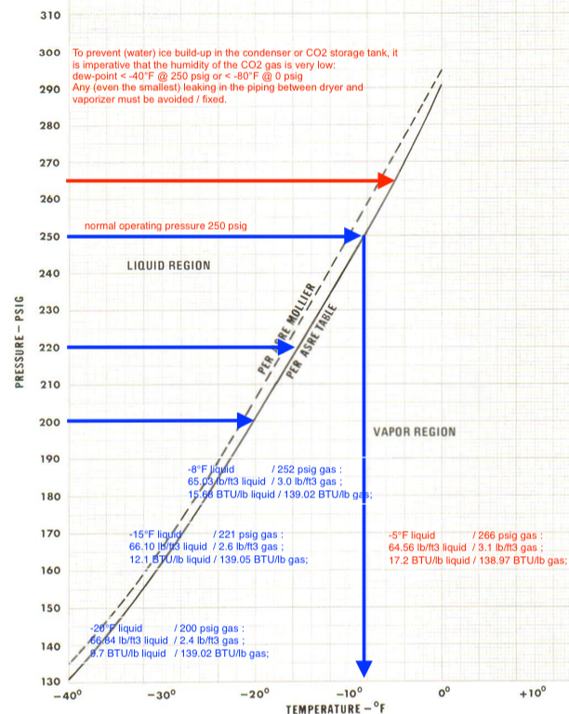
CO2 Recovery
Notes:
Technical data of CO2 …

Slide 12
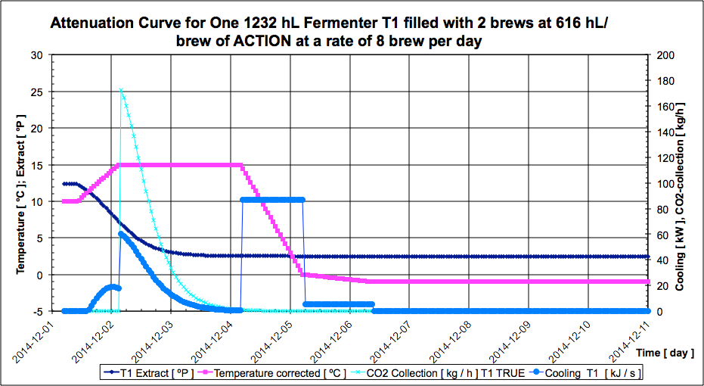
CO2 Recovery
Notes:
Now we need some input about the brand’s fermentation, which we collect the CO2 from.
Red is the temperature in ºC according to recipe, dark blue the extract in ºP, in cyan the CO2 collection curve in kg/h, and medium blue the refrigeration load caused by the fermentation in kW. [3.517 kW per T.R.]
This is an example where the collection is started relatively late, almost half of the extract is already digested by “our guys” the yeast.

Slide 13
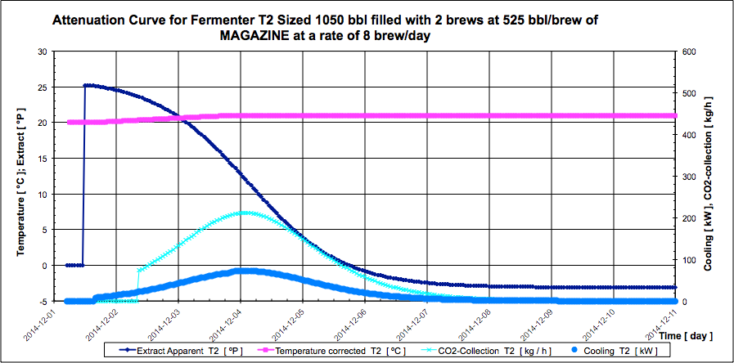
CO2 Recovery
Notes:
Another high gravity brand with slower fermentation, filled into the second and third tank.

Slide 14
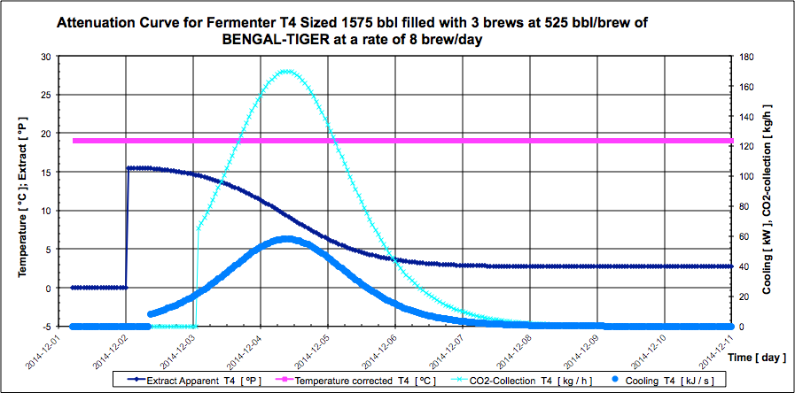
CO2 Recovery
Notes:
A third brand with more common characteristics goes into the fourth tank.

Slide 15
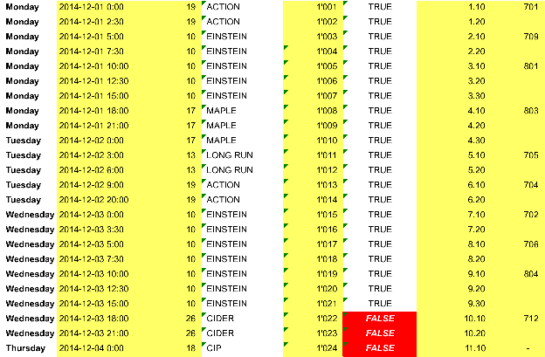
CO2 Recovery

Slide 16
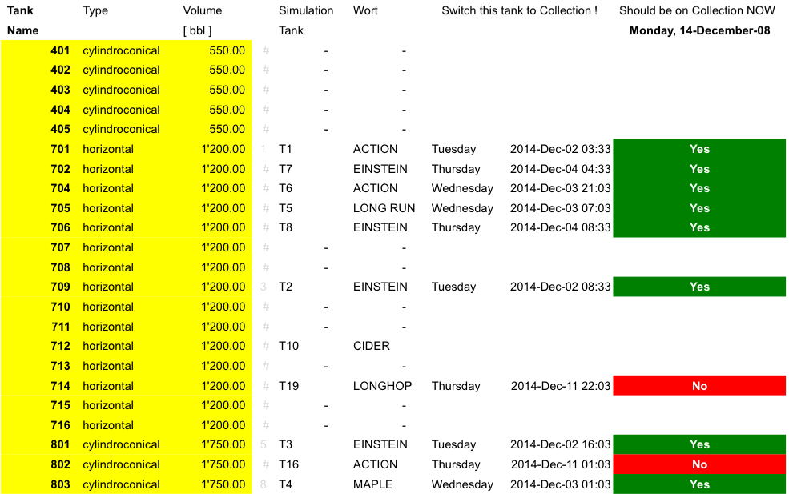
CO2 Recovery

Slide 17
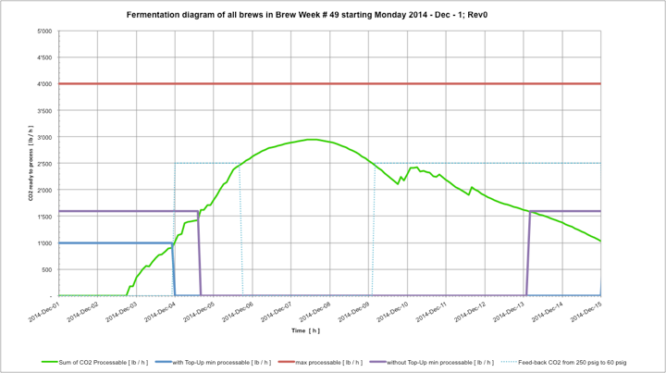
CO2 Recovery

Slide 18
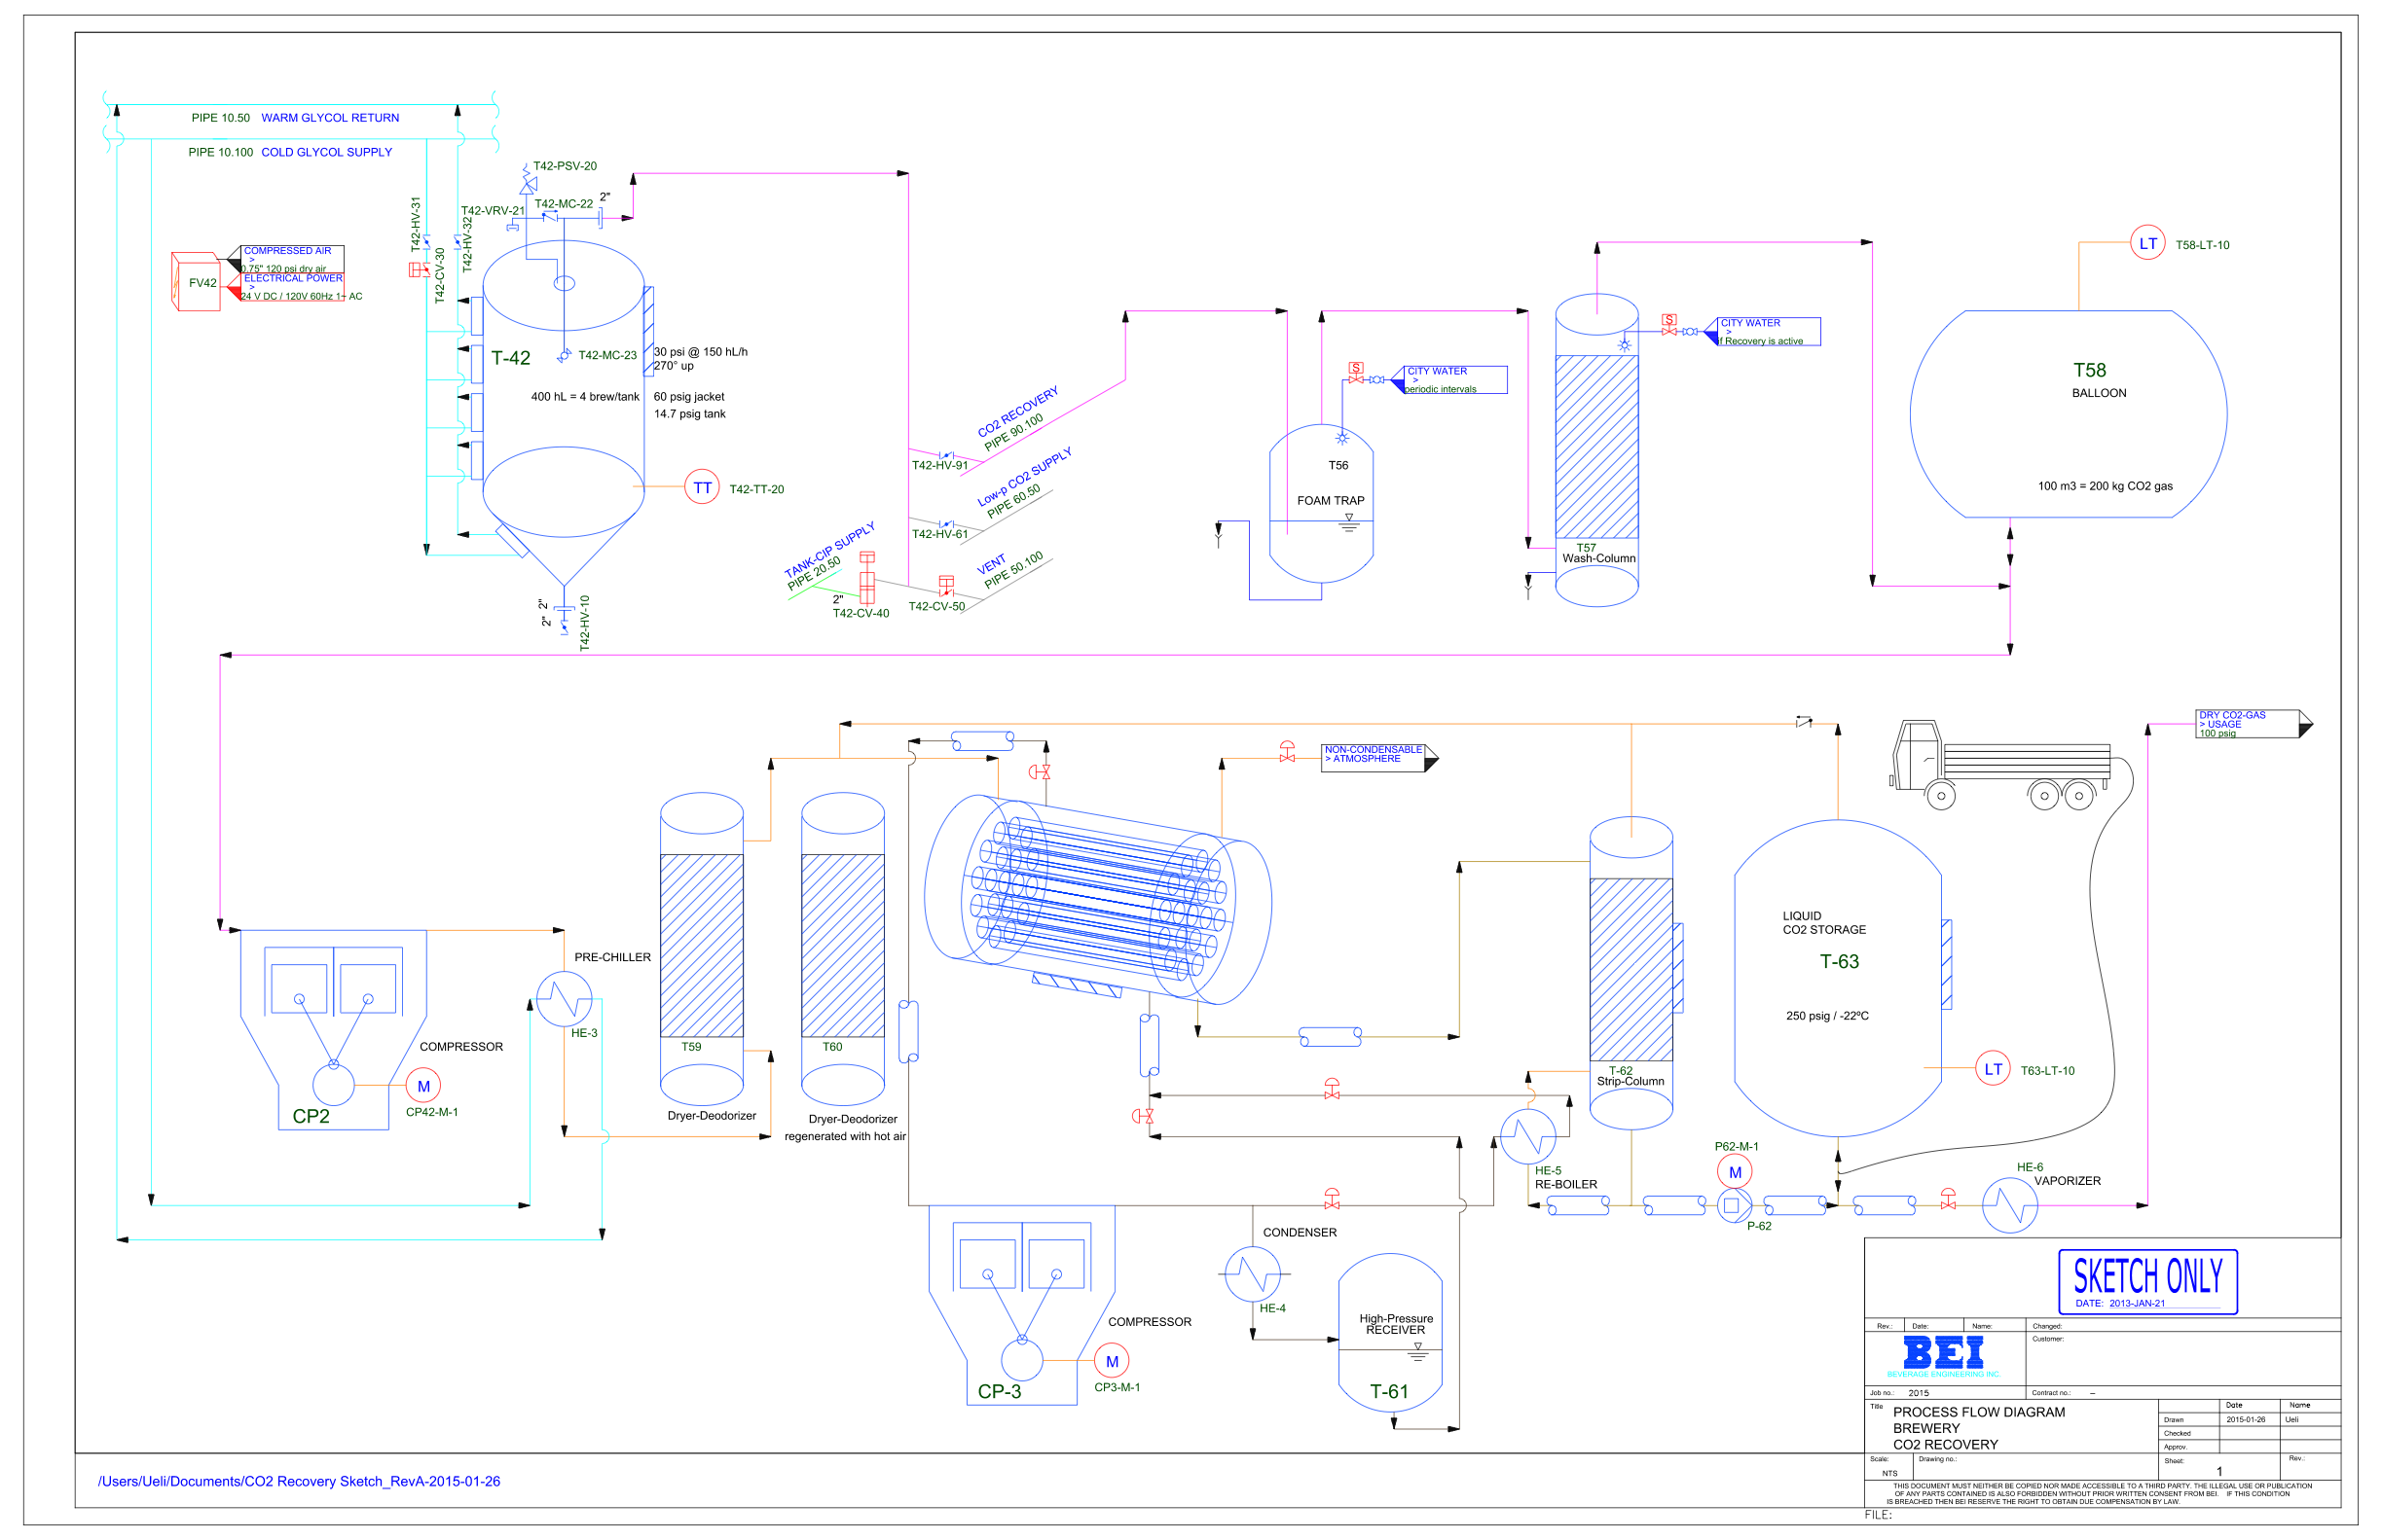
CO2 Recovery

Slide 19
CO2 Recovery

Slide 20
CO2 Recovery

Slide 21
CO2 Recovery

Slide 22
CO2 Recovery

Slide 23
Thank You
For Listening
Attila Soti and BEI for letting me
Notes:
for your time and attention
for letting me work on this as one of my last tasks in this company.

