Slide 1
Tasked with Terroir Investigating the contributions of barley to wort ionic composition, impacting brew process and flavor. Hannah Turner – Montana State University

Slide 2
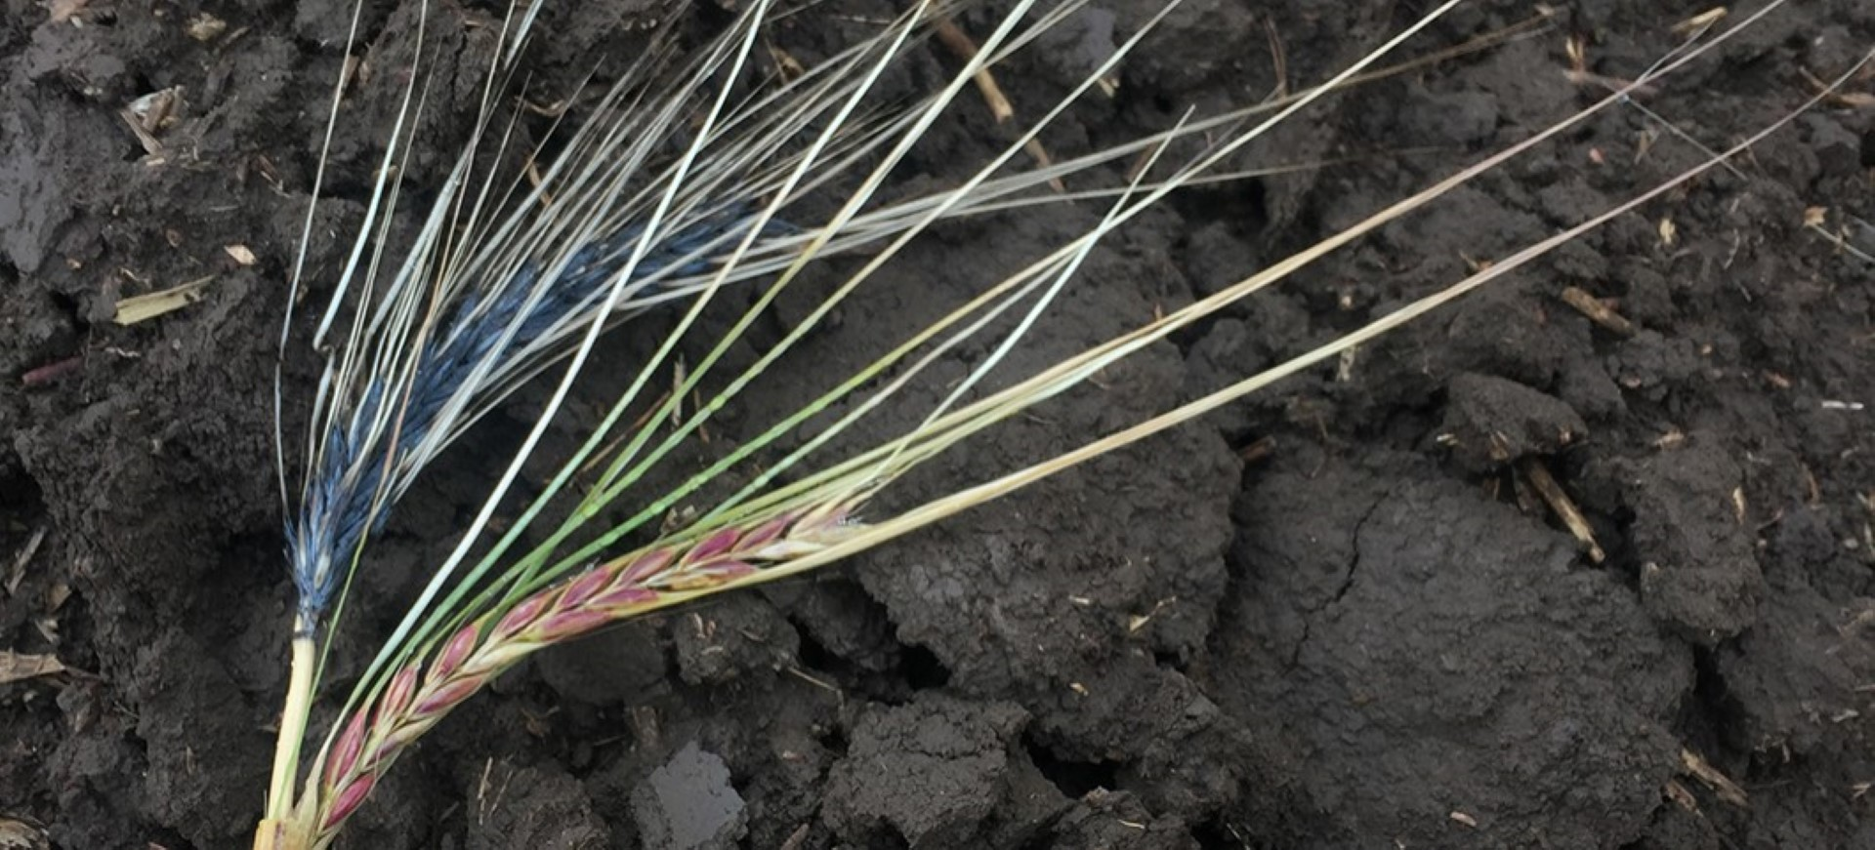
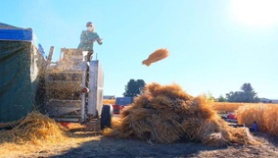
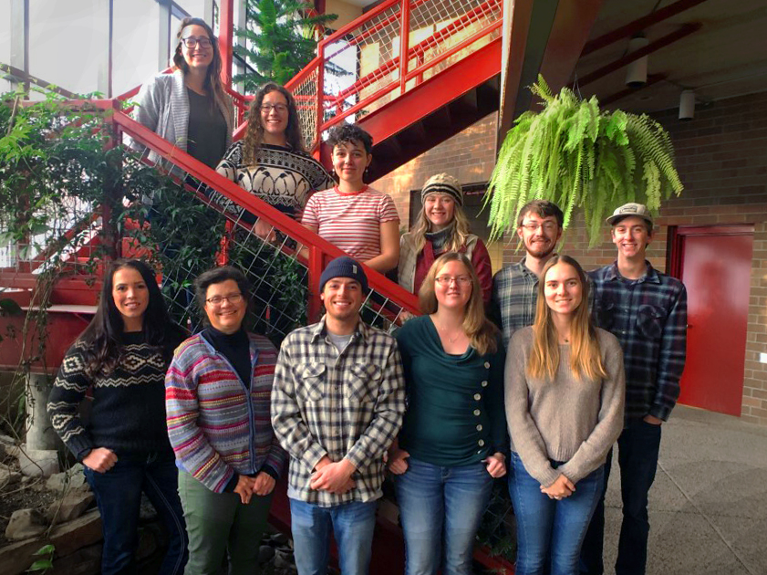
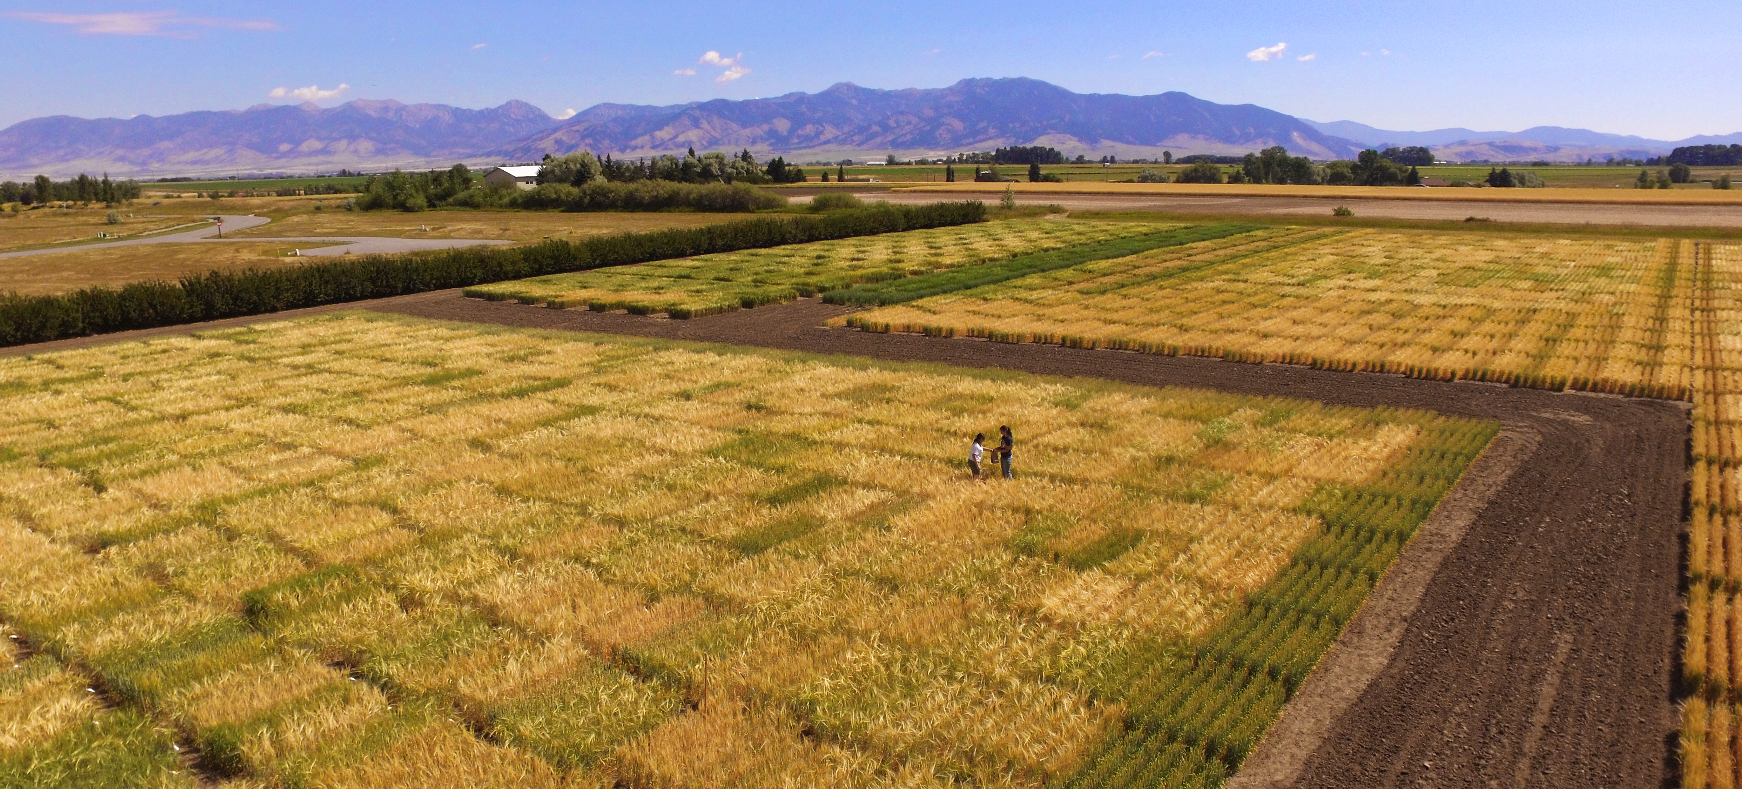
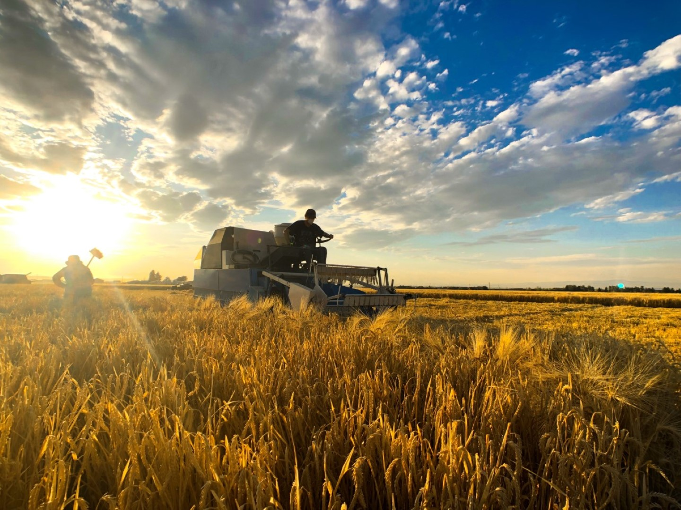
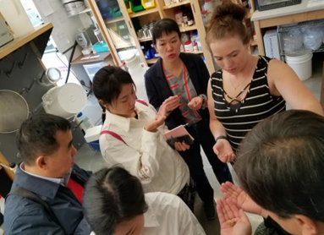
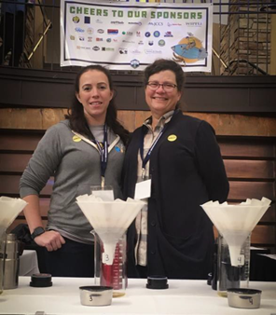
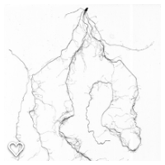
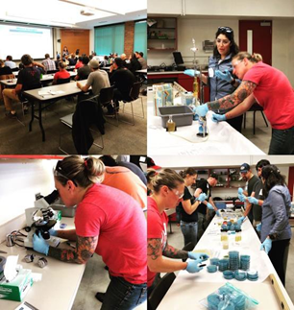
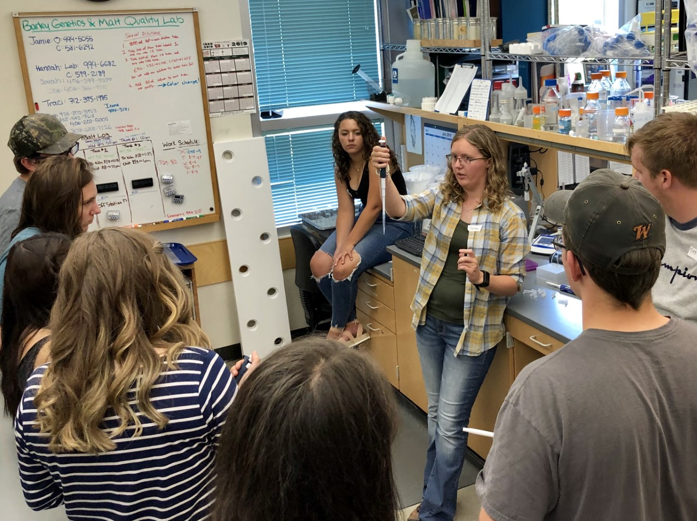
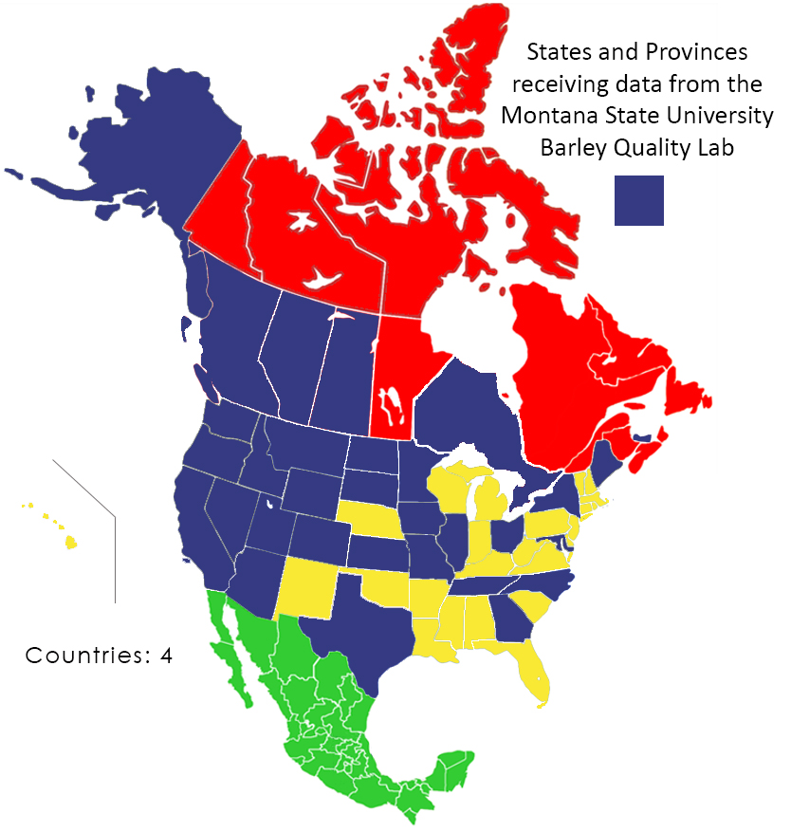
Barley Breeding, Malt & Brewing Quality
Supporting the region and beyond via
Research | Service | Education
www.montana.edu/barleybreeding

Slide 3
Recent studies show terroir to be impactful for barley, yet causation is not defined.
Beer – Oregon: Herb et al 2017
Sensory on a large number of beers
Three varieties, three locations
Conclusions:
Variety & environment have an effect
Whiskey – Ireland: Kyraleou et al 2021
Ireland
Sensory & chemical on new make whiskeys
Two varieties, two locations
Conclusions:
Variety, environment & season have impacts
Oregon

Slide 4
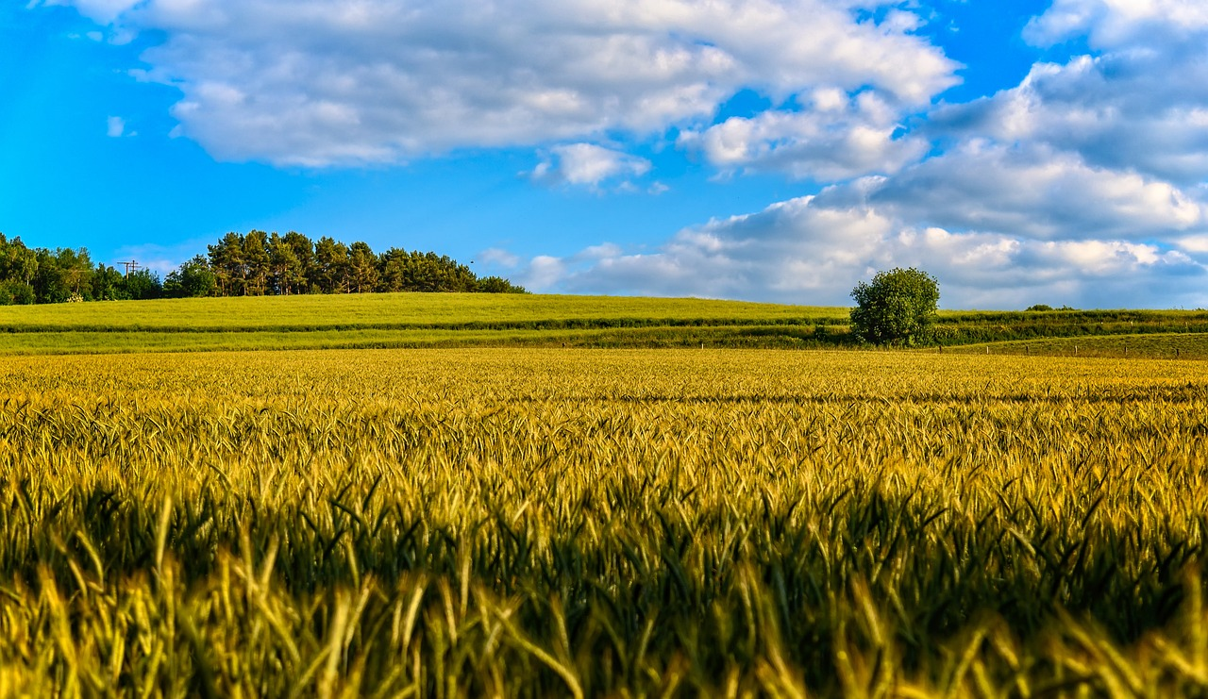
What Could Cause Barley Terroir?
Growing Environment:
Malting
Environment:
Soil
Nutrients applied
Moisture availability
Rain/Water profiles
Temperature
Seasonal variation
Water profile
Process amendments
Temperature
Timing
Floor/pneumatic
G x E
Barley genetics (regulated reactions specific to each variety) will interact with environment to create unique variances
One approach to measuring –> mineral content of malts

Slide 5
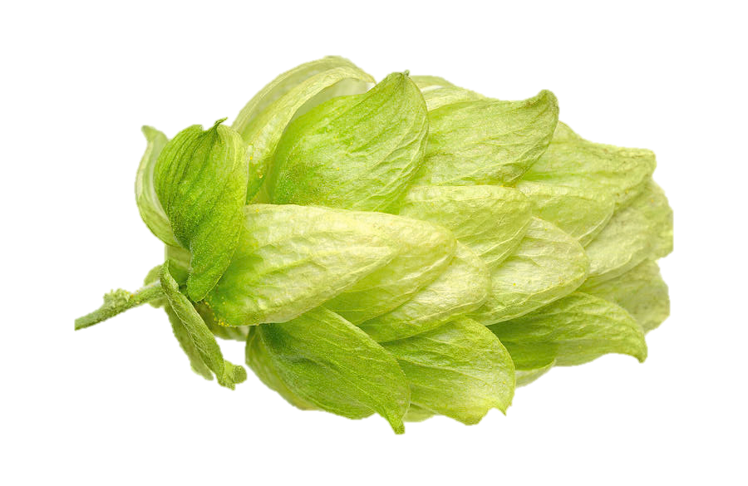
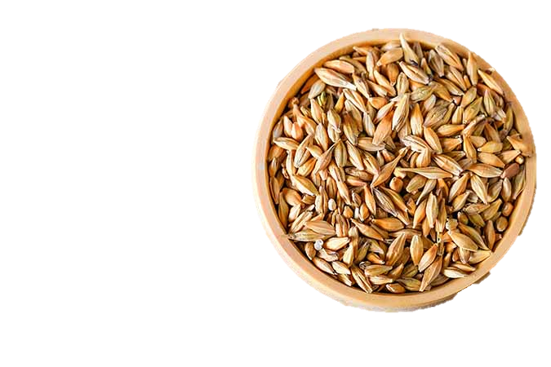
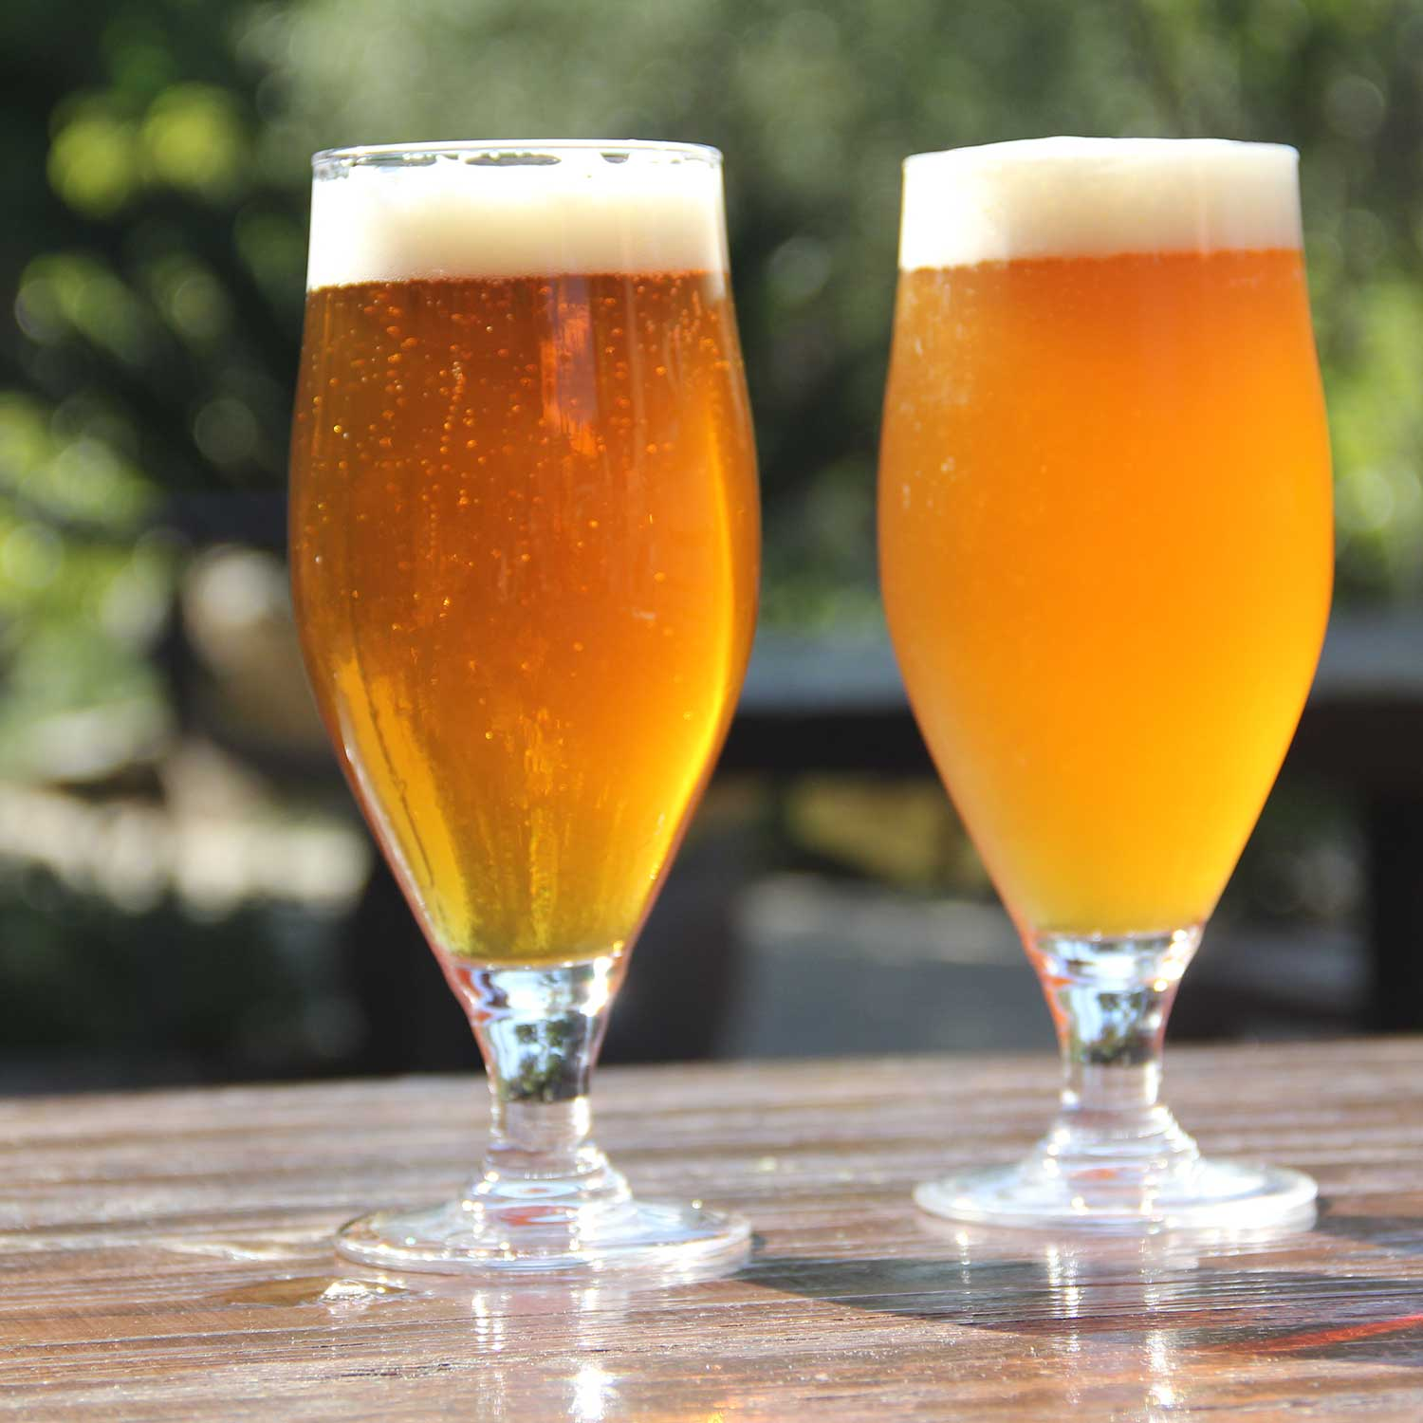
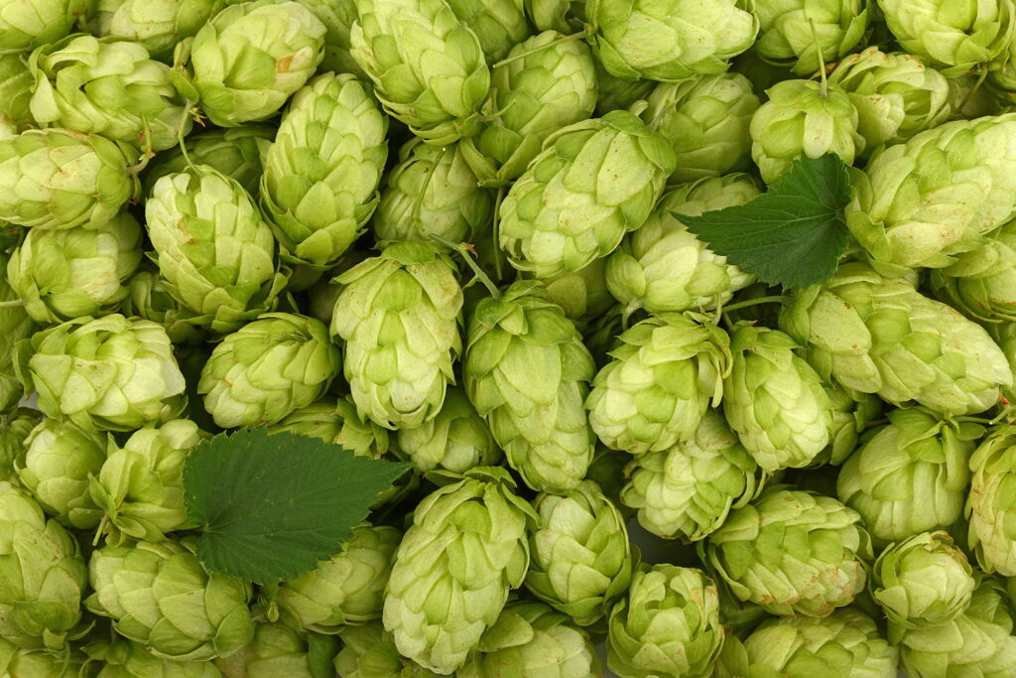
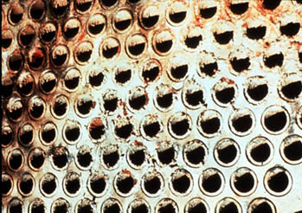
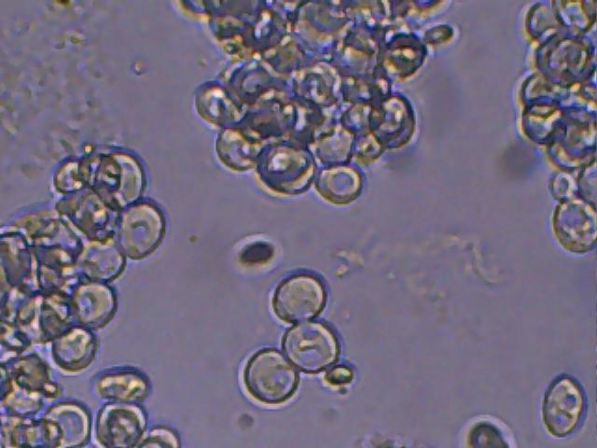
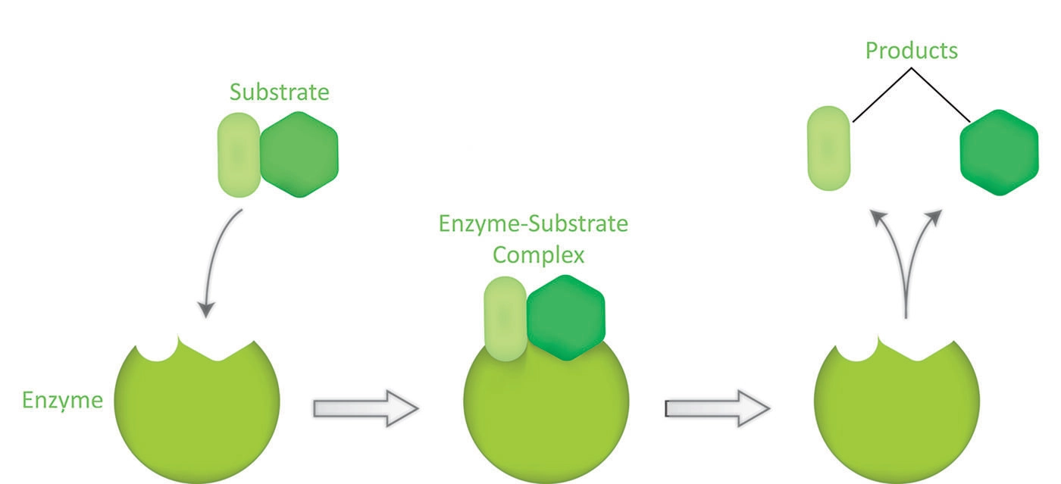
IMPACTS OF MINERAL COMPOSITION
FLAVOR: HOPPY MALTY
CLEAN SWEET SOUR
APPEARANCE:
HAZE COLOR
PROCESS:
Time, enzymes, beer stone, runoff, yeast flocculation, hop utilization, waste stream
Notes:
Chloride
Chloride is associated with palate fullness and contributes to the perception of beer body. Excessive chloride may inhibit yeast flocculation and promote can corrosion. Important in ratio to Sulphate.
Iron
Iron in beer can be detrimental for sensory, stability, and quality. Beer iron content should be as low as possible. Levels above 0.2 mg/l can lead to incomplete conversion, haze, and hampered yeast activity
Magnesium
Enhance beer character with sour astringent flavor. Key yeast nutrient (helps under stress)
Potassium
Malt is naturally high in potassium. Potassium can taste salty at high concentrations and brewers using potassium softened water may have issue if malt contributions are high.
Silica
Silicates can be extracted from malt husks. High levels can cause slow runoff and haze in beer. Silica can combine with calcium and magnesium to produce heavy scale in pipes and can foul reverse osmosis membranes.
Sodium
Can round out beer flavor, accentuating the sweetness of malt, especially in association with chloride. Low sodium will create a cleaner flavor while high levels may taste harsh and excessively sour.
Sulfate
Sulfate accentuates hop bitterness, making it seem drier and crisper. Important in ratio to Chloride. Sulphates positively affect protein and starch degradation, which promotes filtration and trub sedimentation. High levels may lead to poor hop utilization and harsh, salty, laxative characters in finished beer.

Slide 6
Early Observations
Do we see differences?
Notes:
Potassium
217 - 348
Sodium
7 - 40
Magnesium
30-95
Sulfate
1 - 110
Chloride
40 - 210
Iron
0.01 – 0.14
Silica
113 - 161

Slide 7
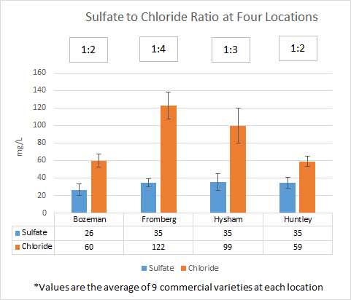
Sulfate to Chloride Ratio
Sulfate favors: dry, bitter flavor -> hoppy
Chloride favors: sweet, full flavor -> malty
Is ratio more important?
Or actual levels?
Either way, its impacted by malt!
General ratios:
2:1 SO₄²⁻:Cl – for bitter beers
1:2 SO₄²⁻:Cl – for mild ales
1:3 SO₄²⁻ :Cl – for stouts and porters
9 commercial varieties grown at 4 diverse locations across Montana
Katy Orr, 2017
Notes:
Sanchez, G.; Salts & Minerals & Their Impacts in Brewing & Beer

Slide 8
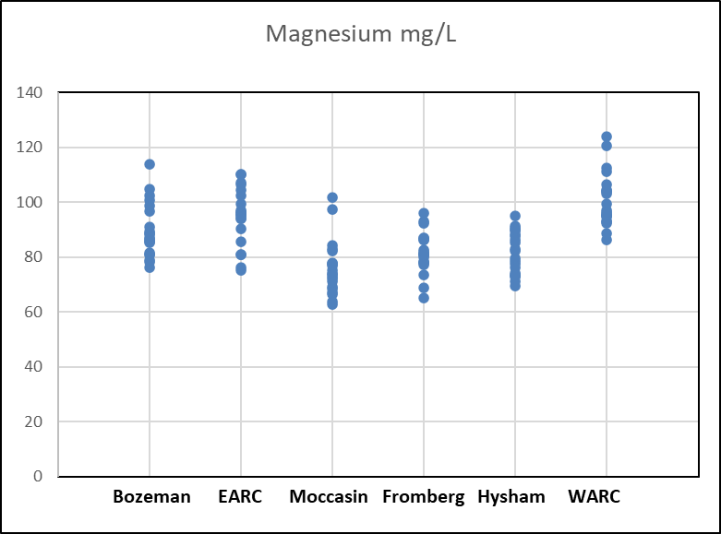
Magnesium-Accelerated Maillard Reactions
Barley, Malt & Brewing Quality Lab
Higher Mg levels in wort = accelerated color and Maillard flavor development
MSU Experimental lines at 6 MT Locations
Omari et al 2020
Notes:
Potassium
217 - 348
Sodium
7 - 40
Magnesium
30-95
Sulfate
1 - 110
Chloride
40 - 210
Iron
0.01 – 0.14
Silica
113 - 161

Slide 9
Variation by Variety
The genetic component

Slide 10
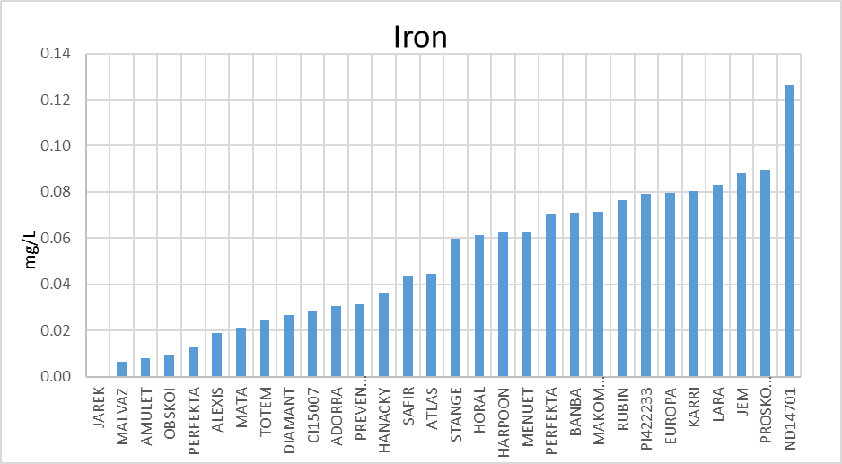
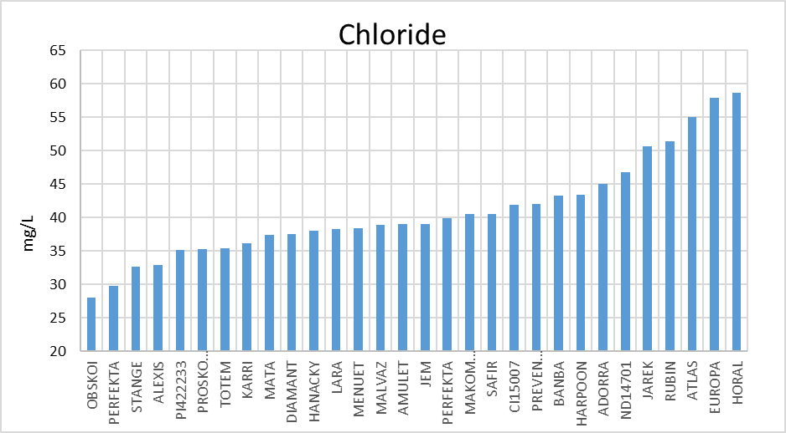
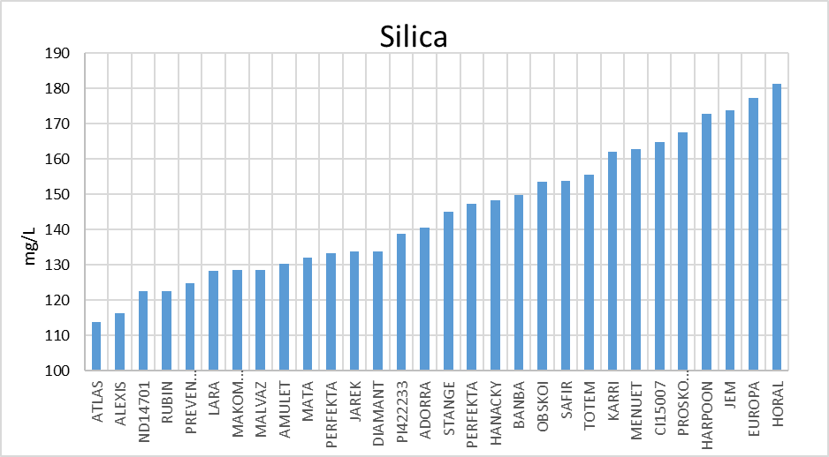
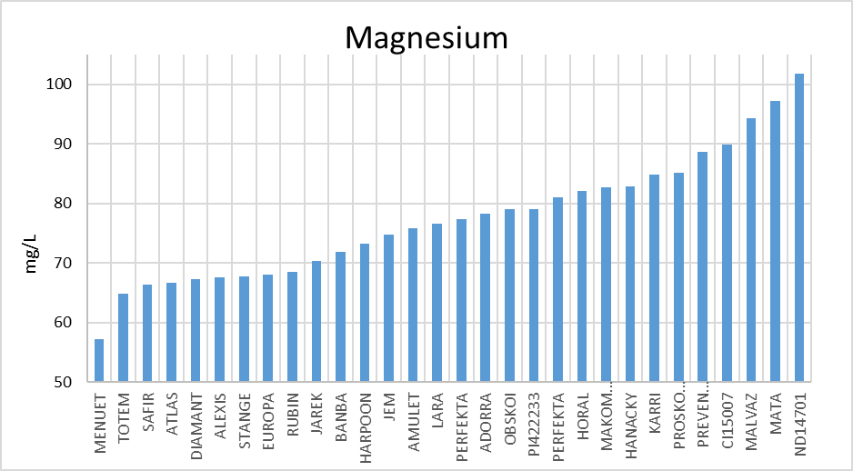
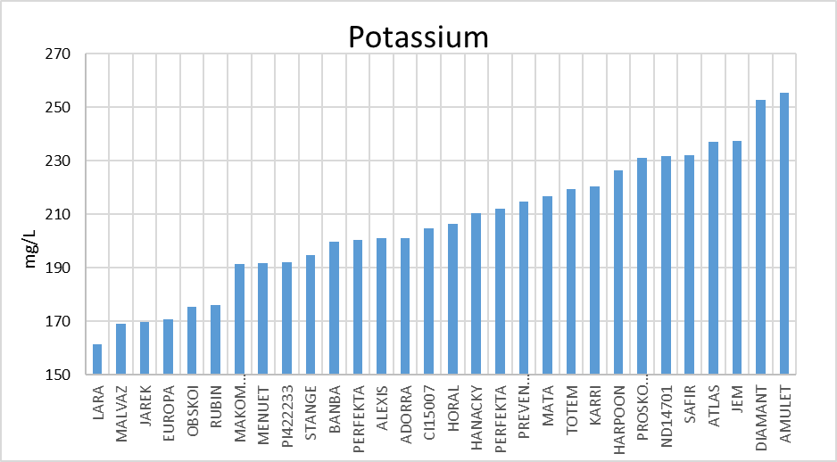
30 Diverse Heirloom Malts -Same growing conditions -Same malting conditions
Range: 0 – 0.13
Most Impacted:
Potassium, doubled+
Silica, doubled+
Chloride, doubled
Magnesium, doubled
Range: 28 - 59
Range: 114 - 181
Range: 57 - 102
Range: 162 - 255

Slide 11
Variation by Location
Environmental component (the field)

Slide 12
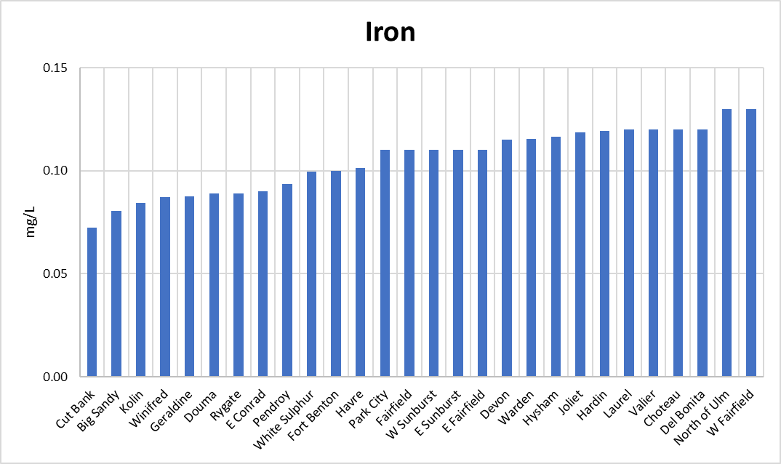
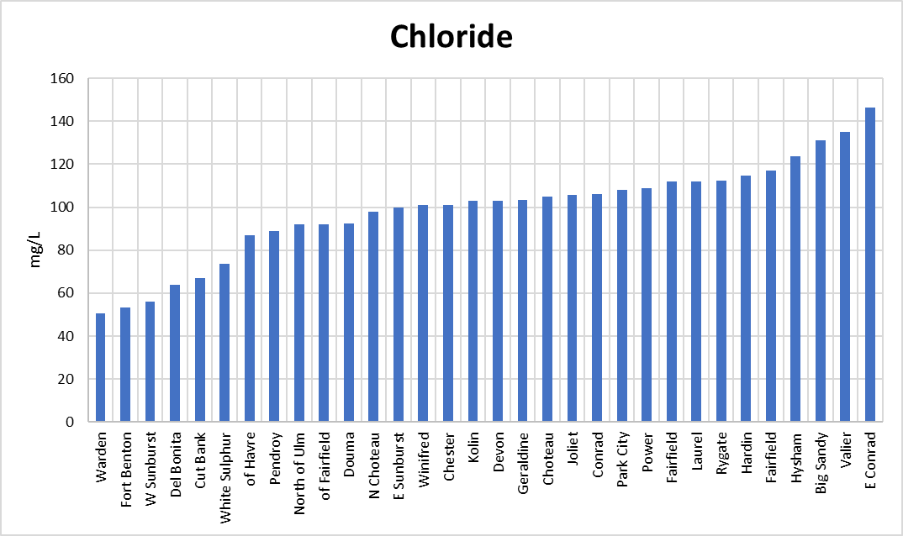
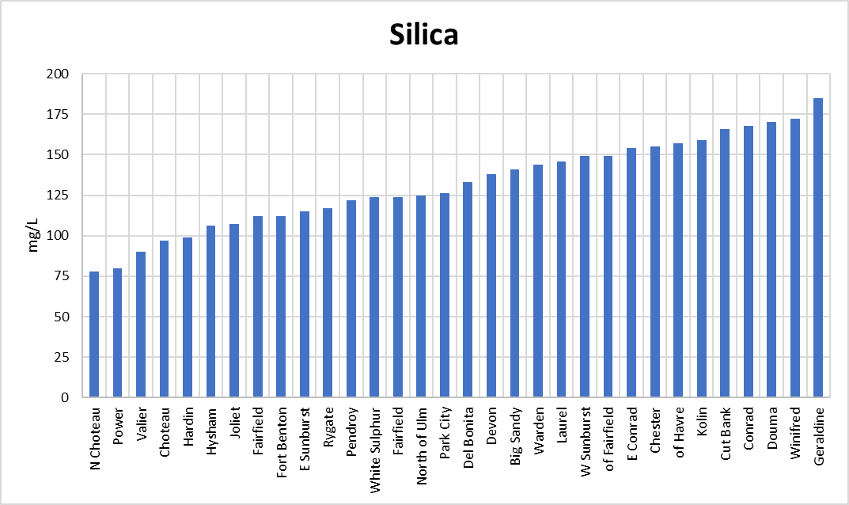
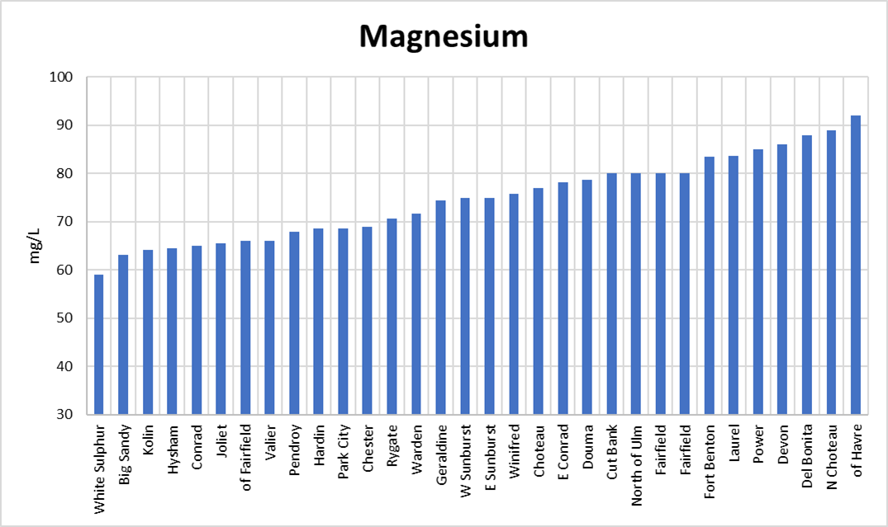
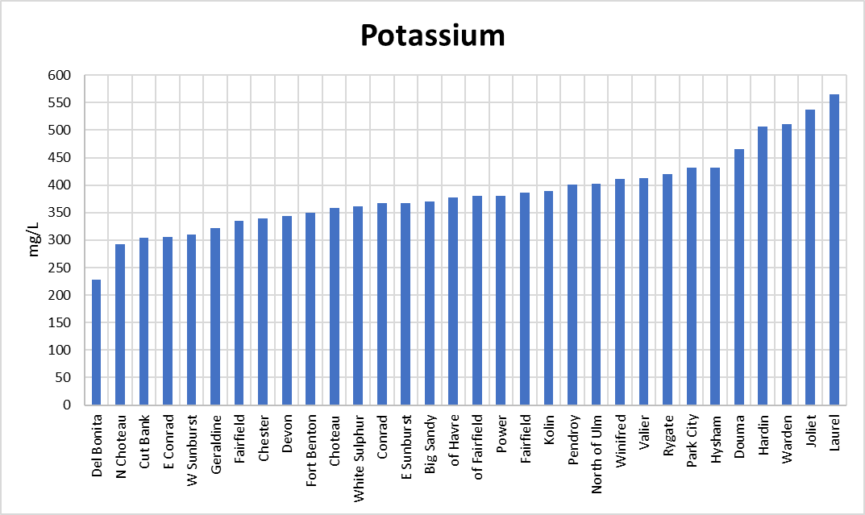
32 Barleys from across Montana -varied varieties -varied locations
Range: 0 – 0.13
Range: 50 - 146
Most Impacted:
Chloride, tripled
Potassium, doubled+
Silica, doubled+
Magnesium, doubled
Range: 78 - 185
Range: 59 - 92
Range: 228- 565

Slide 13
Variation by Malthouse
Includes genetic and environmental variation

Slide 14
34 Malthouses, 90 malts
Range: 0.05 - 0.33
Impacts:
Iron, 6 fold +
Chloride, quadrupled
Potassium, doubled+
Silica, 5 fold +
Magnesium, doubled
Range: 37 - 179
Range: 35 - 187
Range: 55 - 107
Range: 248 - 628

Slide 15
Terroir -34 malthouses, 1-4 malts from each
Two malthouses (3 malts each), from similar proximity.
A demonstration of terroir!
Each bar represents one malt, 90 total. The high sodium bars represent 6 malts from two different, but closely located malthouses.

Slide 16
Tailored Malting Water
Does malting water profile matter?

Slide 17
Study: Can Malthouse Water Impact Malt Minerals?
Beers are styled by traditional water profiles,
Malts from those historic beers would have been made with the same water!
5 varieties, 3 reps (from varied environments)
Buzz, Copeland, Genie, Metcalfe, Violetta
45 samples total
3 mineral profiles: Zero, medium, high
RO, Dortmond, Burton on Trent
Malting kept consistent but for water treatment
Water Mineral Content: mg/L
Mineral | RO | Dortmund | Burton on Trent
K | <1 | 0.8 | 2.5
Mg | <1 | 53 | 54
Na | <1 | 109 | 66
SO4 | <1 | 310 | 800
Cl | <1 | 130 | 29
Hardness | <1 | 320 | 650

Slide 18
Effect of Water Treatment on Malt Quality
Letters (a, b, c) indicate statistical differences p < 0.00, or p < 0.05
a
c
b
c
b
a
a
b
c
b
b
b
c
a
a

Slide 19
Effect of Water Treatment on Minerals
Letters (a, b, c) indicate statistical differences p < 0.00, or p < 0.05
b
a
c
a
b
b
Can round out beer flavor, accentuating the sweetness of malt, especially in association with chloride ions. Low sodium will create a cleaner flavor while high levels may taste harsh and excessively sour.
Enhances beer character with sour astringent flavor. Key yeast nutrient (helps under stress), impacts pH and accelerates Maillard chemistry (color, flavor).
Malt naturally has high potassium contributions. Potassium can taste salty at high concentrations – brewers utilizing potassium softened water may have issue if malt contributions are high.
<1 109 66
<1 52.5 53.6
<1 0.73 2.49
*values measure in the varied waters

Slide 20
Applied Concept
Does malting water profile matter?

Slide 21
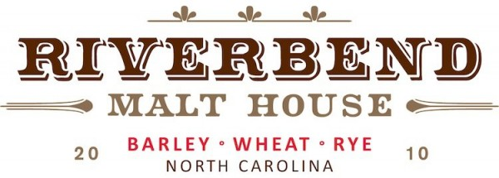
Bespoke Malt: Farmhouse Pilsner
A custom malt from targeted water profile
All in mg/L | Starting Water | Target Water
Calcium | 1.7 | 88
Magnesium | <1 | 14
Sulfate | 2 | 90
Sodium | 18 | 18
Chloride | 3 | 35
Bicarbonate | 22 | 183
Floor malted 2 ton batch,
salts dissolved in a 5 G bucket and added to each steep.

Slide 22
Resulting Malts
 | Control | Bespoke
Extract (FG %) | 80.8 | 80.7
B-Glucan (mg/L) | 81 | 562 (normal filtration)
Color (SRM) | 1.8 | 2.0
A-amylase (D.U.) | 52 | 54
pH | 6.1 | 5.8
Chloride (mg/L) | 125 | 51
Potassium (mg/L) | 444 | 400
Hardness (mg/L) | 293 | 341
Tasting Notes | Better clarity, rich body, lingering finish. Sugar cookie and green tea. | Reduced clarity, less pronounced melon and fruit with more grainy/hay flavor. Undercooked pasta.
Brewing Partners | Little Animals Brewing, Leveller Brewing Company *Brewers reported smooth brew days with great efficiency

Slide 23
Possible Impacts
Possible Impacts
Empower maltsters -> greater product understanding
Empower brewers -> more informed mineral decisions
Improve brewhouse performance
Reduce wastewater treatment needs
Generate a terroir basis for barley and malt
New product development – targeted malt water profiles?
Empower maltsters -> greater product understanding
Empower brewers -> more informed mineral decisions
Improve brewhouse performance
Reduce wastewater treatment needs
Generate a terroir basis for barley and malt
New product development – targeted malt water profiles?
We are just scratching the surface,
so many more questions to explore!

Slide 24
Q
A
Check out our website for more info!
Hannah Turner
Hannah.turner2@montana.edu
Instagram: @msu.barley.malt.brew.lab
www.montana.edu/barleybreeding
Notes:
SAY:
It’s time to answer some of the questions you’ve been asking from the Q&A panel.
DO:
Make sure to use their name and show appreciation for the comment.

