Slide 1
Effects of genotype, and environment on physical and compositional starch traits of malting barley
Maany Ramanan¹, Christine Diepenbrock², and Glen Fox¹ ¹ Department of Food Science and Technology, University of California Davis, USA ² Department of Plant Sciences, University of California Davis, USA
Oct 2023
Notes:
SAY:
Good morning everyone and welcome to today’s session. The [name association] presents [name of session title].
I would like to introduce myself. I am [insert name], from [company] and I am [position at company, brief relationship to association or topic] and I will be moderating the session.

Slide 2
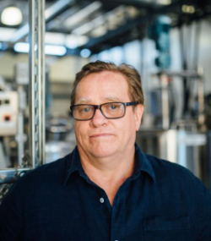
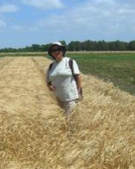
Acknowledgements
Dr Glen Fox (UC Davis)
Dr Christine Diepenbrock (UC Davis)
Dr Charlotte F. De Schepper (KU Leuven)
Dr Christophe M. Courtin (KU Leuven)
Dr Mark Lundy & Ms Taylor Nelsen (UC-ANR)
Dr Gail Bornhorst (UC Davis)
Dr Isabel Alicia del Blanco (UC Davis)
Thank you for the funds
Plant Sciences Department, UC Davis
22-23 AMBA research grant

Slide 3
Content
Introduction to barley in California
Objective
Methods
Results
Summary
Resources (lookout for a QR code!)
Q&A

Slide 4
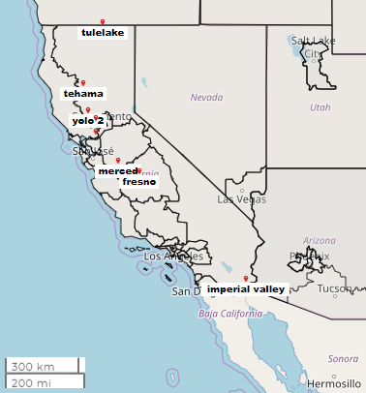
Malting Barley in California
Total 2022 and 2021 production in the US was 174 and 120 million bushels, respectively.
In 2022 and 2021, 0.82 and 1.04 million bushels were produced in California respectively (AMBA, 2023).
The malting barley samples for this work have originated from 13 different environments in California, with unique weather patterns and soil profiles.
Ten genotypes (mix of UC and commercial 2-row, spring varieties).
Samples were collected from 2016 to 2022. For each season, they were planted in Nov of the first year, and harvested in June of the next year. So, 2020-21 means that they were planted in Nov 2020 and harvested in June 2021.
Latitude: 41.96 N, 32.92 S
Longitude: -122.36 W, -115.329 E
Notes:
Talk about how California is a relatively smaller growing region for malting barley.
Weather profile similar to Mediterranean climate (hot and dry summers, and rainy winters).
Talk about the locations chosen for the study span across the state.
Tulelake has a malting barley grown as a rotation crop, whereas imperial valley is a desert like region with minimal rainfall.
Central valley locations all have either a Mediterranean or semi-arid type climate profile.
Balanced mix of adapted varieties and commercial varieties.

Slide 5
Objective
Questions we asked:
How does genotype (G), environment (E) and their interaction (GxE) affect starch traits
endosperm texture (glassy/mealy)
starch granule size (inside the barley)
starch gelatinization (how quickly barley starch converts)
total starch
Amylose/Amylopectin ratio A:AP
total protein
Why does it matter:
Should I change my malting/mashing protocol based on GxE effects?
Which grain quality measurements are more/less important in a changing climate?
Physical
Compositional
Notes:
The reason we decided to focus on this objective is 2 fold: one is because the effect of GXE has not yet been studied on starch gelatinization, and two we wanted to see if extreme environments do tend to have a dominant impact on starch quality from both a physical and compositional standpoint. These questions have not been examined in conjunction to date.

Slide 6
Methods

Slide 7
Methods
Parameter | Method | N
Endosperm texture | Particle size distribution of milled barley (0.2 mm settings) using laser diffraction | 30
Starch granule size | Initial visualization was done using Scanning Electron microscopy Volume and number of small and large starch granules was quantified by firstly isolating starch, and imaging using confocal microscopy | 30
Starch Gelatinization | Onset, peak and offset temperatures and enthalpy or heat flow was measured using differential scanning calorimetry | 84
Total starch content | Megazyme Colorimetric Assay | 58
Total protein content | Near infrared machine (calibrated using combustion as reference method) | 84
Amylose/Amylopectin ratio | Megazyme Colorimetric Assay | 58

Slide 8
Results

Slide 9
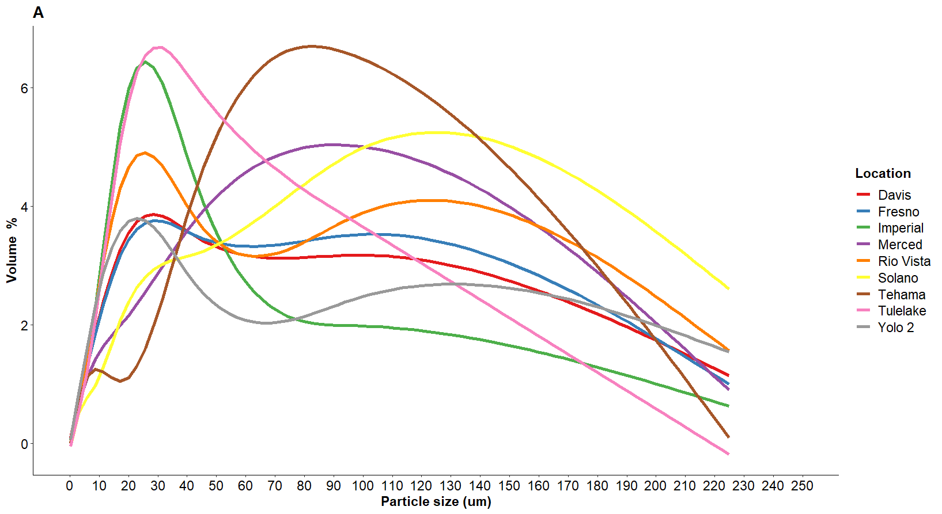
Endosperm texture shows a bimodal relationship
Notes:
We talk about mealy and steely grains in the industry, but this is a visual observation based on a handful of grains. There is not much evidence wehre texture of the grain has been quantified in some way. Here we used consistently milled barley samples via laser diffraction and identified two peaks – one between 1-25 um and one between 25 to 100um. This bimodal distribution is unique and seem to follow a similar trend of the bimodal relationship between small and large starch granules.
Tulelake and Imperial (northernmost and southernmost locations) have a higher proportion of finer particles (A). 2016-17 and 2020-21 year have a higher proportion of finer particles (B). In terms of genotypes, UC Capay and Tahoe seem to have finer textures, compared to Full Pint and AAC Synergy had coarser textures.

Slide 10
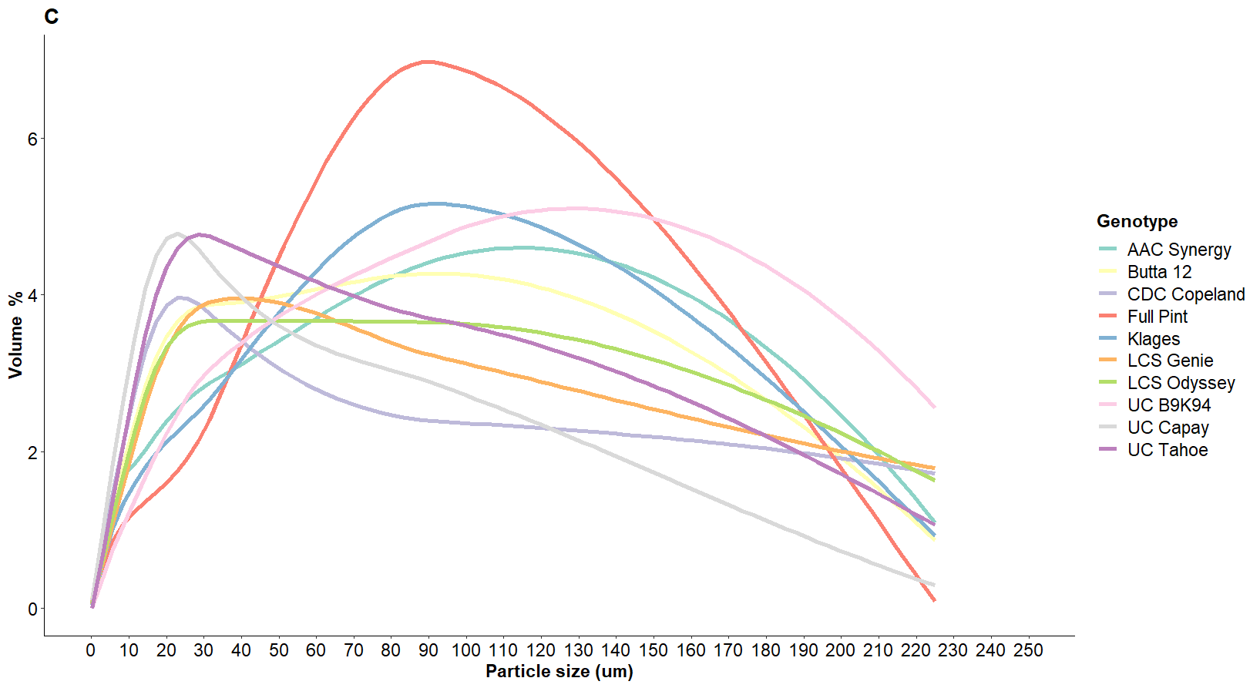
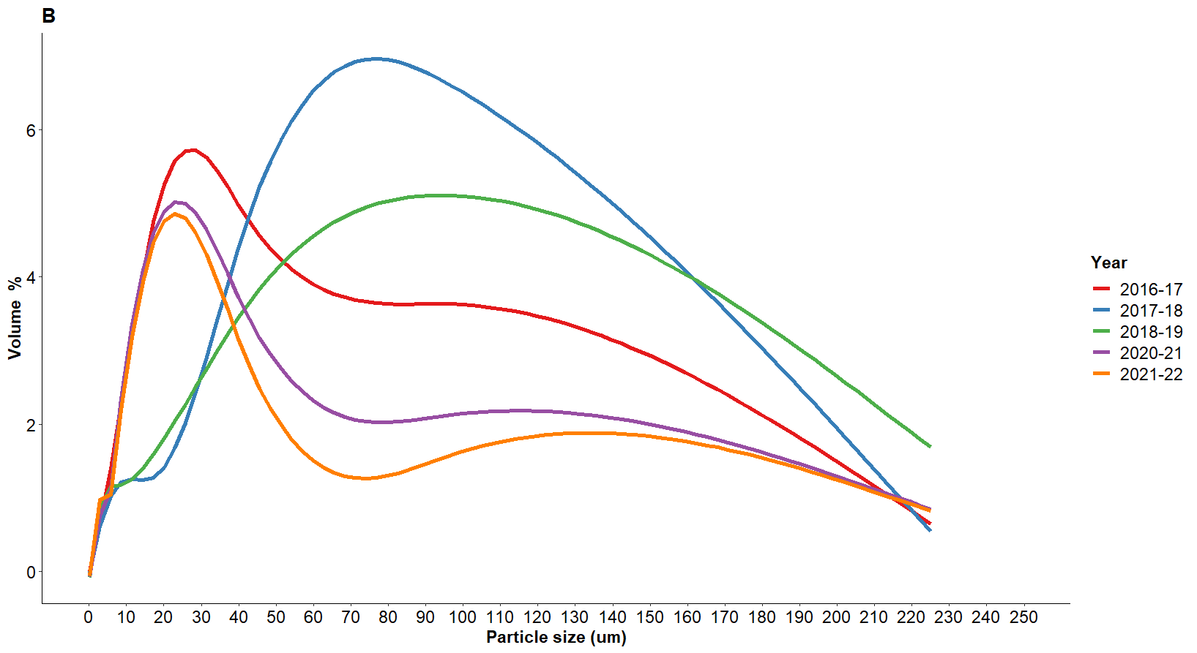
Endosperm texture shows a bimodal relationship
Notes:
We talk about mealy and steely grains in the industry, but this is a visual observation based on a handful of grains. There is not much evidence wehre texture of the grain has been quantified in some way. Here we used consistently milled barley samples via laser diffraction and identified two peaks – one between 1-25 um and one between 25 to 100um. This bimodal distribution is unique and seem to follow a similar trend of the bimodal relationship between small and large starch granules.
Tulelake and Imperial (northernmost and southernmost locations) have a higher proportion of finer particles (A). 2016-17 and 2020-21 year have a higher proportion of finer particles (B). In terms of genotypes, UC Capay and Tahoe seem to have finer textures, compared to Full Pint and AAC Synergy had coarser textures.

Slide 11
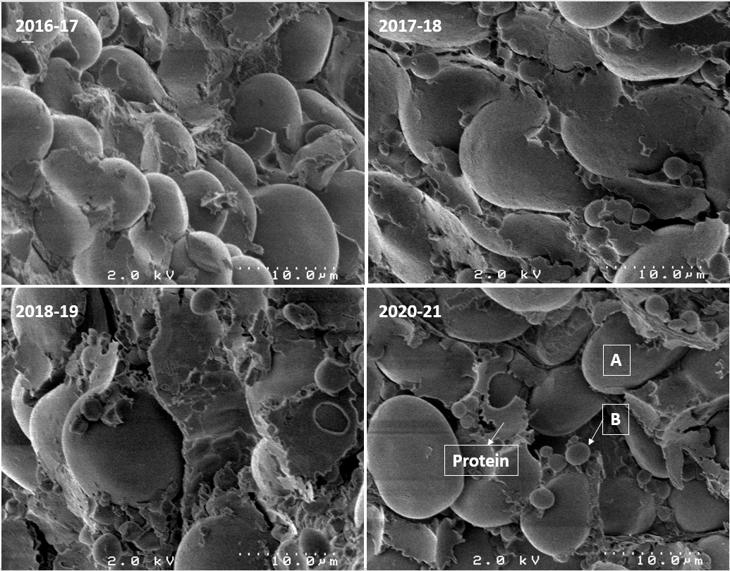
Higher volume of small starch granules in 2020-21
Genotype: UC Tahoe
Location: Davis
B-type (small) starch granules are produced later in the grain development process.
Small starch granules gelatinize slower than large starch granules and more likely to form dextrins than fermentable sugars.
Higher proportion of small granules reduce mashing efficiency and total fermentable sugars.
Unpublished results
Karlsson et al., 1983; Langenaeken et al., 2019
Notes:
2016-17 and 2020-21 sample contains visually more B-type granules than other years. The protein matrix seems to be surrounding the B-type granules more in these years, therefore explaining why it might take these granules to gelatinize last (higher offset and/or enthalpy)
Charlotte Schepper and the research group in Leuven have come up with a method to accurately quantify A-type and B-type starch granules. We collaborated with them to run Californian samples through their recently published method.

Slide 12
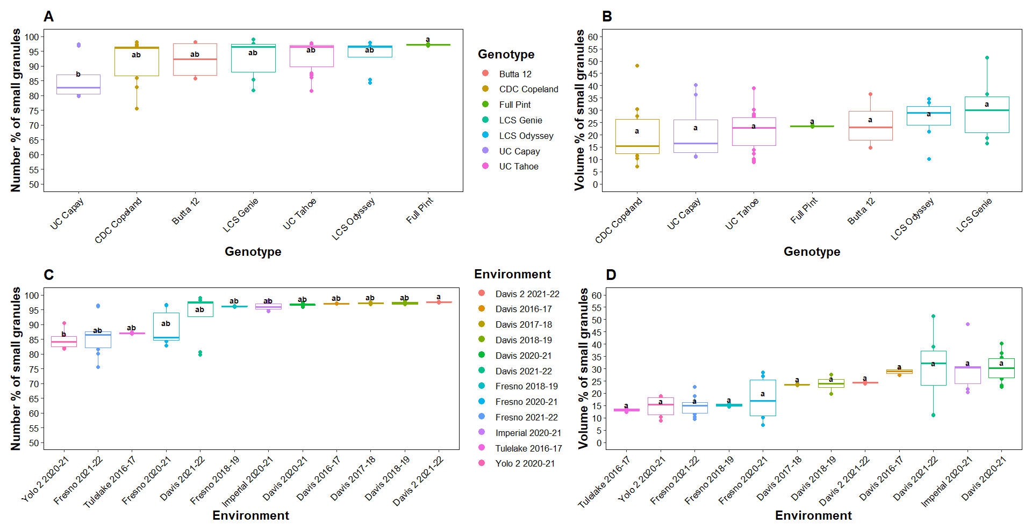
Davis samples had a higher number and volume of small starch granules
Schepper et al., 2022
Notes:
In line with the texture results, 2016-17 and 2020-21 year samples had the highest proportions of B-type granules. The cut off use to distinguish A and B type granules here was 5um.
However, we also wanted to see how the starch granule radius is distributed for these samples.

Slide 13
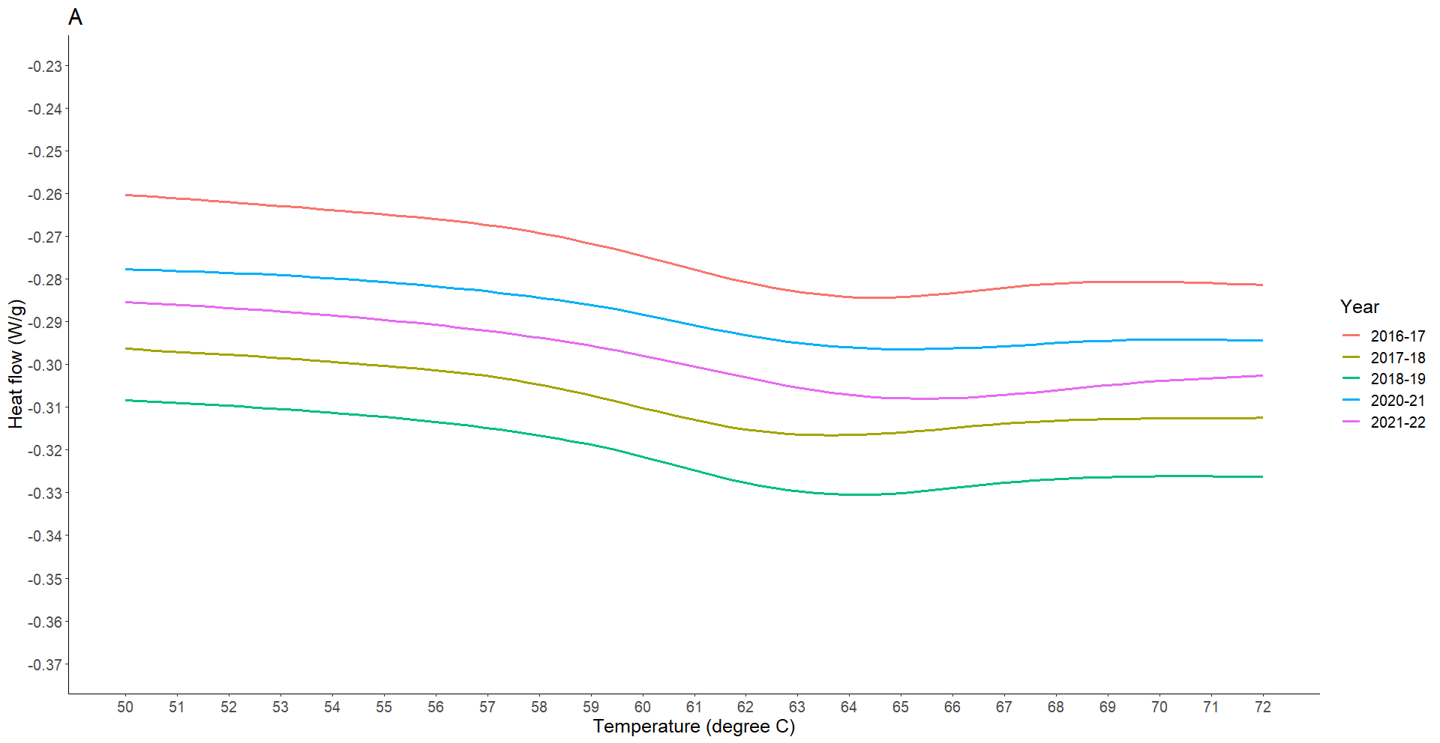
A higher difference between peak and offset temperature can be problematic downstream
Genotype: UC Tahoe
Onset
Peak
Offset
Notes:
Gelatinization temps are measured using Diffraction Scanning Calorimetry. The onset, peak and offset temps with the heat flow are usually measured.
This example if for the UC Tahoe genotype grown in multiple locations across multiple years.
Most industry folks tend to use peak temp to indicate starch conversion during mashing. But this figure demonstrates that while two samples can have almost the same onset and peak temps, the offset temp may be very different. You can also see the difference between peak and offset temps is quite different too. Its important to consider this during mashing, since if the mashing temp is set too low (or close to peak), not all of the starch will get converted in time.

Slide 14
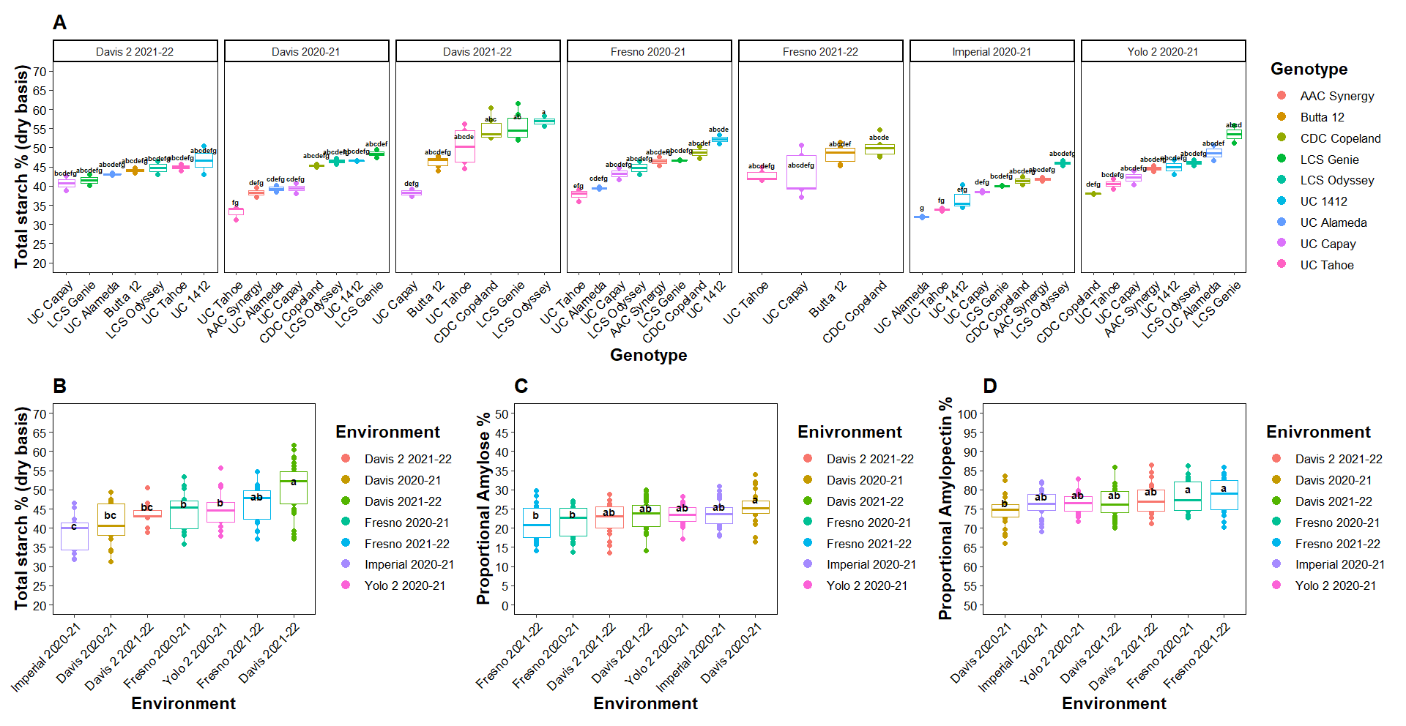
Starch content and A/AP ratio varies due to environment
Notes:
The top graph highlights how starch content differs between environments and genotypes within each environment. LCS Genie and Odyssey were usually higher in starch in most environments except Davis 2 21-22. Davis and Davis 2 are essentially plots in Davis that were managed quite differently. Davis 2 was irrigated less than Davis (40mm for former, 109 mm for latter). Its possible this is the reason the two are significantly different in their average TSC (B). Nitrogen levels between the two was comparable. Samples were run as triplicates for both TSC and A:AP. The higher levels of amylose was seen in 2021-21 years than 2021-22 years. Its also looks like Imperial 2020-21 was one of the year with lowest TSC and highest Amylose %

Slide 15
Environment found to explain the largest variance in starch physical and compositional traits
Trait name | % Variance explained
 | G:E | E | G | Res
V/V Small Granules (%) | - | 23 | 0 | 77
N/N Small Granules (%) | - | 50.4 | 8 | 41.2
Particle size (25%) | 45 | 41.2 | 13.6 | 0
Particle size (90%) | 86.5 | 7.1 | 1 | 5
Enthalpy (J/g) | 0 | 74.3 | 0.0 | 26
T_{on} (°C) | 4.9 | 34.1 | 28 | 32.9
T_{peak} (°C) | 0 | 41 | 35.3 | 23.3
T_{off} (°C) | 0.0 | 65.5 | 10.7 | 23.8
T_{on-off} (°C) | 0.0 | 57.7 | 9.5 | 32.8
TPC (db %) | 15.4 | 76.5 | 6.8 | 1.2
TSC(db %) | 18.3 | 31.0 | 18.0 | 32.7
A:AP | 0 | 25 | 12.9 | 62.4
Notes:
Results were run using LME model. For starch granule traits, due to a smaller N, G:E interaction was not inputted. Model selected due to unbalanced samples.

Slide 16
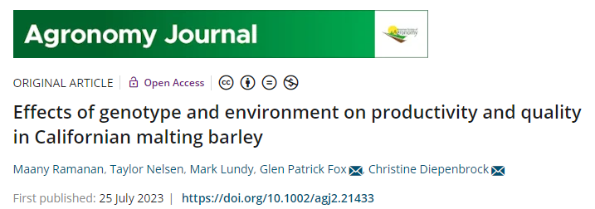
Resources
Please take a minute to help us!
https://acsess.onlinelibrary.wiley.com/doi/full/10.1002/agj2.21433
Notes:
If you found today’s topic particularly interesting, find ways to continue the learning. This paper talks about some background on grain quality assessment in California, and some key findings related to the importance of GxE.
I am happy to answer any questions today, or via email.
A bunch of us from UC Davis are working on building a solution for maltsters to help you predict grain yield and quality. Please take a minute to scan the QR code on the right and help us by answering a few simple questions. It should only take you a minute, but would be incredibly valuable for our market research. Thank you for your attention and I am open to any questions now

Slide 17
Please take a minute to help us!
Q
A
Notes:
SAY:
It’s time to answer some of the questions you’ve been asking from the Q&A panel.
DO:
Make sure to use their name and show appreciation for the comment.

