Slide 1
Hopping Down the Rabbit Hole: A Technical Round Table on Hop Driven Science, Products, and Brewing
Breeze Outhwaite (Totally Natural Solutions)
Mike Pelechaty (Masthead Brewing)
Aaron Justus (East Village Brewing Co)
Tim Wallen (Hoptechnic®/Virgil Gamache Farms)
Marshall Ligare (Vuca Farms)
Notes:
SAY:
Make sure this matches the MBAA title and description and subtitle etc
Good morning everyone and welcome to today’s session. The [name association] presents [name of session title].
I would like to introduce myself. I am [insert name], from [company] and I am [position at company, brief relationship to association or topic] and I will be moderating the session.

Slide 2
Meet The Panelists

Slide 3
Introductions
Marshall Ligare - Director of Research and Development at Vuca Farms
Breeze Outhwaite- Senior Innovations Chemist at Totally Natural Solutions
Aaron Justus- East Village Brewing Co. Founder/ Head Brewer
Mike Pelechaty- Masthead Brewing Co. Founder/Head of Operations
Tim Wallen - Research Chemist/Technical Outreach at Hoptechnic®/Virgil Gamache Farms

Slide 4
Overview of Hops and Hop Products

Slide 5
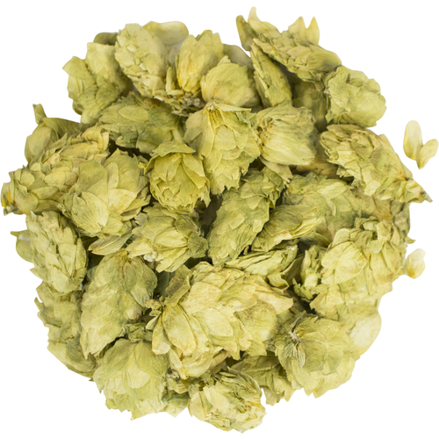
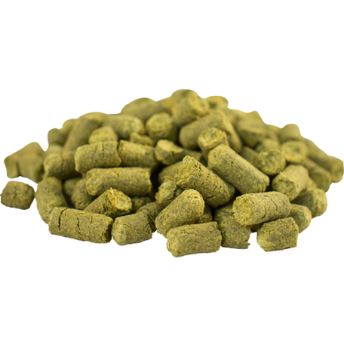
Whole Cone and Pellets
Whole Cone
  Kilned
  Fresh Frozen
Pellets
  T-90 and BBC™
  American Noble™
  Concentrated
    T-45
    Cryohops®
    Lupomax®
    CGX™
https://www.morebeer.com/products/cascade-hops-cone.html
https://www.morebeer.com/products/mosaic-hops-pellets.html

Slide 6
Hop Extracts
Supercritical CO₂
  Bittering
    Generic or Variety Specific Extract
    Isomerized Kettle Extract (ISOHOP®)
    Flex®
    Flow
  Flavor / Aroma
    Variety Specific Extract
    Incognito®
    Salvo™
Downstream
  Bittering
    Tetra, Hexa, Rho, etc.
  Flavor / Aroma
    Hop Oils
    Spectrum
    Hopkick®
    Aromahop®
https://www.morebeer.com/products/cascade-hops-cone.html
https://www.morebeer.com/products/mosaic-hops-pellets.html

Slide 7
Hop Utilization and Absorption

Slide 8
Tracking Hop Utilization
 | 60 Min Hops lbs/BBL | Knockout Gravity | Knockout pH | Post Boil IBU | 60 Min Utilization
Amber | 0.07 | 12.7 | 5.32 | 40.60 | 61.73%
Scottish Ale #1 | 0.18 | 13.8 | 5.17 | 22.43 | 60.46%
Scottish Ale #2 | 0.18 | 13.7 | 5.08 | 23.52 | 64.44%
IPA #2 | 0.23 | 15 | 5.08 | 61.12 | 43.56%
Porter | 0.39 | 14.6 | 5.06 | 46.45 | 45.49%
Imperial Red #1 | 0.61 | 19.9 | 5.08 | 85.25 | 20.10%
Imperial Red #1.2 | 0.85 | 20.4 | 5.17 | 81.45 | 19.60%
 |  |  |  | AVG | 45.1%
 |  |  |  | STDEV | 19.0%
* IBUs measured using ASBC Wort 23 and ASBC Beer 23A

Slide 9
Tracking Hop Utilization
 | 60 Min Hops lbs/BBL | Knockout Gravity | Knockout pH | Post Boil IBU | 60 Min Utilization
Amber | 0.07 | 12.7 | 5.32 | 40.60 | 61.73%
Scottish Ale #1 | 0.18 | 13.8 | 5.17 | 22.43 | 60.46%
Scottish Ale #2 | 0.18 | 13.7 | 5.08 | 23.52 | 64.44%
IPA #2 | 0.23 | 15 | 5.08 | 61.12 | 43.56%
Porter | 0.39 | 14.6 | 5.06 | 46.45 | 45.49%
Imperial Red #1 | 0.61 | 19.9 | 5.08 | 85.25 | 20.10%
Imperial Red #1.2 | 0.85 | 20.4 | 5.17 | 81.45 | 19.60%
 |  |  |  | AVG | 45.1%
 |  |  |  | STDEV | 19.0%
* IBUs measured using ASBC Wort 23 and ASBC Beer 23A

Slide 10
Tracking Hop Utilization
 | 60 Min Hops lbs/BBL | Knockout Gravity | Knockout pH | Post Boil IBU | 60 Min Utilization
Blonde #1.1 | 0.13 | 12.9 | 5.12 | 42.63 | 45.30%
Blonde #1.2 | 0.21 | 12.5 | 5.16 | 38.97 | 42.60%
Blonde #1.3 | 0.30 | 12.9 | 5.16 | 36.30 | 39.80%
Blonde #1.4 | 1.18 | 13 | 5.11 | 28.03 | 30.60%
* IBUs measured using ASBC Wort 23 and ASBC Beer 23A

Slide 11
Tracking Hop Utilization
 | 60 Min Hops lbs/BBL | Knockout Gravity | Knockout pH | Post Boil IBU | 60 Min Utilization
Blonde #1.1 | 0.13 | 12.9 | 5.12 | 42.63 | 45.30%
Blonde #1.2 | 0.21 | 12.5 | 5.16 | 38.97 | 42.60%
Blonde #1.3 | 0.30 | 12.9 | 5.16 | 36.30 | 39.80%
Blonde #1.4 | 1.18 | 13 | 5.11 | 28.03 | 30.60%
* IBUs measured using ASBC Wort 23 and ASBC Beer 23A

Slide 12
Tracking Hop Utilization
 | Whirlpool Hop Rate lbs/BBL | Knockout Gravity | Pre WP Hop IBU | Knockout IBU | Utilization
Scottish Ale | 0.1 | 13.6 | 22.4 | 32.7 | 44.4%
IPA #1 | 0.1 | 15.0 | 89.7 | 102.7 | 29.6%
IPA #2 | 1.0 | 15.0 | 61.1 | 129.5 | 18.0%
Imperial Red | 0.9 | 20.4 | 85.3 | 114.1 | 10.1%
* IBUs measured using ASBC Wort 23 and ASBC Beer 23A

Slide 13
Tracking Hop Utilization
 | Whirlpool Hop Rate lbs/BBL | Knockout Gravity | Pre WP Hop IBU | Knockout IBU | Utilization
Scottish Ale | 0.1 | 13.6 | 22.4 | 32.7 | 44.4%
IPA #1 | 0.1 | 15.0 | 89.7 | 102.7 | 29.6%
IPA #2 | 1.0 | 15.0 | 61.1 | 129.5 | 18.0%
Imperial Red | 0.9 | 20.4 | 85.3 | 114.1 | 10.1%
* IBUs measured using ASBC Wort 23 and ASBC Beer 23A

Slide 14
Hop Absorption
T90 pellets roused, settled for 7 days at 40°F, carefully decanted
 | Rate (g/l) | Rate (lb/BBL) | ml/g absorption | gal/lb absorbtion
Pellet #1 | 3.8 | 1.0 | 7.6 | 0.91
Pellet #2 | 3.8 | 1.0 | 7.1 | 0.85
Pellet #3 | 3.8 | 1.0 | 7.1 | 0.85
Pellet #3 | 7.6 | 2.0 | 6.2 | 0.74
Pellet #3 | 11.4 | 2.9 | 6.0 | 0.71
 |  |  | 6.8 | 0.81
T90 pellets roused, settled for 7 days at 40°F, centrifuged
 | Rate (g/l) | Rate (lb/BBL) | ml/g absorption | gal/lb absorbtion
Pellet #2 | 3.8 | 1.0 | 3.9 | 0.46
 |  |  | 3.9 | 0.46

Slide 15
Key Takaways
Kettle and whirlpool hop utilization decreases with increased hop dosage due to vegetal matter.
Use high alpha hops or enhanced products to boots IBUs in aggressively hopped beers.
Hops absorb 4-7 times their weight, depending on what equipment you use to process beer.
The use of enhanced products can significantly improve wort and beer yeilds.

Slide 16
Brewing with Extracts
A Case Study

Slide 17
Hop Journal Malt Bill 20BBL
Canada Pilsen | 1375 lbs | 89%
Dextrin Malt | 55 lbs | 3.50%
Munich Malt | 15 lbs | 1%
Cane Sugar | 100 lbs | 6.50%

Slide 18
Hop Journal Hop Bill 20BBL
 |  | Trial 1 | Trial 2 | Trial 3
1st Hop 60min | Warrior Extract | 300gm | 300gm | 300gm
2rd Hops 20min | Strata T90 14.3%AA | 5.5 | 5.5 | 5.5
 | Citra T90 14.2%AA | 5.5 | 5.5 | 0
 | Citra Cryo 22.1%AA | 0 | 0 | 2.75
 | Nelson T90 14.5%AA | 5.5 | 5.5 | 5.5
3rd Hops 5min | El Dorado T90 14.6%AA | 11 | 0 | 0
 | El Dorado Salvo | 0 | 1 kg | 1 kg
Whirlpool Hops | Citra T90 14.2%AA | 11 | 5.5 | 0
 | Citra Cryo 22.1%AA | 0 | 2.75 | 5.5
 | Nelson T90 14.5%AA | 11 | 11 | 0
 | Nelson CGX 17.3%AA | 0 | 0 | 5.5
 | Strata T90 14.3%AA | 11 | 0 | 0
 | Strata CGX 24.6%AA | 0 | 5.5 | 5.5
Total Hops Hot Side |  | 60.5/3.03 | 41.25/2.06 | 30.25/1.51
 |  | Trial 1 | Trial 2 | Trial 3
Dry Hop Day 5 | Citra T90 | 16.5 | 5.5 | 5.5
 | Citra Cryo | 0 | 5.5 | 5.5
 | Strata T90 | 16.5 | 5.5 | 5.5
 | Strata CGX | 0 | 5.5 | 5.5
 | Nelson T90 | 16.5 | 16.5 | 5.5
 | Nelson CGX | 0 | 0 | 5.5
Total Dry Hops |  | 49.5/2.48 | 38.5/1.925 | 33/1.65
Total Hops |  | 110/5.5 | 79.75/3.99 | 63.25/3.16

Slide 19
Hop Journal Analytical Data
 | Trial 1 | Trial 2 | Trial 3
OG | 17.3 | 17.3 | 17.3
FG Pre Dry Hop | 2.7 | 2.7 | 2.7
FG Post Dry Hop | 2.2 | 2.5 | 2.5
ABV | 8.2 | 8.05 | 8.05
FAN Pre Dry Hop (mg/L) | 143 | 137 | 138
FAN Post Dry Hop (mg/L) | 190 | 169 | 147
IBU Pre Dry Hop* | 72.2 | 57.1 | 68.4
IBU Post Dry Hop* | 58.9 | 55 | 55.2
Concentrate as % of Impact | 0 | 45% | 60%
Brite Volume (BBL) | 15 | 16.9 | 17.5
Volume Increase | 0% | 12.70% | 16.70%
Brite Tank DO (PPB) | 11.5 | 11.5 | 11.4
Packaging TPO (PPB) | 50-60 | 45-60 | 45-60
*IBUs were measured with the CDR BeerLab using the optimized EBC reference method.

Slide 20
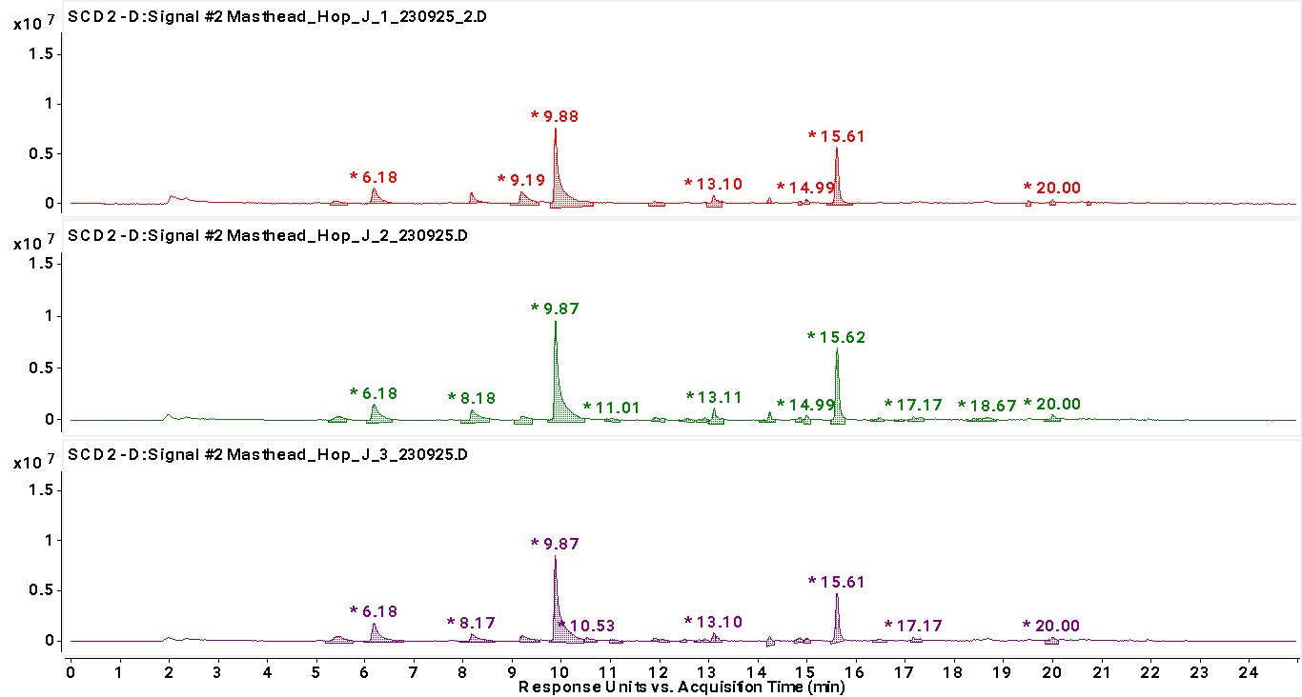
Hop Journal Sulfur Intensity
Trial 1
1x10⁷
Trial 2
1x10⁷
Trial 3
8x10⁶

Slide 21
Hop Journal PCA Analysis
Trial 1
Control
Trial 2
0.98
Trial 3
0.97

Slide 22
Hop Journal Taste Panel Data
 | Trial 1 | Trial 2 | Trial 3
Taste Panel Day 3 | Score: 2/4 Notes: Drying and green, savory, Weak aroma and flavor. | Score: 2.5/4 Notes: Bitterness is perceived on the low side. Full persisting hop flavor is present | Score: 2.66/4 Notes: Bitterness perceived on the low side. Persisting hop flavor without any harshness. Great hop body.
Taste Panel Day 10 | Score: 2/4 Notes: Soft tropical fruit aroma. Persisting tropical flavor. Slightly vegetal | Score: 2.2/4 Notes: Moderately intense aroma with persisting tropical hop flavor. Well rounded | Score: 2/4 Notes: Sweaty aroma. Pithy, but tropical flavor. A bit vegetal
Taste Panel Day 14 | Score: 2.3/4 Notes: Aroma was tropical fruit, but slightly weak. Hop flavor is maturing into itself. Nice Tropical flavor, but with slightly drying bitterness. | Score: 2.4/4 Notes: Aroma was moderate and tropical. Rich tropical fruit flavor. Somewhat botanical. | Score: 2.4/4 Notes: Aroma was tropical. Tannic bitterness. Hop Flavor was tropical, but fleeting. Malt was prominent.
Notes:
Mike will update day 10 and 14 between now and the meeting

Slide 23
Key Takeaways of the Study
Our estimation of flavor and aroma impact of 2:1 on T90:Cryo/CGX and 11lbs:1kg of T90:Salvo seems correct.
Material improvements in yield can be seen with modest substitution of T90 pellets for concentrated products.
Reduced hop creep was seen in Trials 2 and 3. The additional concentrated hop product inclusion in Trial 3 did not further reduce hop creep.
There seems to be a cliff for inclusion of concentrated products on our system as evidenced by Trial 3's sensory data

Slide 24
Key Takeaways- part 2
The trials with concentrated products had superior sensory data younger whereas the T90 trial had to age into itself.
In spite of superior residual FAN and comparable DO, Trial 3 aged the worst. Could T90 pellets be protective of flavor and aroma?
Could the relative lack of success of Trial 3 be due to the T90 lots being selected while the concentrated lots were spot?
This was an N=1 trial and more data is required to corroborate the sensory takeaways.

Slide 25
Harvest Timing and Raw Material Selection

Slide 26
Amarillo® (VGXP01) Sulfur vs. Terpenes (2023)
Final Lot | Terpene Intensity | Sulfur Intensity
23-WA358-001 | 5.00E+08 | 1.80E+06
23-WA358-002 | 5.00E+08 | 1.70E+06
23-WA358-004 | 5.50E+08 | 2.80E+05
23-WA358-006 | 5.00E+08 | 6.50E+05
23-WA358-008 | 5.00E+08 | 4.00E+05
23-WA358-012 | 5.50E+08 | 2.75E+07
23-WA358-013 | 5.50E+08 | 2.00E+07
23-WA358-015 | 5.50E+08 | 1.00E+07
23-WA358-016 | 5.50E+08 | 5.50E+05
23-WA358-022 | 5.00E+08 | 2.50E+05
Final lots run on GC-FID/SCD (Wallen et al., MBAA TQ (Vol. 58, no. 2) (2021))

Slide 27
Amarillo® (VGXP01) Sulfur vs. Terpenes (2023)
Final Lot | Terpene Intensity | Sulfur Intensity
23-WA358-001 | 5.00E+08 | 1.80E+06
23-WA358-002 | 5.00E+08 | 1.70E+06
23-WA358-004 | 5.50E+08 | 2.80E+05
23-WA358-006 | 5.00E+08 | 6.50E+05
23-WA358-008 | 5.00E+08 | 4.00E+05
23-WA358-012 | 5.50E+08 | 2.75E+07
23-WA358-013 | 5.50E+08 | 2.00E+07
23-WA358-015 | 5.50E+08 | 1.00E+07
23-WA358-016 | 5.50E+08 | 5.50E+05
23-WA358-022 | 5.00E+08 | 2.50E+05
Final lots run on GC-FID/SCD (Wallen et al., MBAA TQ (Vol. 58, no. 2) (2021))

Slide 28
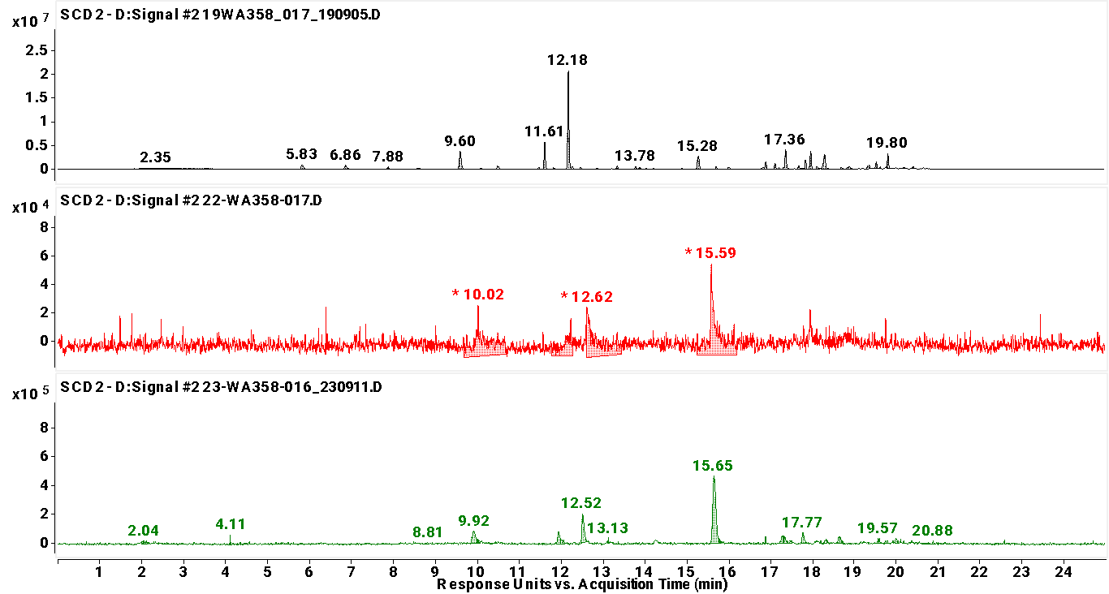
Amarillo® (VGXP01) Harvest Year Differences
19-WA358-017
09/2/19
22-WA358-017
09/5/22
23-WA358-016
09/5/23

Slide 29
Amarillo® (VGXP01) Sulfur Intensity
19-WA358-017
09/2/19
2.5x10⁷
22-WA358-017
09/5/22
7x10⁴
23-WA358-016
09/5/23
8x10⁵

Slide 30
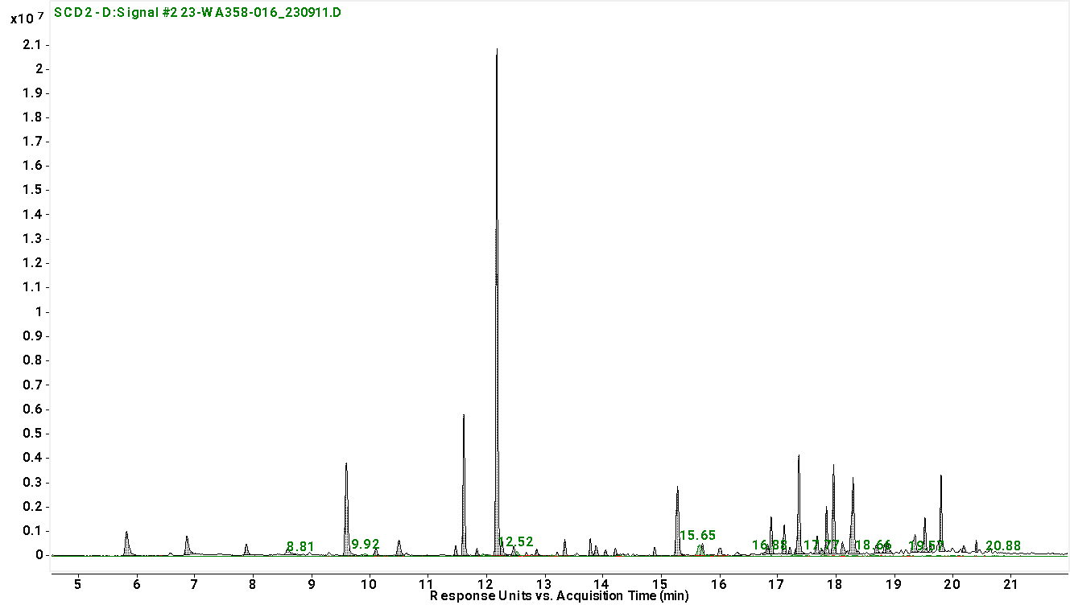
Amarillo® (VGXP01) Sulfur Intensity
2019 (09/2/19)
2022 (09/5/22)
2023 (09/5/23)

Slide 31
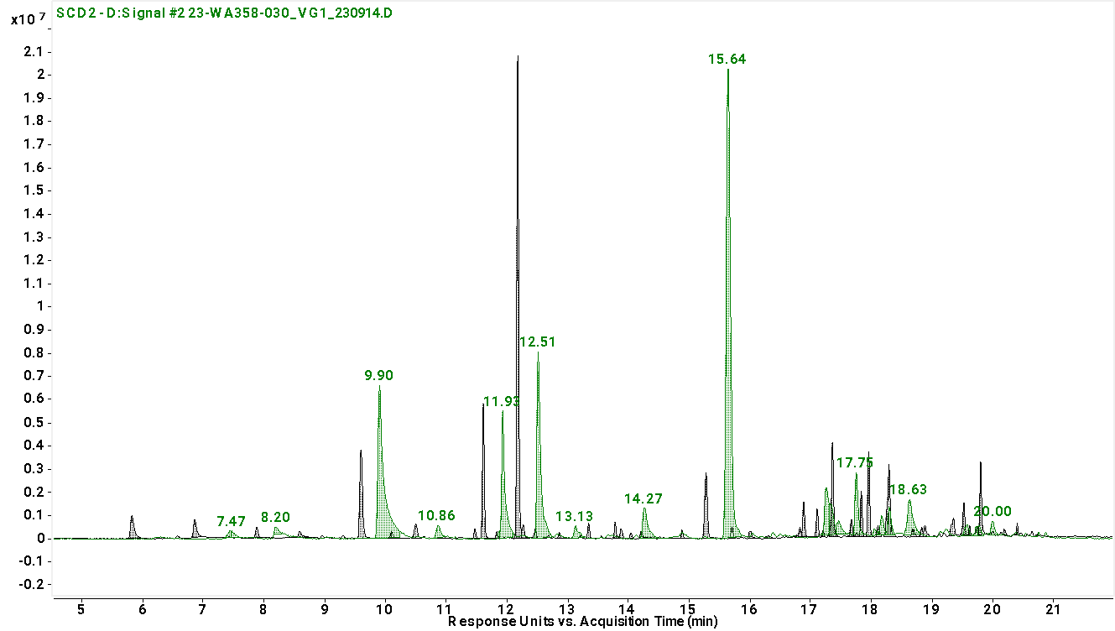
Amarillo® (VGXP01) Sulfur Intensity
2019 (09/2/19)
2023 (09/11/23)

Slide 32
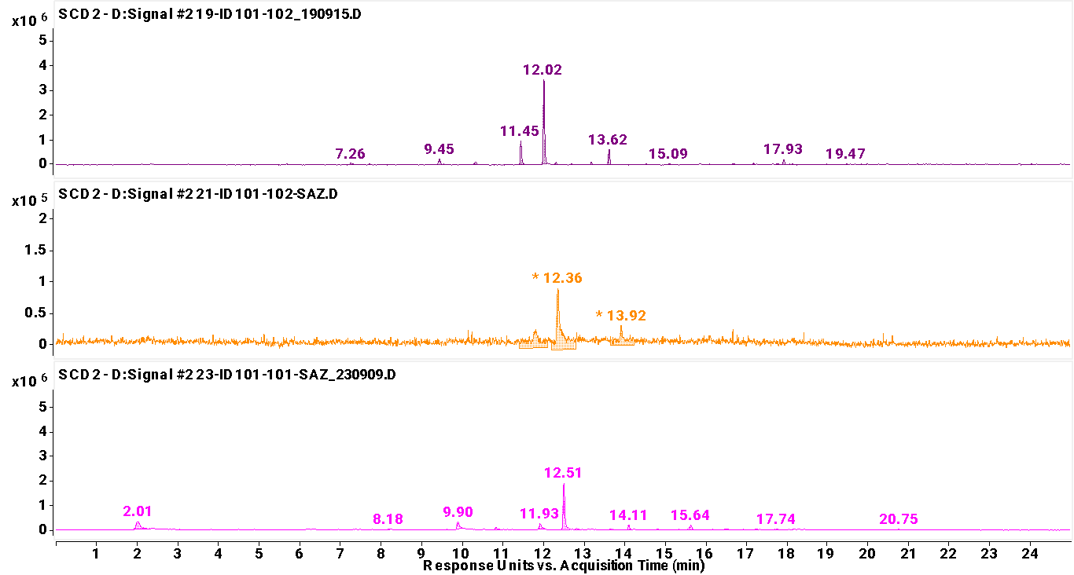
Saaz (Ozvald-72 c.v.) Harvest Year Differences
19-ID101-102
08/22/19
21-ID101-102
08/24/21
23-ID101-101
08/7/23

Slide 33
Saaz (Ozvald-72 c.v.) Sulfur Intensity
19-ID101-102
08/22/19
4x10⁶
21-ID101-102
08/24/21
1.2x10⁵
23-ID101-101
08/7/23
2.5x10⁶

Slide 34
“Fresher” = Better?

Slide 35
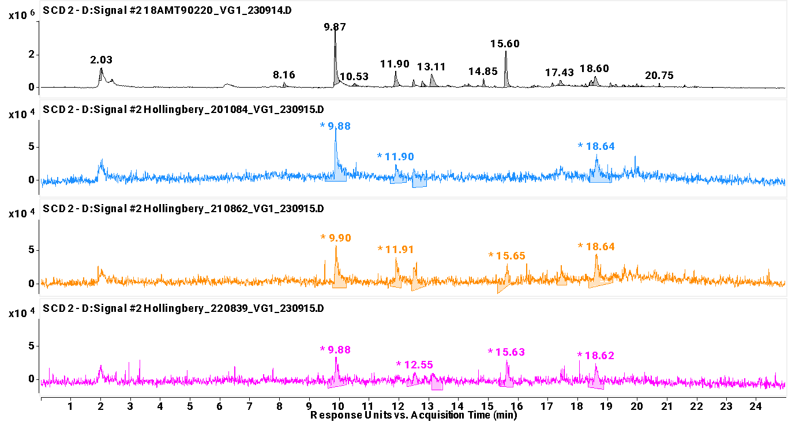
Amarillo® T-90 Lots
2018
Sampled
09/14/23
2020
Sampled
09/15/23
2021
Sampled
09/15/23
2022
Sampled
09/15/23
2020-2022 Samples provided by Hollingbery

Slide 36
Amarillo® Sulfur Intensity
2018
Sampled
09/14/23
3.8x10⁶
2020
Sampled
09/15/23
1x10⁵
2021
Sampled
09/15/23
6x10⁴
2022
Sampled
09/15/23
4x10⁴
2020-2022 Samples provided by Hollingbery

Slide 37
Evaluating a COA

Slide 38
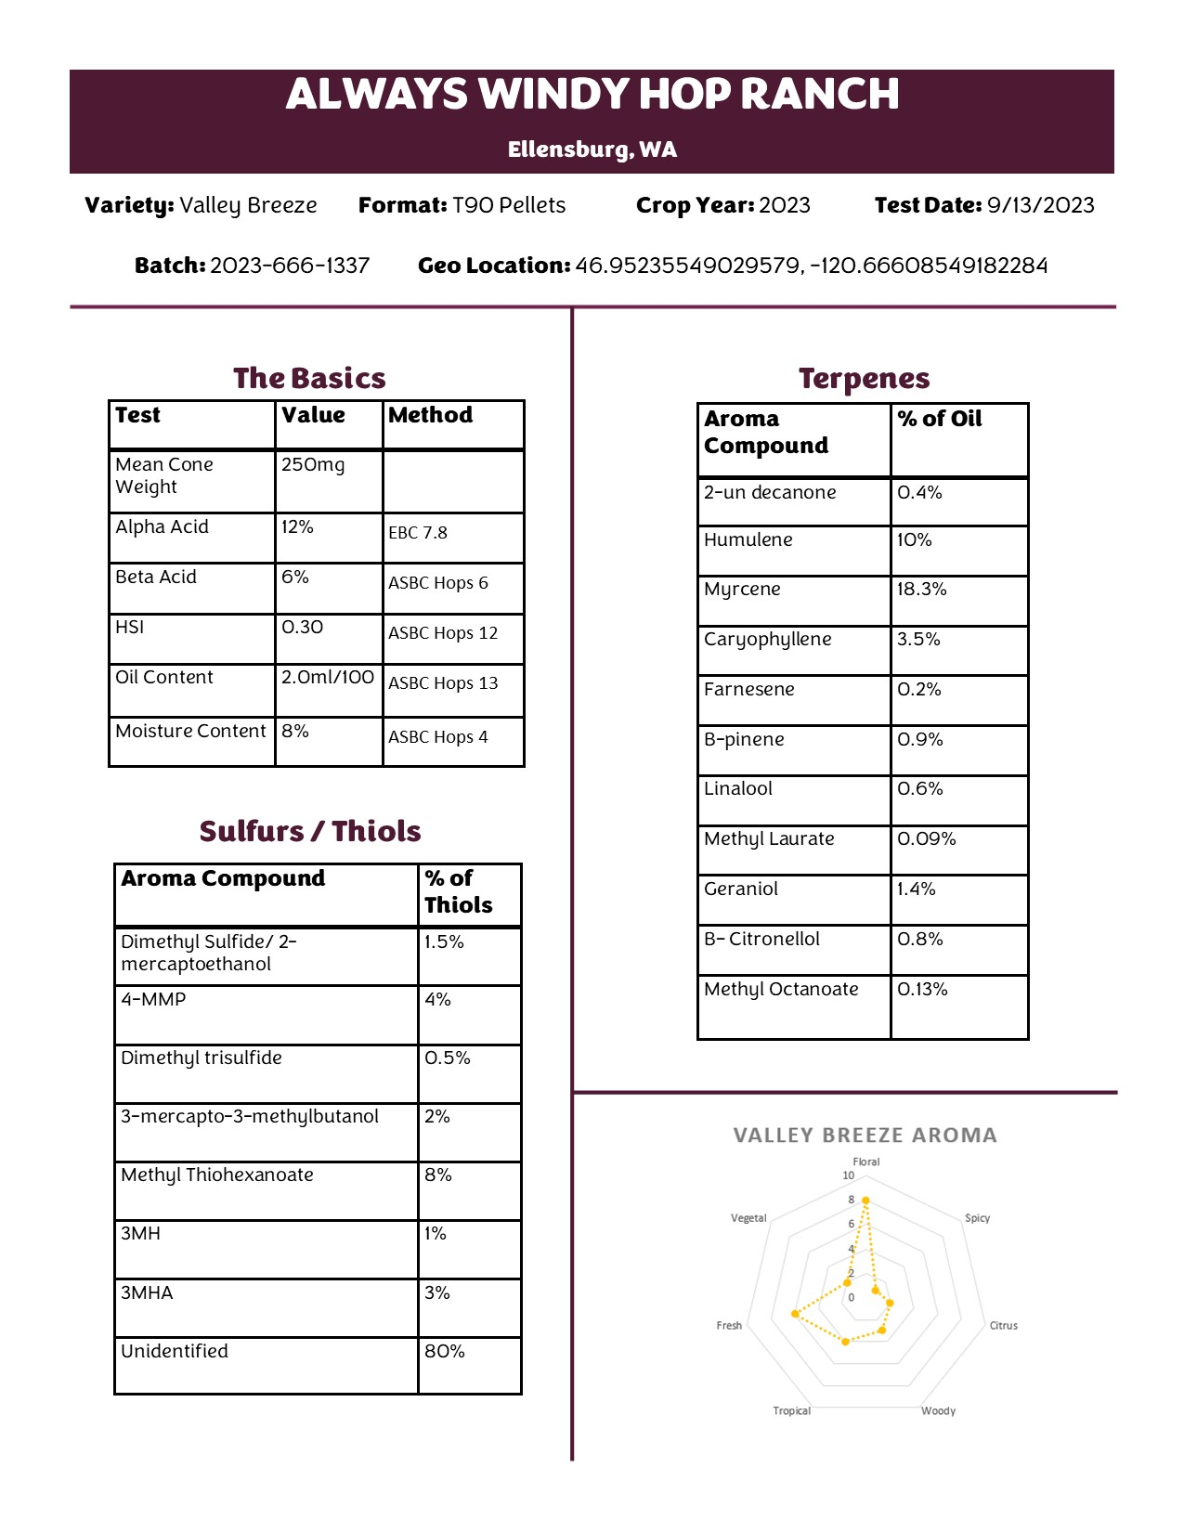
Notes:
Rikki futz to make sure it can be seen clearly on like a black background etc. Then a round table with the guys about what they care about and what they mean etc

Slide 39
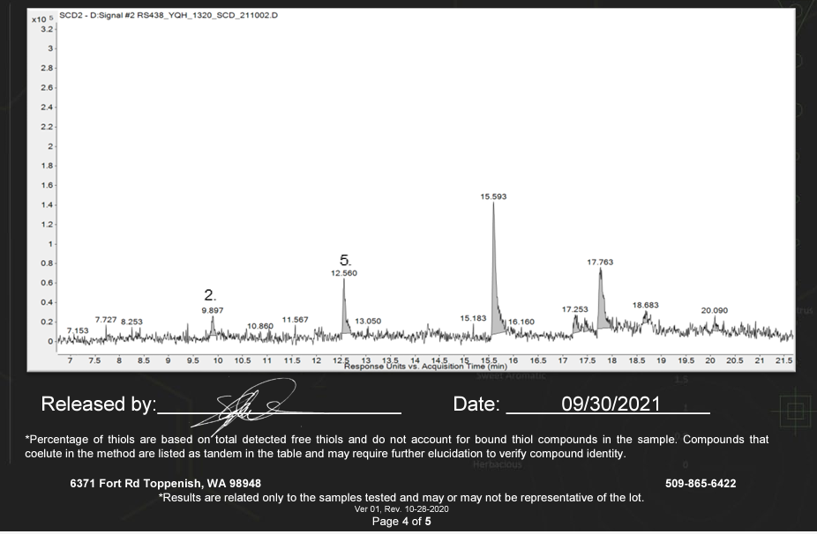
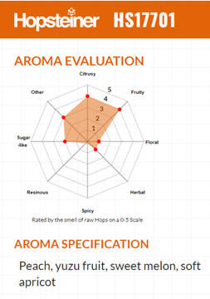
Commercial Examples of COA Contents
Elani™ Hops (YQH 1320 c.v.) Thiol Profile, Analzed by HopTechnic®
HS17701 Aroma Profile, Hopsteiner®

Slide 40
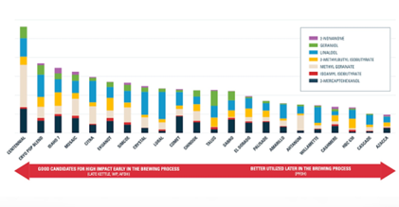
Commercial Examples of COAs, Continued
Yakima Chief Hops®, “Survivable Compounds”

Slide 41
Key Takeaways

Slide 42
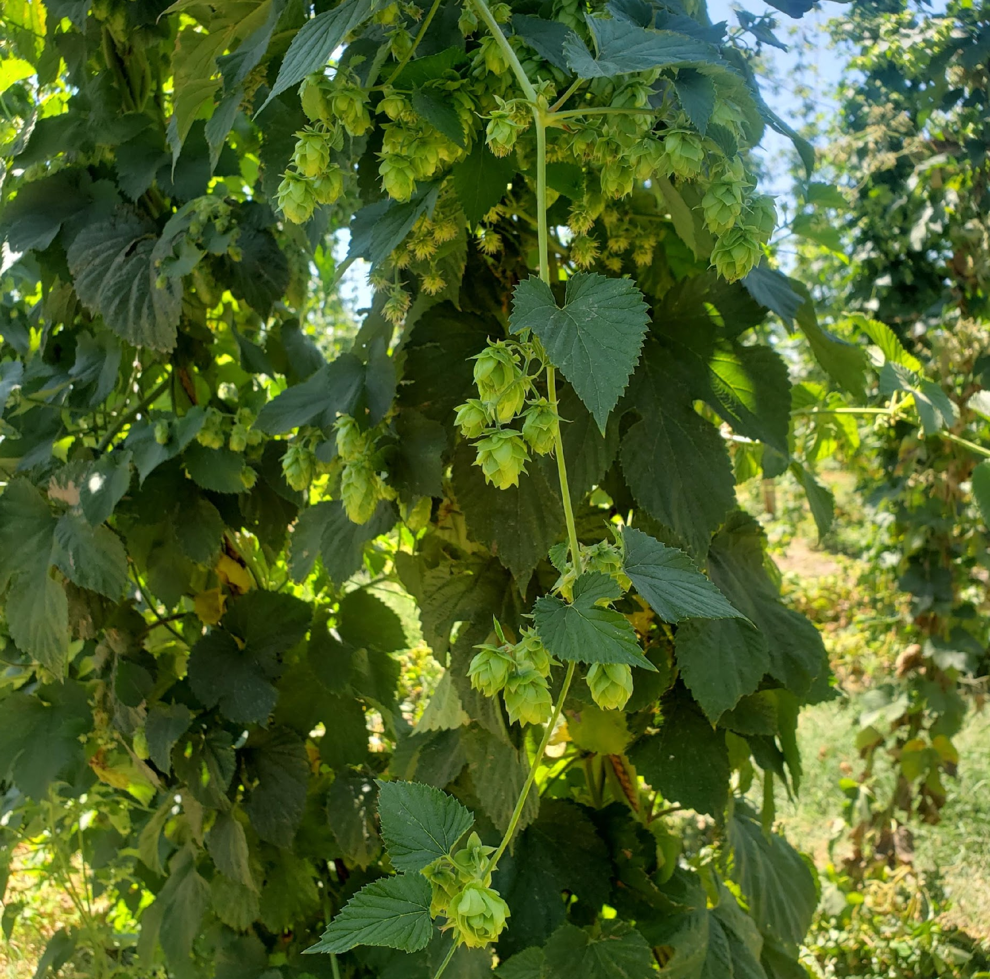
Key Takeaways for Sourcing Hops
Flavor/Aroma expression > any other “metric”
  Total Oils
  Alphas
  HSI
  Crop Year
Pay attention to:
  Sensory data
  Aroma intensity and composition (Sulfurs, Terpenes, etc.)
  Harvest year growing conditions
  Storage conditions
  Flavor/aroma in finished beer

Slide 43
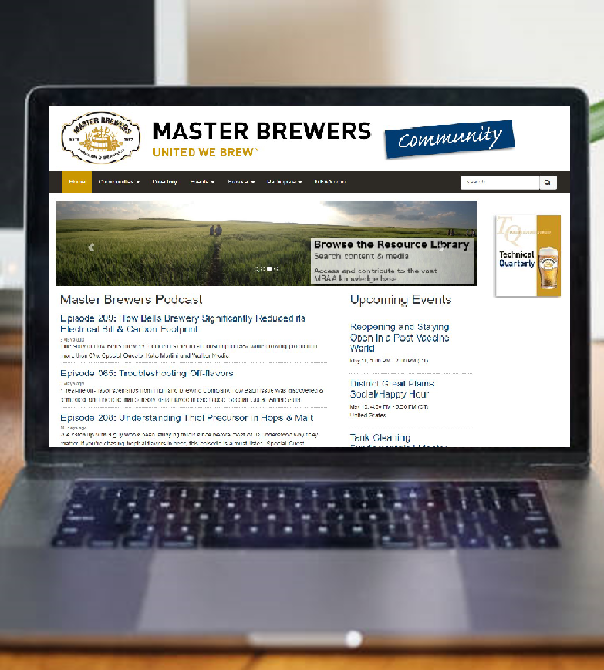
Resources
  Vucafarms.com
  Eastvillagebrew.com
  Mastheadbrewingco.com
  Hoptechnic.com
  Aron et al. J. Inst. Brew. 116(4), 369–380, “A Discussion of Polyphenols in Beer Physical
  and Flavour Stability” (2010)
  Ting et al. J. Am. Soc. Brew. Chem. 75(3):161-180 “The Bitter, Twisted Truth of the Hop: 50 Years of Hop Chemistry” (2017)
  MBAA TQ vol. 55 no. 3 “Tracking IBU Through the Brewing Process: The Quest for Consistency” (2018)
  MBAA TQ vol. 58 no. 2 “Tracking Biotransformation of
  Sulfur Compounds in Beer” (2021)
Notes:
SAY:
If you found today’s topic particularly interesting, find ways to continue the learning. We’ve provided a few additional resources to extend the topic outside of this session. Write them down. Use your phone to take a picture of this screen. Review the slide deck that came in your session email today. Our association is here to support your goals.
DO:
Locate and additional resources to share with members that extend beyond this session – pubs, websites, name people and share email address or other.

Slide 44

Q
A
Notes:
SAY:
It’s time to answer some of the questions you’ve been asking from the Q&A panel.
DO:
Make sure to use their name and show appreciation for the comment.

