Slide 1
Using this Slide Deck
This slide deck is like a workbook. Add in and take out what’s needed (other than required slides).
REQUIRED slides must remain. Update the slides content for your session and delete the “required” label
These slides ensure consistent messaging and branding across association events and a foundation for a quality member learning experience.
Other than the required slides, use the template slides that work for your event. Right-click>Duplicate Slide as needed. Delete the others.
Update an image – Right- click > Change Picture.
The notes panel for the required slides contains suggested script. Update this script as needed.
Add your thoughts about the session topic into the Notes Panel. Print notes prior - File>Export>Create Handouts>Notes below slides OR use multiple monitors so the notes panel can be visible.
Contact your SciSoc program manager for support as needed.

Slide 2
Ensure Slide Clarity
Contact your SciSoc program manager for support as needed.
Notes:
The clarity of your slide and what you put on it should enhance your message.
Ensure the following:
Ample white space. Don’t crowd the slide.
Ideally 1-2 ideas discussed per slide.
Avoid dense bullet point slides and a content dump. Put those details in your notes instead.
Aim for foreground/background color contrast.
Use purposeful images or illustrations that you can talk to from your presenter notes.

Slide 3
Get Copyright Permission
Contact your SciSoc program manager for support as needed.
Notes:
As a reminder, you must own or have permission to use all media (images, illustration, video) or documentation used in this presentation.
This is an issue that can have financial repercussion to your association and one we are careful to adhere to.

Slide 4
Maltose-Negative Yeasts Richard Preiss NABLAB Workshop
Notes:
SAY:
Good morning everyone and welcome to today’s session. The [name association] presents [name of session title].
I would like to introduce myself. I am [insert name], from [company] and I am [position at company, brief relationship to association or topic] and I will be moderating the session.

Slide 5
NA Beer Production Methods
Dealcoholization Methods | Fermentation Methods
Evaporation (e.g. vacuum distillation) | Limited fermentation with maltose negative yeasts (~10-25% attenuation)
Membranes (e.g. reverse osmosis) | Limited fermentation with maltotriose negative yeasts (~40-60% attenuation)
 | Arrested fermentation (cooling or removing yeast before completion)
 | Cold contact fermentation (pitching yeast into cold wort)
I will be covering this topic

Slide 6
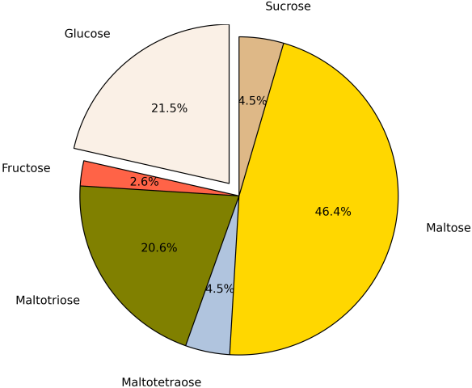
Sugar profile of wort
Source: Eureka Brewing

Slide 7
Fermentation by regular yeast (ale or lager)
~70-80% ADF
+
+
+
+
Variable
-
Source: Eureka Brewing

Slide 8
Maltotriose negative yeast
~40-60% ADF
+
+
+
+
-
-
Source: Eureka Brewing

Slide 9
Maltose negative yeast
~10-25% ADF
+
+
-
+
-
-
Source: Eureka Brewing

Slide 10
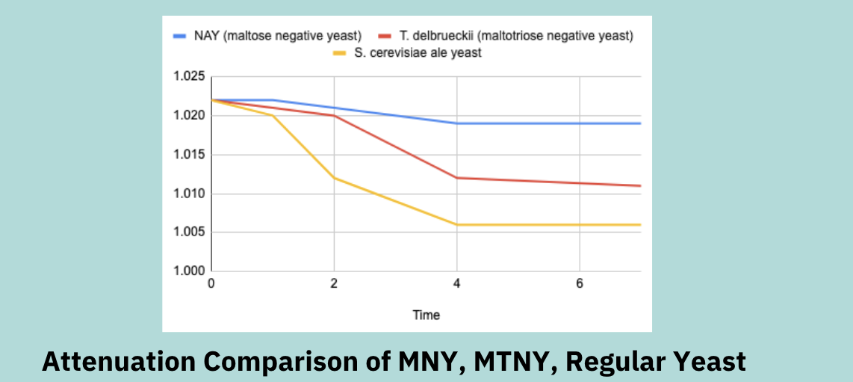
Typical fermentation profiles – Ale yeast, maltotriose negative, maltose negative

Slide 11
Comparing fermented NA methods
Method | Benefits | Drawbacks
Arrested Fermentation | You can use any yeast. | Missing the cold-crash and removal of yeast by a couple of hours can mean your beer is over 0.5% ABV. Risk of fermentation intermediates such as acetaldehyde, DMS.
Maltose Negative Yeast | Benefits: Easy process, “set it and forget it” for a few days. | Drawbacks: Limited flavour expression possibilities compared to many Saccharomyces yeasts. Low or no flocculation is typical.
Maltotriose Negative Yeast | Can use maltotriose-negative S. cerevisiae yeasts and their benefits (flocculation and flavour). | Also at risk of over-fermenting or over-attenuating the wort.
Cold Contact Fermentation | Benefits: simple process. | Very little fermentation actually occurs - just enough contact between yeast and wort to call the resulting product “beer”.

Slide 12
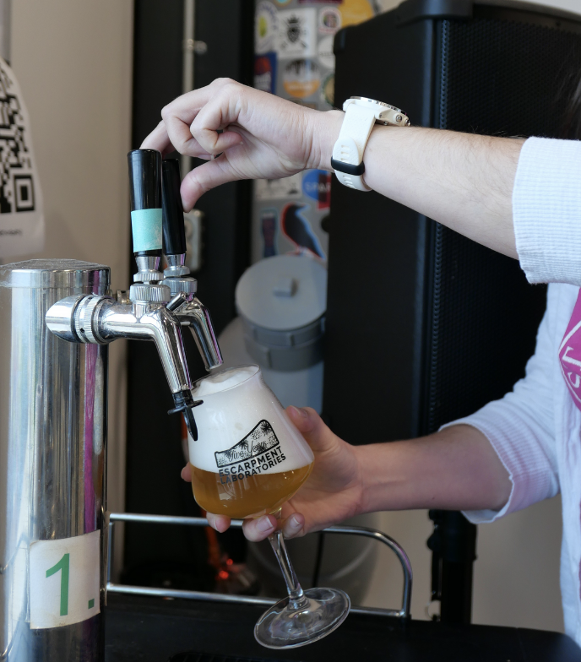
General tips for fermented NA beer with maltose negative yeasts
Use ALDC enzyme to reduce the risk of diacetyl formation
Make a low-gravity wort with a high mash temperature to reduce fermentability
Use yeast nutrients in the whirlpool to make up for the low-nutrient wort
Pasteurize the finished beer
Build in malt character with specialty grains e.g. Vienna malt

Slide 13
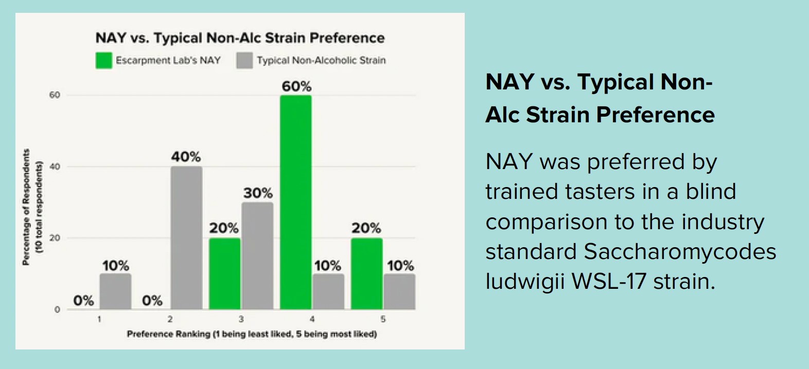
Comparing maltose negative yeasts

Slide 14
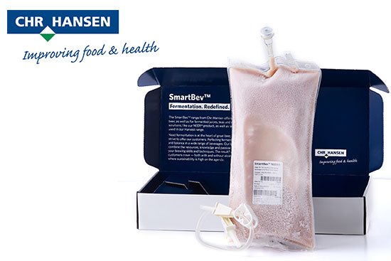
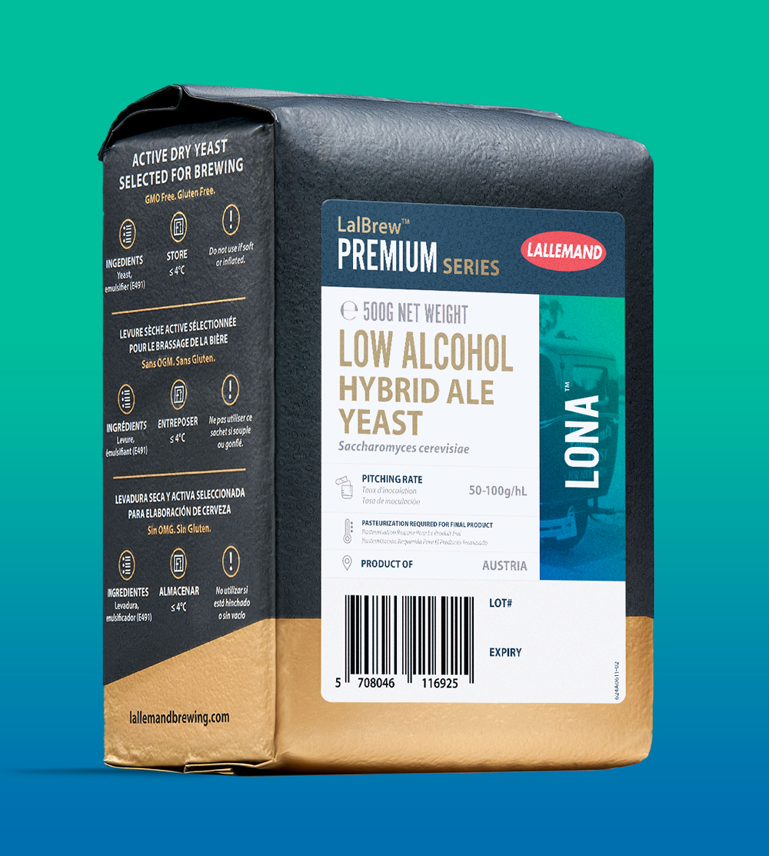
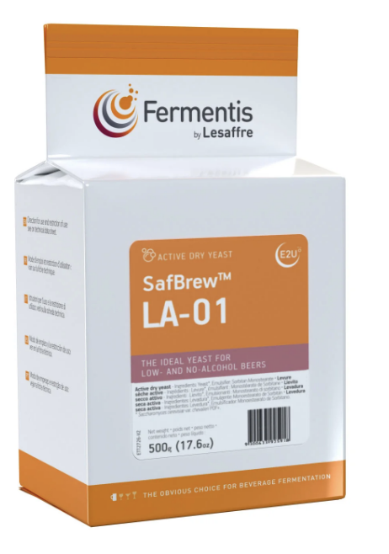
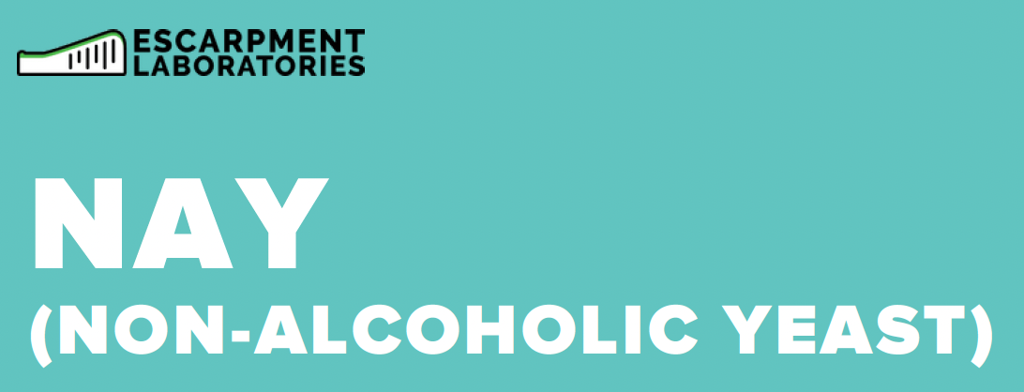
Maltose negative yeast options
Escarpment Labs NAY Hanseniaspora uvarum
Chr Hansen NEER Pichia kluyveri
Lallemand LoNa S. cerevisiae
Fermentis LA-01 S. cerevisiae
Var. chevalieri

Slide 15
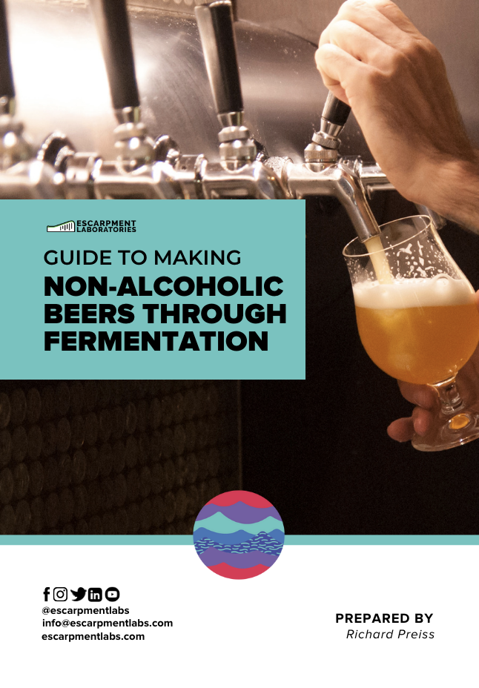
Learn More
<-
Free download on escarpmentlabs.com
->
Recorded Webinar on YouTube

