Slide 1
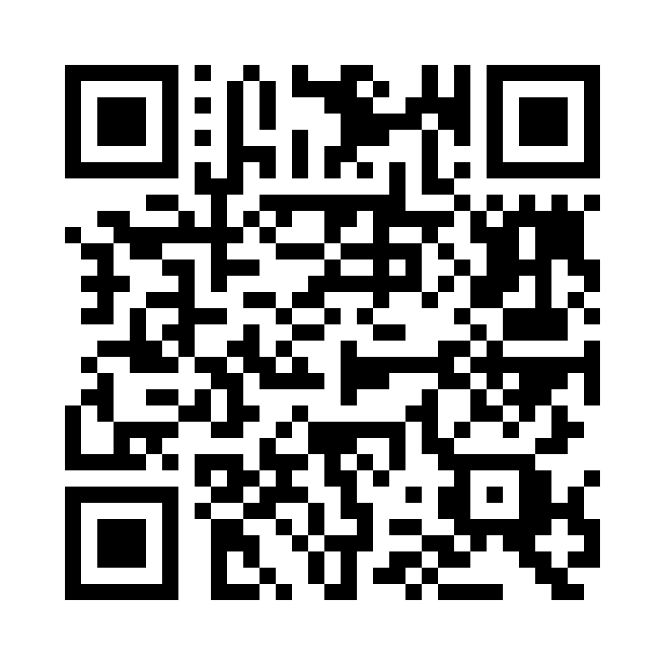
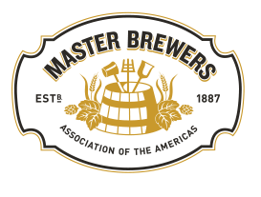
JOIN THE TASTING
Get Sample Ox, open the MBAA 2023 event or use this QR code

Slide 2
Diving Into Low and Non Alcohol Sensory
Speakers:
Ben Kehs: Deschutes Brewing
Richard Preiss: Escarpment Laboratories
Ryan Bross: Surly Brewing Company
Lindsay Barr: DraughtLab Sensory
Moderator:
Molly Browning, Lallemand Brewing

Slide 3
Ben Kehs Innovation Brewing Manager, Deschutes Brewery
Ben is currently the Innovation Brewing Manager at Deschutes Brewery, overseeing Pilot Plant, Pub Brewing, and Barrel Aging Operations
Prior positions held at Deschutes include Brewer, Cellar Manager, Portland Pub Head Brewer, and Barrel Program Manager
Ben received his Bachelors Degree from Penn State University and has a Diploma in Brewing from the Institute of Brewing and Distilling

Slide 4
Richard Preiss Co-Founder, Escarpment Laboratories
Richard is cofounder of Escarpment Laboratories, a yeast producer in Guelph, Ontario.
Richard guides the company's R&D efforts and acts as the connecting point between sales, laboratory, and production activities.
Richard graduated from the University of Guelph with a Masters of Science in Molecular Biology & Genetics.

Slide 5
Ryan Bross Laboratory Manager, Surly Brewing Company
Ryan is the Laboratory Manager at Surly Brewing Company. He joined the industry in 2020 having previously worked in food manufacturing in a large fortune 500 companies doing quality control with probiotics and milk cultures.
Fun fact, Ryan was also a laboratory supervisor at a food pathogen testing lab and so is able to bring this previous knowledge to hopefully influence the brewing laboratory world.

Slide 6
Lindsay Barr, CSO and Founding Partner, DraughtLab Sensory
Lindsay is the CSO and Founding Partner of DraughtLab Sensory Software where she helps food & beverage companies use tasting technology to make products that people love.
After earning a Masters in Food Science from UC Davis, she began her career at New Belgium Brewing Company managing the Sensory and Consumer Research program.
Along with her work at DraughtLab, she teaches Sensory for the Master Brewers course at UC Davis and the Siebel Institute and judges global beer competitions.
During her career, she has published numerous groundbreaking techniques to lower the barrier-to-entry into sensory science and continues to be passionate about making sensory accessible for all businesses.

Slide 7
Outline of Workshop
Ben Kehs: Mechanical removal of alcohol and flavor effects
Richard Preiss: Maltose negative yeast strains
Ryan Bross: Discussion of different maltose negative yeast evaluations at Surly
Lindsay Barr: Discussion of beer related sensory gap
Notes:
This workshop will seek to answer one fundamental but perplexing question. And that is: How to you get from flavors of a traditional strength beer to one with less or no alcohol?

Slide 8
Mechanical removal of alcohol and flavor effects

Slide 9
Removal of Alcohol and Sensory Effects
Review of RO membrane alcohol removal w/ a brief comparison to evaporative removal (specifically vacuum distillation)
Sensory attributes of ethanol
De-alcoholization and sensory
How to close the gap

Slide 10
Our Take and Experience
We are primarily focused on RO membrane filtration
Currently installing RO membrane skid for on-site production
Tunnel pasteurizer for package stabilization
Notes:
- Our de-alcoholization focus is on RO membrane filtration.

Slide 11
RO Membrane Filtration

Slide 12
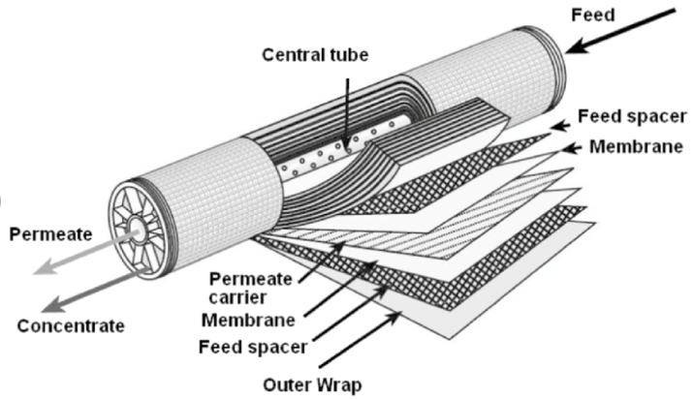
The Membranes
RO or Nanofiltration (NF) Spiral Wound Membranes
Use high pressure to molecularly separate water and ethanol from the product stream
Small carryovers include volatile aromas, flavor-active fatty acids, and acidifying components
Susceptible to membrane fouling and require membrane-specific CIP chemicals for cleaning
Susceptible to heat damage >120°F

Slide 13
Phase One: Concentration
Higher-Strength Permeate
Correlates to the ABV of the product
Effective to a Point
Great for early-stage dealcoholization
The less water/ethanol in the feed, the harder time the membranes will have removing it
Typically reduces the volume in the process tank by 50% (2x concentration)

Slide 14
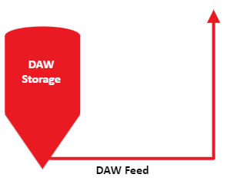
Phase Two: Diafiltration
Introduction of de-aerated water into the product feed
Assists in later-stage ethanol removal (washes out remaining ethanol)
All water added is removed through the membranes as permeate along with residual ethanol
Can effectively remove ethanol down to <1% ABV

Slide 15
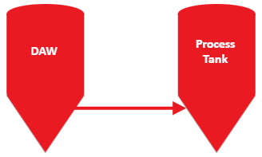
Phase Three: Reconstitution
Adds back the water removed during concentration
Important to find balance between yield and flavor of reconstitution
Brings the product ABV to <.50%

Slide 16
Pros and Cons of Alcohol Removal Methods
 | Thermal/Evaporative | Membrane
Pros | Fully fermented beer Dual output streams Particulate flexibility 0.0 capability | Fully fermented beer Dual output streams Scalable Selective membranes
Cons | Capex and opex Higher liquid temp needed to reach boiling point – thermal degradation | Larger capex and opex Membrane fouling considerations
Notes:
Pros
Both start with a fully fermented beer and both yield two product streams (low alcohol beer and water/ethanol stream)

Slide 17
Sensory Attributes of Ethanol
Sweet/Bitter/Sour
Scinska et al, “Bitter and sweet components of ethanol taste in humans”
Alcohol “heat”
Solvent properties
Notes:
Takeaways from Scinska paper:

Slide 18
De-alcoholization and Sensory

Slide 19
What is lost during your process?
Organoleptic qualities of your permeate stream?
Membrane Filtration
Balance between product integrity and operating efficiency
Membrane selection
Operational parameters
Concentration and dilution strategy
Potential impacts to head retention
Thermal/evaporative processes
Re-introduction of lost aroma fraction?
Solvent properties of your beer
Impact to hopping and adjunct additions

Slide 20
Oxygen and Stabilization – Sensory
Oxidation considerations
Process complexity – more touch points and equipment
Stabilization
Flavor impact of preservatives?
Thermal degradation of pasteurization

Slide 21
How to close the gap

Slide 22
How to close the gap
Consider your process
Addition timings
Common body/sweet/mouthfeel adjustments
Higher final extract
Maltodextrin
Glycerol/glycols
Lactose
Capsaicin for alcohol heat???

Slide 23
How to close the gap
Hop Aroma/Flavor
Cold side hop products
Haze
Haze stabilizers (tannic acid)

Slide 24
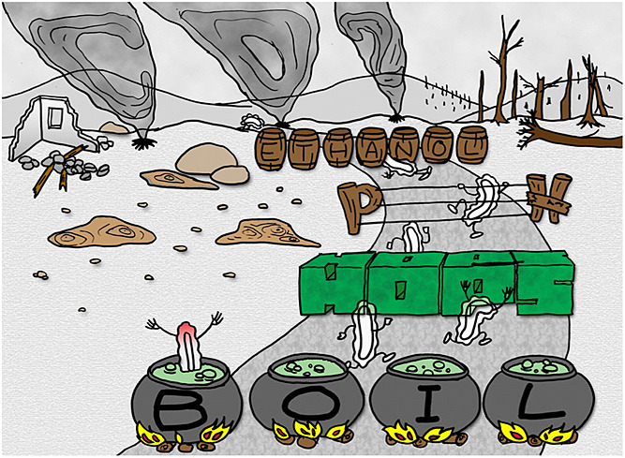
Protect your customer!
Non-alcohol Beer: A Review and Key Considerations (Brewers Association)

Slide 25
Thanks to:
Ryan Brei, Deschutes Brewery
Ben Jordan, ABV Technology
“A Guide to NA Beer Production”
Scinska et al
“Bitter and sweet components of ethanol taste in humans”
Brewers Association
Authors of “Non-alcohol Beer: A Review and Key Considerations”

Slide 26
Thank You
Ben Kehs
bkehs@deschutesbrewery.com

Slide 27
Maltose-Negative Yeasts Richard Preiss NABLAB Workshop
Notes:
SAY:
Good morning everyone and welcome to today’s session. The [name association] presents [name of session title].
I would like to introduce myself. I am [insert name], from [company] and I am [position at company, brief relationship to association or topic] and I will be moderating the session.

Slide 28
NA Beer Production Methods
Dealcoholization Methods | Fermentation Methods
Evaporation (e.g. vacuum distillation) | Limited fermentation with maltose negative yeasts (~10-25% attenuation)
Membranes (e.g. reverse osmosis) | Limited fermentation with maltotriose negative yeasts (~40-60% attenuation)
 | Arrested fermentation (cooling or removing yeast before completion)
 | Cold contact fermentation (pitching yeast into cold wort)
I will be covering this topic

Slide 29
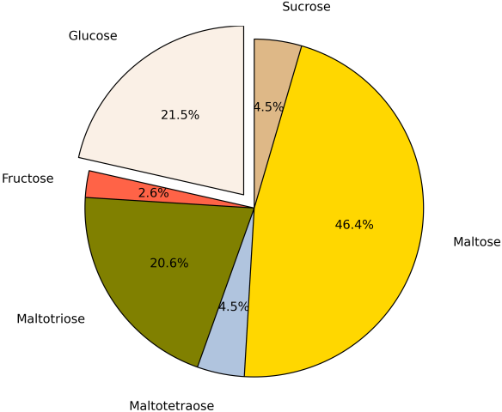
Sugar profile of wort
Source: Eureka Brewing

Slide 30
Fermentation by regular yeast (ale or lager)
~70-80% ADF
+
+
+
+
Variable
-
Source: Eureka Brewing

Slide 31
Maltotriose negative yeast
~40-60% ADF
+
+
+
+
-
-
Source: Eureka Brewing

Slide 32
Maltose negative yeast
~10-25% ADF
+
+
-
+
-
-
Source: Eureka Brewing

Slide 33
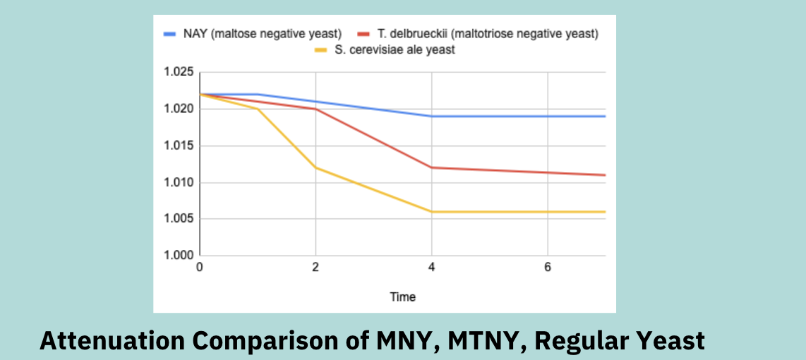
Typical fermentation profiles – Ale yeast, maltotriose negative, maltose negative

Slide 34
Comparing fermented NA methods
Method | Benefits | Drawbacks
Arrested Fermentation | You can use any yeast. | Missing the cold-crash and removal of yeast by a couple of hours can mean your beer is over 0.5% ABV. Risk of fermentation intermediates such as acetaldehyde, DMS.
Maltose Negative Yeast | Benefits: Easy process, “set it and forget it” for a few days. | Drawbacks: Limited flavour expression possibilities compared to many Saccharomyces yeasts. Low or no flocculation is typical.
Maltotriose Negative Yeast | Can use maltotriose-negative S. cerevisiae yeasts and their benefits (flocculation and flavour). | Also at risk of over-fermenting or over-attenuating the wort.
Cold Contact Fermentation | Benefits: simple process. | Very little fermentation actually occurs - just enough contact between yeast and wort to call the resulting product “beer”.

Slide 35
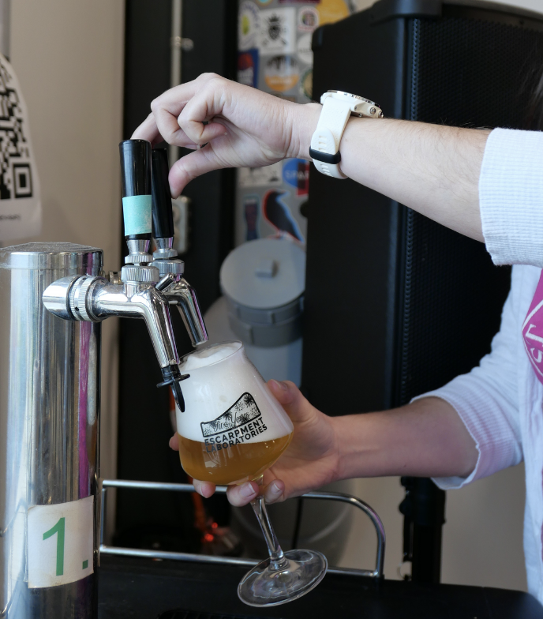
General tips for fermented NA beer with maltose negative yeasts
Use ALDC enzyme to reduce the risk of diacetyl formation
Make a low-gravity wort with a high mash temperature to reduce fermentability
Use yeast nutrients in the whirlpool to make up for the low-nutrient wort
Pasteurize the finished beer
Build in malt character with specialty grains e.g. Vienna malt

Slide 36
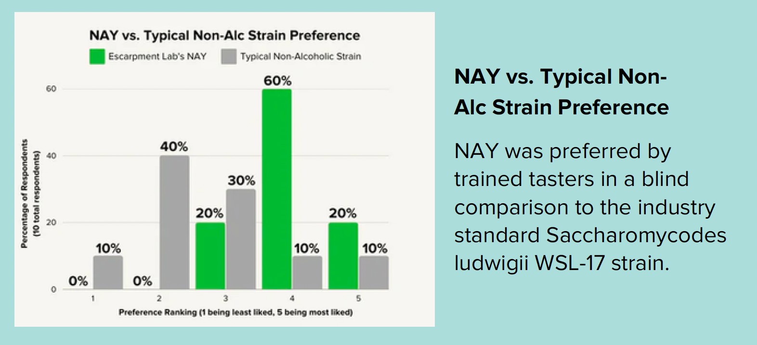
Comparing maltose negative yeasts

Slide 37
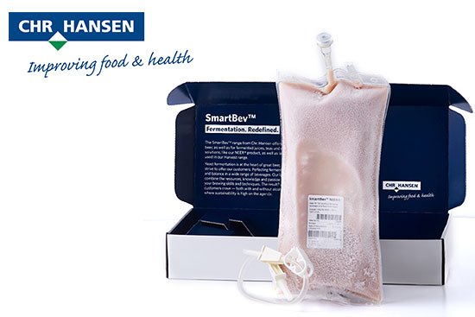
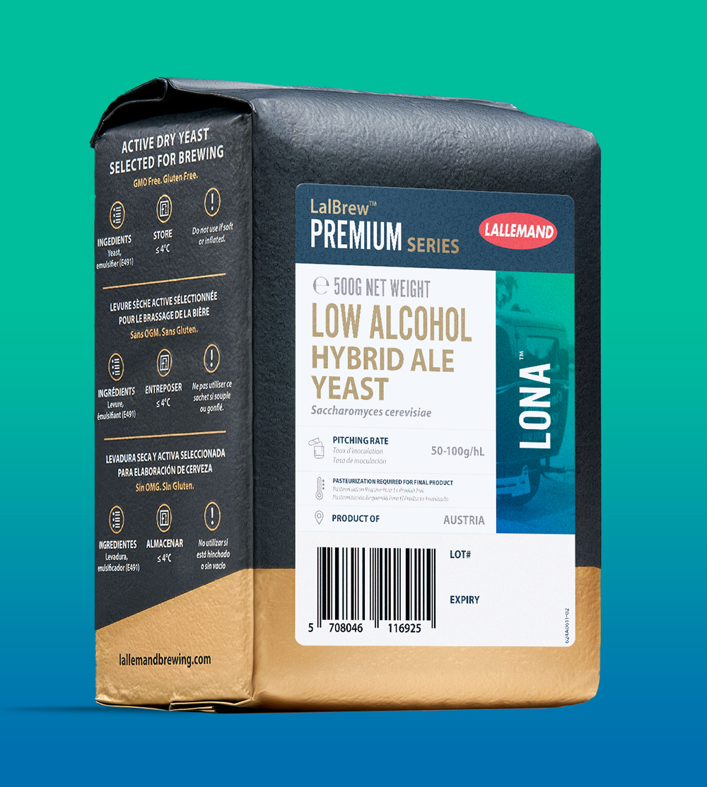
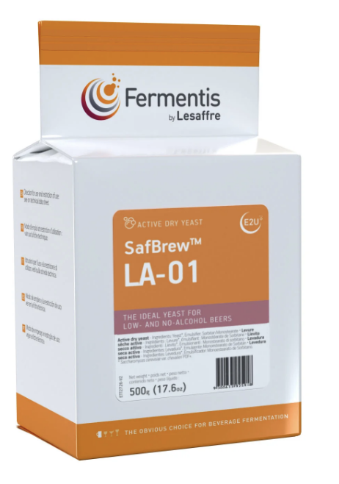
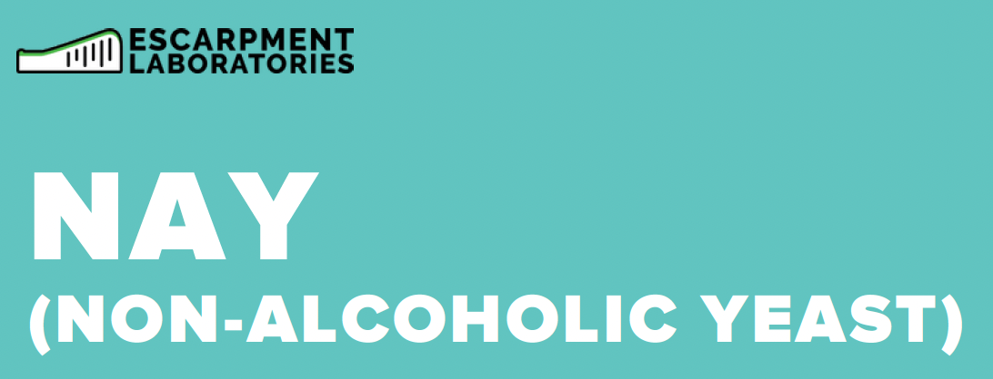
Maltose negative yeast options
Escarpment Labs NAY Hanseniaspora uvarum
Chr Hansen NEER Pichia kluyveri
Lallemand LoNa S. cerevisiae
Fermentis LA-01 S. cerevisiae
Var. chevalieri

Slide 38
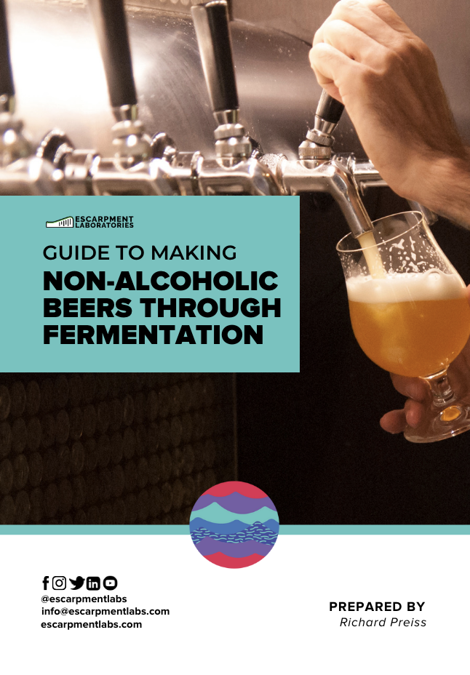
Learn More
<-
Free download on escarpmentlabs.com
->
Recorded Webinar on YouTube

Slide 39
Ryan Bross Surly Brewing Company NA Beer Trial

Slide 40
Maltose Negative Yeast strain evaluation
We chose seven different Maltose and Maltotriose negative yeast strains to evaluate the flavor impact using the same wort stream
Each of these were pitched at the same rate and fermented under the same conditions
The only strains grown up in house were the Berkley Yeast BY1502-1503
These organisms arrived on plates for selection and to be grown in the lab to the right concentration
These were grown in a YPD broth until desired concentration was reached
Commercial yeast used
Fermentis (LA-01): Saccharomyces cerevisiae var. chevalieri
Lallemand (LONA): Saccharomyces cerevisiae hybrid
Christian Hansen (Neer Poly):Pichia Kluyveri
White Labs (NA All Day):Saccharomycodes Ludwigii
Berkley Yeast BY1502 (experimental strain)
Berkley Yeast BY1503 (experimental strain)
Escarpment Labs (NAY) Hanseniaspora Uvarum

Slide 41
How was the wort made?
Ingredients were mashed at 168F for 60min
This was chosen to limit the creation of simple sugars produced and create more unfermentable dextrins
The mash pH was adjusted to 5.2 using citric acid
The mash was sparged at 168f until target amount of wort was collected
Target pre boil Plato 3.5
Boiled for 60min with small bittering hop addition
Aroma hops were added in the whirlpool once temperature hit 195f and allowed to steep for 30min
Citric acid was also added during whirlpool step to drop the wort to 4.4pH
Wort was chilled to 70f and aerated at 3L/min or 10ppm and pumped to the 7 fermenters
The yeasts were added to each of the fermenters at desired pitching rates from each manufacture
These were then set at 70f and left to ferment

Slide 42
Fermentation results
These yeasts were left to ferment for 5 days at 70f
After fermentation was completed, the tanks were chilled.
These were all packaged and tested for sugar analysis, Ester and fusel alcohol analysis, and sensory analysis.
All NA beers were packaged with a 0.075% Sodium Benzoate and Potassium Sorbate preservative blend.
All analytical samples were taken before preservatives were added.
Name | Abv% (v/v) | Plato | pH | SRM | IBU | Total Acidity g/L | S.G. | % Lactic Acid
Wort NA | 0.02 | 3.74 | 4.54 | 2.81 | 33.9 |  | 1.01281
NA Escarpment | 0.11 | 3.51 | 4.30 | 4.51 | 29.5 | 1.4428 | 1.01191 | 0.131
Fermentus LA-01 | 0.29 | 3.23 | 4.41 | 2.75 | 28.5 | 2.0380 | 1.01079 | 0.185
LONA Lallemand | 0.3 | 3.18 | 4.38 | 2.65 | 28.4 | 1.2864 | 1.01061 | 0.117
CH Neer | 0.1 | 3.57 | 4.33 | 2.78 | 29.0 | 1.3437 | 1.01211 | 0.122
WL NA All Day | 0.3 | 3.26 | 4.37 | 2.94 | 29.8 | 1.8597 | 1.01092 | 0.169
BY1502 | 0.28 | 3.26 | 4.41 | 2.91 | 30.9 | 0.7122 | 1.01090 | 0.065
BY1503 | 0.27 | 3.25 | 4.40 | 2.90 | 30.6 | 1.5234 | 1.01088 | 0.139

Slide 43
Sugar Analysis Table
Carbohydrates | NA Wort | Escarpment NAY NA#1 | Fermentis LA-01 NA#2 | Lallemand LONA NA#3 | CH Neer NA#4 | White Labs NA All day NA#5 | Berkley BY1502 NA#6 | Berkley BY1503 NA#7
Maltose (ppm) | 4,337 | 4,454 | 4,226 | 4,359 | 4,498 | 4,421 | 4,478 | 4,495
Maltotriose (ppm) ¹ | 2,978 | 2,946 | 3,004 | 2,978 | 2,977 | 2,973 | 3,009 | 3,021
Maltotetraose (ppm) ² | 2,152 | 2,165 | 1,997 | 1,995 | 2,181 | 1,965 | 1,983 | 1,999
Sucrose (ppm) | 1,995 | 2,158 | 153 | 157 | 2,175 | 133 | 158 | 155
Glucose (ppm) | 1,866 | ND | ND | ND | 462 | ND | ND | ND
Fructose (ppm) | 435 | 390 | 388 | ND | ND | 568 | 360 | 366
Total (ppm) | 13,763 | 12,113 | 9,768 | 9,489 | 12,293 | 10,061 | 9,988 | 10,035
Ethanol (ppm)* | 0 | 1,337 | 2,984 | 3,029 | 1,017 | 3,277 | 2,873 | 2,846
Ethanol (%)* | 0.00% | 0.13% | 0.30% | 0.30% | 0.10% | 0.33% | 0.29% | 0.28%
Source: Rahr Technical Center

Slide 44
Sugar Analysis graph
Berkley BY1503 NA#7
Berkley BY1502 NA#6
White Labs NA All day NA#5
CH Neer NA#4
Lallemand LONA NA#3
Fermentis LA-01 NA#2
Escarpment NAY NA#1
NA Wort
Source: Rahr Technical Center

Slide 45
Ester and Fusel Alcohol analysis Table
Test | Units | NA Wort | Escarpment NAY NA#1 | Fermentis LA-01 NA#2 | Lallemand LONA NA#3 | CH Neer NA#4 | White Labs NA All day NA#5 | Berkley BY1502NA#6 | Berkley BY1503NA#7
1-Propanol | ppm | < 0.1 | 2.26 | 3.42 | 3.11 | < 0.1 | 2.73 | 3.15 | 3.22
2,3 Pentanedione (As-Is) | ppb | < 15 | < 15 | < 15 | < 15 | < 15 | < 15 | < 15 | < 15
Acetaldehyde | ppm | 0.64 | 14.83 | 14.93 | 21.62 | 2.55 | 3.32 | 11.22 | 11.26
Acetone | ppm | 1.91 | 1.88 | 1.87 | 1.84 | < 0.1 | 2.46 | 1.88 | 1.86
Amyl Alcohols | ppm | < 0.1 | 0.93 | 5.18 | 6.46 | < 0.1 | 5.64 | 3.91 | 3.66
Diacetyl (As-Is) | ppb | 93.35 | 15.60 | < 15 | < 15 | 73.44 | < 15 | 64.00 | 58.94
Ethyl Acetate | ppm | < 0.1 | 3.54 | 0.25 | 0.23 | 5.82 | 0.56 | 0.06 | 1.99
Ethyl Butyrate | ppm | < 0.1 | < 0.1 | < 0.1 | < 0.1 | < 0.1 | < 0.1 | < 0.1 | < 0.1
Ethyl Hexanoate | ppm | < 0.1 | < 0.1 | < 0.1 | < 0.1 | < 0.1 | < 0.1 | < 0.1 | < 0.1
Ethyl Octanoate | ppm | < 0.1 | < 0.1 | < 0.1 | < 0.1 | < 0.1 | 0.07 | < 0.1 | < 0.1
Isoamyl Acetate | ppm | < 0.1 | < 0.1 | < 0.1 | < 0.1 | 1.54 | < 0.1 | < 0.1 | < 0.1
Isobutanol | ppm | < 0.1 | 1.77 | 2.25 | 2.29 | 3.71 | 3.18 | 1.37 | 1.34
Isobutyl Acetate | ppm | < 0.1 | < 0.1 | < 0.1 | < 0.1 | < 0.1 | < 0.1 | < 0.1 | < 0.1
Methanol | ppm | 3.34 | 0.85 | 1.76 | 0.85 | < 0.1 | < 0.1 | 1.31 | < 0.1
Source: Rahr Technical Center

Slide 46
Ester and Fusel Alcohol Analysis Graph
Berkley BY1503 NA#7
Berkley BY1502 NA#6
White Labs NA All day NA#5
CH Neer NA#4
Lallemand LONA NA#3
Fermentis LA-01 NA#2
Escarpment NAY NA#1
NA Wort
Source: Rahr Technical Center

Slide 47
Sensory Results
Yeast | Most common flavors/ aromas noted
Escarpment NAY | Carmel, Lemon, astringent, funky, rubbery
White Labs NA All Day | Green apple, lemon peel, honey, astringent, vegetal/ cooked corn
Berkley BY1502 | Orange note, green bell pepper, wort forward, green apple
Berkley BY1503 | Well balanced, smooth, lemon zest, slight orange notes, butter, dried fruit forward
Fermentis LA-01 | Black Pepper, Phenolic, Less wort like, smokey, banana
Lallemand LONA | Balanced, good mouth feel, neutral, not any fruit aromas, least prominent hop characteristic
CH NEER | Stone Fruit rind, Bubblegum, Slightly stale, butter/diacetyl
There was a total of 14 tasters who were blindly given the NA beer samples
All the tasters did say that each of the beers were very astringent and lack a full mouthfeel.
Most of the tasters commented on some wort like characteristics for each sample
Each yeast has favorable and unfavorable characteristics noted by our tasters.

Slide 48
Conclusion and further studies
Each of the 7 yeast strains preformed better than expected
All the yeast strains produced a nonalcoholic beer with <0.5% ABV
Tasters will have to be trained on how to evaluate nonalcoholic beers.
More R&D will be needed. Two experimental NA pale ales have been made for stability, shelf life, and flavor comparisons using the top two yeasts from the study.
Two of our top NA strains have been chosen and rebrewed to get more data on characteristics of each and which fits what we are looking for in a NA yeast.
We have each of these two to taste through today
8 common beer spoiler organism have been chosen and inoculated in the NA beer at differing concentrations. This was done side by side with differing concentrations of preservatives to see the effectiveness in stabilizing a NA beer with alternative techniques

Slide 49
NA Techniques & Flavor
Consumers Dislike…
Bitterness, Astringency, Sourness, Malty
Consumers Like…
Sweet, Fruity, Hop Aroma, Alcohol ;)
“Beer Likeness”
DMS – Consumers like a bit of DMS
Skunky – Consumers tend to dislike this flavor, but it enhances “beer likeness”
Restricted Fermentation
Worty, Thick, Sweet
Physical Methods
Dull, Sour, Thin
Mixed methods tend to produce the most favorable flavor

Slide 50
What tips would you give someone starting out in NABLAB production when designing a beer/recipe? (all)
Hot side choices
Hop selection (cold side hop choice)
Yeast selection
Other flavor additive selection
Stabilization selection
What do you do to counteract the perception of low body or the beer tasting watery? (to Ben, Ryan, and Lindsay)
How should brewers taste NABLAB, what changes should they make in their program compared to traditional beer? (to Lindsay)
How much is NABLAB production dependent on yeast strain selection for flavor? (to Richard, Ryan, Ben)
Do you notice a flavor difference between chemical stabilization and pasteurization? (to Ryan)
Follow up: in choosing between stabilization methods, is flavor effect a deciding factor?
Q
A

Slide 51
Thank you!

