Slide 1
A Short Dive into a Novel Maltose Negative Saccharomyces cerevisiae strain:
Hybrid Technology and Flavor Benefits
MBAA Annual Conference 2023
Sylvie Van Zandycke and Molly Browning
Lallemand Brewing

Slide 2
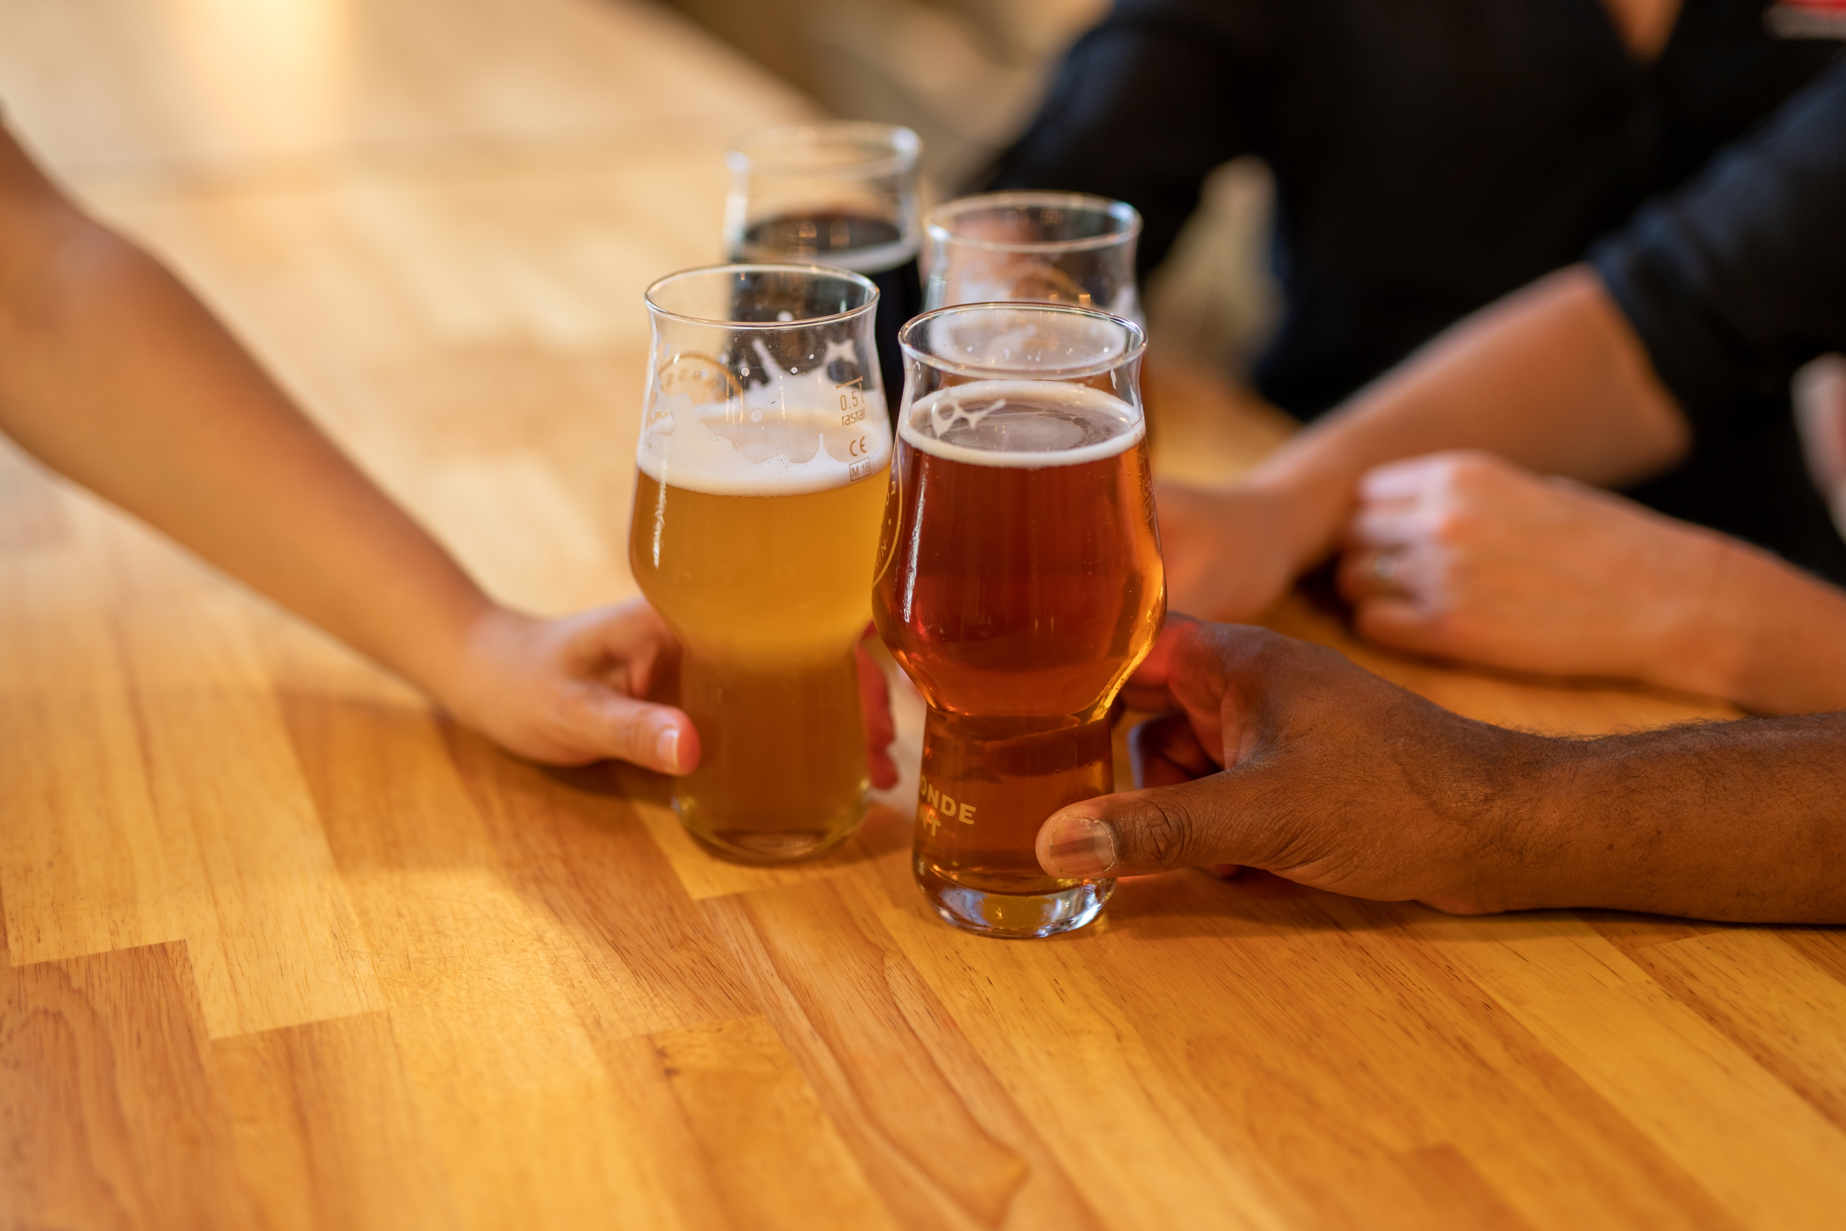
Outline of Talk
Maltose Negative Yeast Strains
Hybrid Technology and Novel Maltose Negative Yeast
Flavor Impacts and Comparison
  Aldehydes
  Flavor Volatiles
Conclusion

Slide 3
Maltose Negative Yeast Strains
Saccharomyces cerevisiae var. chevalieri
Pichia Kluyveri
Saccharomycodes ludwigii
Hanseniaspora uvarum

Slide 4
Hybrid Technology and Novel Maltose Negative Yeast

Slide 5
The challenge: how to make a better NABLAB
Desired Traits:
Fermentation solution (no ethanol removal equipment required)
Cleaner profile
No POF
Reduced worty flavors
Consistent performance
Simple process
Versatility for different styles

Slide 6
Low or Non-Alcoholic Beer Production Procedure
Mash a well modified Ale malt at a high mash temperature to limit glucose and maltose production
  A very high temperature mash can lead to a very hazy wort and processing problems
Target a low OG between 1.020 – 1.027 (5.1-6.8°P)
Lauter as normal but ensure pH and gravity remain within normal brewing levels. (5.1-5.4) Acid additions may be necessary.
Boil as normal and cool as normal, monitoring the pH
The pH should be adjusted to 4.6 prior to fermentation.

Slide 7
Low or Non-Alcoholic beer production
6. Pitch maltose negative yeast
7. Final pH should be less than 4.4 and ideally between 3.9-4.1
8. Pasteurize to ensure product stability and safety

Slide 8
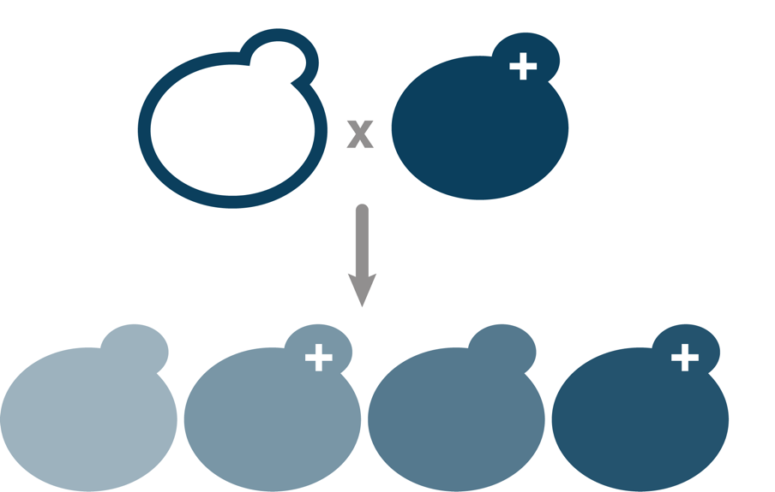
What is a hybrid yeast?
A hybrid yeast contains genes of interest from their parental strains.
Asexual reproduction
Sexual reproduction

Slide 9
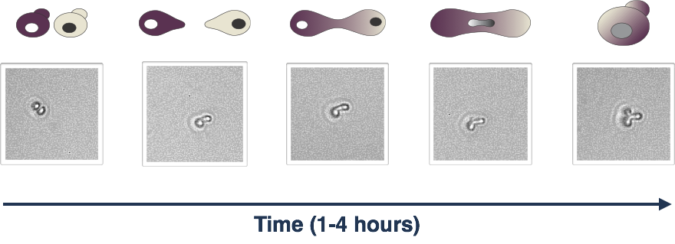
How does it work?
Spore Pair
Shmooing
Cell Fusion
Karyogamy
Hybrid

Slide 10
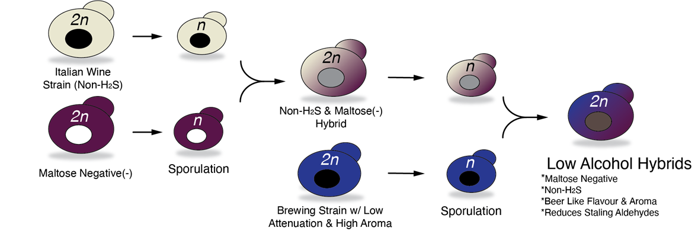
Breeding Chart – How It’s Made
All parents are Saccharomyces cerevisiae

Slide 11
Novel hybrid maltose-negative Saccharomyces cerevisiae
Fermentation characteristics
Based on an 8°P wort
Pitch Rate in dry form: 50-100g/hl
Fermentation Temperature: 20-25°C (68-77°F)
Attenuation: 16-20% (lower with high mashing conditions)
Flocculation: Medium
Fermentation Completed in 3-4 days
Repitchability: Not repitchable
It is recommended to adjust wort pH to ≤4.6 to limit growth of pathogenic bacteria.
Pasteurization is required to avoid refermentation after packaging and ensure beer stability

Slide 12
Flavor Impacts
Comparing different Maltose Negative Yeast Strains
Notes:
As well all know, producing low/non alcohol beer has many challenges and one that is the holy grail of sorts for these type of beverages is that their sensory impacts are typically vastly different than what you observe in a traditional strength beer.
The rest of this talk is going to take a closer look at the different maltose negative yeast strains and how they compare with key flavor elements that are observed in these beverages

Slide 13
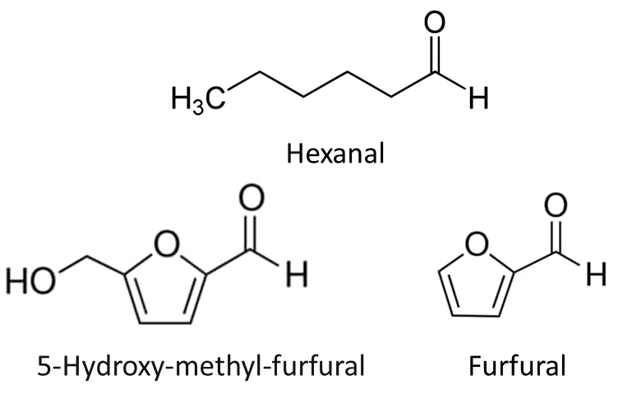
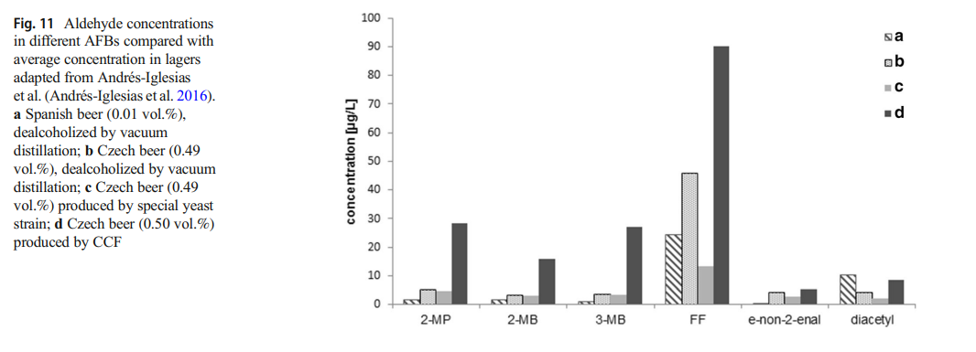
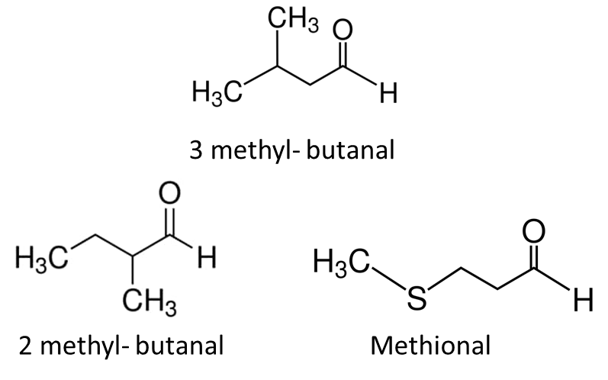
Aldehydes: Predominate Flavor Contributor in NABLAB
  Source:Gernat, D.C., Brouwer, E., Ottens, M., “Aldehydes as Wort Off-Flavors in Alcohol-Free Beers- Origin and Control”, Food and Bioprocess Technology (2020), 13: 195-216.
Notes:
The first key flavor impact are the work of aldehydes. come from various sources including the Maillard reaction, Strecker degradation, and the oxidation of fatty acids. Each of these have different flavors associated with them
Examples of aldehydes are: * 2-Methylbutanal (Strecker aldehyde) 45–1250 ■ Produced through Strecker degradation of isoleucine or in presence of oxygen ■ Almond, apple-like, malty
3-Methylbutanal (Strecker aldehyde) 56a –600 ■ Produced through Strecker degradation of leucine or in presence of oxygen ■ Malty, chocolate, cherry, almond
* Hexanal (linear aldehyde) 88–350 ■ Product from fatty acid oxidation ■ Green, grassy
* Methional (Strecker aldehyde) 4.2–250 ■ Produced through Strecker degradation of methionine ■ Cooked potatoes, worty
* Furfural (heterocyclic aldehyde) 15,000a –150,000 ■ Product of Maillard and caramelisation reaction (heat indicator) ■ Indicator of flavour instability in beer ■ Caramel, bready, cooked meat
* Graph shows that aldehyde levels depend on method of alcohol removal
Lack or limited ethanol matrix, limited esters, flavor volatiles in NABLAB contributes to more of a perception of these aldehydes (sweet, worty flavor)

Slide 14
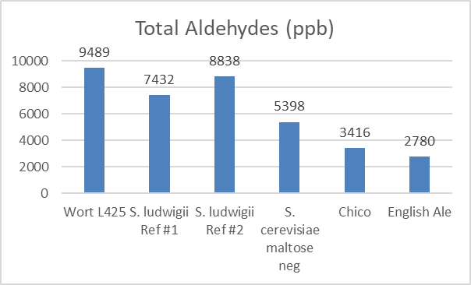
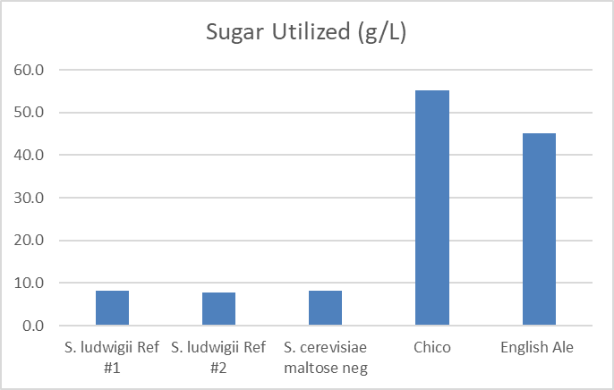
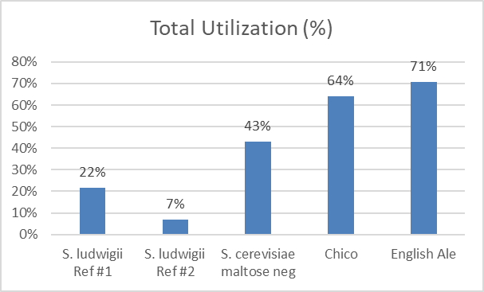
Aldehyde Comparison in NABLAB
NABLAB Specs:
  10.4°Plato
  3 day fermentation at 21°C
Notes:
Comparison of different maltose and traditional brewing strains
(Maltose neg strains ended up less than 1% ABV).
Normally see high aldehyde utilization using Sacch cerevisiae and we see a similar occurrence in the hybrid maltose neg Sacch cerevisiae strain

Slide 15
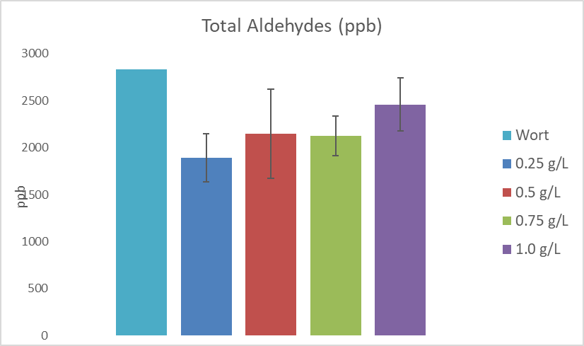
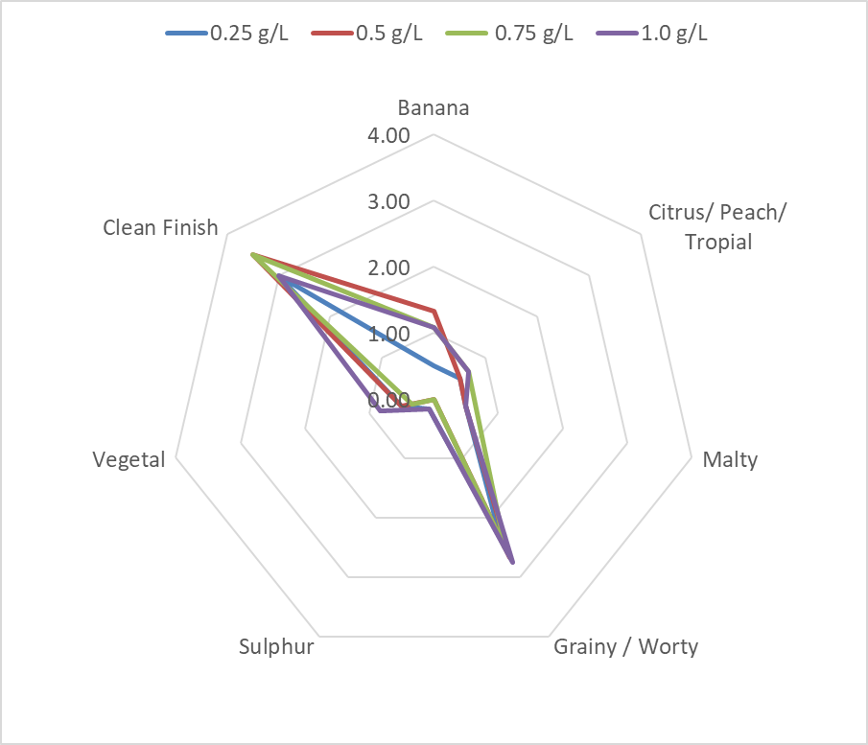
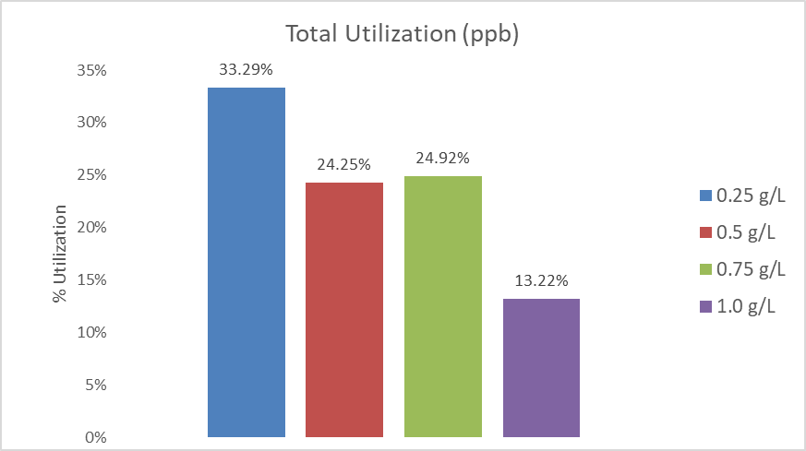
Aldehyde Utilization and Pitch Rate
Hybrid S. cerevisiae maltose negative strain:
  4°Plato
  3 day fermentation
Lower pitch rate yields more aldehyde utilization
Slight but notable differences in sensory
Notes:
*Aldehyde utilization can depend on pitch rate
Taste panel done with 5 tasters
* 0.5g/L leans more towards the tropical fruit with all the tasters having positive comments: Worty, vegetal, subtle fruit acetate ester, worty, no off aroma banana, tropical, malty, worty, clean finish, easy-drinking, taste slightly more flavorful than others. banana, honey, sweet Light mouthfeel, nice acidity and fresh, some grainy flavour, no sweetness

Slide 16
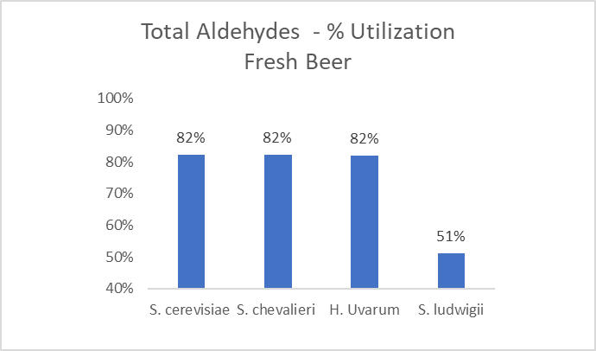
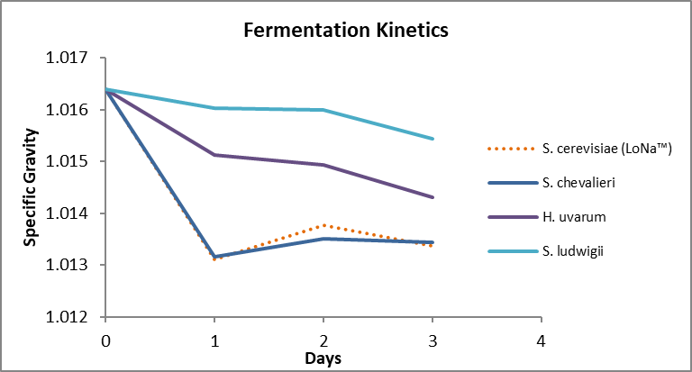
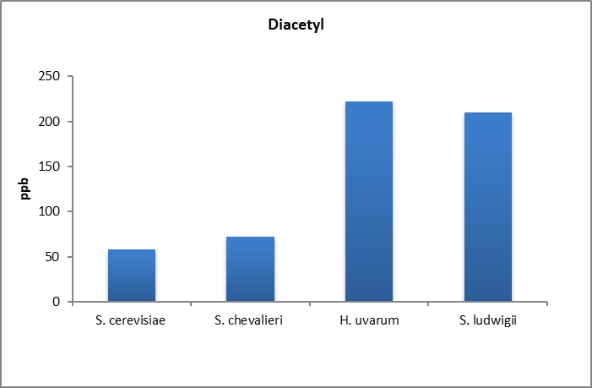
Flavor Compound Analysis
Across different maltose negative strains
Notes:
Not all maltose neg yeast strains perform the same way.
large differences in performance of S. cerevisiae strain versus maltose negative non-Sacch strains
With some maltose neg strains, similar strain performance broadly across all aldehydes however, there were slight differences seen in individual aldehydes (for the S. cerevisiae strains) (wort was all grain, 4plato)
Aldehydes are only a picture of NABLABs, flavor analysis shows the complex chemistry in these beverages
Noticeable difference in diacetly levels between cerevisiae and non sacch strains (which is what you would expect, it is one reason why Sacch is such a dominate yeast)

Slide 17
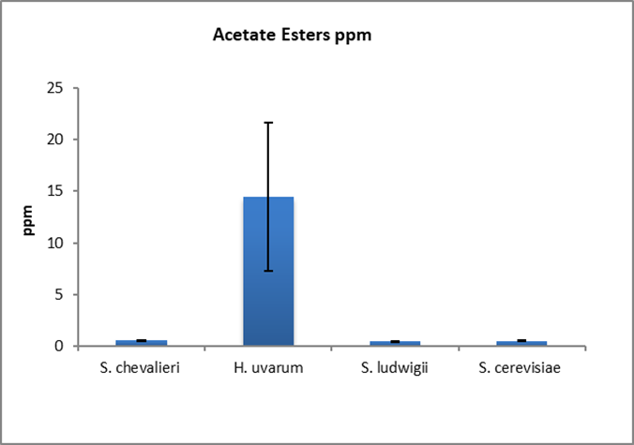
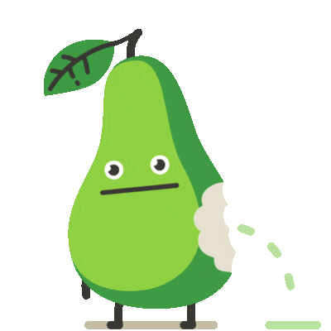
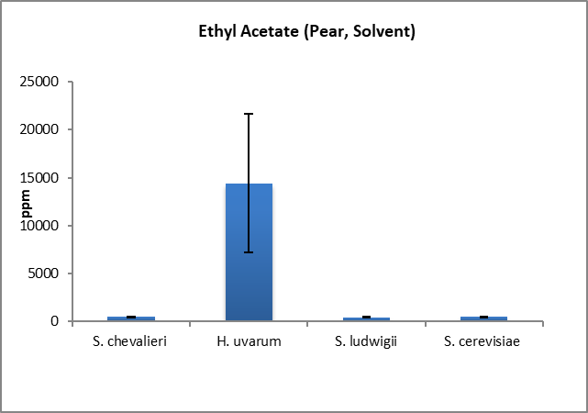
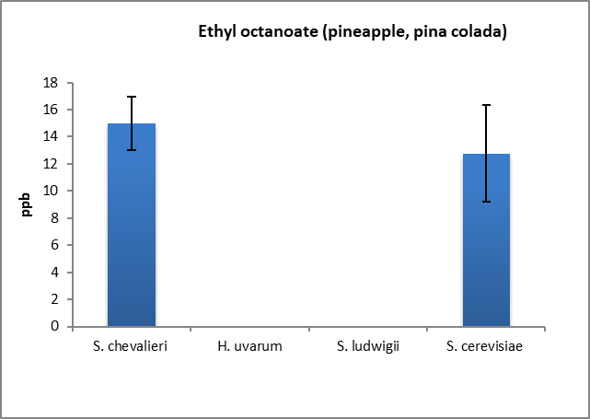
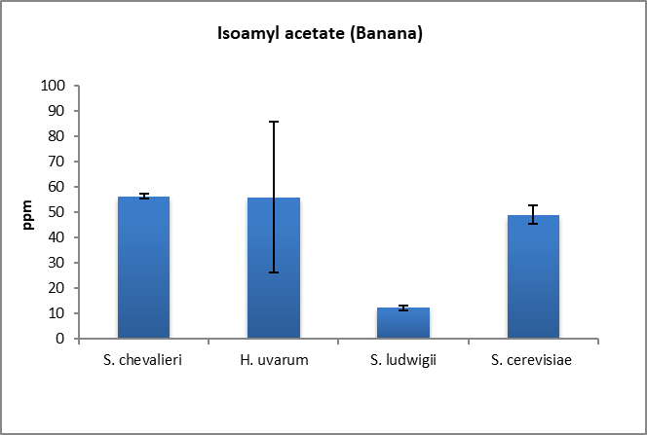


Ester Flavor Comparison
Notes:
Similar story with esters, in terms of similar performance of the Sach compared to non Sacch strains.
uvarum stands out as producing more acetate esters, but the Sacch strains produce more isoamyl as well as more ethyl octanoate.

Slide 18
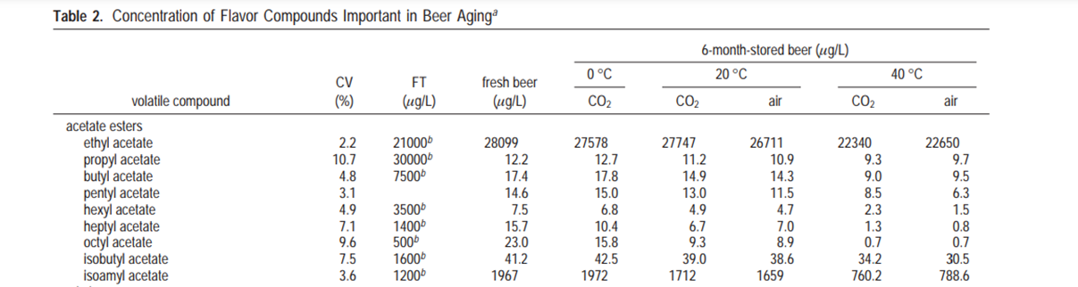
Esters in Beer
Source: Bart Vanderhaegen, Hedwig Neven, Stefan Coghe, Kevin J. Verstrepen, Hubert Verachtert, and Guy Derdelinckx, “Evolution of Chemical and Sensory Properties during Aging of Top-Fermented Beer,” Journal of Agricultural and Food Chemistry 2003 51 (23), 6782-6790
Notes:
How does this compare to what we see in traditional strength beer? this is the concentration in beer of acetate esters that shows how they change over time.
In traditional strength beer, these esters are naturally higher (about 14x higher for ethyl acetate), but the isoamyl acetate pretty close to hybrid maltose neg Sacch cerevisiae
The flavor threshold for these compounds are: 30ppm for ethyl acetate and 1.2ppm for isoamyl acetate
Obviously the amount of these esters will differ depending on the beer style. This beer was a 7.5% fresh pale ale from a Belgian brewery

Slide 19
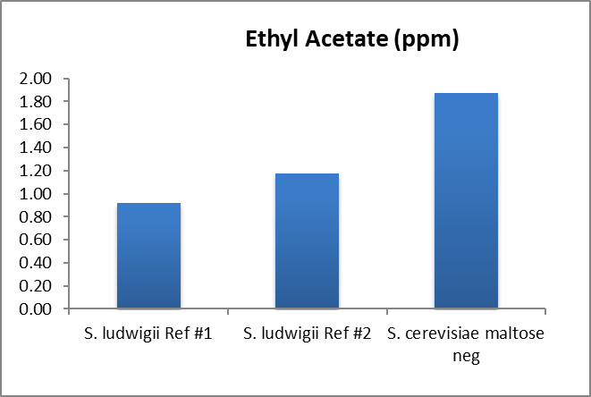
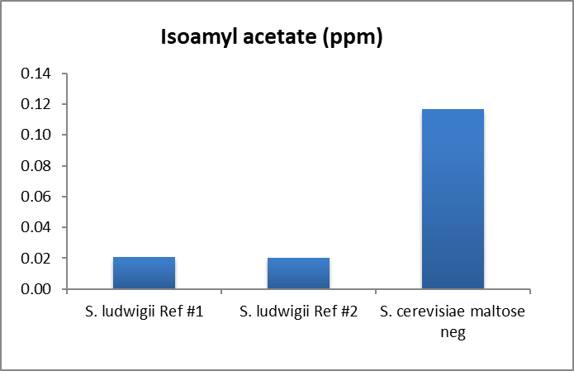
Flavor Compound Analysis
Hybrid S. cerevisiae versus S. ludwigii
NABLAB Specs:
  10.4°Plato
  3 day fermentation at 21°C
Notes:
Comparing Sacch to two different strains of ludwigii confirms the picture of more beer like flavors coming from S. cerevisiae

Slide 20
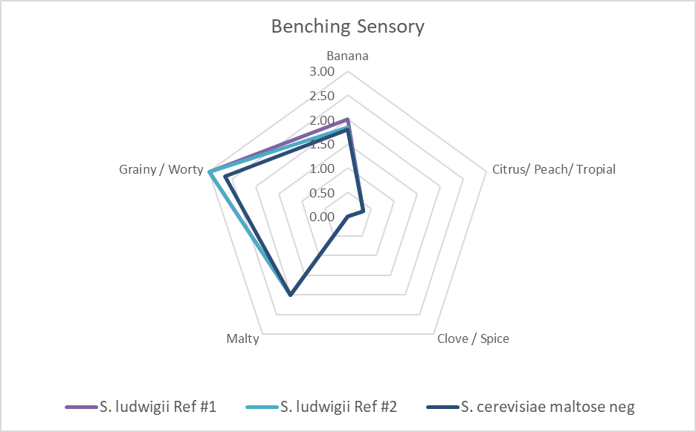
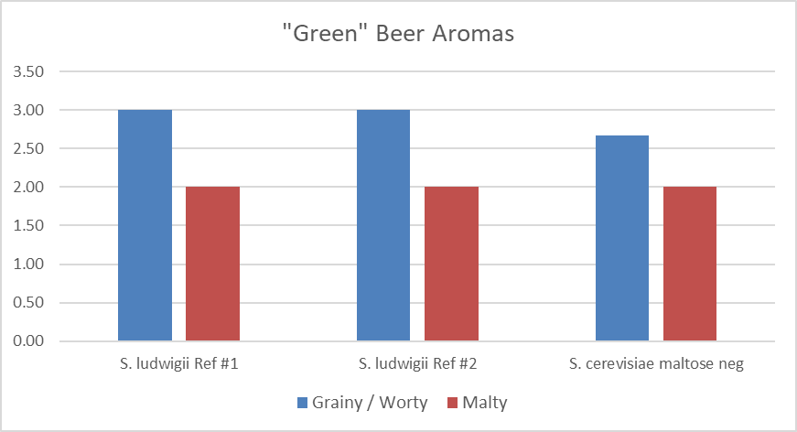
Laboratory Taste Panel
Tasters noted less green beer aroma
Notes:
Does this translate in taste panel? We see less green beer/worty aroma with the Sacch maltose neg strain

Slide 21
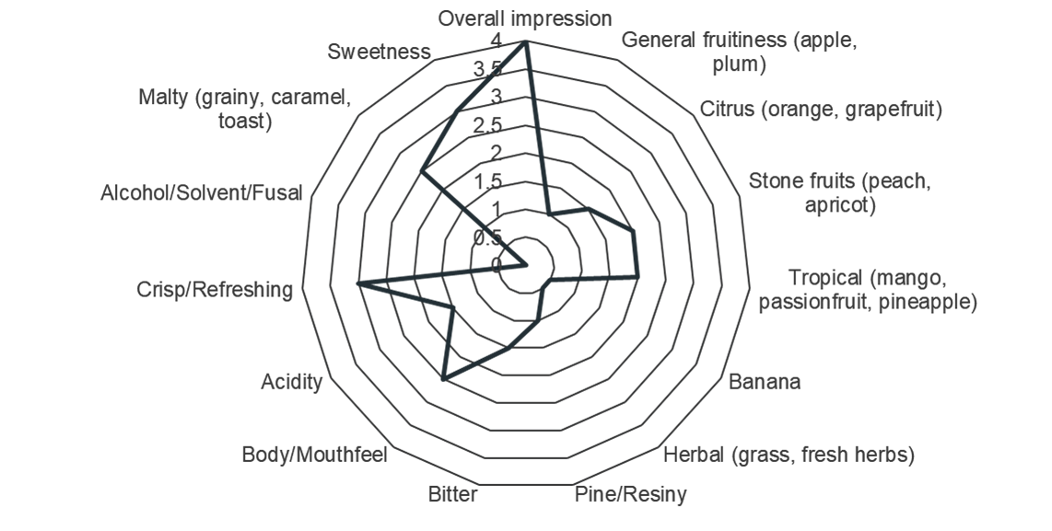
Commercial Trials with Hybrid Maltose Negative S. cerevisiae strain
 | Apparent Attenuation | ABV | Start pH | End pH | pH drop | Fermenation Time (Days) | Flocculation
Averages | 13.2 | 0.5 | 4.8 | 4.5 | 0.3 | 3.2 | 3.3 / 10
Notes:
Looking at commercial trials now for the hybrid Sachh maltose neg strain
Commercial trials reinforce the reason for a hybrid Sacch cerevisiae strain (remember this strain is also POF – and does not produce sulphur)
Data based on 7 Commercial early trials

Slide 22
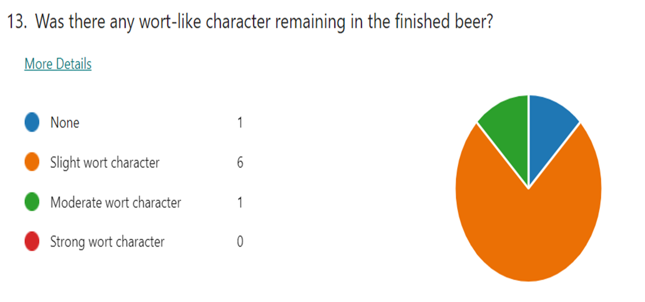

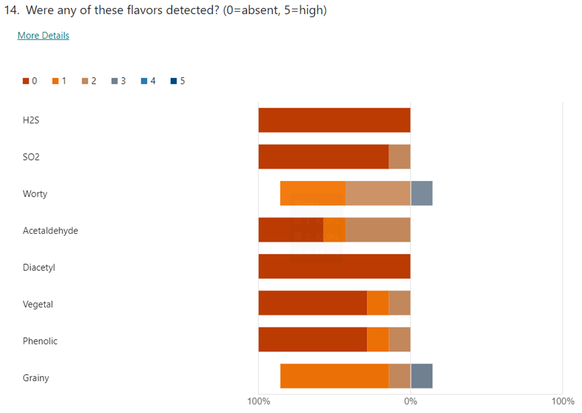
Brewers Feedback
Notes:
Brewers noted little to no wort character along with the absence of H2S, S02, phenols, and diacetyl

Slide 23
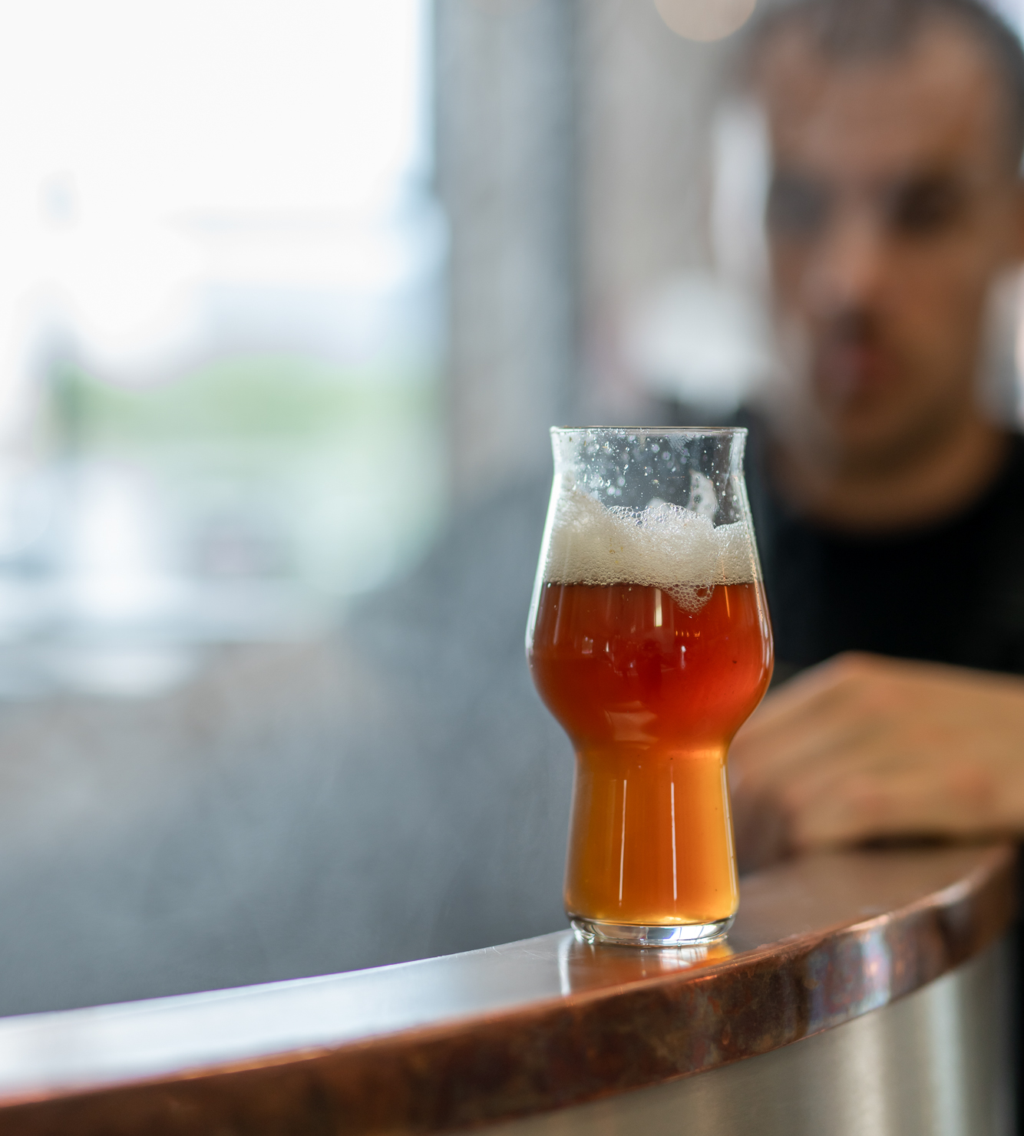
What Does this Mean?
Different yeast will impact product differently
Sensory Highly Influences Production in NABLAB
Possibility of combining a maltose negative yeast + physical alcohol removal to achieve 0.0%
Use of Saccharomyces cerevisiae is a safe bet
  You still need to pasteurize!
This technology can be applied to different strains according to beer style
DEI…
Notes:
Probably more so than in traditional strength beer, getting the sensory correct in NABLAB offers huge production savings – for example if your 0.5% ABV beer already tastes fairly close to beer, you do not need to do much on the backend of correct any flavor offenses

Slide 24

Resources
  MBAA Food Safety Committee
    Food Bites, flow chart
  Non and Low Alcohol Beer Production Best Practice
  Webinar: Introducing a Hybrid Maltose Negative Saccharomyces cerevisiae strain

Slide 25
Thank you!
Sylvie VanZandycke: svanzandycke@lallemand.com
Molly Browning: mbrowning@lallemand.com

Slide 26

Q
A

