Slide 1
Optimizing Flavor Profiles: Unveiling the Impact of Hop Selection and Addition Timing on Survivable Compounds in Beer
Notes:
SAY:
Good morning everyone and welcome to today’s session. The [name association] presents [name of session title].
I would like to introduce myself. I am [insert name], from [company] and I am [position at company, brief relationship to association or topic] and I will be moderating the session.

Slide 2
SYDNEY MASOVERO
TECHNICAL BREWER, YAKIMA CHIEF HOPS
“Sydney Masovero serves as the Technical Brewer at Yakima Chief Hops, collaborating closely with the R&D and Sales teams to prioritize beer quality, experimental brewing, and customer relations. After graduating from Central Washington University's Craft Brewing program in 2020, she immediately entered the hop industry, and has been in it ever since. Her initial role as a Sensory Scientist allowed her to refine her expertise in sensory data analysis as well as internal and external trainings on hop and beer sensory. Eager to immerse herself more deeply in brewing, she joined Yakima Chief Hops in 2023. An active participant in industry groups like MBAA, ASBC, and Pink Boots Society, Sydney passionately melds the art and science of brewing.”

Slide 3
AGENDA
Describe “Survivables” Framework and Utility
Outline Research Project and Discuss Results
Suggestions for Implementation in Your Recipe Design Process

Slide 4
Survivables Framework

Slide 5
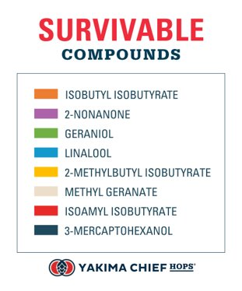
SURVIVABLE COMPOUNDS
Monoterpene Alcohols​​
Much higher solubility than their monoterpene cousins, due to their increase polarity​​
Provides tropical, fruity, and floral aromas
Soluble Esters​
​
Contains a carboxyl functional group between two carbon chains​​
Provides tropical, berry, and fruity aromas.
Polyfunctional Thiols​
Contain a sulfhydryl group (-SH) along with more than one organic functional groups​
Miniscule amounts provide high amounts of tropical and grapefruit aromas​
Notes:
For this study, we focused on the survivability of aromatically active hop compounds, rather than those that contribute to bitterness, mouthfeel, or other sensory attributes. ​
The listed compounds are soluble in beer, meaning they will survive the heat of the whirlpool, yeast interaction, and CO¬2 off-gassing.

Slide 6
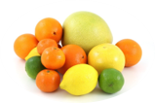
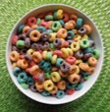
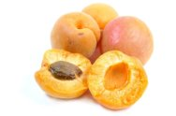
SURVIVABLE COMPOUNDS
Geraniol​
Monoterpene alcohol​
Can survive late boil and whirlpool additions​
Geranium-like and citrusy aroma​
Linalool​
Monoterpene alcohol​
Commonly survives the brewing process​
Strong fruity and floral aroma
2-methylbutyl isobutyrate​
Ester derived from hops​
Fruity aroma, specifically apricot
Isoamyl isobutyrate​
Hop-derived ester​
Fruity and tropical aromas

Slide 7
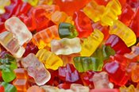
SURVIVABLE COMPOUNDS
Isobutyl isobutyrate​
Hop-derived ester​
Fruity and pineapple aromas
Methyl geranate​
Methyl ester​
Fruity and floral aroma
2-nonanone​
Ketone​
Can be sweet and fruity…​
…but can also be cheesy, buttery, and waxy
3-mercaptohexanol​
Polyfunctional thiol​
Tropical and grapefruit aroma​
Can be converted by yeast into 3MHA (3SHA)
Notes:
These compounds listed in an rough order of solubility. Our Monoterpene Alcohols make the biggest impact, followed by our isobuteric ester group, and thiols. Thiols can be smelled in parts per billion which allows even minute amounts to make a bug impression

Slide 8
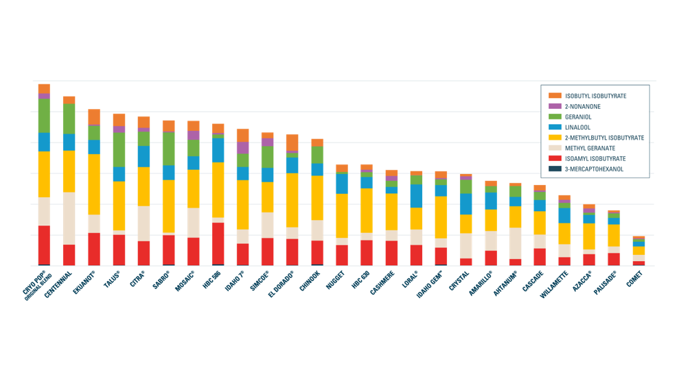
SURVIVABLES FRAMEWORK
Notes:
The typical information on a COA is not that useful or determinant of how a brewer will use a hop in a recipe. Through our study on survivability, we measured compounds by variety. For the rest of this session, we will discuss hop substitutions and how to utilize this information. ​

Slide 9
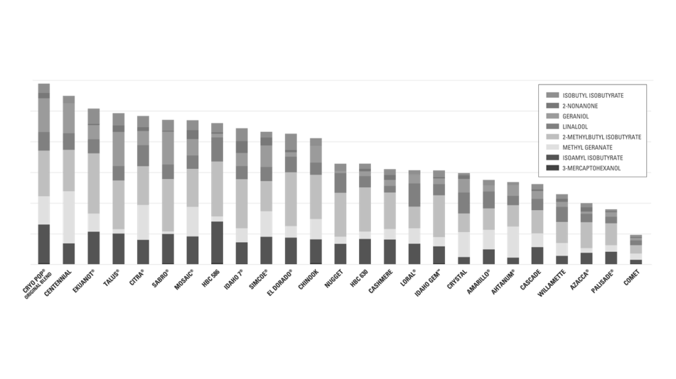
SURVIVABLES FRAMEWORK
Use hops with high concentrations of survivables early​
Hops with higher concentrations of survivable compounds have a better likelihood of being successful when used earlier in the brewing process​
​
Ekuanot® is likely a better choice for high-impact whirlpool hopping than Palisade, since it contains higher concentrations of beer soluble compounds​
Notes:
There are four primary points to cover when looking at this chart. 1. Use high survivables hops early (or late). When hops are used in the whirlpool or active fermentation, hops higher in survivables will make the most impact.​

Slide 10
SURVIVABLES FRAMEWORK
Use hops with low survivables late​
Hops with lower concentrations are likely to find better success and a more positive impact in beer when used later in the process, such as post fermentation dry hopping (PFDH).​
Willamette contains smaller concentrations of beer soluble compounds that can survive heat and fermentation activity, so using it later in the process will provide the best chance of getting these compounds into the final beer
Notes:
2. Hops lower in survivables will make the most impact in post-fermentation dry hop. This is also an economical way to look at recipe design. ​

Slide 11
SURVIVABLE FRAMEWORK
Blend hops to create a balanced blend of compounds​
Since Loral® is high in linalool and Talus™ is high in geraniol, the two of them are likely to work well in concert. Loral and Crystal are both high in linalool and would therefore likely create a less dynamic ​and more one-dimensional blend.​
Survivable compounds all taste good on their own, but using multiple can build layered flavors in a beer
Notes:
3. Blend hops to maximize beneficial concentrations. Depending on the recipe you are designing, you can pair hops to make more dynamic blends or maximize the same compound for a more assertive and one-dimensional blend. ​
​
Survivable compounds all taste good on their own, but using multiple allows you to create complex flavors

Slide 12
SURVIVABLES FRAMEWORK
​Load wort streams with survivables early​
High concentrations of survivables are required in the fermenter to encourage biotransformation​
A whirlpool addition of Idaho 7® combined with an active ​fermentation dry hopping addition of Sabro® and Simcoe® is likely to yield huge flavor impact because it loads the wort stream with a diverse array of “raw materials” needed to favor biotransformation.
Notes:
4. Load the wort stream with survivables early. High concentrations of survivables in the whirlpool and active fermentation can create conditions necessary for biotransformation. ​

Slide 13
Design & Results

Slide 14
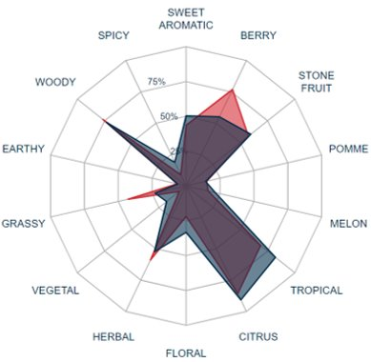
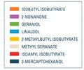
APPLYING THE FRAMEWORK – EXPERIMENTAL DESIGN
Notes:
The study investigated the effect of swapping a low Survivables variety that shared similar sensory characteristics. ​
Explain about these two hops just being an example.

Slide 15
EXPERIMENTAL DESIGN
Notes:
To ensure the experimental design reflected real-world brewing practices, a hop blend composition of 50% Cascade T90 was used in each beer, with the remaining 50% of the blend being changed. In addition, three different hop addition timings were examined alongside the variety swap, while maintaining the same overall hopping rate for each beer condition. This resulted in six experimental beers​
​
Quantitative Descriptive Analysis (QDA®) 10 validated panelists, major to minor​
Descriptive analysis is when you can identify aromas to fit within a specified lexicon​
QDA takes that a step further and has panelists rate intensities of aromas​
​
Paired Preference Test – 25 panelists​
This is a hedonic test where Two samples are compared to determine which product is preferred. ​
​
sulfur chemiluminescence detector - ​
​
High-performance liquid chromatography (HPLC) is a broad analytical chemistry technique used to separate compounds in a chemical mixture To collect IBU analysis of beer samples, a 1:1 ratio of methanol and degassed beer is prepared and analyzed by HPLC for humulinones, iso-alpha acids and alpha acids. The concentration of these compounds are then used to calculate an IBU value.​
​
​
Anton Paar: Results reported include specific gravity, ABV %v/v, ABV %w/w, original extract, real extract, apparent extract, real degree of fermentation, apparent degree of fermentation and calories.​
​

Slide 16
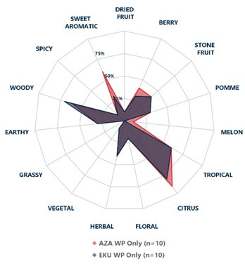
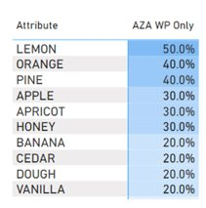
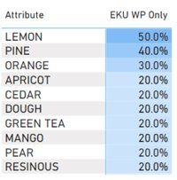
WHIRLPOOL ONLY - SENSORY RESULTS
Notes:
In the Whirlpool Only trial, the beers were rated fairly similarly in Descriptive Analysis, with Lemon, Pine, and Orange being the top descriptors for both. The low survivables beer was statistically significantly higher in Sweet Aromatic character (p < 0.05), but the two beers were nearly identical outside of that complex.. ​

Slide 17
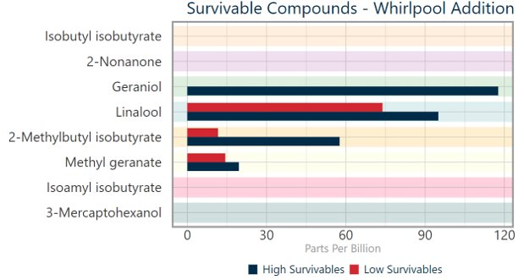
WHIRLPOOL ONLY – ANALYTICAL RESULTS
Notes:
Regarding Survivables content, the high survivables beer was measured as having about 120ppb geraniol, while the LS beer had none. Methyl geranate, Linalool, and 2-Methylbutyl isobutyrate were also higher in the HS beer, but by a slightly less dramatic margin. ​

Slide 18
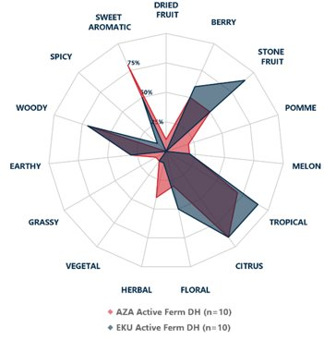
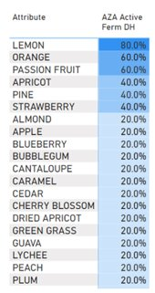
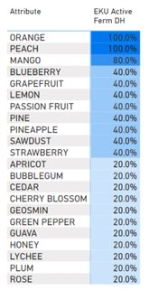
ACTIVE FERMENTATION – SENSORY RESULTS
Notes:
The Active Fermentation dry hop beers displayed a higher degree of sensory differentiation than the Whirlpool Only condition. Again, the LS beer displayed statistically significantly higher Sweet Aromatic character (p < 0.05), as well as higher Lemon (p < 0.05). The HS beer, on the other hand, was reported as being significantly higher in Peach and Mango (p < 0.01 and 0.05 respectively). The LS beer appeared to be higher in Pomme and Herbal character, and HS higher in Berry, Stone Fruit, Tropical, and Floral character, but these differences were not statistically significant. ​

Slide 19
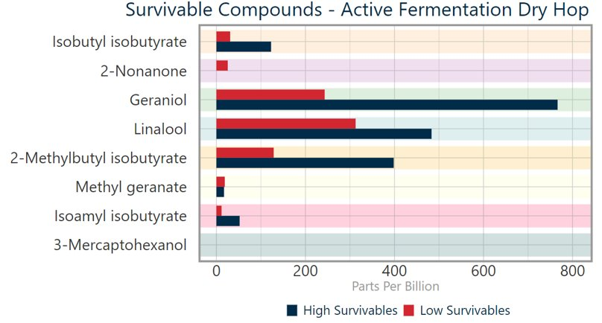
ACTIVE FERMENTATION – ANALYTICAL RESULTS
Notes:
In the Active Fermentation trail, Survivable compounds that were not present in the Whirlpool Only trial emerged. Isobutyl isobutyrate, Isoamyl isobutyrate, and 2-Nonanone appeared, though the 2-Nonanone only appeared in the LS beer. The HS beer remained higher levels of Linalool, Geraniol, and 2-methylbutyl isobutyrate, and was also higher in the Isobutyl isobutyrate and Isoamyl isobutyrate. ​

Slide 20
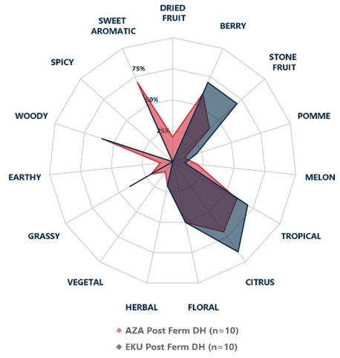
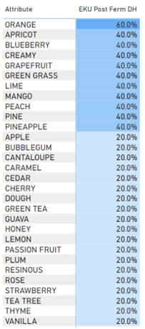
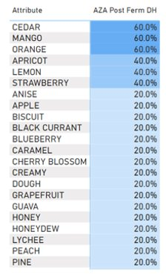
POST FERMENTATION – SENSORY RESULTS
Notes:
The Post Fermentation dry hop beers displayed the largest list of minor sensory characteristics reported with consensus, which can be interpreted as indicating a larger complexity of flavor in these beers. The HS beer displayed significantly higher Stone Fruit, Green Grass, and Lime characteristics (p < 0.05 for each). While not to a statistically significant extent, the LS beer appeared somewhat higher in Dried Fruit character, and the HS beer appeared higher in Berry, Tropical, and Citrus character. ​

Slide 21
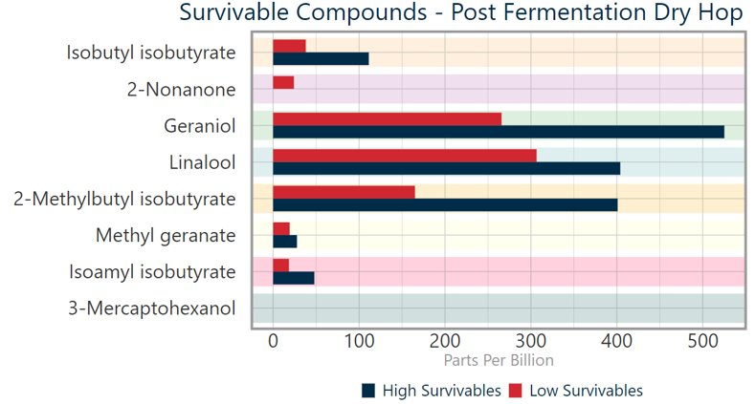
POST FERMENTATION – ANALYTICAL RESULTS
Notes:
Regarding Survivable compounds, the HS beer continued to be higher in Methyl geranate, Linalool, Isobutyl isobutyrate, Isoamyl isobutyrate, and 2-Methylbutyl isobutyrate. As in the Active Fermentation drop hop condition, only the LS beer contained measurable 2-Nonanone. ​

Slide 22
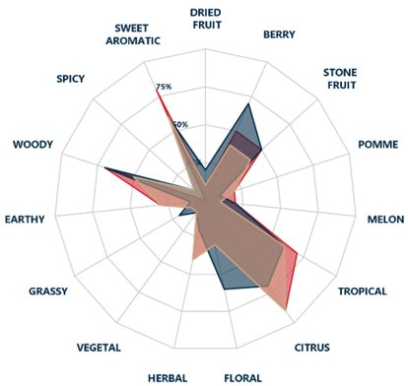
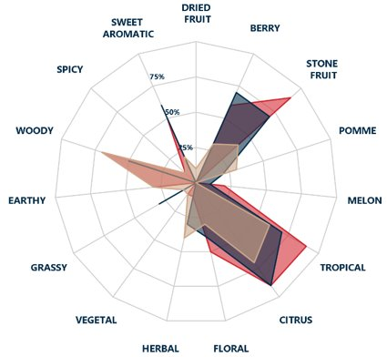
ADDITION TIMING WITHIN VARIETY – SENSORY RESULTS
Notes:
Examining the impact of hop addition timing on sensory and analytical characteristics, we find, as expected, that dry hopping (whether during Active Fermentation or Post Fermentation) yielded more robust flavor and higher Survivables concentration. Comparing the sensory differences between the two dry hop addition timings, the Active Fermentation LS beer had significantly higher Mango character (p < 0.05) than the Post Fermentation version, while the Post Fermentation beer had significantly higher Bubblegum character (p < 0.05). ​
​
From a sensory perspective, The Active Fermentation Ekuanot beer was significantly higher in Earthy and Peach character (p < 0.05). Though not statistically significant, the Active Fermentation Ekuanot beer also appeared to have greater Tropical and Stone Fruit character as well.

Slide 23
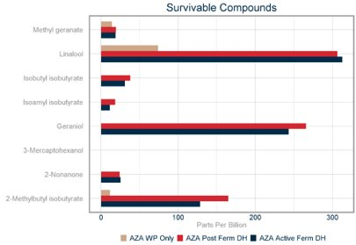
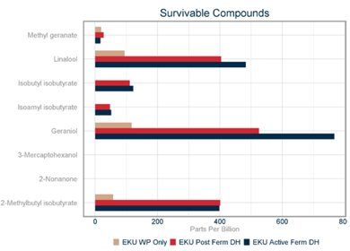
ADDITION TIMING WITHIN VARIETY – ANALYTICAL RESULTS
Notes:
In the LS beers, the concentration of Survivables was fairly equivalent across the two dry hopping conditions. In the HS beers, a slightly different trend in Survivable concentration was observed. Whirlpool Only HS beer had lower concentrations of Survivables across all compounds, and the Active Fermentation and Post Fermentation were fairly equal across all compounds, with one exception. The concentration of Geraniol appeared much higher in the Active Fermentation Ekuanot dry hop beer. From a sensory perspective, The Active Fermentation Ekuanot beer was significantly higher in Earthy and Peach character (p < 0.05). Though not statistically significant, the Active Fermentation Ekuanot beer also appeared to have greater Tropical and Stone Fruit character as well. ​
​
In conclusion, In alignment with expectations, replacing a low-Survivables component of a hop blend with a high-Survivables alternative yielded a beer with higher concentrations of key Survivable compounds. This increase in Survivables may be responsible for an increased consumer preference for these beers.

Slide 24
PREFERENCE TEST – SENSORY RESULTS
Notes:
A paired preference test was conducted by 25 YCH employee assessors, who were presented with three pairs of beers (paired based on hop addition timing) and asked which sample they preferred. The samples were blind coded and randomized for each assessor. Statistical significance was determined by running a Binomial test with a confidence interval.​
​
Preference testing indicated overall preference for the Ekuanot beers. The preference for Ekuanot was statistically significant (p < 0.01) for both the Whirlpool Only and the Post Fermentation conditions. No statistically significant difference was found between the two Active Fermentation beers. ​

Slide 25
Implementation in Your Recipe Design

Slide 26
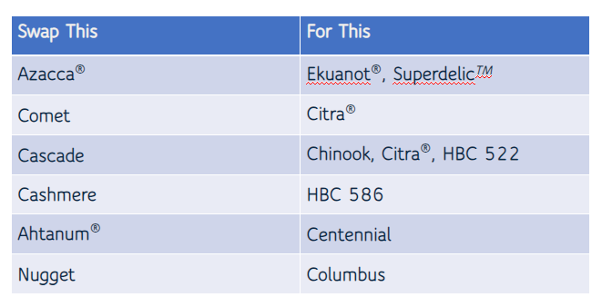
THEORETICAL VARIETY SWAPS

Slide 27
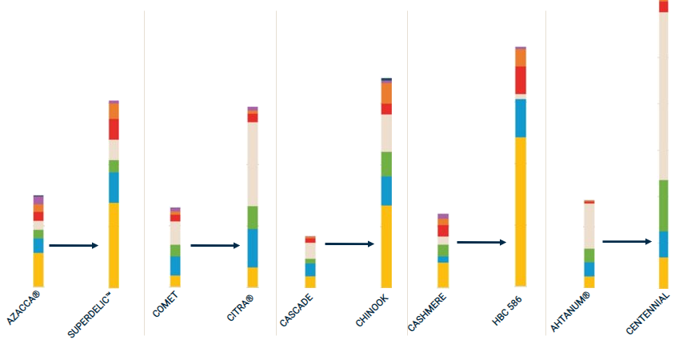
THEORETICAL VARIETY SWAPS

Slide 28
NEXT STEPS
Explore the theoretically variety swaps with in-depth brewing trials​
Continue to research Survivables compounds​
There might be more!​
Collaborate with brewers to verify our findings in commercial scale trials

Slide 29
ACKNOWLEDGEMENTS
Patrick Jensen and Jaqueline Brummett for the creation of the Survivables methods and for running the chemical analyses​
Tiffany Pitra for building a sensory program that makes YCH look good
YCH Beer Sensory Panelists for tirelessly tasting beer, and Dominic Wise for tirelessly serving it to them​
Tommy Yancone for making the pretty graphs

Slide 30
RESOURCES
YCH Sensory:
sensory@yakimachief.com
YCH Brewing Help:
brewinghelp@yakimacheif.com
Me:
sydney.masovero@yakimachief.com
Notes:
SAY:
If you found today’s topic particularly interesting, find ways to continue the learning. We’ve provided a few additional resources to extend the topic outside of this session. Write them down. Use your phone to take a picture of this screen. Review the slide deck that came in your session email today. Our association is here to support your goals.
DO:
Locate and additional resources to share with members that extend beyond this session – pubs, websites, name people and share email address or other.

Slide 31
REFERENCES
Aitken, R. A., Bruce, A., Harris, J. O., & Seaton, J. C. (1970). Hop-derived materials in beer. Journal of the Institute of Brewing, 76(1), 29–36. https://doi.org/10.1002/j.2050-0416.1970.tb03255.x ​
Takoi, K., Itoga, Y., Koie, K., Kosugi, T., Shimase, M., Katayama, Y., Nakayama, Y.; Watari, J. (2010). The contribution of geraniol metabolism to the citrus flavour of beer: Synergy of geraniol and β-citronellol under coexistence with excess linalool. Journal of the Institute of Brewing, 116(3), 251–260. https://doi.org/10.1002/j.2050-0416.2010.tb00428.x ​
Sharp, D. C., Steensels, J., Shellhammer, T. H. (2017). The effect of hopping regime, cultivar and β-glucosidase activity on monoterpene alcohol concentrations in wort and beer. Journal of the Institute of Brewing, 123(2), 185–191. https://doi.org/10.1002/jib.418

Slide 32
REQUIRED
Q
A
Notes:
SAY:
It’s time to answer some of the questions you’ve been asking from the Q&A panel.
DO:
Make sure to use their name and show appreciation for the comment.

