Slide 1
The effects of varying concentrations of honey on lactic acid forward, barrel-aged mixed fermentation beer.
Presented by: Michael Mathis
Notes:
SAY:
Good morning everyone and welcome to today’s session. The [name association] presents [name of session title].
I would like to introduce myself. I am [insert name], from [company] and I am [position at company, brief relationship to association or topic] and I will be moderating the session.

Slide 2
Objectives
Determine optimal amount of honey
Analyze data through laboratory testing
Compare and rank samples through sensory
Determine greater application
Notes:
The main objective is to determine IF the application of honey during the beginning of barrel aged mixed fermentation is going to lead to desirable results on the finished product of beer.
It was assumed that a percentage of honey WOULD increase the sensorial quality of the beer, just no idea as to how much. There was hope that the honey attributes would be present in the finished product, if possible.
The biggest problem was not knowing how much to use and how far the beer would go with the addition of honey and a mixed culture.
Data was collected in house and also sent out to a reference laboratory, to track everything that was occurring within the oaks.
Lastly, attempting to figure out if the process and the application of honey made sense on a larger scale and what would it look like.

Slide 3
Process
Set up:
  14° Plato beer
  Belgian Abbey yeast
  House mixed culture for inoculant
  Neutral oak
  Blueberry honey
Testing:
  In-house
  Reference laboratory
  Sensory
Notes:
A base 14-degree plato wheat beer was brewed and fermented for this project. The beer was fermented with a Belgian abbey yeast strain and given an extended period to cold condition prior to barreling down into neutral oak.
A house mixed culture was propagated and used to inoculate the different oaks within the project.
163 kg of blueberry honey total for the project
The oaks were filled by weight of honey, beer, and inoculant, in the most robust block and bleed series of TC fittings that I have ever used. Steam was also used to help heat up the honey to get it to mix better into the beer. Oaks were kept in roughly 64 degrees Fahrenheit and 75% humidity
Testing was performed in-house every 45 days to collect data on pH, specific gravity, and TOTAL acidity of the beers.
Samples were also sent out to a reference laboratory to test for concentrations of Acetic and lactic acid bacteria concentrations, wild yeast bacteria concentrations and lactic acid concentration.
Sensory was also performed during the sampling for testing and at the end of the research through blind sensory with a group of individuals extensively familiar with barrel-aged mixed fermentation beers.

Slide 4
Oak Setup Chart
Oak ID | Base beer | Inoculant added | Concentration of honey to beer
Oak 1 | 1.8 bbls | .1bbls standard inoculant | 0% honey
Oak 2 | 1.8 bbls | .1bbls standard inoculant | 5% honey
Oak 3 | 1.7 bbls | .1bbls standard inoculant | 10% honey
Oak 4 | 1.6 bbls | .1bbls standard inoculant | 15% honey
Oak 5 | 1.52 bbls | .1bbls standard inoculant | 20% honey
Use simple gray box for callouts
Notes:
This is the easiest way to sum up what the oaks looked like for the experiment. The addition of the honey and the steam added to the oaks was all verified with the final weight being the same for all of oaks and hitting our target fill level in oak.

Slide 5
Start and finish
OAK | Barrel OG | Barrel FG
Control | 4.1 | 1.9
5% honey | 9.2 | 1.6
10% honey | 14.2 | 3.6
15% honey | 19.2 | 4.0
20% honey | 23.4 | 9.0
ABV
6.58%
9.67%
11.52%
14.35%
14.09%
Initial pH | Terminal pH
4.2 | 3.2
4.2 | 3.2
4.8 | 3.4
4.7 | 3.5
4.3 | 3.5
Initial TA | Terminal TA
0.40% | 1.19%
0.39% | 1.23%
0.45% | 1.15%
0.54% | 1.13%
0.40% | 0.87%
Notes:
The in house collected data reflects the beginning of the project and the ending of the project.
All of this information provided useful in assuring that the appropriate amount of honey was added, that additional fermentation was occurring, that we were also developing further acids and that the project was not a complete fail after adding all of that honey to the oaks.
This data also shines a light on how much of a difference the honey made even in the differences between the additions, while they may not seem that large they made a larger difference on the final result of the product, which was a relief to see as the project went on.

Slide 6
Reference lab results
Similarities
  A lot of Lactobacillus!
  B. brux and Acetic acid
  Pediococcus
  Non-reportable results!
Differences
  S. cerevisiae and the lone oak
Notes:
All of the oaks had 1,000,000 cells/ml, still, after 150 days of Lactobacillus brevis/hilgardii/fermentum
The control and the 5% oaks shows the highest peaks in Brettanomyces bruxellensis and acetic acid bacteria concentrations, and the earliest decline in Saccharomyces activty at the same test intervals.
The 10 and 15% oaks showed the highest peaks of Pediococcus species and Lactobacillus plantarum/casei/mali concentrations along with similar declines on the same test intervals.
The 20% oak showed the largest concentration of Saccharomyces in solution for the longest period of time, at 282 days.
O. oeni, Saccharomyces diastaticus, and Zygosaccharomyces were not reported due to values being less than the reportable range!

Slide 7
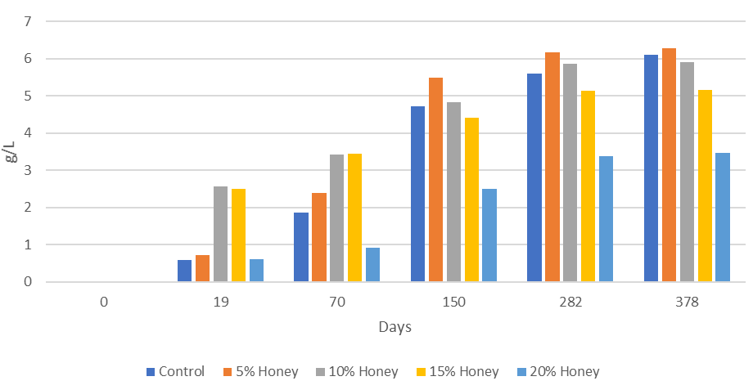
L-Lactic acid concentration
Notes:
Through our reference lab testing of L-Lactic acid, there was more to evaluate than what sensory could capture alone.
There was a lot of information to be gleaned from the testing of the lactic acid, as it was completely new territory aside from this project using honey, it was a glimpse at how the inoculant was working while we were not paying attention! As the days went on between testing and sensory was still being carried out, we were able to notice more of the acid being present in the samples and it was enjoyable in the lower concentrations and nearly the same as our control. .

Slide 8
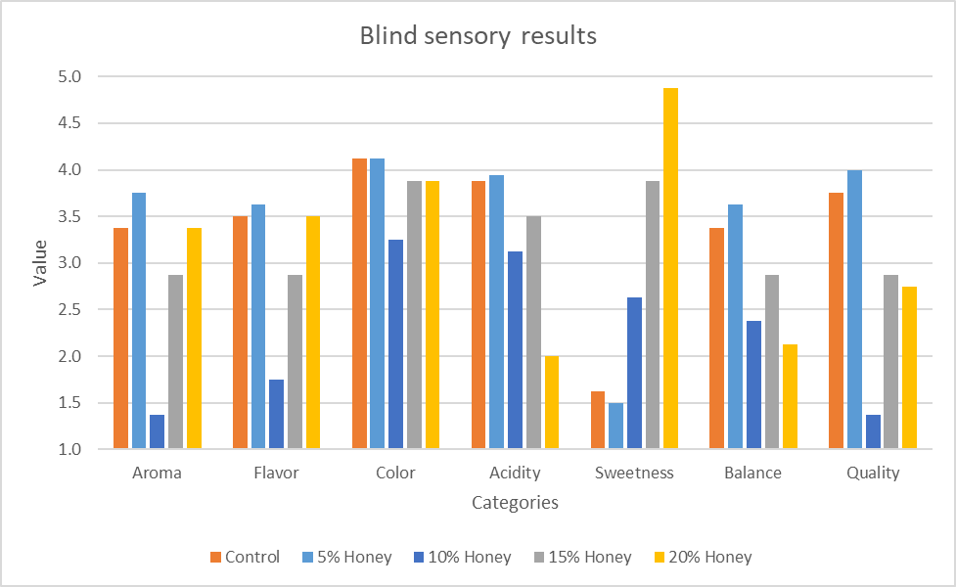
Blind Sensory Results
Notes:
Sensory testing revealed that the highest quality overall sample was from the 5% honey oak. This oak showed the most favorable results across the board with the second preference being towards the control. The 20% oak was the least desirable and revealed that it was unbalanced on multiple qualities.

Slide 9
Conclusion
Success!
Faster?
Nutrients?
So how do I use this?
Notes:
Most importantly, it worked! Aside from the success of it working out, the 5% oak was a clear winner for being the better beer out of the entire project. The beer came across to be the brightest in acidity, with wonderful citrus notes of acidity without any residual honey characteristics. While being more dry than the rest of the samples it also presented itself as the more well-rounded to drink. The majority of the tasting subjects suspected the 5% oak was the control based on blind tasting.
The 5% oak also showed through testing that it was done with fermentation and acid development faster than the control, with the 10% not much farther behind on the same results.
One of the major pieces that stood out from the project was that everything seemed to end all around the same time, as the concentrations of microbes just dropped off and seemed to succumb to the final sedimentation. Considering barrel aging and mixed fermentation, this project helped reiterate the importance of nutrients for microbes upon the end of their aging and potential preparation for packaging.
I have spent a lot of time thinking about this project and ways that it could be applicable outside of a mixed fermentation honey beer. One of the best applications I could come up with, is a beer that did not finish with the terminal gravity that was planned and ended up a bit higher than it should have. The ability to lower that terminal gravity would be aided by the use of honey and a slower fermentation if you can commit the time and space, along with some other microbes. It will not solve all of your problems, but it will get you closer to where you were going!

Slide 10

Q
A
Feel free to reach out!
mike@cmnsl.co

