Slide 1
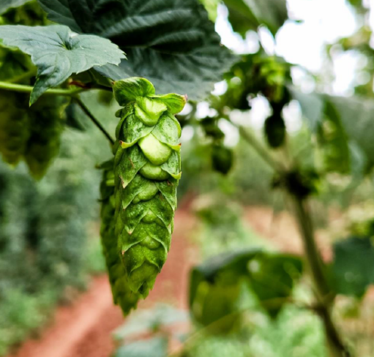
Terroir Effects in Hops: Differences in the Content of Volatile Thiol Compounds between Areas Impact Beer Flavor
Yuto Furukawa
Crop Research Laboratories
Sapporo Breweries Ltd.
Notes:
Thank you for having me here. I appreciate the opportunity to speak to you today.
My name is Yuto Furukawa. I’m a hop assistant breeder at the Crop Research Laboratories in Sapporo Breweries.
And today, I will present my findings on “terroir” effects in hops.

Slide 2
-Introduction
-Materials & Methods
-Results & Discussion
1.Thiol contents in hops from different regions
2.Brewing trials
- Conclusion
Agenda
Notes:
Before I start, please allow me to introduce the topics I will discuss today.
I have divided my presentation into 4 sections.
I will begin with some background about the definitions of terroir and thiol compounds.
After that, I will talk about the materials and methods employed in the study.
Next, I will talk about the Results and Discussions.
Last, I will present the conclusion of the study.

Slide 3
-Introduction
-Materials & Methods
-Results & Discussion
1.Thiol contents in hops from different regions
2.Brewing trials
- Conclusion
Agenda
Notes:
OK, I’d (I would) like to start by giving you some introductory information about terroir and thiol compounds.

Slide 4
What is a “terroir”?
The following is quoted from the Cambridge Dictionary:
The special character that a wine is thought to get from the particular place where the grapes were grown to make it
The particular environment in which the grapes for a wine were grown, which give the wine a special character
Notes:
This slide outlines the definition of terroir.
I looked up terroir in the Cambridge dictionary and came across two definitions.
The first one emphasizes it as -The special character that a wine is thought to get from the particular place where the grapes were grown to make it
The second definition highlights it as -The particular environment in which the grapes for a wine were grown, which gives the wine a special character

Slide 5
What is a “terroir”?
The following is quoted from the Cambridge Dictionary:
The special character that a wine is thought to get from the particular place where the grapes were grown to make it
The particular environment in which the grapes for a wine were grown, which give the wine a special character
Notes:
In this presentation, I have adhered to the first definition, which is that terroir is the special characteristic that a wine acquires from the particular place where the grapes were cultivated for its production.

Slide 6
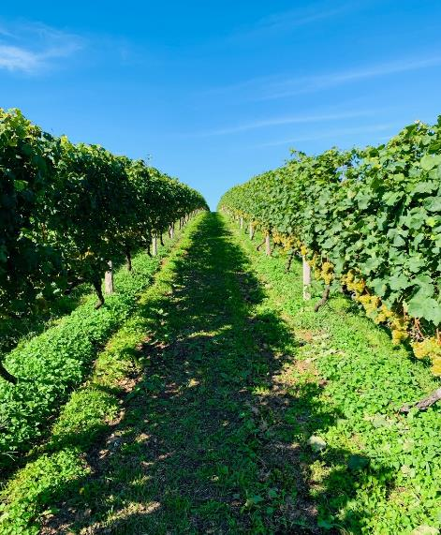
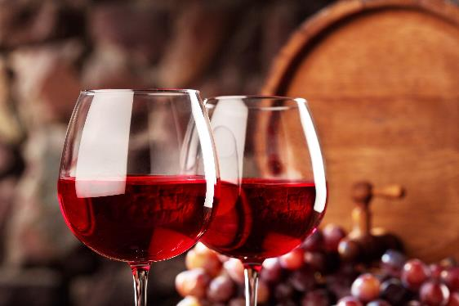
The “terroir” effect of wine grapes
In the wine industry, the terroir is one of the most important factors for winemakers and consumers.
CLIMATE
CULTIVATION
SOIL
Notes:
Terroir is commonly associated with wine.
It holds significance in ensuring that the flavors of the wine reflect the unique characteristics of the region.
The terroir effect on wine grapes is created by various factors such as climate, soil, and cultivation practices.
In the wine industry, terroir stands out as one of the most important factors for both winemakers and consumers.

Slide 7
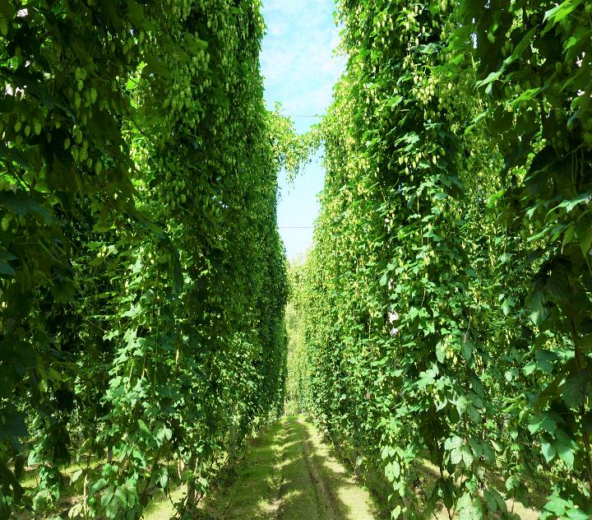
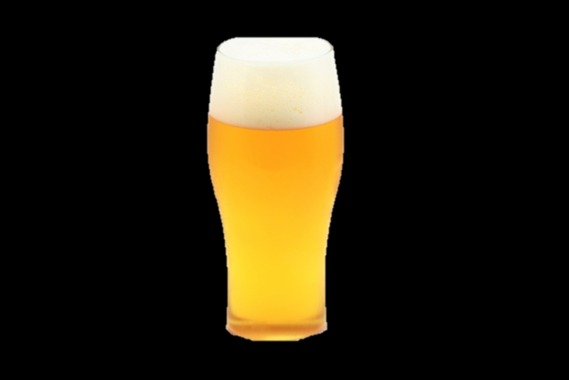
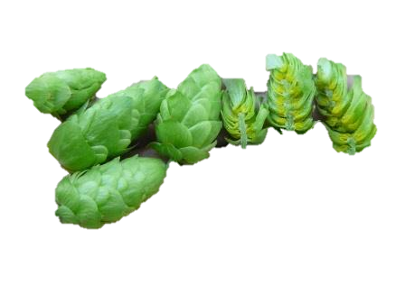
The “terroir” effect of hops
There is little knowledge of the “terroir” of hops.
?
Notes:
What is about the terroir of hops?
The understanding of the "terroir" impact on hops is relatively limited at this point. Nevertheless, there has been a growing interest among brewers regarding the terroir effects of hops in recent times.

Slide 8
Prior reports on the “hop terroir”
Prior Reports | Varieties | Regions | Differences | Differences in beer
Prior report | Varieties | Regions | Compounds | Sensory
1) Van Holle et al., 2017. | Amarillo | USA (Idaho-Washington) | Linalool, Limonene (WA > ID) | Citrus (WA > ID)
2) A. Forster et al., 2014 | Cascade Comet | USA (Yakima)-Germany (Hallertau) | Polyphenol (GE > US) Linalool (US > GE) | No significant difference
Notes:
This slide presents some findings on hop terroir from previous studies.
Holle et al. found that when using Amarillo hops for beer production, Washington outshines Idaho regarding linalool and limonene content.
Additionally, sensory tests show that the beer from Washington has more citrus points than that of Idaho.
Forster’s research group found that the linalool content in cascade and comet hop was higher in the beer produced in Yakima than in Hallertau. However, the sensory tests showed no significant differences.

Slide 9
Volatile Thiol Compounds
Characteristic flavor compounds in hops
Having very low flavor thresholds
Volatile Thiol Compounds | Flavor Thresholds (ng/L)
4MSP | 1.2
3S4MP | 40
3SH | 60
3S4MPA | 120
3SHA | 4
4-Methyl-4-sulfanylpentan-2-one (4MSP)
3-Sulfanyl hexan-1-ol
(3SH)
3-Sulfanylhexyl acetate (3SHA)
CH3
CH3
OH
O
CH3
SH
O
SH
O
SH
3-Sulfanyl-4-methylpentan-1-ol (3S4MP)
3-Sulfanyl-4-methylpentyl acetate (3S4MPA)
OH
O
SH
O
3) A. Tanigawa., et al. (2022)
SH
Notes:
In this slide, I will explain thiol compounds.
Volatile Thiols are responsible for the characteristic flavor in hops.
These compounds are of great interest to numerous researchers because of their flavor characteristics and remarkably low flavor thresholds. The table on the right illustrates the specific flavor thresholds for each volatile thiol.

Slide 10

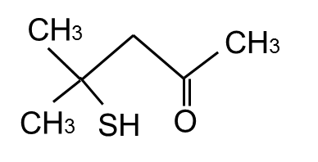
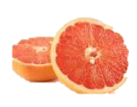
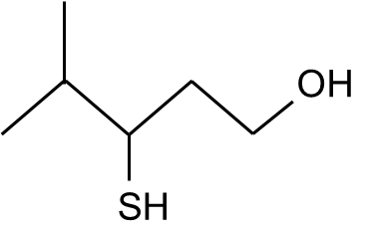
Volatile Thiol Compounds
4MSP (4-methyl-4-sulfanylpentan-2-one)
Odor: Black currant-like
Threshold: 1.2 ng/L
3S4MP (3-sulfanyl-4-methylpentan-1-ol)
Odor: Grapefruit-like
Threshold: 40 ng/L
Notes:
In the current study, we mainly focused on 4-methyl-4-sulfanylpentan-2-one (hereafter referred to as 4MSP) and 3-sulfanyl-4-methylpentan-1-ol (hereafter referred to as 3S4MP). 4MSP has an extremely low flavor threshold of 1.2 ng/L in beer, with a black currant-like odor. 3S4MP also has a very low flavor threshold of 40 ng/L with a Grapefruit-like aroma.

Slide 11
Aims of this study
Investigation of the volatile thiols in hops grown in different regions
Characterization of test beers using hops grown in different regions
Will we be able to find
the hop “terroir” effect in hops?
Notes:
This slide outlines the aims of our study.
Firstly, I will talk about the investigation of volatile thiols in hops grown in different regions.
After that, I will cover the characterization of test beers using hops grown in different regions.
Now, the question remains: if we achieve these goals, will we be able to find the “terroir” effect in hops?

Slide 12
-Introduction
-Materials & Methods
-Results & Discussion
1.Thiol contents in hops from different regions
2.Brewing trials
- Conclusion
Agenda
Notes:
Now, I’d like to tell you about the materials and method used in this study.

Slide 13
Materials & Methods - Hop Cone
Hop Variety | Growing Region (Year of sampling) | Analysis
Furano Magical | Japan -Hokkaido (2017~2022) Czech Republic (2017~2022) | α-acids Monoterpenes Volatile Thiols
Furano Queen | Japan -Hokkaido (2019~2022) -Aomori (2020~2022) -Iwate (2020~2022) Czech Republic (2019~2022)
Sorachi Ace | Japan -Hokkaido (2019~2022) -Aomori (2020~2022) -Iwate (2020~2022) Czech Republic (2021) USA (2019, 2021) | α-acids Monoterpenes Geranic acid
Notes:
In our study, we have considered three distinctive hop varieties, namely Furano Magical, Furano Queen, and Sorachi Ace, all bred by Sapporo Breweries.
Each variety was cultivated in multiple growing regions.
Furano Magical was harvested in Hokkaido in Japan and the Czech Republic, while Furano Queen was harvested in Hokkaido, Aomori, and Iwate in Japan and the Czech Republic. In both these varieties, alpha-acids, monoterpenes, and volatile thiols were analyzed.
Sorachi Ace was harvested in Hokkaido, Aomori, and Iwate in Japan, the Czech Republic, and the USA. In this varieties, alpha-acid, monoterpenes, and geranic acid were analysed.
The figure in parentheses represents the year of sampling.

Slide 14
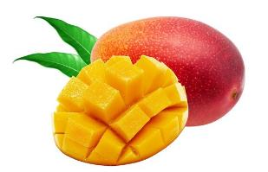
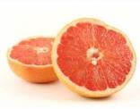
Hop Varieties
Furano Magical
High 4MSP
Mango-like aroma in beer
Furano Queen
High 3S4MP
Grapefruit-like aroma in beer
Both registered in US, EU and JP
Notes:
Now, I would like to talk about the hop varieties.
Furano Magical has a high 4MSP content. The beer produced from Furano Magical has a tropical, mango-like aroma.
Furano Queen has a high 3S4MP content. And the resulting beer from this hop has a grapefruit-like aroma.
Both these unique varieties are registered in the USA, EU, and Japan.

Slide 15
Hop Varieties
500
Furano Queen
400
Halletau Blanc
3S4MP (µg/kg)
Nelson Sauvin
300
200
100
Furano Magical
Citra
0
0
20
40
60
80
100
120
4MSP (µg/kg)
Notes:
This scattergram shows the 3S4MP and 4MSP content of several hop varieties.
As you can observe here, among the hop varieties containing Citra, Nelson Sauvin, and Hallertau Blanc, both Furano Queen and Furano Magical exhibit the highest levels of thiol compounds.

Slide 16
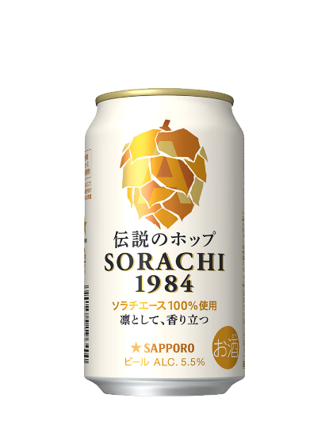
Hop Varieties
Sorachi Ace
High content of geranic acid
Woody, citrus, lemongrass-like aroma in the beer
Registered in JP in 1984
Geranic acid
Having sensory interaction with terpene alcohols, such as linalool and geraniol
O
OH
Notes:
Now, I shall elaborate on some unique characteristics of Sorachi Ace.
Sorachi Ace has a notably high content of geranic acid, a compound that is known for its sensory interaction with terpene alcohols like linalool and geraniol. When Sorachi Ace is used in brewing, it imparts a woody, citrus, and lemongrass-like aroma to the beer.
It was officially registered as a hop variety in 1984.

Slide 17




Regions
Czech Republic
- Žatec
Japan
- Hokkaido
-Tohoku
USA
- Yakima
Notes:
This slide shows the geographical origins of the materials used in our study. These include Žatec in the Czech Republic, Hokkaido and Tohoku in Japan, and Yakima in the US.
Incidentally, these areas are located within the prime latitude of 40 to 50 degrees north, providing the optimal hop cultivation environment.

Slide 18
Chemical Analysis
Monoterpenes: GC analysis
Volatile Thiols: GC-MS/MS analysis described by Takazumi et al. (2017) in Anal. Chem.
Geranic acid: GC-MS
α-acids: HPLC-DAD ( Modified method of EBC 7.7)
4) K. Takazumi., et al. (2017)
Notes:
Moving on to the Chemical Analysis of hop cones.
Monoterpenes, such as linalool and geraniol, were analyzed using Gas Chromatography.
Volatile Thiols, including 4MSP and 3S4MP, were analyzed using the published method that involved extraction and purification using a silver ion column.
Geranic acid was analyzed using GC-MS.
Lastly, α-acids were analyzed using HPLC-DAD, following a modified method based on EBC 7.7 standards.

Slide 19
Materials & Methods - Brewing Trials
Beer Brewing
All malt wort
Lager yeast
Late Hopping (1.2 g/L)
Furano Magical and Furano Queen harvested in JP and CZ
Sensory test
6 sensory attributes (Green, Flowery, Citrus, Sulfur-like, Tropical, Impact)
Scoring (0–3)
Chemical Analysis
Hop-derived aroma compounds (linalool, geraniol, 4MSP, 3S4MP) by GC
Notes:
Now, to the methodology employed in our study.
We initiated the process by fermenting an all-malt wort with lager yeast. To establish the base bitterness, we added Hallertau Tradition at the beginning of the boiling stage. Subsequently, we employed a late hopping technique for Furano Magical and Furano Queen hops harvested from both Japan and the Czech Republic. Each hop variety was added separately at a dosage rate of 1.2 grams per liter.
The final beer was evaluated using six sensory attributes: green, flowery, citrus, sulfur-like, tropical, and impact. Hop-derived volatile aroma compounds, specifically linalool, geraniol, 4MSP, and 3S4MP, were analyzed using GC.

Slide 20
-Introduction
-Materials & Methods
-Results & Discussion
1.Thiol contents in hops from different regions
2.Brewing trials
- Conclusion
Agenda
Notes:
In this section, I’ll talk about results and discussions.
First, I'd like to highlight our findings regarding the thiol contents in hops sourced from various regions."

Slide 21
Flavor compounds in Furano Magical
JP
CZ
* ; P < 0.05
* ; P < 0.05
*
*
Notes:
Here, bar graphs illustrate the chemical compounds found in Furano Magical hops.
The green bars represent the data from Japan, while the blue bars represent those from the Czech Republic.
These graphs show that Furano Magical hops cultivated in Hokkaido, Japan, exhibit a higher 4MSP content than those grown in Zatec, Czech Republic.
Conversely, hops from Zatec contain more 3S4MP than their counterparts in Hokkaido. No significant differences between these regions regarding linalool and geraniol content were found.

Slide 22
Flavor compounds in Furano Queen
JP
CZ
*
* ; P < 0.05
*
Žatec
Žatec
* ; P < 0.05
** ; P < 0.01
**
**
*
Zatec
Žatec
Žatec
Notes:
This slide shows the chemical compounds found in Furano Queen.
As you can see from these graphs, Furano Queen, grown in Zatec in the Czech Republic, contained more 3S4MP than those cultivated in Japan.
In geraniol, significant differences were observed in regions within Japan. However, as this presentation emphasizes the behavior of thiol compounds, a detailed explanation of this observation has been omitted.
No significant differences between the regions were found in linalool and 4MSP.

Slide 23
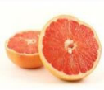
Volatile thiol contents in hops from different regions
JP
CZ
Furano Magical
Furano Queen
Hokkaido
Aomori
Iwate
Notes:
In these scatterplots, we present data on 3S4MP and 4MSP values for each variety in the years.
The vertical axis represents 3S4MP, while the horizontal axis represents 4MSP.
The key takeaway here is the notable variation in 3S4MP content across different regions for several hop varieties.

Slide 24
Flavor compounds in Sorachi Ace
JP
CZ
*
*
Žatec
Zatec
Žatec
Zatec
Zatec
Žatec
Notes:
This slide shows the chemical compound data for Sorachi Ace hops. Similar to the results observed for Furano Queen, it's worth noting that the geraniol content varies among regions within Japan. While we won't delve deeply into this aspect, it's intriguing to consider potential differences among production regions in Japan. On the other hand, our analysis did not reveal any significant distinctions between regions for linalool and geranic acid."

Slide 25
Short summary
The 3S4MP content was higher in CZ than in JP (Furano Magical, Furano Queen).
The 4MSP content was higher in JP than in CZ (Furano Magical).
The geraniol content was higher in Hokkaido than in Tohoku (Furano Queen, Sorachi Ace).
Notes:
Here is a summary of this session.
We observed that the
In Furano Magical and Furano Queen, the 3S4MP content was higher in the Czech Republic than in Japan
In Furano magical, the 4MSP content was higher in Japan than in the Czech Republic.
In Furano Queen and Sorachi Ace, the geraniol content was higher in Hokkaido than in Tohoku
I would like to emphasize the differences in the thiol compounds, specifically 4MSP and 3S4MP, in the hop cones grown and harvested in different regions. To further investigate the impact of growing regions on beer flavor, we brewed test beers using Furano Magical and Furano Queen cultivated in both Japan and the Czech Republic.

Slide 26
-Introduction
-Materials & Methods
-Results & Discussion
1.Thiol contents in hops from different regions
2.Brewing trials
- Conclusion
Agenda
Notes:
In the following slides, I will discuss the results obtained in the brewing trials and our findings.

Slide 27
Brewing trials - Furano Magical
Hop-derived aroma compounds in the beer
 | Unit | Czech Republic | JP
Linalool | µg/L | 147 | 226
Geraniol | µg/L | 7 | 15
4MSP | ng/L | 36 | 106
3S4MP | ng/L | 724 | 146
Notes:
In this slide I would like to talk about the results from the brewing trials of Furano Magical.
The table provides insights into the hop-derived aroma compounds present in the beer. The Japanese-brewed beer contains notably higher levels of linalool and 4MSP than its Czech counterpart, consistent with the analysis of the hops themselves.

Slide 28
Brewing trials - Furano Magical
Sensory scores of the test beers
*
*
*
Notes:
You can see a radar chart displaying the sensory scores for the test beers. The beers brewed with hops from Japan are represented in green, while those from Czech are in blue. It's evident that the Japanese-sourced hops had significantly higher scores of "Tropical" and "Impact" compared to the Czech hops. We know that the interaction between linalool and 4MSP results in a tropical aroma profile. Therefore, these components may have influenced the sensory scores that we observed.

Slide 29
Brewing trials - Furano Queen
Hop-derived aroma compounds in the beer
 | Unit | Czech Republic | Japan
Linalool | µg/L | 99 | 67
Geraniol | µg/L | 9 | 9
4MSP | ng/L | 11 | 21
3S4MP | ng/L | 642 | 101
Notes:
In this slide, I shall talk about the results from the brewing trials of Furano Queen.
The table provides Hop-derived aroma compounds in the beer.
The Czech-brewed beer contains notably higher levels of 3S4MP than its Japan counterpart, consistent with the analysis of the hops themselves.

Slide 30
Brewing trials - Furano Queen
Sensory scores of the test beers
*
*
Notes:
You can see a radar chart displaying the sensory scores. Czech-produced beers received higher scores for sulfur-like characteristics compared to the Japanese counterparts, while Japan had higher scores for Flowery characteristics than Czech beers. Czech beer had the higher 3S4MP content, so we anticipated that it would exhibit a higher citrus score. However, that was not the case. The reasons behind this disparity remain unclear and warrant further investigation.

Slide 31
Short Summary
We found that the volatile thiol contents in beer follow the same pattern detected in hop cones.
(3S4MP: CZ > JP, 4MSP: JP > CZ)
Differences in the sensory scores were observed for several items.
    Furano Magical Impact: JP > CZ, Tropical: JP > CZ
    Furano Queen Flowery: JP > CZ, Sulfur Like: CZ > JP
Notes:
To summaries this section:
We found that the volatile thiol contents in beer follow the same pattern as in hop cones.
Additionally, we noted differences in sensory scores for several parameters.

Slide 32
-Introduction
-Materials & Methods
-Results & Discussion
1.Thiol contents in hops from different regions
2.Brewing trials
- Conclusion
Agenda
Notes:
In the following slides, I will present the conclusion and the future prospects of our study.

Slide 33
Conclusion
The contents of volatile thiols in the hop cones of identical hop varieties differed between growing areas.
The contents of volatile thiols in the beers using identical hop varieties differed between growing areas.
Notes:
In conclusion, the levels of volatile thiols in the hop cones of identical hop varieties vary depending on their growing regions. Furthermore, the volatile thiol concentrations in beer brewed using these identical hop varieties also differ based on their growing areas.

Slide 34
Future Works
The “terroir” factors, such as climate, soil, etc., which may be causing the differences, have not been studied yet.
We plan to accumulate climate and soil data by increasing the number of regions and crop years of monitoring.
If we can acquire more information about hop “terroirs”,
we could possibly give additive value to beer.
Notes:
Our future research endeavors will explore the "terroir" factors, such as climate and soil composition, that could potentially be responsible for the observed differences.
We plan to accumulate climate and soil data by increasing the number of regions and crop years of monitoring.
It's important to highlight that we still don’t know much about the terroir effect of hops. Nonetheless, if we can acquire more information about hop “terroirs”, we could possibly give an additive value to beer.

Slide 35

Resources
REQUIRED
  A. Van Holle., et al. (2017) J. Inst. Brew., 123: 312–318.
  A. Forster., A. Gahr., et al. (2014) J. Brewing Science., 67.
  A. Tanigawa., et al. (2022) Brewing Science., 75.
  K. Takazumi., et al. (2017) Analytical Chemistry 2017 89 (21), 11598-11604
Notes:
If you found today’s topic interesting, you can continue learning. We’ve provided a few additional resources to extend the topic outside this session. You may note them down. Alternatively, you can take a picture of this screen using your phone. You can also review the slide deck that came in your session email today. Our association is here to support your goals.

Slide 36
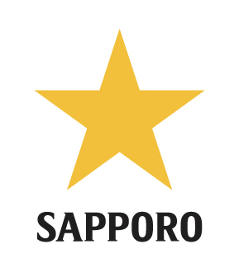
Thank you for your attention
36/42
Notes:
We have reached the end of my presentation.
I will be happy to receive your advice and comments, and answer any questions you may have.
Thank you for your kind attention.

Slide 37

REQUIRED
Q
A
Notes:
Does anyone have any questions or comments ?

Slide 38
Prior reports on the “hop terroir”
Prior Reports | Varieties | Regions | Differences | Differences in beer
Prior report | Varieties | Regions | flavor compounds | Sensory
1) Van Holle et al., 2017. | Amarillo | USA (Idaho-Washington) | Linalool, Limonene (WA > ID) | Citrus (WA > ID)
2) A. Forster et al., 2014 | Cascade Commet | USA (Yakima)-Germany (Hallertau) | Polyphenol (GE > US) Linalool (US > GE) | No significant difference
3) M. Rodolfi et al., 2019 | Cascade | Italy-USA-Germany-Slovenia | (In hop cones) Limonene (IT > others) | (In hop cones) woody and flower (SL > others)

Slide 39
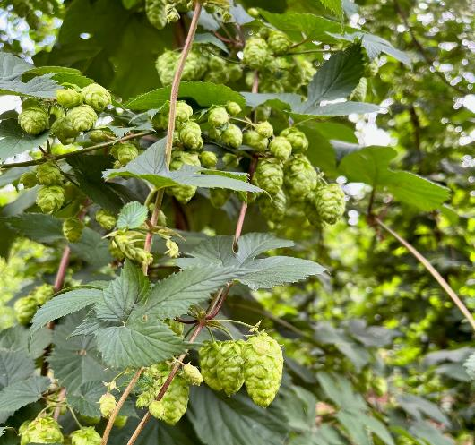
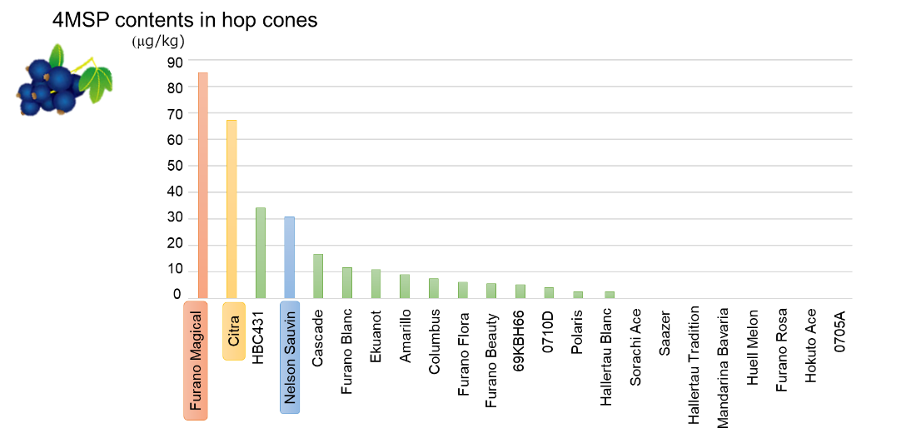
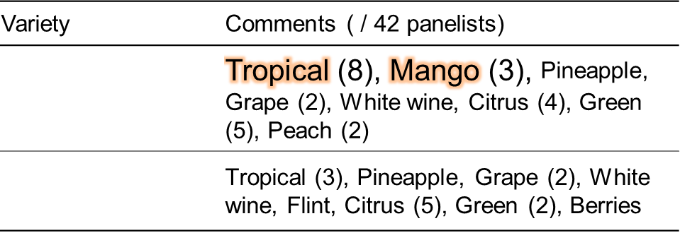
Hop Variety 1 - Furano Magical
Notes:
分析方法について（高澄さん確認）
GC、LCについても簡易的にやり方を説明
複数年サンプリングを表に追記

