Slide 1

Analytical Characterization of Mouthfeel Using a Tribological Method with Test-Brewed Beers
Tomohiro Koizumi
SAPPORO BREWERIES LTD.
1
Notes:
Thank you, for kind introduction.
I’m Tomohiro Koizumi from Sapporo breweries in Japan. Today, I will present our recent study, titled ‘Analytical Characterization of Mouthfeel Using a Tribological Method with Test-Brewed Beers’.
SAY:
Good morning everyone and welcome to today’s session. The [name association] presents [name of session title].
I would like to introduce myself. I am [insert name], from [company] and I am [position at company, brief relationship to association or topic] and I will be moderating the session.

Slide 2
Agenda
Introduction
Materials and Methods
Results
-Beer color and BU
-Filtration
-Ingredients
-Dose tribology change due to staling?
Conclusion
2
Notes:
This is today's agenda.
First, I will explain the background of the study.
Next, I will talk about the test methods and test examples.
In the third part, I will present the evaluation results of the samples tested with each parameter.
Lastly, I will summarize the main findings of this study.

Slide 3
Agenda
Introduction
Materials and Methods
Results
-Beer color and BU
-Filtration
-Ingredients
-Dose tribology change due to staling?
Conclusion
3
Notes:
I will now provide an introduction to mouthfeel and tribology.

Slide 4
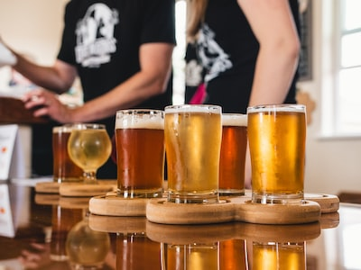
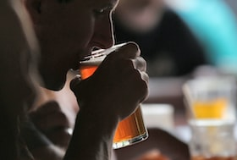
What is Mouthfeel?
Introduction
The mouthfeel plays a significant role in the sensory evaluation of beer.
However, it is still an unknown entity compared to aroma and taste.
Notes:
The mouthfeel plays a significant role in the sensory evaluation of beer.
Various methods have been developed to analyze mouthfeel.
Although reports are available on mouthfeel, it is still an unknown entity compared to aroma and taste.

Slide 5
Physical methodology food texturing
Introduction
Rheology ： Viscosity, Elasticity
Tribology ： Friction, Lubrication
Morphology ： Rough-Smooth, Large-Small
Nakamura, 2018
Notes:
According to Nakamura, the physical methodology of food texturing can be divided into three categories: rheology, tribology, and morphology.
Of these three categories, rheology is measured in beverages.
However, when describing the mouthfeel of a beer, viscosity alone is often not enough to explain it.

Slide 6
Physical methodology food texturing
Introduction
Rheology ： Viscosity, Elasticity
Tribology ： Friction, Lubrication
Morphology ： Rough-Smooth, Large-Small
Nakamura, 2018
Notes:
Therefore, this study focused on the tribology of alcoholic beverages.
Tribology is the study of friction and lubrication

Slide 7
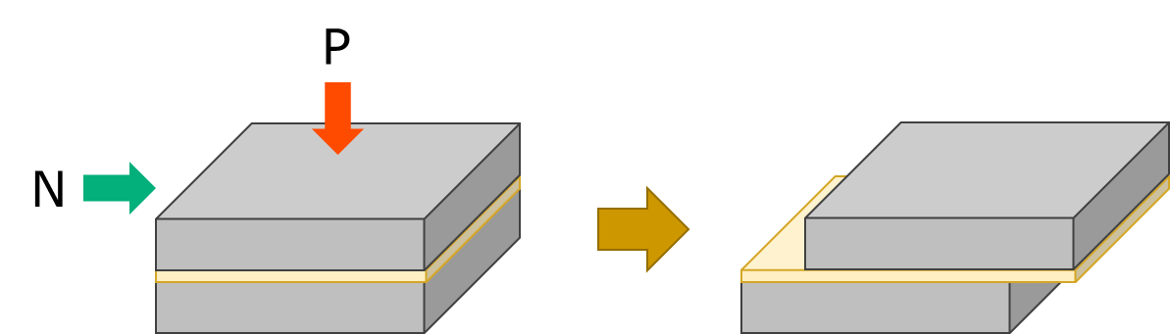
What is Tribology?
Introduction
Rheology focuses on the study of viscosity, whereas tribology focuses on the study of friction.
Tribology is the science and technology related to mutually interacting surfaces in relative motion.
Notes:
In beverages, rheology focuses on the study of viscosity, whereas tribology focuses on the study of friction.
Tribology is the science and technology related to mutually interacting surfaces in relative motion.
In recent years, there have been reports of tribological measurements for beverages.

Slide 8
Rheological and Tribological analysis methods
Introduction
Rheometer
rotates a cylinder system and measures its stress levels.
Tribometer
spins a ball and measures the friction occurring at the interface between the pin and ball.
Ball
Sample beer
Viscosity
Friction
Sample beer
Pin
Notes:
This slide depicts the rheological and tribological analysis methods.
A rheometer measures viscosity by rotating a cylinder system and measures its stress levels.
Tribology can be measured by changing the attachment of the rheometer.
A tribometer spins a ball and measures the friction occurring at the interface between the pin and ball

Slide 9
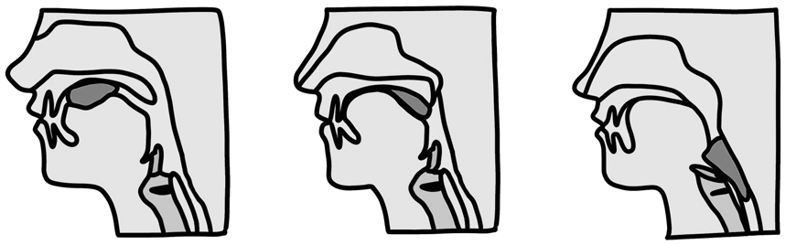
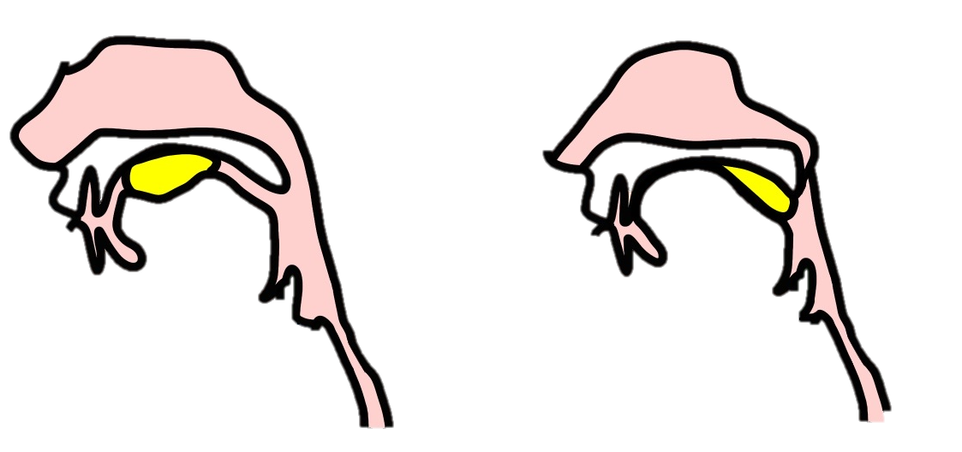
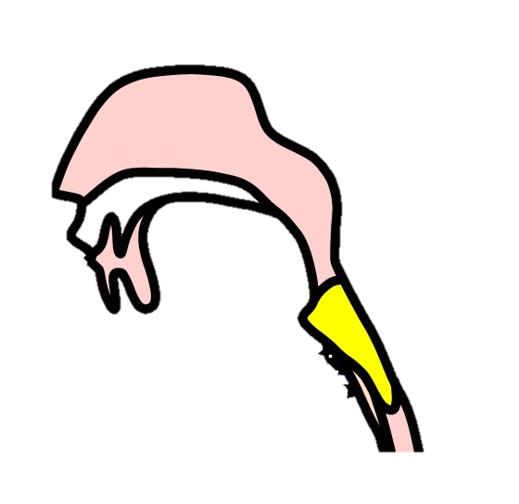
To simulate intraoral friction
Introduction
Ball
Tribology measurements
Sample
Pin
Palate
Swallowing
Tongue
A tribometer is used to measure the friction between two surfaces.
Kajita, 2019
9
Notes:
As shown in the previous slide, tribological measurements assess the friction between the pin and ball.
At the start of the measurement, the pin and ball are in contact.
As the ball rotates faster, the sample liquid is drawn into the space between the pin and ball.
When we swallow food items and drinks, they move between the palate and tongue to reach the throat.
The food items or drinks move while in contact with the surface of the oral cavity.
Therefore, it is thought that tribological analysis can simulate intraoral friction.

Slide 10
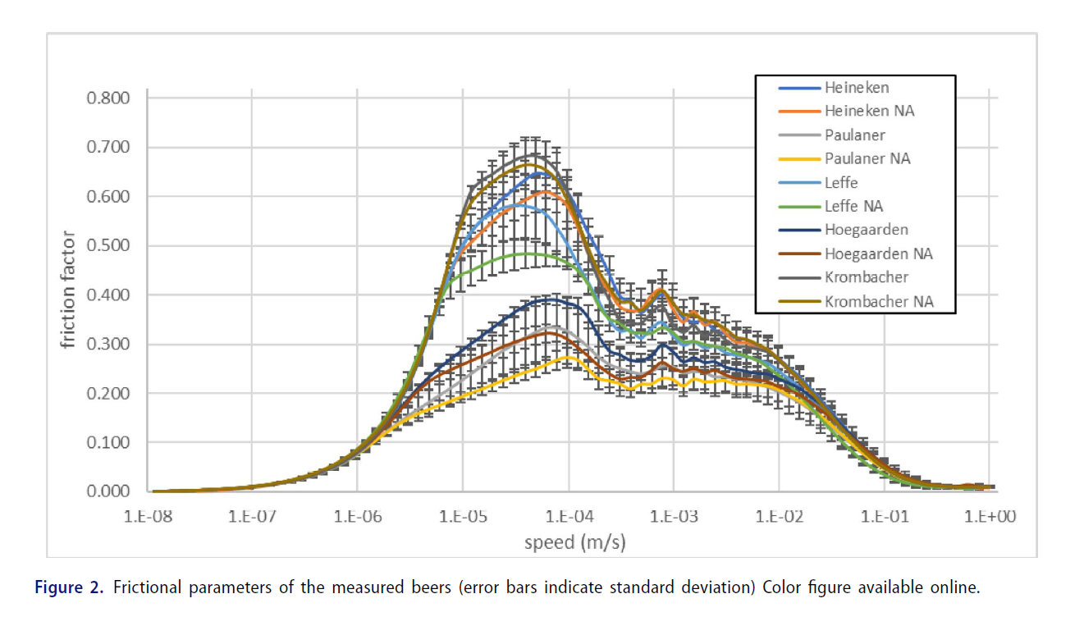
Previous study on tribology of beer
Introduction
Fox et al., 2021
Tribological data on both five regular and five non-alcoholic commercial beers.
  Based on the frictional parameters of the beers, clear differences were observed between alcoholic and non-alcoholic beers.
  The beers could be distinguished into those with plain and complex mouthfeel depending on their alcohol content.
In this study we used test beers to measure tribology with different parameters other than alcohol.
Fox et al., 2021
Notes:
Fox et al. have performed a tribological analysis of beer, providing tribological data for five regular and five non-alcoholic beers.
Based on the frictional parameters of the beers, clear differences were observed between alcoholic and non-alcoholic beers.
The beers could be distinguished into those with plain versus complex mouthfeels depending on their alcohol contents.
In this study we used test beers to measure tribology with different parameters other than alcohol.

Slide 11
In this study
Introduction
We investigated whether tribological analysis can be used to evaluate the mouthfeel of beer.
We evaluated the effects of malt types, BUs, and beer filtration, among others.
  We test brewed with different parameters.
  Tribological measurements, sensory evaluations, and other analyses were also performed.
Notes:
In this study,
we investigated whether tribological analysis can be used to evaluate the mouthfeel of beer.
we evaluated the effects of malt type, BUs and beer filtration.

Slide 12
Agenda
Introduction
Materials and Methods
Results
-Beer color and BU
-Filtration
-Ingredients
-Dose tribology change due to staling?
Conclusion
12
Notes:
Next, I will talk about the test method and test examples.

Slide 13
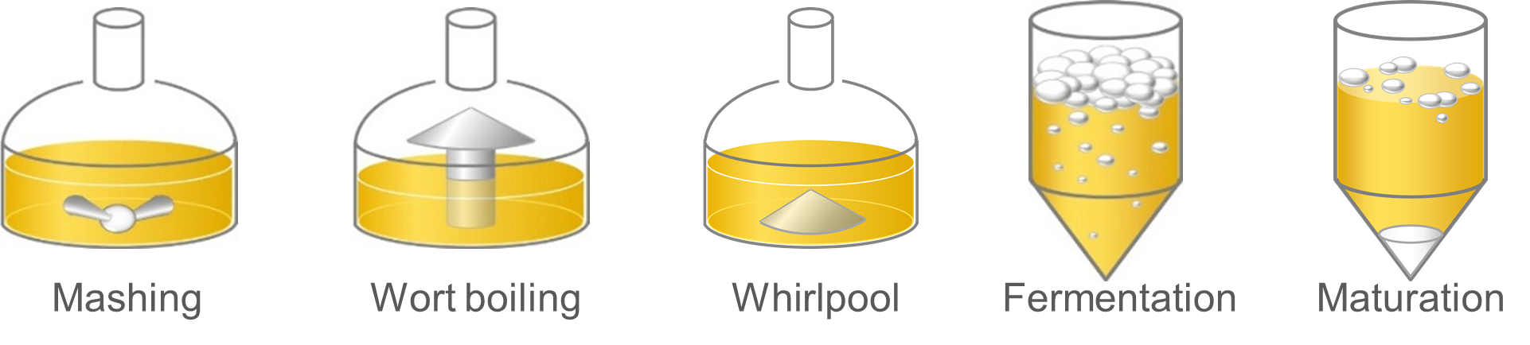
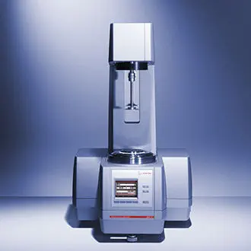

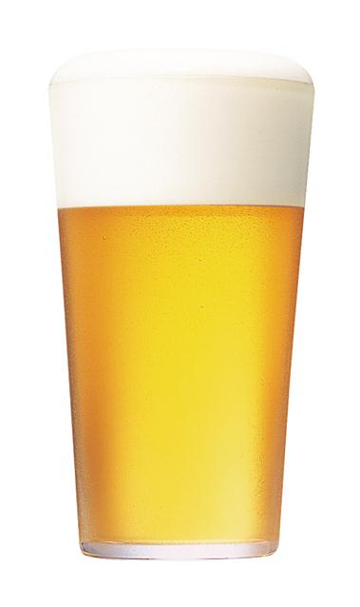
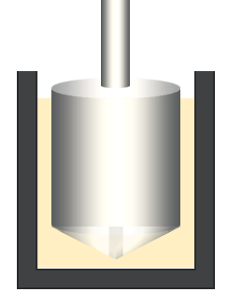
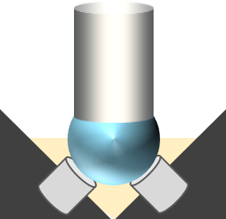
Materials and Methods
Samples
Measuring conditions
MCR502 (Anton Paar GmbH)
100L-scale pilot brewing
or commercial samples
Rheometer
Tribometer
Concentric cylinder system
Ball-on-3-pins tribology attachment
https://www.anton-paar.com/us-en/products/group/rheometer/
Notes:
The beer used in this study was brewed in a 100-L-scale pilot plant.
We also used commercial samples.
We used an Anton Paar MCR502 device for the measurements.
For the rheological measurements, we used a concentric cylinder system.
We used a ball-on-a 3-pin tribology attachment for the tribological measurements.

Slide 14
Measurement example 5 %EtOH, Beer
Rheometer
Tribometer
Viscosity (mPa·s)
Friction Factor μ
stick slip
Swallowing speed range
static friction
kinetic friction
Share rate (1/s)
Sliding Velocity (m/s)
Notes:
This slide shows an example of rheometer and tribometer test results.
The left figure shows the test results of the rheometer and the right figure shows the test results of the tribometer.
In this measurement, 5% ethanol and 5% alcohol beer were used.

Slide 15
Measurement example 5 %EtOH, Beer
Rheometer
Tribometer
Viscosity (mPa·s)
Friction Factor μ
stick slip
Swallowing speed range
static friction
kinetic friction
Share rate (1/s)
Sliding Velocity (m/s)
It is suggested that the viscosity was increased by the extract in the beer.
Notes:
A rheometer can measure viscosity.
The swallowing speed of a typical human is thought to be approximately 30–100 (1/s).
In this range, the viscosity of beer was higher than that of ethanol.
It is suggested that the viscosity was increased by the extract in the beer.

Slide 16
Measurement example 5 %EtOH, Beer
Rheometer
Tribometer
Viscosity (mPa·s)
Friction Factor μ
stick slip
Swallowing speed range
static friction
kinetic friction
Share rate (1/s)
Sliding Velocity (m/s)
Static and kinetic friction were reduced by various beer components.
The stick-slip phenomenon was stronger in ethanol solution than in beer.
Notes:
On the other hand, a tribometer measures friction.
The friction factor increased as the sliding velocity increased, and it decreased when it exceeded the static friction force.
The stick–slip phenomenon occurred on the right side, where the peak moved upward and downward.
Static and kinetic friction were reduced by various beer components.
The stick–slip phenomenon was stronger in ethanol solution than in beer.
We performed these two analyses on various beers.

Slide 17
Test conditions
Parameter
Alcohol content | 5, 7, 9 %
BU | 16, 51 unit
Color | 6, 125 °EBC
Malt type | Barley, Wheat
Filtration
Ingredients | Lactose, Whey
Staling
Notes:
This is the list of the test conditions for the test beers used in this study.

Slide 18
Agenda
Introduction
Materials and Methods
Results
-Beer color and BU
-Filtration
-Ingredients
-Dose tribology change due to staling?
Conclusion
18
Notes:
In the next section, I will explain the results of our analysis.

Slide 19
Result：Can detect differences?
Parameter |  | Rheology | Tribology
Alcohol content | 5, 7, 9 % | Yes | Yes
BU | 16, 51 unit | No | No
Color | 6, 125 °EBC | No | Yes
Malt type | Barley, Wheat | No | Yes
Filtration |  | No | Yes
Ingredients | Lactose, Whey | No | Yes
Staling |  | No | Yes
Trial 1
Trial 2
Trial 3
Trial 4
Notes:
First, I will present a summary of the results.
We performed rheological and tribological analyses.
The only rheological differences were observed in the samples with different alcohol contents.
On the other hand, most samples exhibited differences in the tribological analysis.
In this presentation, I report the results of these four trials in detail.

Slide 20
Result：Can detect differences?
Parameter |  | Rheology | Tribology
Alcohol content | 5, 7, 9 % | Yes | Yes
BU | 16, 51 unit | No | No
Color | 6, 125 °EBC | No | Yes
Malt type | Barley, Wheat | No | Yes
Filtration |  | No | Yes
Ingredients | Lactose, Whey | No | Yes
Staling |  | No | Yes
Trial 1
Trial 2
Trial 3
Trial 4
Notes:
In Trial 1, we assessed the differences in BU and color.

Slide 21
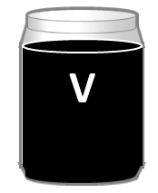
Trial 1 BU ,Color
Different BUs
(Pilsner type beer)
Different Colors
(Pilsner type beer
or black beer)
BU (unit) 16 51
OG (%) 13.7 13.6
Alc. (%) 6.2 6.3
Color (°EBC) 7 120
OG (%) 12.5 12.4
Alc. (%) 5.4 5.5
We measured by both the rheological and tribological properties.
Notes:
This slide presents the analytical values for the beers used in Trial 1.
We used pilsner-type beers with bitterness units of 16 and 51,
and we also used beers with color intensities of 7 and 120 EBC.
For these samples, we measured by both the rheological and tribological properties.

Slide 22
Trial 1
Rheometer
Tribometer
Friction Factor μ
BU
Viscosity (mPa·s)
Share rate (1/s)
Sliding Velocity (m/s)
Friction Factor μ
Viscosity (mPa·s)
Color
Share rate (1/s)
Sliding Velocity (m/s)
No difference in viscosity was found. The use of a colored malt resulted in a difference in friction.
Notes:
TPP 187.78（51）、168.92（16）
This slide shows the results of Trial 1.
First, the rheometer results did not reveal differences in BU or color.
Second, the tribometer results revealed no differences in the BU values but did reveal differences in the colors of the beers.
We found that beers with darker colors exhibited reduced friction.

Slide 23
Result：Can detect differences?
Parameter |  | Rheology | Tribology
Alcohol content | 5, 7, 9 % | Yes | Yes
BU | 16, 51 unit | No | No
Color | 6, 125 °EBC | No | Yes
Malt type | Barley, Wheat | No | Yes
Filtration |  | No | Yes
Ingredients | Lactose, Whey | No | Yes
Staling |  | No | Yes
Trial 1
Trial 2
Trial 3
Trial 4
Notes:
In Trial 2, we applied our analysis to filtered versus unfiltered beers.

Slide 24
Trial 2 Filtration
I 100% wheat malt Filtered
II 100% wheat malt Unfiltered
I
II
OG (%) 12.1 12.0
Alc. (%) 5.1 5.1
Notes:
This slide shows the beer conditions used in Trial 2.
The samples were brewed with 100% wheat malt, and the conditions were changed only for filtration.

Slide 25
Trial 2 Result : Rheometer and Tribometer
Viscosity (mPa·s)
Friction Factor μ
stick slip
static friction
kinetic friction
Share rate (1/s)
Sliding Velocity (m/s)
Static and kinetic friction were reduced in unfiltered beer compared to filtered beer.
25
Notes:
This slide shows the results of the rheological and tribological measurements.
We found no difference in viscosity between filtered and unfiltered samples.
However, we found differences in the tribological analysis.
Static and kinetic friction were reduced in unfiltered beer compared to those in filtered beer.
We then also performed a sensory test.

Slide 26
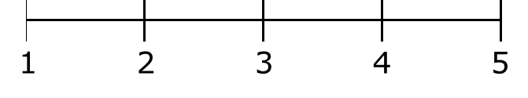

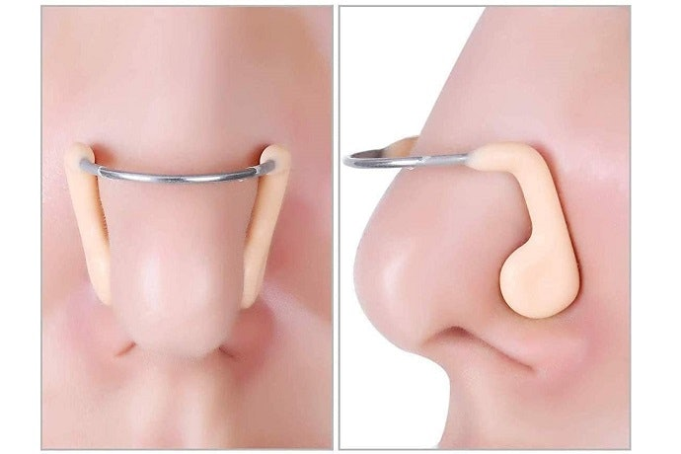
Trial 2 Sensory evaluation
Not
Smoothness
Smoothness
Sensory evaluation
Can panelists determine smoothness?
Blind-folded and
nose plugged.
Smoothness
*
Not
Smoothness
N=9, p<0.05
The results of tribological analysis correlated with those of sensory evaluation when comparing unfiltered to filtered beer.
Notes:
Sensory evaluation was performed using a five-point scale by a panel of nine individuals, with the score increasing as the smoothness increased.
To eliminate appearance and olfactory influences, the test was performed with blind-folded and nose plugs.
The sensory evaluation revealed that the unfiltered beer was considered to be smoother.
The tribological analysis showed that the unfiltered beer had lower friction.
Therefore, the results of the tribological analysis correlated with those of the sensory evaluation when comparing unfiltered to filtered beer.

Slide 27
Result：Can detect differences?
Parameter |  | Rheology | Tribology
Alcohol content | 5, 7, 9 % | Yes | Yes
BU | 16, 51 unit | No | No
Color | 6, 125 °EBC | No | Yes
Malt type | Barley, Wheat | No | Yes
Filtration |  | No | Yes
Ingredients | Lactose, Whey | No | Yes
Staling |  | No | Yes
Trial 1
Trial 2
Trial 3
Trial 4
Notes:
In Trial 3, we applied our analysis to beers with different ingredients.

Slide 28
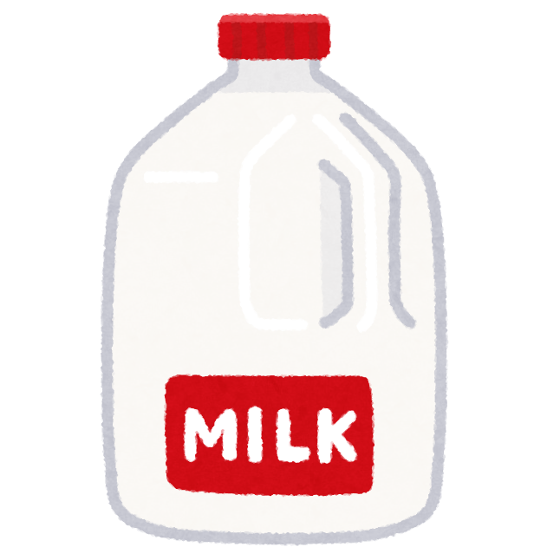
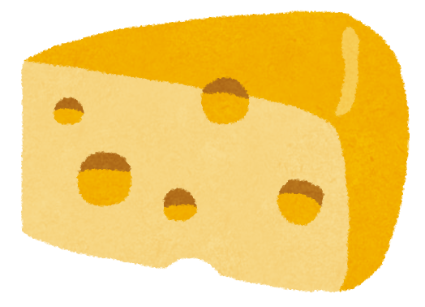
Trial 3 Ingredients, Lactose or Whey
Lactose or Whey
Trial3
Notes:
Sample beers were brewed by adding lactose or whey at wort boiling.
Whey is a byproduct of cheese production. Whey contains lactose, and some brewers use whey in the brewing of milk stouts.
The test beers had similar amounts of lactose.
On the other hand, protein content was higher in beers made with whey.

Slide 29
Trial 3 Result : Rheometer and Tribometer
Viscosity (mPa·s)
Friction Factor μ
stick slip
static friction
kinetic friction
Share rate (1/s)
Sliding Velocity (m/s)
The addition of lactose increased static and kinetic friction.
On the other hand, the addition of whey, which contained the same amount of lactose, decreased static and kinetic friction.
29
Notes:
This slide shows the results of the rheometer and tribometer measurements.
The addition of lactose increased static and kinetic friction.
On the other hand, the addition of whey, which contained the same amount of lactose, decreased static and kinetic friction.
Therefore, it is suggested that components other than lactose in whey reduce friction.

Slide 30
Trial3 Sensory evaluation
Not
Smoothness
Smoothness
Sensory evaluation
Can panelists determine smoothness?
Nose plugged.
**
Smoothness
*
N=10
*p<0.05
**p<0.01
Not
Smoothness
The results of tribological analysis correlated with those of sensory evaluation when comparing beer with lactose and with whey.
Notes:
Sensory evaluation was performed same method.
To eliminate olfactory influences, this test was performed with nose plugs.
The sensory evaluation revealed that the beer with whey was considered to be smoother.
The tribological analysis showed that the beer with whey had lower friction.
Therefore, the results of the tribological analysis correlated with those of the sensory evaluation when comparing these beers.

Slide 31
Result：Can detect differences?
Parameter |  | Rheology | Tribology
Alcohol content | 5, 7, 9 % | Yes | Yes
BU | 16, 51 unit | No | No
Color | 6, 125 °EBC | No | Yes
Malt type | Barley, Wheat | No | Yes
Filtration |  | No | Yes
Ingredients | Lactose, Whey | No | Yes
Staling |  | No | Yes
Trial 1
Trial 2
Trial 3
Trial 4
Notes:
Finally, in Trial 4, we used storage samples.

Slide 32
Trial 4 Dose tribology change due to staling?
Pilsner-type beer（commercial）
Rheology
Tribology
Sensory evaluation test
Particle Measurement
Storage
for 3 months
at 5, 20, 40 °C
Pilsner-type beer
Notes:
In this trial, we used commercial beer.
The sample beer was stored at 5 °C, 20 °C, or 40 °C for 3 months.
The beer was then tested using a rheometer, a tribometer, sensory evaluation, and particle measurements.

Slide 33
Trial 4 Result : Rheometer and Tribometer
stick slip
Viscosity (mPa·s)
Friction Factor μ
static friction
kinetic friction
Share rate (1/s)
Sliding Velocity (m/s)
As the storage temperature increased, both the static and kinetic friction decreased.
33
Notes:
This slide shows the results of the rheometer and tribometer measurements.
We found that as the storage temperature increased, both the static and kinetic friction decreased.

Slide 34
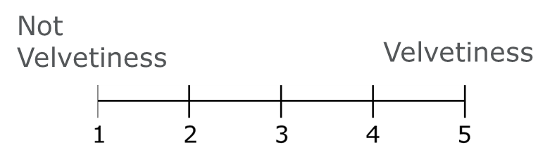
Trial 4 Sensory evaluation
Sensory evaluation test
Can panelists determine velvetiness?
Nose plugged
Velvetiness
***
*
**
N=10
*p<0.05
**p<0.01
***p<0.001
Not
velvetiness
Tribology analysis results and sensory evaluation results were correlated for the stored beer.
Notes:
Sensory evaluation was performed using a five-point scale by a panel of 10 participants, with the score increasing as the velvetiness increased.
To eliminate olfactory influences, this test was performed with nose plugs.
The sensory evaluation revealed that storage at high temperatures increased the velvetiness.
The tribological analysis showed that beer stored at higher temperatures had lower friction.
Therefore, the tribological analysis and sensory evaluation results were correlated for the stored beer.

Slide 35
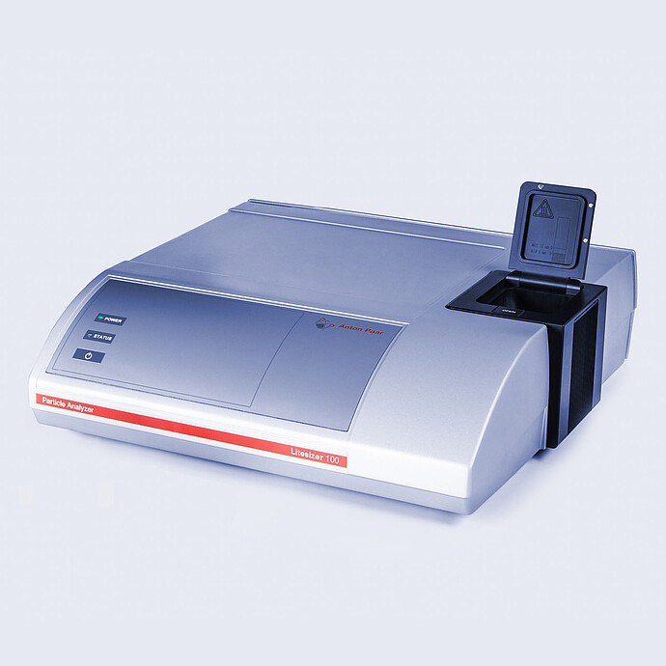
Trial 4 Particle Measurement
Litesizer 500, Anton Paar
Relative frequency (%)
Particle diameter (nm)
The particle size increased during storage.
https://www.anton-paar.com/jp-jp/products/details/litesizer/
Notes:
This slide shows the results of the analysis of beer stored using an Anton Paar particle analyzer.
It is well known that particle size increases with increasing storage temperature.
It has been suggested that the increase in particle size results in a change in the mouthfeel in the oral cavity.

Slide 36
Summary：Can detect differences?
Parameter |  | Rheology | Tribology | Sensory evaluation “mouthfeel”
Alcohol content | 5, 7, 9 % | Yes | Yes | Not tested
BU | 16, 51 unit | No | No | Not tested
Color | 6, 125 °EBC | No | Yes | Not tested
Malt type | Barley, Wheat | No | Yes | Not tested
Filtration |  | No | Yes | Yes
Ingredients | Lactose, Whey | No | Yes | Yes
Staling |  | No | Yes | Yes
Notes:
Here is a brief summary of this section.
Beers with similar alcohol contents and extract did not exhibit significantly different rheological properties.
Beers that did not exhibit differences in the rheological analysis nonetheless exhibited differences in the tribological analysis. For example, there were differences in color, filtration, and storage.
Sample beers that exhibited different tribological values also differed significantly in terms of their sensory properties.

Slide 37
Agenda
Introduction
Materials and Methods
Results
-Beer color and BU
-Filtration
-Ingredients
-Dose tribology change due to staling?
Conclusion
37
Notes:
Finally, I would like to summarize the results of this study.

Slide 38
Conclusion
We measured friction using a tribometer as a parameter related to mouthfeel.
We found differences in tribology between the following samples.
  -Filtration, colored malt, lactose or whey
Differences in friction with storage were observed. These samples exhibited similar differences in sensory characteristics. This suggests a correlation between the tribological analysis results and sensory properties. This may be due to differences in particle size.
Based on these results, we consider that mouthfeel is related to the particles in beer.
Notes:
In this study, we reached the following important conclusions:
In many cases, there is a difference in sensory evaluation of mouthfeel, but the difference cannot be detected in viscosity.
We measured friction as a parameter related to mouthfeel using a tribometer.
We found differences between unfiltered and filtered beers, with lactose and with whey, with and without colored malt.
Differences in friction with different storage times were also observed. The samples exhibited differences sensory characteristics. This suggests a correlation between the tribological analysis results and the sensory properties. This may be because of the differences in particle size.
Based on these results, we consider that mouthfeel is related to the particles in beer.

Slide 39
Future Work
Investigation of factors related to mouthfeel
  What other particles are involved in the mouthfeel?
  Interaction between beer ingredients and the oral cavity
Determine what kinds of particles can improve the mouthfeel
  In this study, we report the relationship between the particles and tribological analysis.
  Not all particles provide a good mouthfeel.
Notes:
We plan to further investigate the factors related to mouthfeel and determine what kinds of particles can improve the mouthfeel.

Slide 40

Resources
Nakamura, T. A Design Method for Creating Novel Food Textures (in Japanese). Food processing and ingredients. 2018, 53(4): 5-7.
Kajita, Y. Food Safety and Tribology: Evaluation of Beverage Texture by Viscoelasticity Measuring (in Japanese). Journal of Economic Maintenance Tribology. 2019; 651:10-14
Fox, D. et al., Mouthfeel of Beer: Development of Tribology Method and Correlation with Sensory Data from an Online Database. Journal of the American Society of Brewing Chemists. 2021
https://www.anton-paar.com/us-en/products/group/rheometer/
https://www.anton-paar.com/jp-jp/products/details/litesizer/
Notes:
In addition, the publications referred in this presentation are previous studies.

Slide 41
Collaborators
Kiyoshi Takoi
Atsushi Tanigawa
Toshihiro Kiyosaki
Notes:
I would also like to acknowledge and introduce my colleagues.

Slide 42

Thank you for your attention
Notes:
This is the end of my presentation.
Thank you for your kind attention.

Slide 43

REQUIRED
Q
A
Notes:
SAY:
It’s time to answer some of the questions you’ve been asking from the Q&A panel.
DO:
Make sure to use their name and show appreciation for the comment.

Slide 44
appendix

Slide 45
Malt type
I 100% barley malt
II 100% wheat malt
I
II
OG(%) 12.1 12.1
Alc.(%) 5.5 5.1

Slide 46
Malt type
Viscosity (mPa·s)
Friction Factor μ
stick slip
static friction
kinetic friction
Share rate (1/s)
Sliding Velocity (m/s)
Comparison of barley and wheat malt static friction was approximately the same, but the kinetic friction was higher for wheat malt.
46

