Slide 1
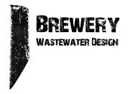
Practical Brewery Wastewater Solutions
John Mercer
Brewery Wastewater Design
www.brewerywastewater.com
john@brewerywastewater.com
All photos by owner or with permission.
Notes:
I have 20 minutes for the talk, plus 5 mins for Q&A.
Lazer pointer = control + hold down left mouse
SAY:
Good morning everyone and welcome to today’s session. I would like to introduce myself. I am John Mercer, owner of Brewery Wastewater Design and I will be presenting this session.
I know this is everyone’s favorite topic, so thanks for your willingness to sit through this. You will hear the word sewer over often, and you will see pictures of a toilet- and we’ll talk about them too. Bear with me.
Think about my last presentation, I had no laptop screen to view during the presentation. That was worst case scenario! Prepare for that.

Slide 2
The nature of brewery wastewater, and why it can be a big deal
Highly variable pH
High BOD
High solids
Potentially high temperature
Actual
Limit
Photo credit:
Nathan Bowling
Notes:
Around the country, pH is the most common regulatory issue. BOD is next.
Highly variable pH
Can lead to corrosion of existing below grade infrastructure
High BOD
Typically the biggest issue, but not in Seattle
BOD is a measure of nutrients in wastewater. For a brewery it is mostly sugar and alcohol. Wastewater plants remove BOD.
High solids
Pipe obstructions
Just like your kitchen sink strainer, keeping solids out of the drains keeps your plumbing working good- also on a bigger scale in the sewer mains
and municipal lift stations.
Municipal solids are typically landfilled as biohazard.
Potentially high temperature
Can lead to underground plastic pipes melting/collapsing
Temperature usually isn’t an issue unless there is a spill, mistake, or accident. A batch of hot wort going to drain is worst case.
Adding cold water to sewer for temperature adjustment is prohibited just about everywhere.
‘Cleaning the floor’ with cold water is not.

Slide 3
King County Brewery Wastewater BMP’s. Really?
It starts with a letter in the mail, we call it Hate mail. It comes after the brewery output exceeds 3000 bbls/yr.
This is a very basic PFD of how KCIW expects things to flow at your brewery.
Notes:
King County is probably the most strict with regards to breweries and their wastewater. Several years ago King County came up with a set of brewery specific wastewater BMPs.
Treated wastewater is ultimately discharged to the Sound.
The image:
With new construction we can do this easy enough.
However an existing brewery is almost never setup like this.
Plan ahead, no matter where your brewery is located, always tie in
domestic and process wastewater pipes outside the building.
Do this even if wastewater is of no concern during construction!

Slide 4
King County Industrial Wastewater = KCIW
Actual discharge requirements:
The list is quite lengthy, brewery specific summary =
pH 5.5-12.0
Temperature <150F
Settleable solids <7 ml/L
Wastewater flow measurement
All breweries must comply. If above 3000 bbls/yr, it must be documented and they are enforced. pH must be continuously documented with an inline sensor.
Notes:
The published BMPs are 6 pages long!
It is no joke and KCIW takes these limits very seriously.
They have created a monster, there are a lot of permits out there and hard to keep track of with limited staff.
Everytime I talk to them about this, they mention all breweries must comply with the above.
It will be enforced only breweries above 3000 bbls/yr.
It’s not just breweries, I have also helped distilleries, cideries, fish plants, paint factories, and a small slaughterhouse.

Slide 5
How to make things easier?
Always tie in domestic and process wastewater pipes outside the building.
Do this even if wastewater is of no concern during design and construction!
Notes:
This is the #1 takeaway I want you all to know.

Slide 6
How to make things easier?
If needed, pretreatment can be added with no saw cutting or excavation inside the building.
Plan for it, we’re all in this for the long haul. Politics, city councils, and local ordinances change.
Notes:
The downstream pipe in the pump vault can function as an overflow.

Slide 7
Brewery #1, New Construction
An expanding brewery must install a pretreatment system.
pH compliance
Temperature compliance
Solids compliance
Measure flow
Local issues
Contaminated soil
Water table
Add submetering
Notes:
Reuben’s

Slide 8
Brewery #1, The Solution
Phase 1
Phase 2
1100 gals
Notes:
New construction
The original plan was do operate with Phase 1 until 20k bbls/yr, then upgrade to Phase 2.
The big deal is we can reuse all equipment, just add a tank.
The brewery is currently at 27k bbl/yr and no plans to upgrade to Phase 2 (no space).
35k bbls/yr is max production.
I wish I could do this more, but many of these systems are retrofits.

Slide 9
Brewery #1, The Solution
Discharge system
Discharge
pH electrode
Mixing system
Process
sample port
Discharge
flow meter
Process
pH electrode
Double sample
port
Return to
tank
From pump
To sewer
From pump
Notes:
This is different from the PFD, it’s an older system.
The function is the same.

Slide 10
Brewery #2, Retrofit
An existing brewery must install a pretreatment system.
pH compliance
Temperature compliance
Solids compliance
Measure flow
Domestic wastewater discharges into the same pipe under the slab.
The pipe runs right through their popular tasting room.
They really want to avoid excavation and related disruption to their taproom.
Notes:
Don’t do this! This is the #1 takeaway I want you all to know.

Slide 11
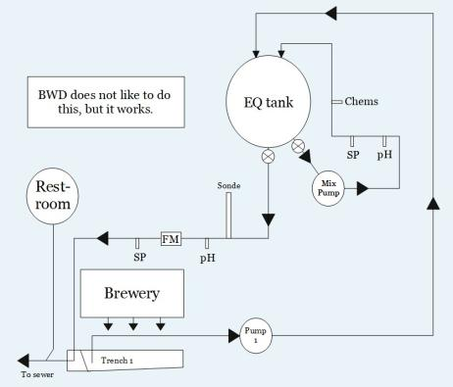
Brewery #2, The Solution
We plugged the trench drains(!), added a float in the trench, then pump out of the trench an into an EQ tank.
After pretreatment, wastewater is discharged back into the trench drain outlet.
Say what?
Notes:
Sounds crazy, but it is working.
There are 2 trench drains total, one plugged with an epoxy concrete and a custom outlet pipe. The other is a common pipe plug.
To be clear, BWD does not like doing this. But we didn’t have to shut things down or dig things up. And its working.

Slide 12
Brewery #2, The Solution
From EQ tank
Custom outlet pipe
Concrete dam
Pump suction
Control float
Notes:
Stoup

Slide 13
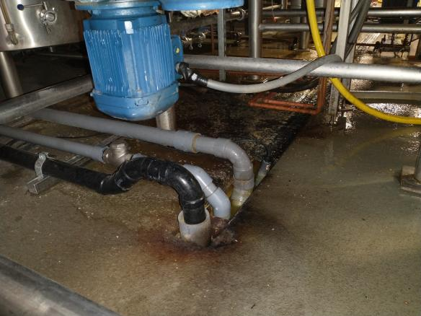
Brewery #2, The Solution
All of this is under the lauter tun.
This is not a preferred method. But it works with no major problems.
Control float
Backup pump suction
Primary suction
To sewer
Notes:
Customer chose to install a 2nd pump as a backup.
The 1st pump was expensive and built to last.
The backup pump was used and cheap, will not last long.

Slide 14
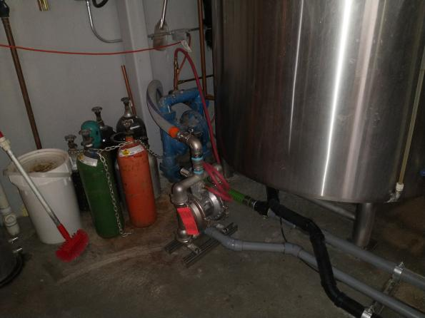
Brewery #2, The Solution
Notes:
Stoup
Just showing the pumps.

Slide 15
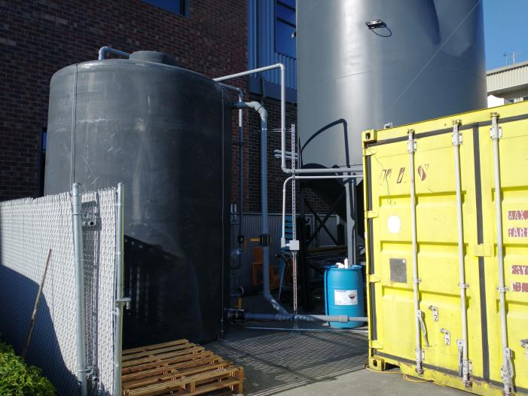
Brewery #2, The Solution
Notes:
Stoup
The tank is 5000 gals and is larger than needed. They initially wanted a manual system to check once a day, dump it, and refill.
But after 1-2 months they decided to add automation.

Slide 16
Brewery #3, Retrofit
An existing brewery must install a pretreatment system.
pH compliance
Temperature compliance
Solids compliance
Measure flow
Two employee restrooms discharge into process wastewater drainage system.
Rented space with a potential move in coming years.
Maybe we can sell the equipment after the move?
They really wanted to avoid excavation.
Notes:
Ghostfish, retrofit
No one wants domestic wastewater in the EQ tank.
Serious yuck factor.
Biohazard with every sample.
Odor.
Gross floaties.
Higher maintenance than normal.
Not 100% certain, requirement for wastewater operator license if domestic waste is involved?

Slide 17
Brewery #3, Prior Conditions
Staff restrooms are connected to process wastewater system.

Slide 18
Brewery #3, The Solution
Notes:
The grinder toilets are something you would put in a basement. They are designed to pump wastewater to an overhead pipe, solids included.
The discharge pipe is 1” PVC.
Needs a good vent.

Slide 19
Brewery #3, The Solution
Everything used to drain into the pump vault.
Adding special toilets at this brewery solved the problem
The toilet has an integral grinder pump. Domestic wastewater is pumped straight to sewer.
Process wastewater is pumped to the EQ tank through existing pump vault.
Vent
To sewer
To EQ tank
New grinder
toilet
Vent
Pump discharge to EQ
Existing pump vault

Slide 20
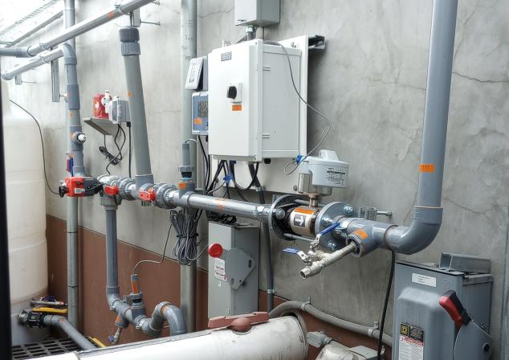
Brewery #3, The Solution
Return to
tank
Chemical
injection
To sewer
EQ tank
Ball
Valve
KCIW sonde
Discharge
pH electrode
Process
pH electrode
Process
sample port
Discharge
flow meter
Double sample
port
Notes:
Talk about the sonde.

Slide 21
Net Metering with Seattle Public Utilities (SPU)
Normally cities charge sewer fees based on incoming water.
All breweries ship water off site as beer, water in spent grain, etc.
SPU has a net metering program.
In smaller towns often times the deduct is a handshake agreement that it is a non-issue as long as surcharges are not applied.
Notes:
The photo is an Itron radio.

Slide 22
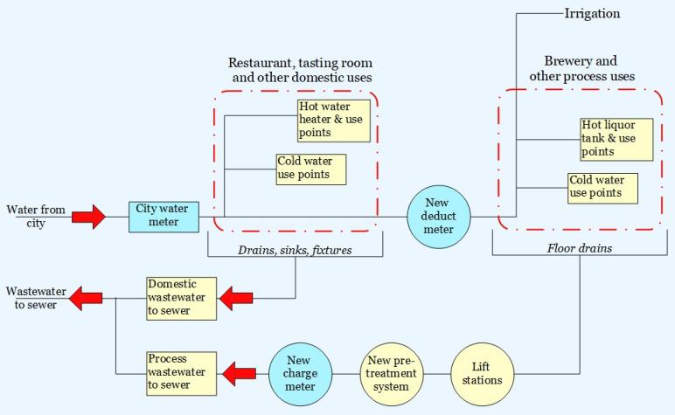
Net Metering with Seattle Public Utilities
Notes:
It is expensive to do this, but the ROI is usually <5 yrs.
Usually fairly easy to do this, the biggest issue is the charge meter.

Slide 23
More Photos and Examples
Real world stuff, the good and the bad

Slide 24
Low tech solids screening
A perforated stainless basket below the brewhouse

Slide 25
Low tech solids screening
Perforated steel sheet on top of the trench drain grate.
Capture the solids before they go down the drain, liquids can pass.
This works in Seattle, with no BOD restrictions.
In most towns this will not work, most BOD is soluble.
Notes:
This will not work in areas with BOD restrictions.

Slide 26
One Thing
That You’ll Apply
Notes:
Always tie in domestic and process wastewater pipes outside the building! I would love to make a one size fits all skid. But it doesn’t work because there are too many variables.
SAY:
What will you either apply back at work right away or that you want to look at further when you leave the session?
Take a moment to consider your ideas or look at your notes and etc. then type it into the chat panel. If you see someone’s idea that you find interesting - feel free to comment back to them. To do this typically you put an @ and then their name and type your thoughts.
I’ll be quiet and give you a few moments to share your thoughts NOW in the Chat panel.
DO:
Watch the chat panel and comment on some of the ideas coming in. Use their name and reiterate the point. “Yes, Jim Smith that was a pretty interesting stat [name] shared on the [fact]” and so on. Use this as an opportunity to ask further questions directly from attendees.

Slide 27
Resources
The website of your main man, John Mercer!
www.brewerywastewater.com
john@brewerywastewater.com
The bureaucrats who enforce this stuff:
King County Industrial Waste Program
King County Brewery Wastewater BMPs
Seattle Public Utilities Submeter Program
Other resources
BA: Water and Wastewater: Treatment/Volume Reduction Manual (2014)
BA: Wastewater Management Guidance Manual (2016)
Notes:
Too much stuff here, but all of these links work and this presentation will available to all of you after the conference.
I will also have it up on my website.

Slide 28
John Mercer
Brewery Wastewater Design
www.brewerywastewater.com
john@brewerywastewater.com
Q
+
A
Notes:
SAY:
It’s time to answer some of the questions you’ve been asking from the Q&A panel.
DO:
Make sure to use their name and show appreciation for the comment.

