Slide 1
Analyzing Beer with Botanical Adds Using GC-MS-O
Steve Gonzalez, MSc Brewing & Distilling, Heriot-Watt University
Senior Manager of Brewing & Innovation, Stone Brewing

Slide 2
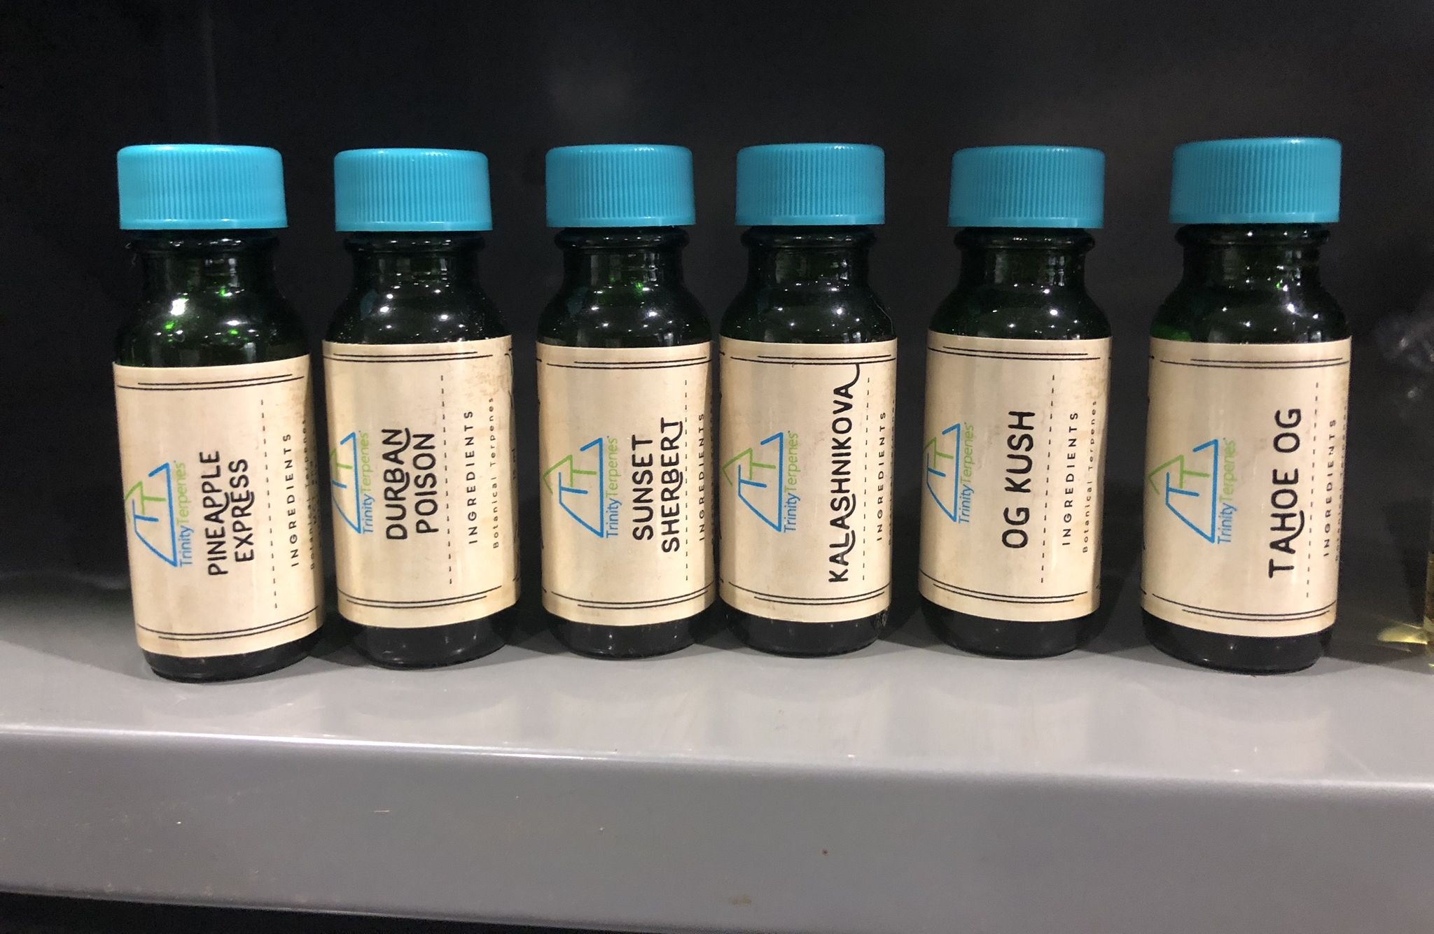
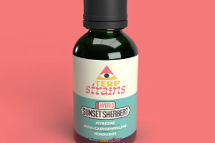

Stage 1: Terpenes from Trinity Terpenes & Analysis by Gerstel
Practical prototyping and analysis approach.

Slide 3
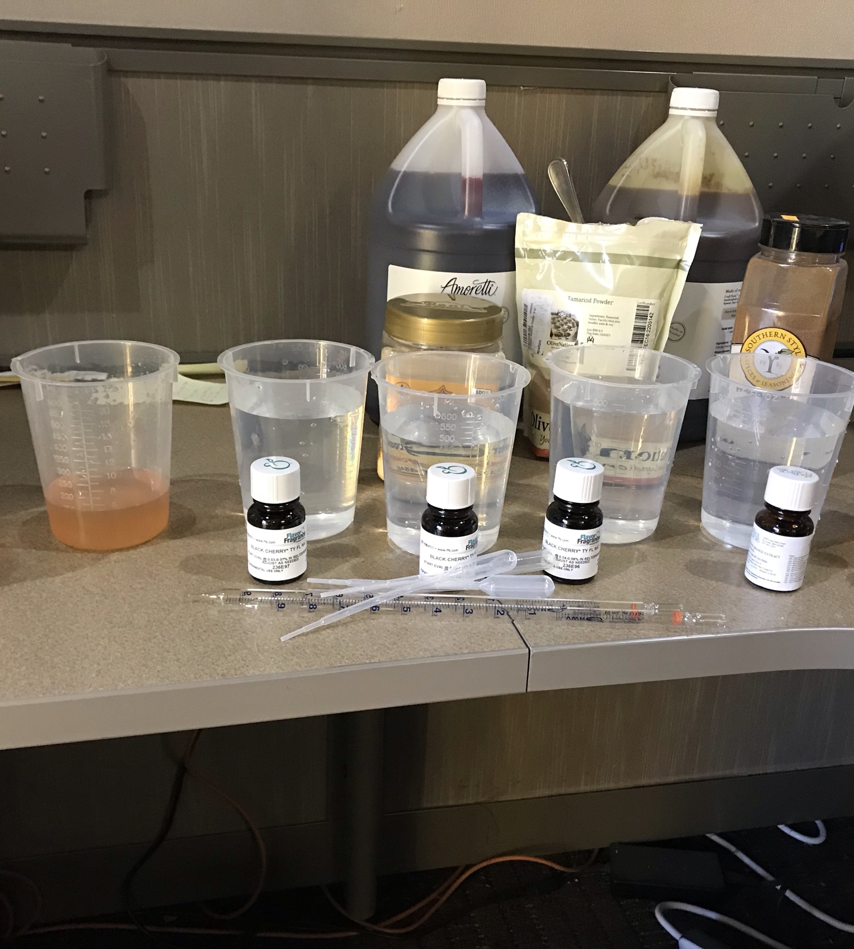
Testing of Samples for Sensory
Terpenes were added to both water & beer at an add rate of 1 ml/liter.
Preliminary evaluation by a small group of tasters.
Winnowed down to 6 samples.
Final evaluation revealed 2 clear standouts that were exceptionally fruity and dank tasting.
  OG Kush
  Sunset Sherbert
These final two samples were replicated in Stone IPA & sent with Control beer to Gerstel for analysis.

Slide 4
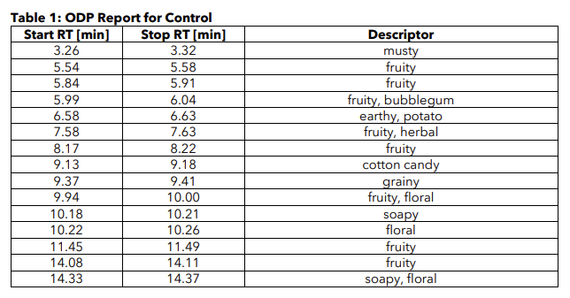
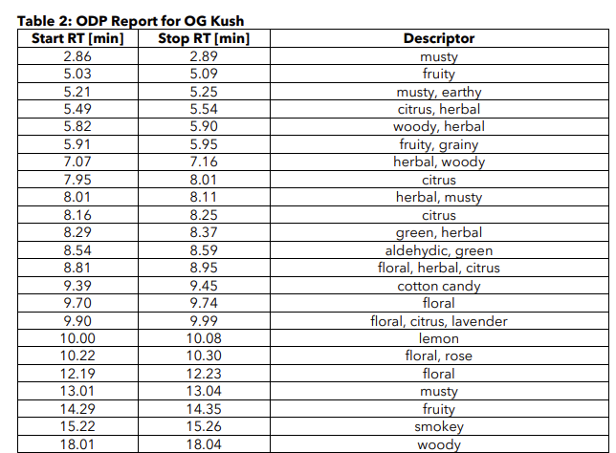









Olfactory Results: Control versus OG Kush
Additional Attributes
Possible Negative Additional Attributes

Slide 5
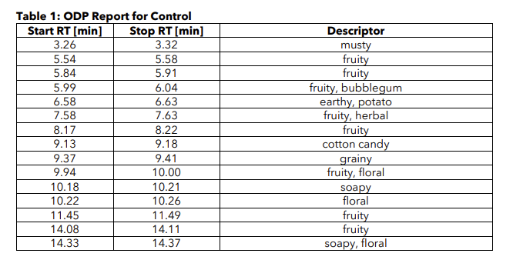
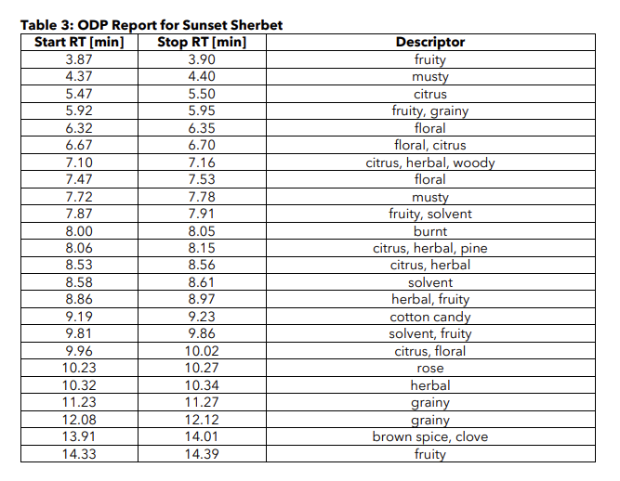
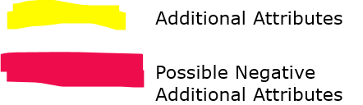


Olfactory Results: Control versus Sunset Sherbert

Slide 6
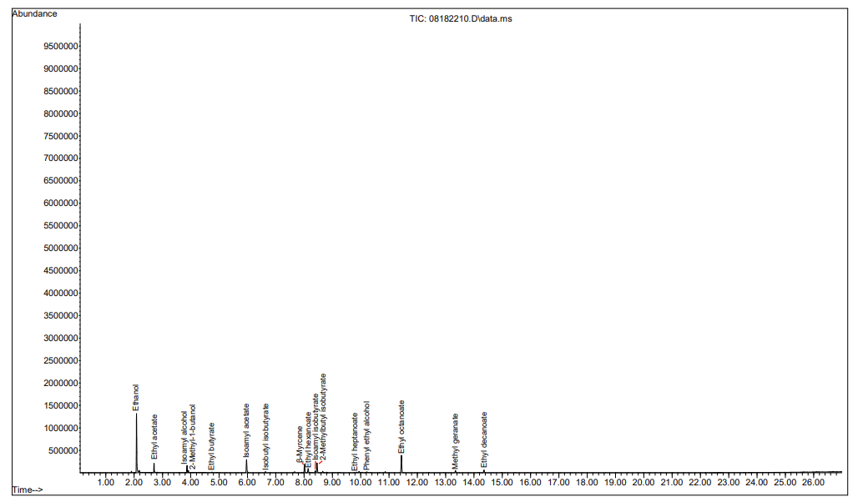
Peak Absorbance Results: Control
Compound with maximum absorbance was Ethanol
Multiple esters detected.
Hop derived compounds detected.

Slide 7
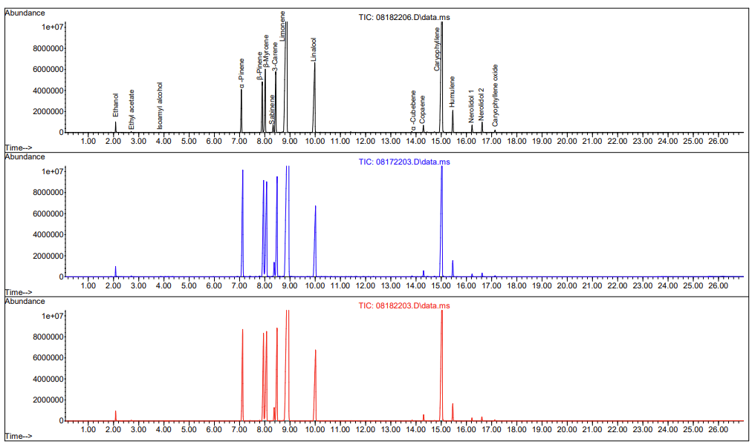
Peak Absorbance Results: OG Kush
High absorbance for compounds such as Caryophyllene, Linalool, & Humulene that are also associated with hops.
High content of other compounds such as Limonene associated with other botanicals.

Slide 8
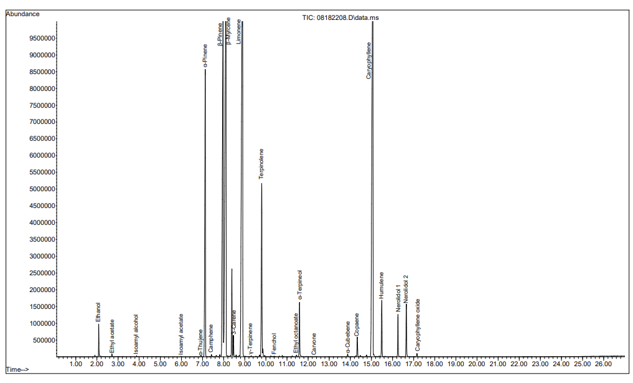
Peak Absorbance Results: Sunset Sherbert
Similar results to OG Kush with notable differences such as absence of Linalool peak.

Slide 9
Scale-Up for Commercial Launch with Sunset Sherbert!
Small scale pilot brew for our local San Diego Market.
Sensory results were mostly favorable; this is a niche market!

Slide 10




Sunset Sherbert Special Creation Sensory Results: 9 Point Scale in Draught Lab
Rating Date | Value | Preference | Comment
11/30/22 | 7 | Like Moderately | Coming together nicely as it moves along. Less dank than it was.
11/30/22 | 4 | Dislike Slightly | Not really very good. Astringent character and slightly off putting fresh rubber aroma.
11/30/22 | 8 | Like Very Much | Pleasant storm dank aromas. Sl astringent bitterness
11/30/22 | 6 | Like Slightly | Stale bong water. It’s progressed but not on a positive note. Some nice citrus. Think about not showing unless for the conversation.
10/31/22 | 8 | Like Very Much | Dank, tropical, a bit of oil, nice bitterness, sl sweet. Love it
10/31/22 | 6 | Like Slightly | Smells and tastes like cut peppers and cucumbers. Kind of has a menthol note in aroma. Despite all that it's still cool and interesting.
10/31/22 | 7 | Like Moderately | Very dank in flavor and aroma
10/31/22 | 7 | Like Moderately | This does seem to be getting better. More citrus than last week. Back end pith though is not pleasant (back to my previous bong-water comment).
10/28/22 | 8 | Like Very Much | I like this more and more each time. Love the dankness, love the fruit, a little harsh on the end.
10/28/22 | 6 | Like Slightly | It’s dank. The rose petal taste is a bit much.
10/28/22 | 7 | Like Moderately | Generally like but heavy mouthfeel
10/28/22 | 9 | Like Extremely | Dank, super fruity, love it
10/28/22 | 7 | Like Moderately | Dank and sherberty. Starts off very pleasant but then becomes slightly chemically
10/26/22 | 7 | Like Moderately | Somewhat slick taste and mouthfeel. Tangerine juice taste
10/26/22 | 6 | Like Slightly | Super tangy peppers. Has this Dole mandarin orange fruit cup character.
10/21/22 | 7 | Like Moderately | Definite as some dankness, some oily character, some citrus and melon, vsl sweet, nice bitterness finish drags a little on the oily side, but I still like it
10/21/22 | 8 | Like Very Much | Delivers on the dank. Some really tasty tropical notes.
10/21/22 | 6 | Like Slightly | Buddha hand, lemon pith, lemon seed, peppers. Sl sandalwood note. Very interesting!
10/21/22 | 6 | Like Slightly | Aroma is tropical and catty but pleasant. Bitterness has a slightly chemical/extract taste to it
10/21/22 | 5 | Neither Like Nor Dislike | Bong water aroma (with some fruit). Astringent. Not popping.

Slide 11
Conclusions for Stage 1
Terpenes produced high quantities of compounds considered positive and favorable to many styles of hoppy beers such as IPA.
Some compounds can be perceived as negative.
A mix of favorable & unfavorable compounds, detected in high concentrations correlated with sensory findings, and a wide swing of rankings and comments.
This is a likely a niche style that some customers will love, as validated by GC-MS-O & Sensory analysis in tandem!

Slide 12
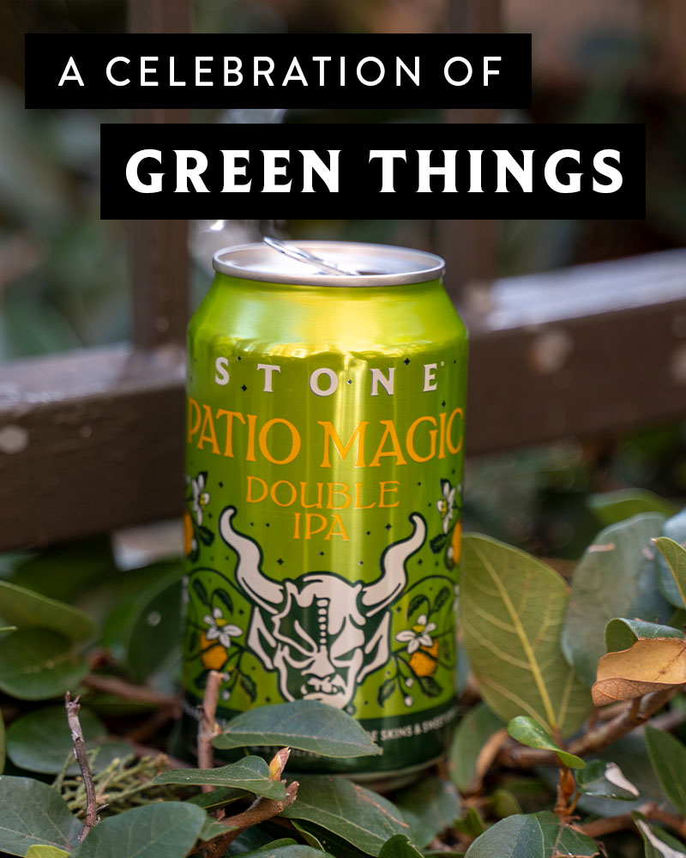
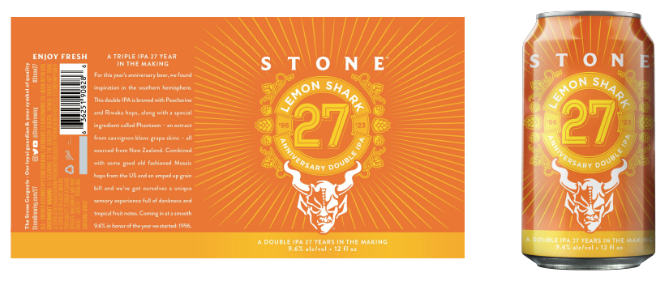
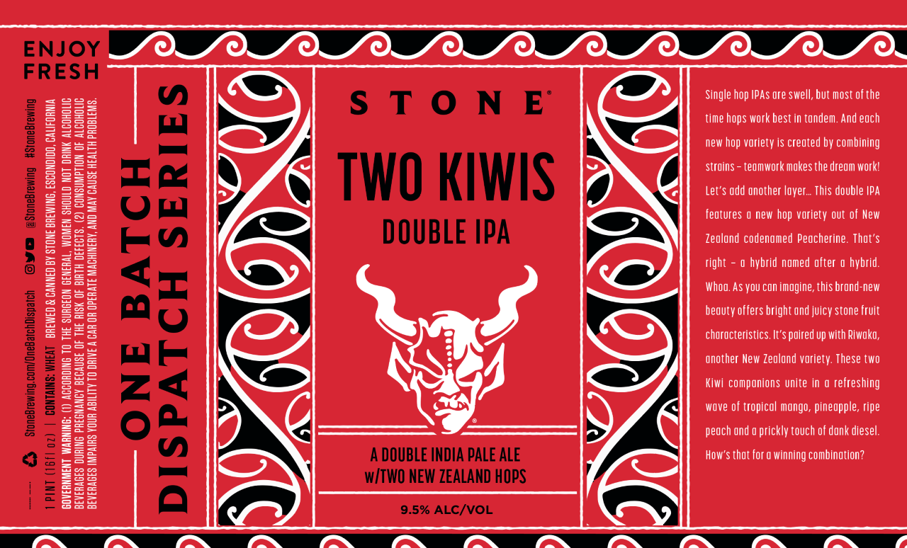
Stage 2: Analyzing Beers Brewed with & without Phantasm at San Diego State University
Practical comparison between beers with and without Phantasm.

Slide 13
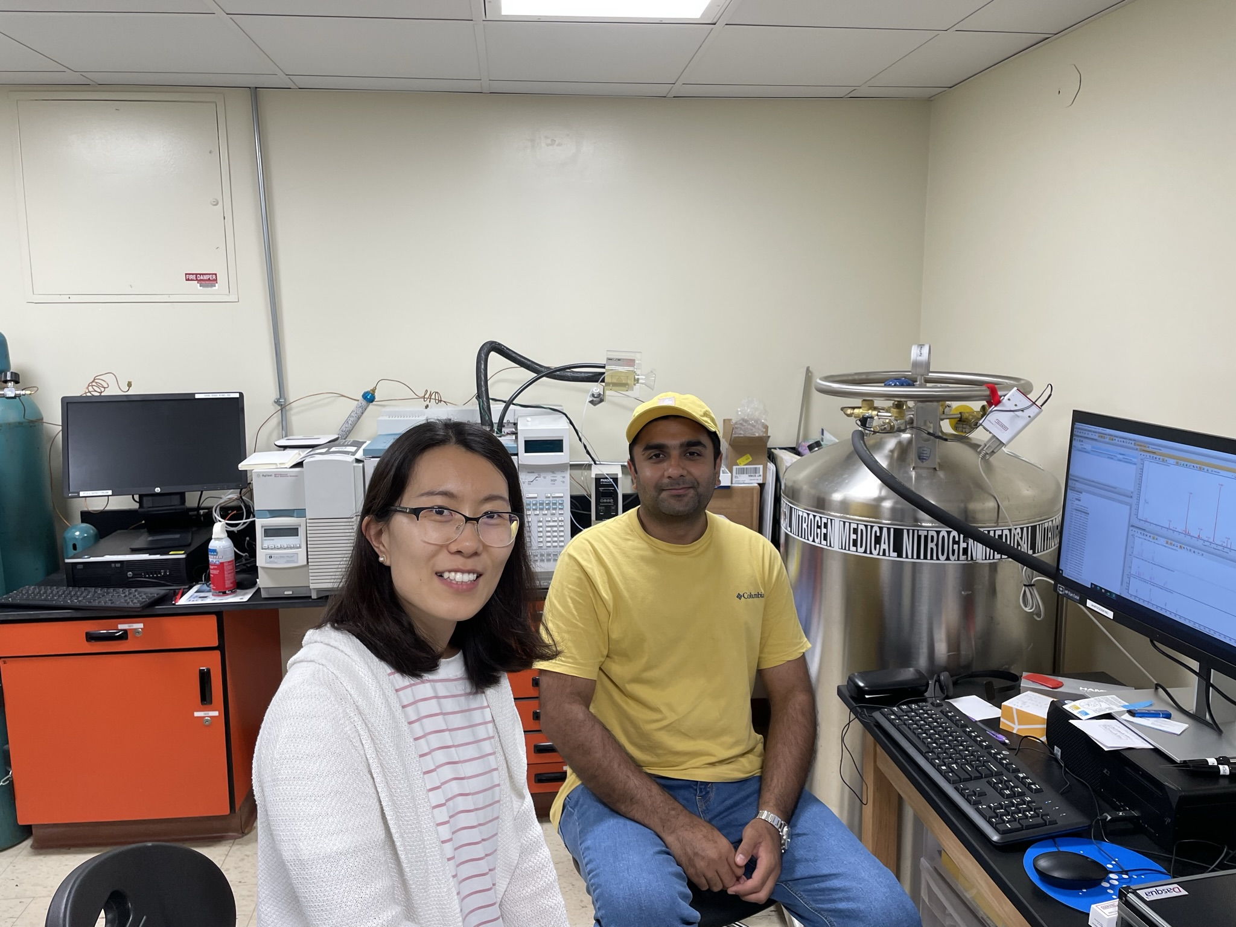
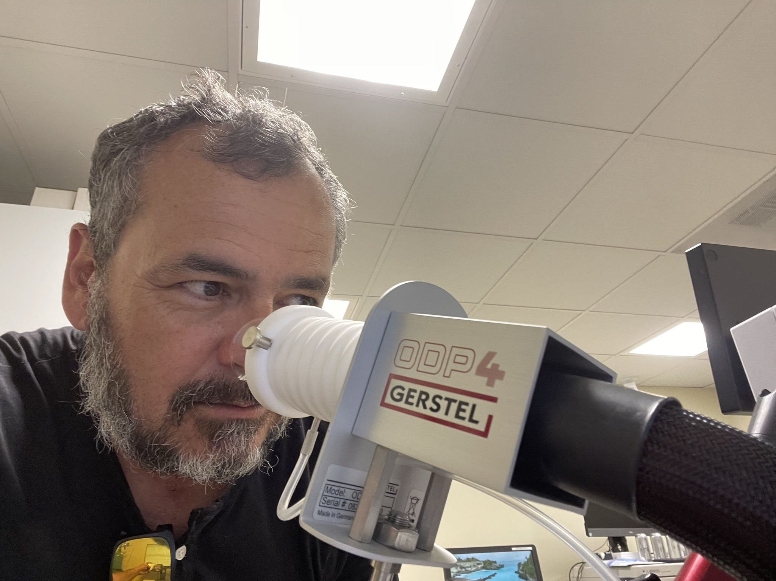
Analyzing Beers with Dr. Jing Zhao & Dr. Ali Reza, SDSU Food Science Lab

Slide 14

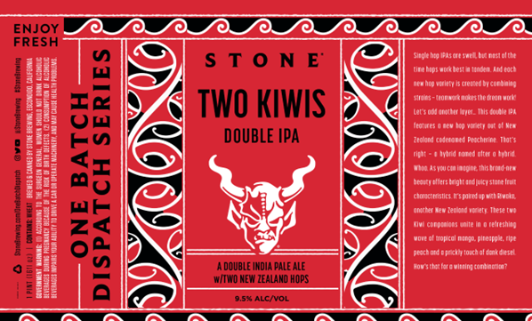
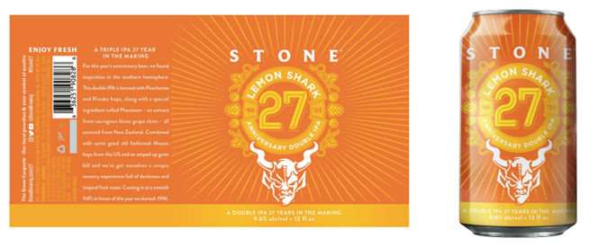
The Beers Analyzed
Stone Patio Magic Double IPA
Brewed with US & South African Aroma Varieties
Brewed with Phantasm
Brewed with orange peel
Stone Two Kiwis Double IPA
Brewed with Peacharine & Riwaka Hops
Not brewed with Phantasm
Stone Lemon Shark Double IPA
Brewed with Peacharine & Riwaka Hops (about 50% less than Two Kiwis)
Brewed with Phantasm

Slide 15
Base Analytical for These Three Beers
Sample Name | ABV | pH | Ea | OG | RDF | kcal | IBU | Color
Lemon Shark | 8.81 | 4.65 | 3.16 | 19.01 | 69.68 | 258.02 | 45 | 6.2
Two Kiwis | 9.67 | 4.56 | 3.78 | 20.94 | 68.83 | 287.32 | 43.5 | 6.4
Patio Magic | 8.88 | 4.62 | 3.21 | 19.16 | 69.61 | 260.28 | 51 | 5.2

Slide 16
Olfactory Results for 2nd Stage: Two Kiwis & Lemon Shark (no data for Patio Magic)
Lemon Shark
Two Kiwis
Descriptor | Time
Acrid | 4:3
Sweet | 7:15
Tropical, Mexican Candy | 8:10
Tropical | 11:3
Pineapple | 11:7
Golden Apple | 12:9
Pear Skin | 19:5
Asian Pear | 20:5
Lychee | 21:5
Descriptor | Time
Trash | 5:14
Mild Floral | 7
Bubblegum | 7:6
Geranium | 9:2
Jackfruit | 11:1
Green Mango | 12:1
Vegetable | 12:4
Chemical | 12:5
Vinyl | 12:8
Candy | 14:7
Green | 14:9
Sweet | 16:6
Butterscotch | 19:1
Sweet, Acrid Chemical | 19:5

Slide 17
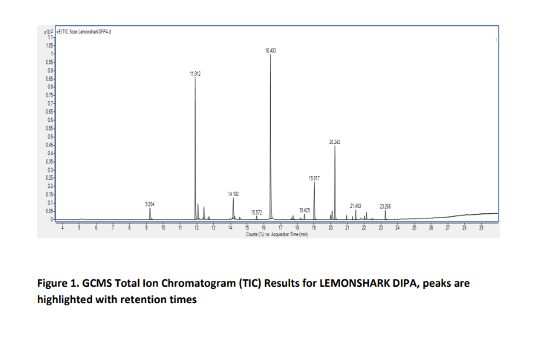
Lemon Shark Results, page 1!

Slide 18
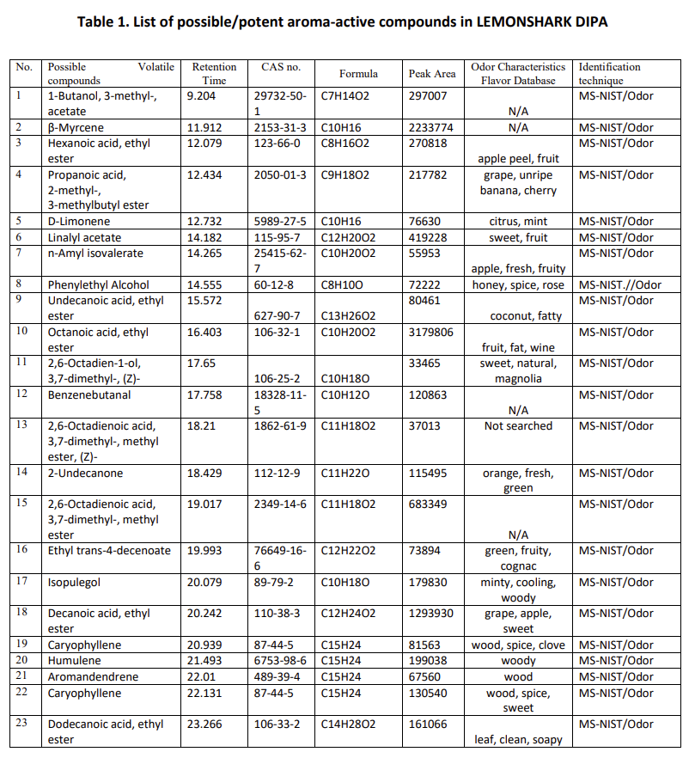
Lemon Shark Results, Page 2, 23 Compounds Detected

Slide 19
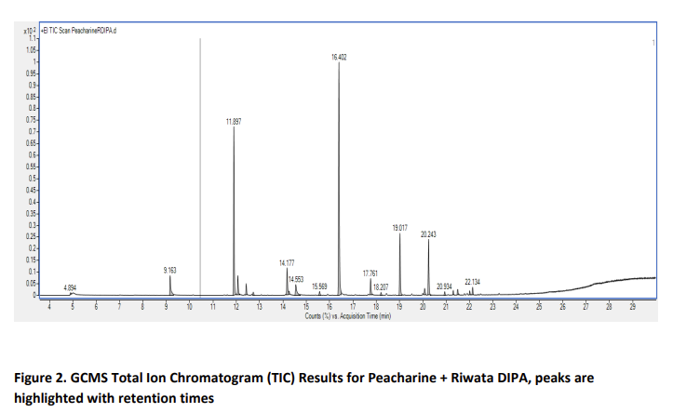
Two Kiwis Results, Page 1

Slide 20
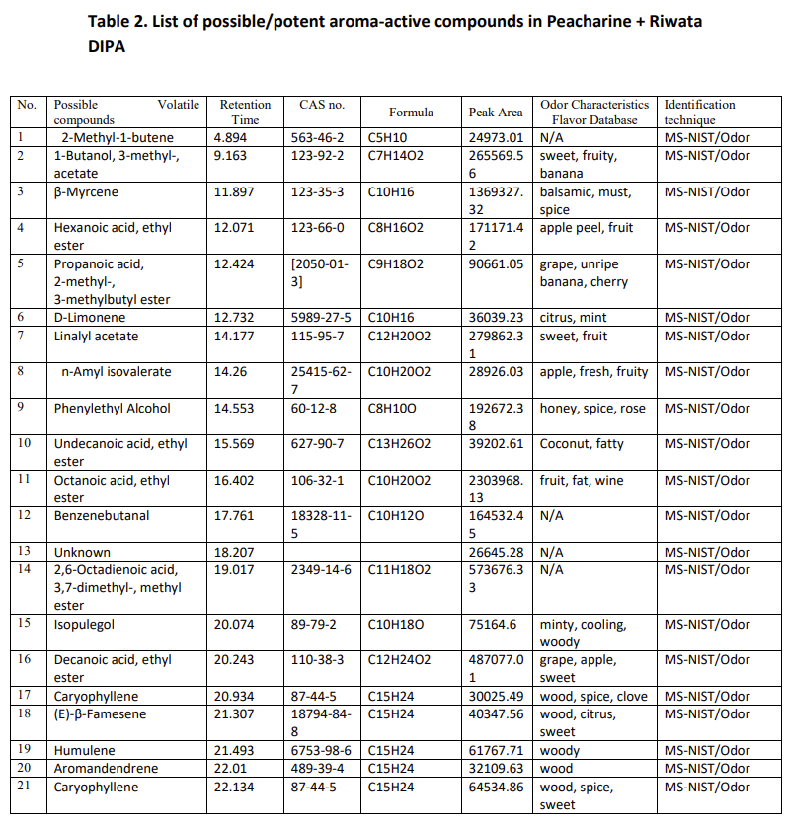
Two Kiwis Results, Page 2, 21 Compounds Detected

Slide 21
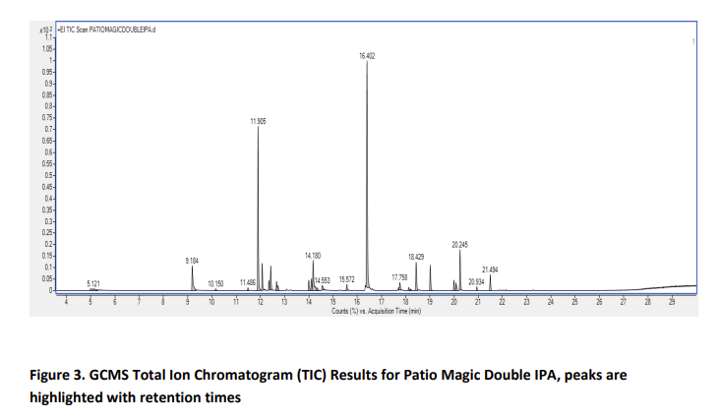
Patio Magic Results, Page 1

Slide 22
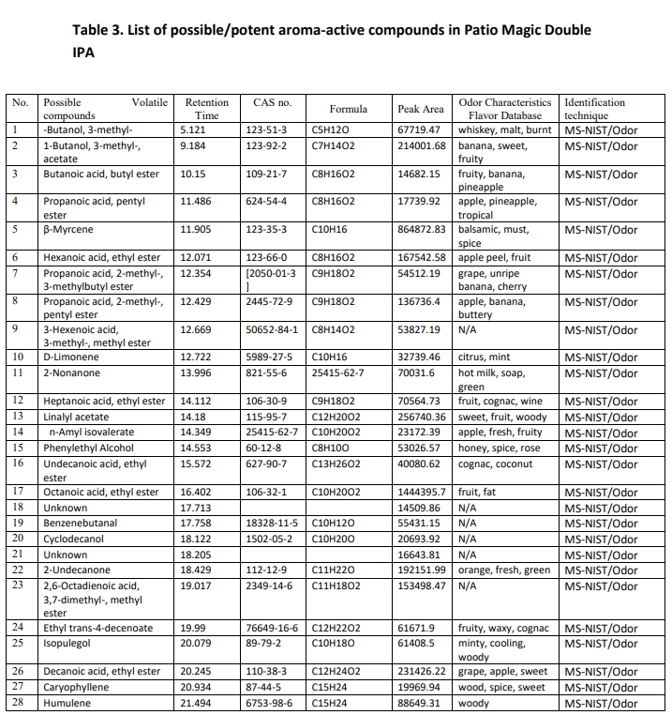
Patio Magic Results, Page 2, 28 Compounds Detected

Slide 23
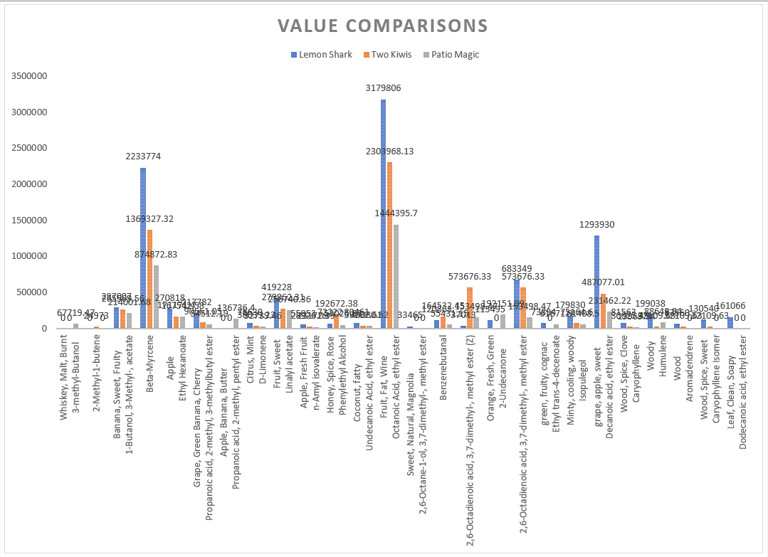
Compiled Results

Slide 24
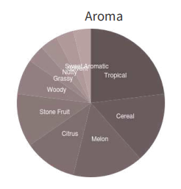
Sensory Data for the Beers: Lemon Shark
Value | Preference | Comment
9 | Like Extremely
9 | Like Extremely
7 | Like Moderately
9 | Like Extremely | Strong sweet aromatics, peach, lychee, wine.
9 | Like Extremely | A very tasty beer. Dig the complexity.
9 | Like Extremely | It’s a Stone anniversary beer. Intense double IPA. Really good.
9 | Like Extremely
8 | Like Very Much | More rough around the edges, tastes like the dilution rate was higher, cuts into the mouth feel
7 | Like Moderately
9 | Like Extremely | Less dank, less sweet aromatics, more pineapple and mango. Better head.
9 | Like Extremely | Like this one equally. Pretty close besides haze.
8 | Like Very Much | I have been liking it very much but next to the RVA beer I do prefer that one. More intensity and abv in RVA version.
8 | Like Very Much
7 | Like Moderately | Dried mango. Over riped fruit
9 | Like Extremely | My kind of beer! So fruity, tons of diesel and overall very good.
7 | Like Moderately | Pretty good! No complaints.
9 | Like Extremely
3 | Dislike Moderately | Not a fan of the diesel notes
8 | Like Very Much | Great tropical aromas w vsl diesel. Moderate bitter with great haze
8 | Like Very Much | I said a lot previously. The more you drink the more complexity comes out. There is some hop burn which should soften and let the Phantasm come out more.
7 | Like Moderately | Sl vegetal note upfront, sl sweet, some orange peel, nice bitterness
8 | Like Very Much | White wine is intense! Refreshing, tropical complex finish.
8 | Like Very Much | This has been pretty consistent across all brews despite slight changes to recipe. This one still has that sweet dank funky berry character. Very sweet though. That keeps it from like extremely cause I could only have the one.
9 | Like Extremely | Big citrus, woody, tropical fruit, sl warm,
8 | Like Very Much | Nice lemon and stone fruit hop aromas with just a touch of nutty. Hop flavor and residual sweetness work really well together!
7 | Like Moderately | Lots of tropical /guava and orange peel for a beer named lemon shark. Great haze, and good smooth/creamy finish. Really approachable for 9.5%. Some fusel in the finish.
8 | Like Very Much
8 | Like Very Much | Dank, juicy, love it.
9 | Like Extremely
9 | Like Extremely
7 | Like Moderately | Citrus, stone fruit, creamy, hazy kids should love it
8 | Like Very Much
9 | Like Extremely | So good! So much fruit! Great complex! Awesome innovative beer.
 | 8.06
Even with low outlier high average score!

Slide 25
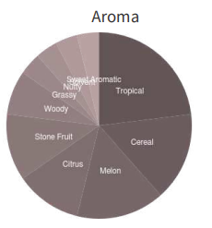
Sensory Data for Beers: Two Kiwis
Value | Preference | Comment
8 | Like Very Much | Diesel, light onion and garlic, definitely some nice fruit too, tropical, ripe citrus, stone fruit, smooth finish
7 | Like Moderately | Vsl pepper note alongside the peachskin and mixed tropical. Some lemon peel too. Sweet finish. Hottt.
8 | Like Very Much | Woody, pine,tropical, diesely
9 | Like Extremely | Big stone fruit aroma pop! Lots of peach. Good hop flavor with moderate lingering bitterness
8 | Like Very Much | Great fruit throughout. Seems sweeter and hotter than previous. More dank components. Still a really-good fruit bomb. Has some fusel at the end.
5 | Neither Like Nor Dislike | Smells like cake frosting, really-hot finish, also high stone fruit.
8 | Like Very Much | Really solid ODB
8 | Like Very Much
9 | Like Extremely
8 | Like Very Much
7 | Like Moderately | Some diesel right upfront, sl grassy, floral, touch of sweetness, nice bitter linger
8 | Like Very Much | Tropical and stone fruit. Shocking amounts of mango. Like biting into a fresh mango.
8 | Like Very Much | Intense stone fruit skin and mixed tropical. Sweet floral honey too.
8 | Like Very Much | Lots of mixed berry, sweet, little earthy
9 | Like Extremely | NZ in a glass. Very fruity even with a little age and that brambly dank edge I love from NZ. This is killer.
 | 7.87
Similar Aroma Compound Distribution to Lemon Shark
Slightly lower average than Lemon Shark.

Slide 26
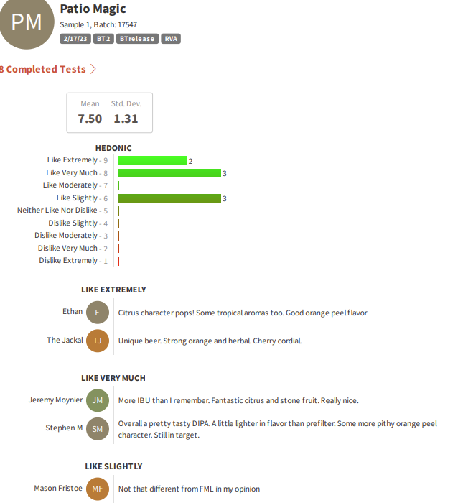
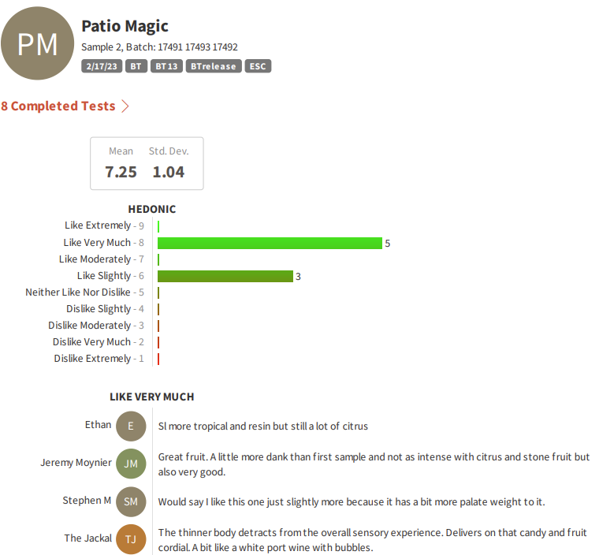
Sensory Data for Beers: Patio Magic

Slide 27
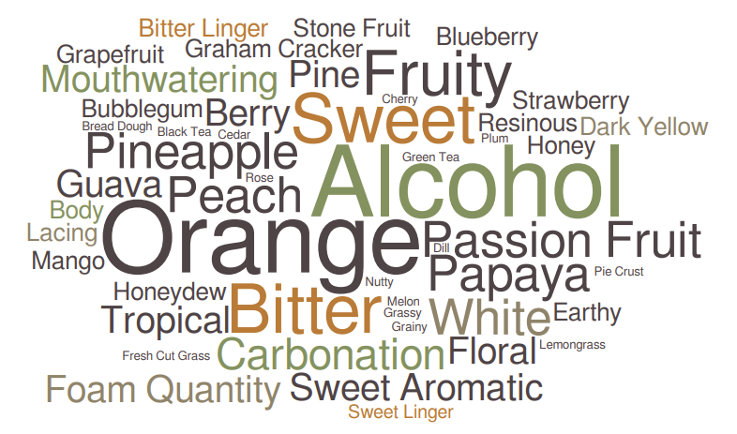
Sensory Data for Beers: Patio Magic Continued

Slide 28
Conclusions, Phase 2
Lemon Shark was significantly higher than Two Kiwis in fruity compounds using the GC-MS-O data.
Strangely Lemon Shark also had much higher beta-Myrcene, even though this beer had fewer hops.
  Could be an addition of Mosaic that was not in Two Kiwis?
Sulfur compounds were not analyzed as that is a different method, NZ hops are known for high sulfur compound content.
Preference extremely high for both beers using our trained panel, comments were radically different!
Less but more complex olfactory descriptors for Lemon Shark than Two Kiwis, could be higher intensity and linger?

Slide 29
Phase 3: Using Dr. Zhao’s Lab & Sensory Analysis to Analyze Sponsored Hop Candidates
In 2023 Stone is looking for a new sponsored hop variety, in partnership with the Hop Breeding Company (HBC).
We evaluated lots of HBC samples and settled on 4 favorites.
Of these 4 we selected enough material to produce 6-barrel pilot brews.
  Varieties were selected from the 3 digit HBC codes, however at the request of HBC will be represented here as HBC A, HBC B, HBC C, and HBC D.
  Recipe was our standard 7.7% abv target Hop Engineer West Coast IPA.
    We have used this recipe with some slight evolution for 9 years in single hop evaluations; we have found it effective as a hop evaluation research tool.

Slide 30
Phase 3: Using Dr. Zhao’s Lab & Sensory Analysis to Analyze Sponsored Hop Candidates, Continued
Enough beer was produced that some was saved for lab analysis and some was sold in our taprooms as is standard practice with these beers.
Between 55 and 62 compounds were detected using GC-MS-O for each hop variety prototype.
  Not all of these compounds were compounds with known sensory properties.
    For our purposes here, not all compounds will be reported in the comparative analysis section of this presentation.

Slide 31
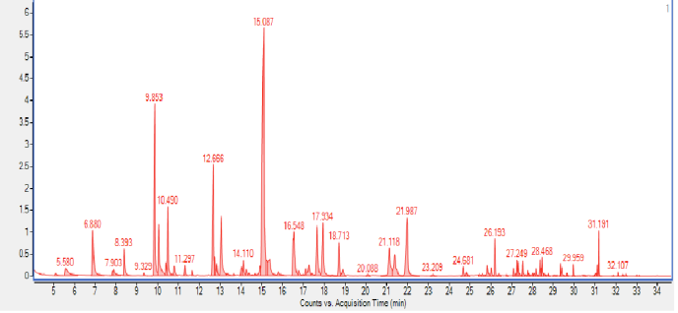
HBC A Pilot Brew GC-MS-O Results

Slide 32
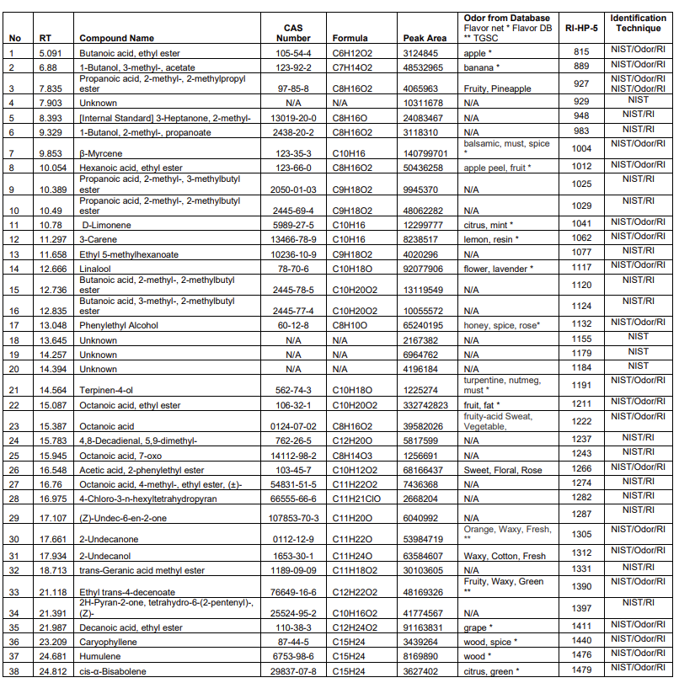
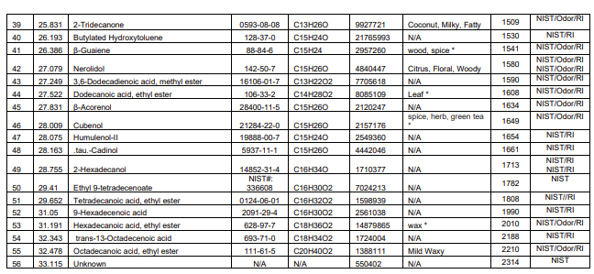
HBC A Results Continued

Slide 33
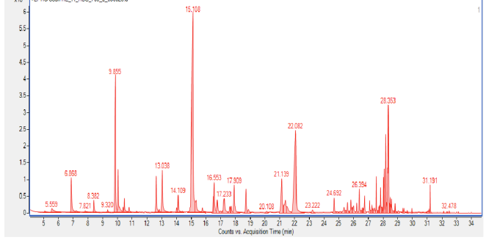
HBC B Pilot Brew GC-MS-O Results

Slide 34
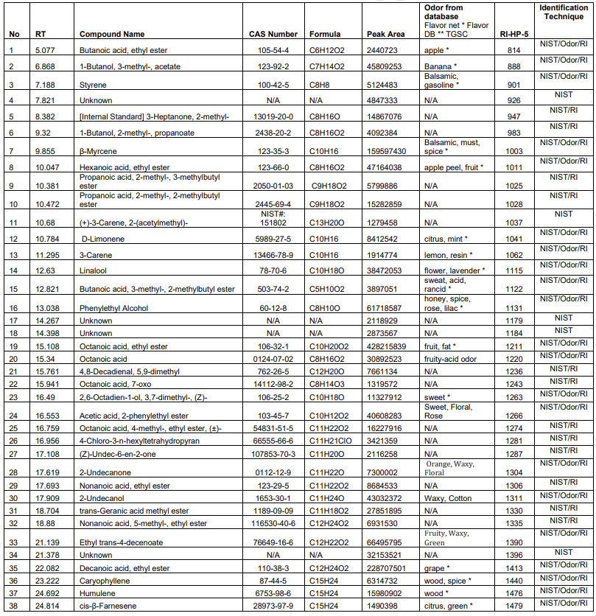
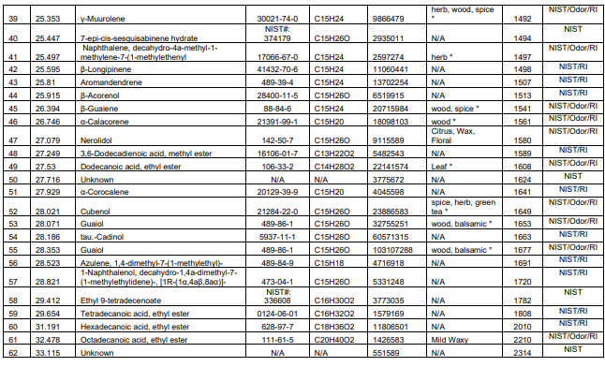
HBC B Pilot Brew GC-MS-O Results Continued

Slide 35
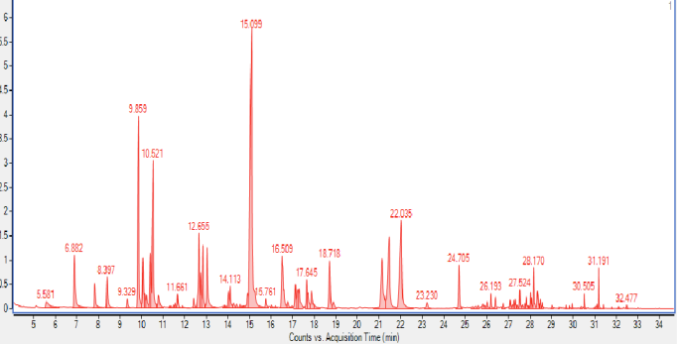
HBC C Pilot Brew GC-MS-O Results

Slide 36
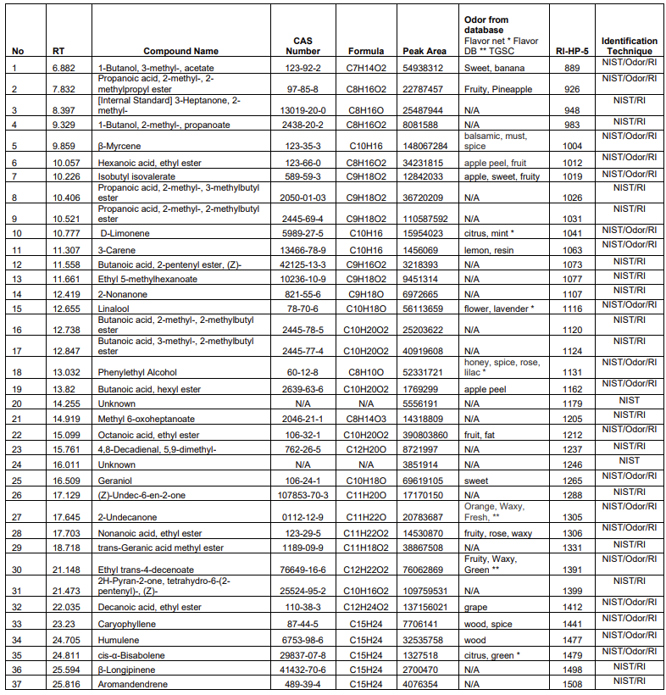
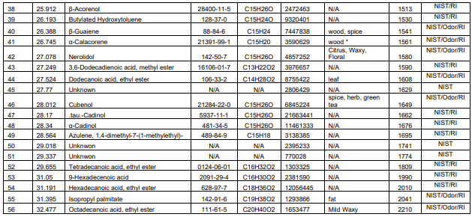
HBC C Pilot Brew GC-MS-O Results Continued

Slide 37
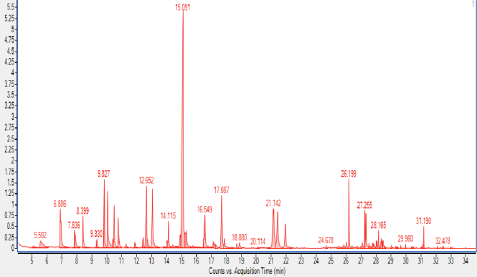
HBC D Pilot Brew GC-MS-O Results

Slide 38
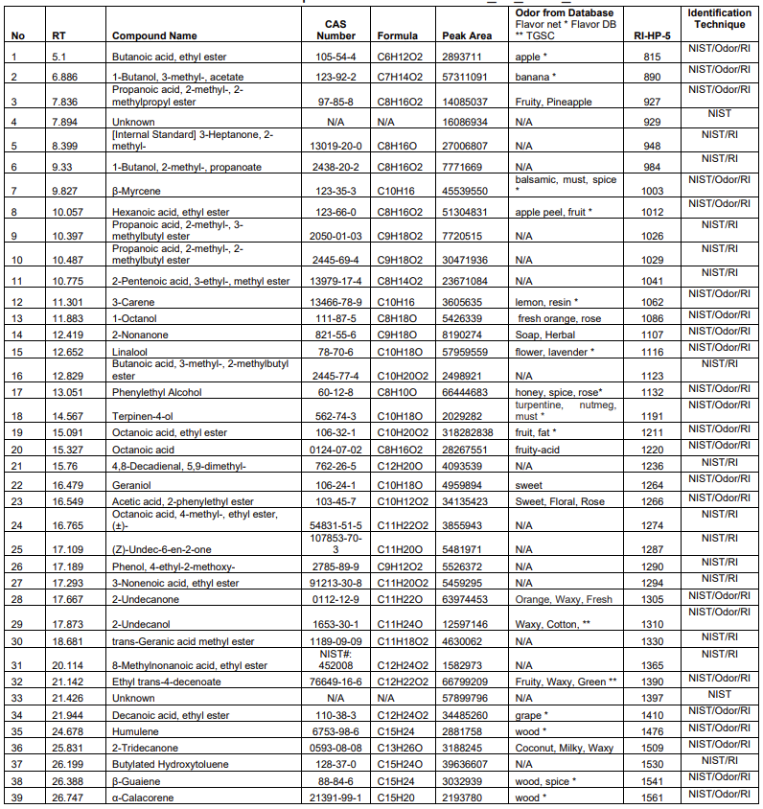
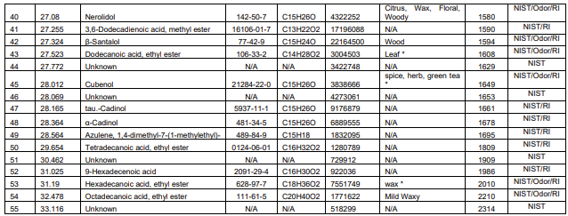
HBC D Pilot Brew GC-MS-O Results Continued

Slide 39
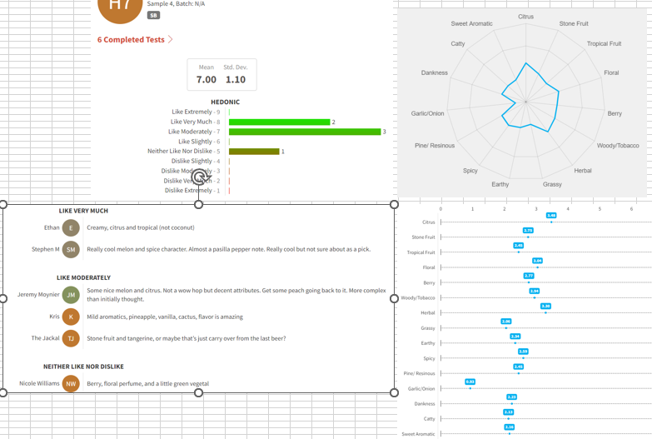
Sensory Results HBC A, Positive Results

Slide 40
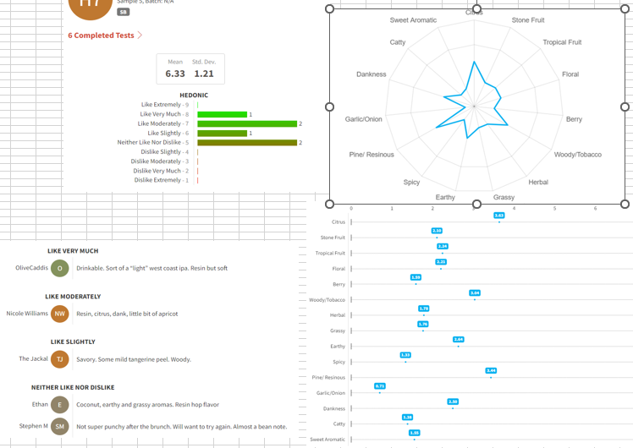
Sensory Results HBC B, Middling Results

Slide 41
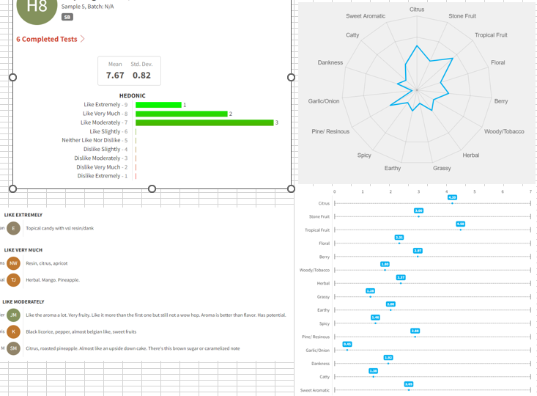
Sensory Results HBC C, Better Results, High Score

Slide 42
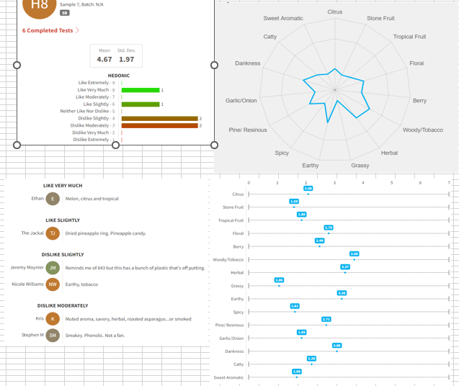
Sensory Results HBC D, Poor Results

Slide 43
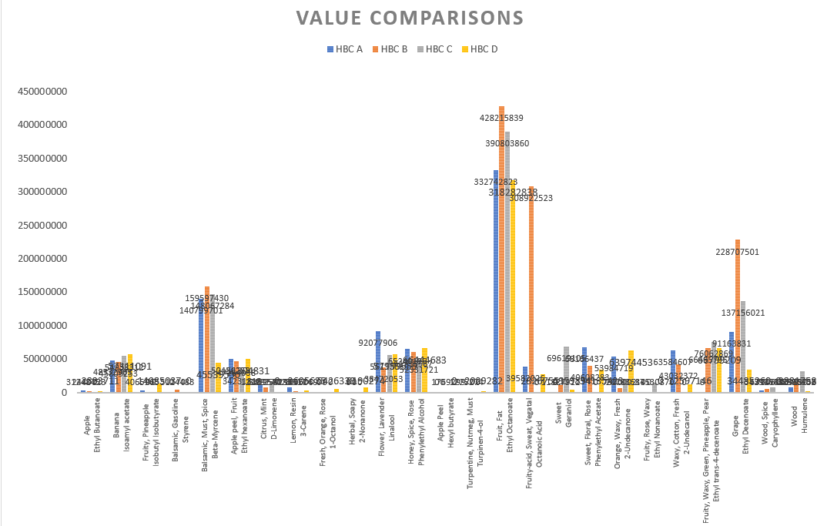
Comparative GC-MS Data for HBC Hops

Slide 44
HBC Hop Comparison Conclusions
Least preferred HBC D had lowest overall peak intensity.
Most preferred HBC A & HBC C did not have highest overall peak intensity for positive fruity & floral hop compounds, but were lower than HBC B.
  HBC A was much lower in peak area for Octanoic Acid, than HBC B, and Octanoic Acid was not detected at all in HBC C.
  Octanoic Acid is a vegetal compound, it’s absence in HBC C may account for our preference for that variety.
Overall the process was exhaustive, once we determined which hops were our favorites and brewed, there seemed to be a correlation with balanced intensity of peak areas for preference.
There seems to be an inverse correlation between peak intensity for Octanoic Acid & preference.

Slide 45
Overall Conclusions
GC-MS and GC-MS-O in tandem with traditional sensory can be a powerful predictive tool.
We are still figuring out how to use this tool!
If we can determine what our reaction criteria are utilizing GC-MS and GC-MS-O using key analytical markers, we could possible innovate more rapidly.
Botanical analysis analyzed by GC-MS-O and sensory analysis shows these as innovative ingredients that create distinctly different beers.

Slide 46
Acknowledgements
Dr. Jing Zhao & Dr. Ali Amari of SDSU
Dr. Wayne Green & Dr. Amanda Green of Trinity Terpenes
Jos Ruffel of Phantasm
Jason Perrault and the entire Hop Breeding Company Team, you guys crush it!
Team Stone, for the support, including my Innovation Team Cecil Menasco, Fritzi Lara Lino, Laura Ulrich, the Escondido Lab Goats & the Richmond Nerd Herd, especially Stephen Moser for the unbiased sensory data, and really everybody in Production

Slide 47
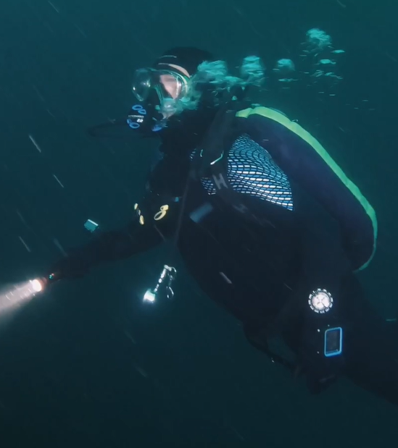
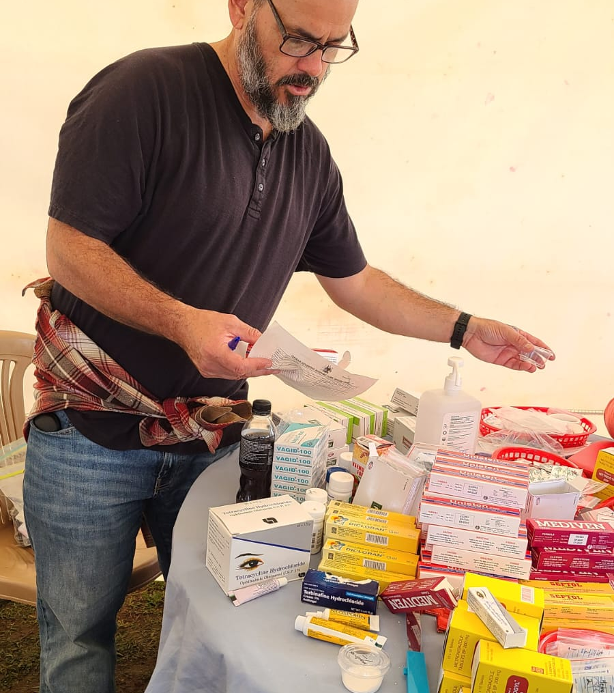
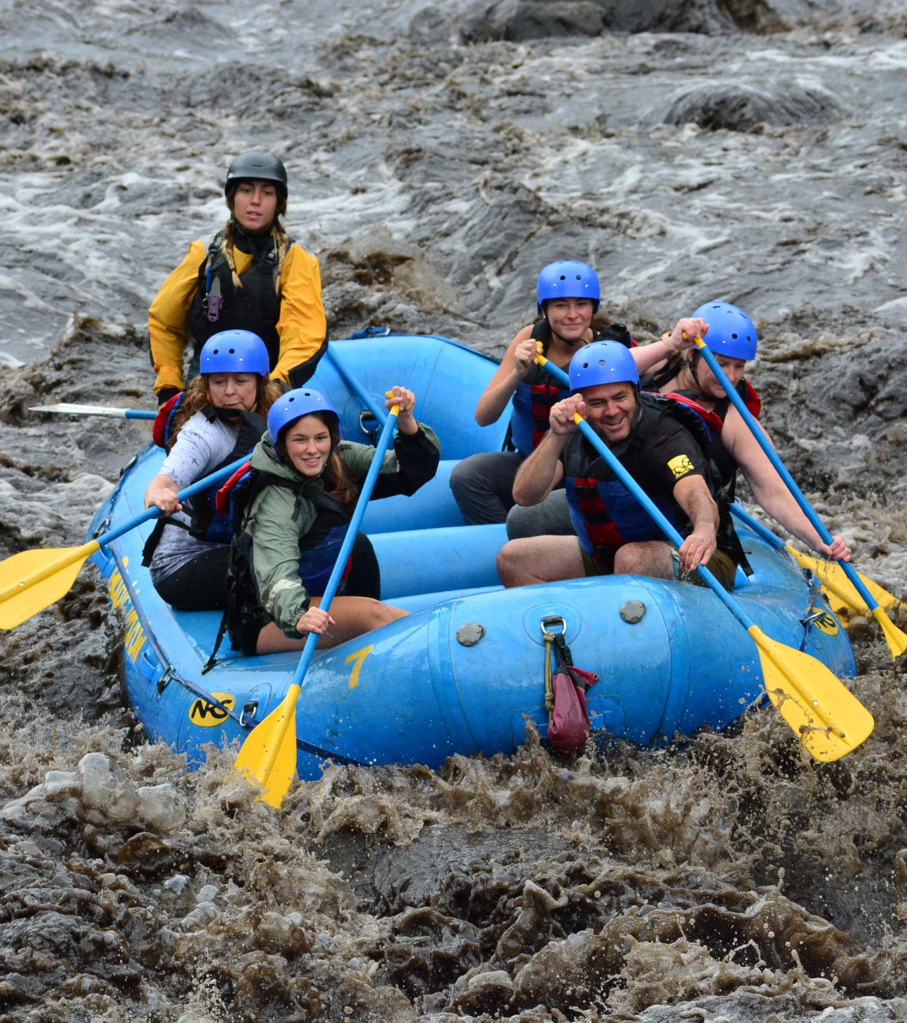

Further Inquiries
Steve.Gonzalez@sapporo-stonebrewing.com
Inspiration can come from so many sources!

Slide 48

REQUIRED
Q
A
Notes:
SAY:
It’s time to answer some of the questions you’ve been asking from the Q&A panel.
DO:
Make sure to use their name and show appreciation for the comment.

