Slide 1

Using this Slide Deck
This slide deck is like a workbook. Add in and take out what’s needed (other than required slides).
REQUIRED slides must remain. Update the slides content for your session and delete the “required” label
  These slides ensure consistent messaging and branding across association events and a foundation for a quality member learning experience.
Other than the required slides, use the template slides that work for your event. Right-click>Duplicate Slide as needed. Delete the others.
Update an image – Right- click > Change Picture.
The notes panel for the required slides contains suggested script. Update this script as needed.
Add your thoughts about the session topic into the Notes Panel. Print notes prior - File>Export>Create Handouts>Notes below slides OR use multiple monitors so the notes panel can be visible.
Contact your SciSoc program manager for support as needed.

Slide 2
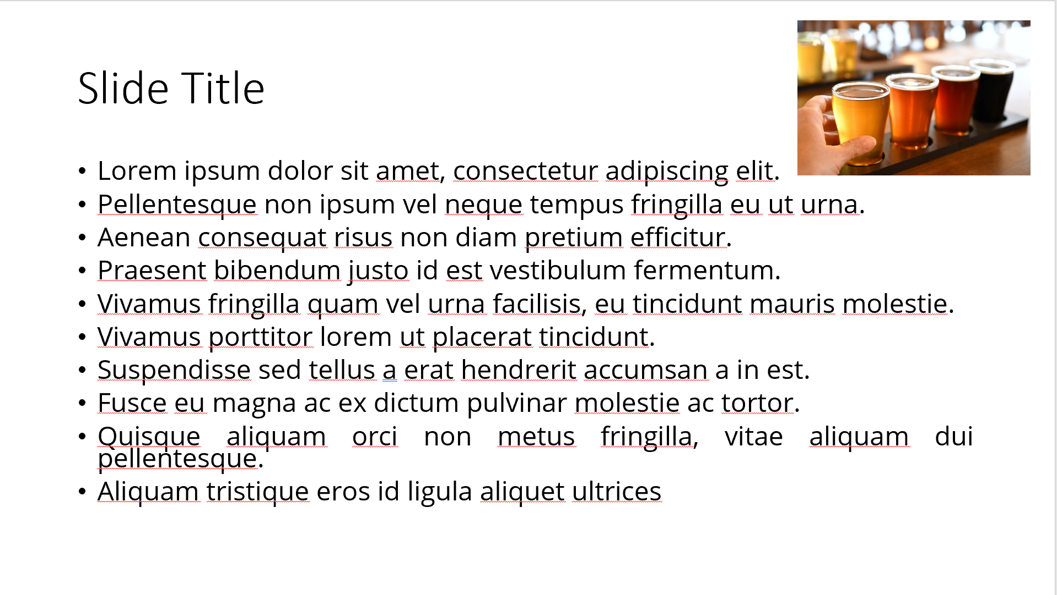
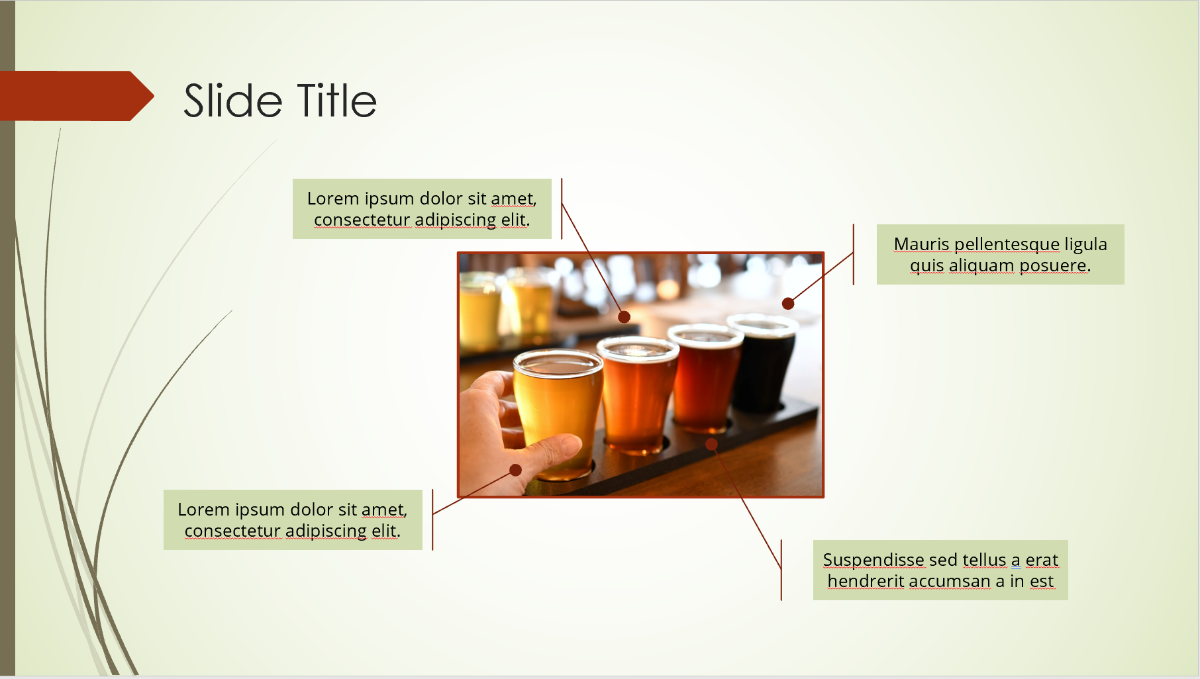
Ensure Slide Clarity
Contact your SciSoc program manager for support as needed.
Notes:
The clarity of your slide and what you put on it should enhance your message.
Ensure the following:
Ample white space. Don’t crowd the slide.
Ideally 1-2 ideas discussed per slide.
Avoid dense bullet point slides and a content dump. Put those details in your notes instead.
Aim for foreground/background color contrast.
Use purposeful images or illustrations that you can talk to from your presenter notes.

Slide 3

Get Copyright Permission
Contact your SciSoc program manager for support as needed.
Notes:
As a reminder, you must own or have permission to use all media (images, illustration, video) or documentation used in this presentation.
This is an issue that can have financial repercussion to your association and one we are careful to adhere to.

Slide 4
Presentation Title Here
Notes:
SAY:
Good morning everyone and welcome to today’s session. The [name association] presents [name of session title].
I would like to introduce myself. I am [insert name], from [company] and I am [position at company, brief relationship to association or topic] and I will be moderating the session.

Slide 5
Title and Content Layout
First level bullet
  increase list level for sub-bullets

Slide 6
Two Content Layout
First level bullet
  second level
    third level
First level bullet
  second level
    third level

Slide 7
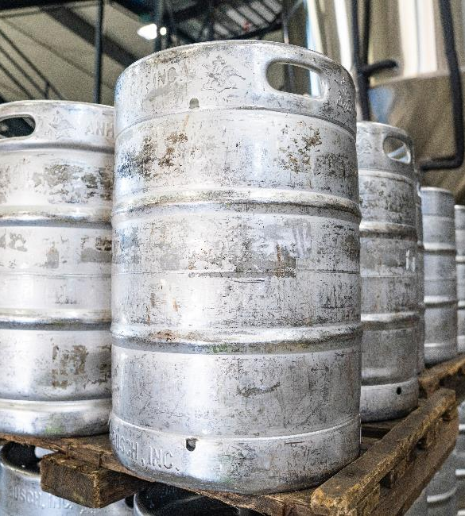
Title, Content & Photo Layout
Click on photo to replace

Slide 8
Chart or Graph
Use simple gray box for callouts

Slide 9
Icons
Icons can be recolored using shape fill. Icons can be used with yellow hex shape (center vertically & horizontally with shape then group). To resize icon and/or shape, use the shift key to keep the original proportions.

Slide 11
Section Header Layout
Subtitle if needed

Slide 12

One Thing
That You’ll Apply
Notes:
SAY:
Alright, so you’ve heard many great ideas, methods, strategies and similar this session, but which ONE thing you heard today stands out?
What will you either apply back at work right away or that you want to look at further when you leave the session?
Take a moment to consider your ideas or look at your notes and etc. then type it into the chat panel. If you see someone’s idea that you find interesting - feel free to comment back to them. To do this typically you put an @ and then their name and type your thoughts.
I’ll be quiet and give you a few moments to share your thoughts NOW in the Chat panel.
DO:
Watch the chat panel and comment on some of the ideas coming in. Use their name and reiterate the point. “Yes, Jim Smith that was a pretty interesting stat [name] shared on the [fact]” and so on. Use this as an opportunity to ask further questions directly from attendees.

Slide 13

Resources
REQUIRED
  Add list of events/publications/etc.
Notes:
SAY:
If you found today’s topic particularly interesting, find ways to continue the learning. We’ve provided a few additional resources to extend the topic outside of this session. Write them down. Use your phone to take a picture of this screen. Review the slide deck that came in your session email today. Our association is here to support your goals.
DO:
Locate and additional resources to share with members that extend beyond this session – pubs, websites, name people and share email address or other.

Slide 14

REQUIRED
Q
A
Notes:
SAY:
It’s time to answer some of the questions you’ve been asking from the Q&A panel.
DO:
Make sure to use their name and show appreciation for the comment.

