Slide 1
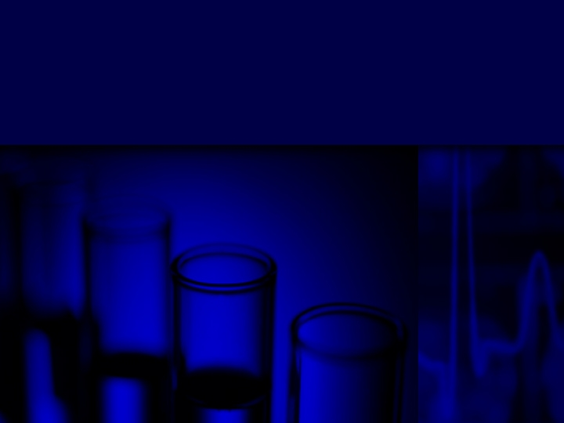

Yeast Settling:
Shutting down the party
Professor Alex Speers, F.I.B.D., C.Sci.
Heriot-Watt University, Edinburgh
Oct 2015
MBAA Conference
Jacksonville, FL
Notes:
Malt fermentability and premature yeast flocculation: Pros and Cons.
Our current knowledge of the malt fermentability and premature yeast flocculation will be discussed from a brewing science perspective. New findings regarding the interactions of malt/wort substances and yeast during the fermentation process and it’s effect on premature yeast flocculation will be introduced. Existing methods of fermentability measurement and the limitations of these methods will also be discussed. The effect of fermenter shear on yeast flocculation and yeast in suspension at the plant and lab-scale will be highlighted. The appropriateness of a use of a new downsized (15 mL) fermentation assay for malt screening will be reviewed.
R. Alex Speers,
Food Science and Technology, Dalhousie University,
P.O. Box 1000
Halifax, CAN
B3J 2X4
<Alex.Speers@Dal.CA>
Dr. Alex Speers is a Professor in the Food Science and Technology program at Dalhousie University, Halifax. He began his career by working for five summers at Columbia Breweries in Creston, BC while gaining his B.Sc. (Agr.). After employment in the Quality Assurance department of Molson Brewery in Vancouver he gained a Ph.D. while examining of the intriguing phenomenon of brewing yeast flocculation. Dr. Speers’ current research encompasses various aspects of the brewing process including yeast flocculation, premature yeast flocculation, fermentability and the properties/problems of malt beta-glucans and arabinoxylans. He has participated in brewing workshops in Changzhou, Qingdao and Yangzhou China (1997, 2004, 2005) and Toronto (2002). Alex is a member of the editorial boards of Food Res. Int., J. Am. Soc. Brew. Chem, J. Inst. Brew. and was recently appointed chair of the MBAA TQ Editorial Board. He has published and presented over 100 papers.

Slide 2
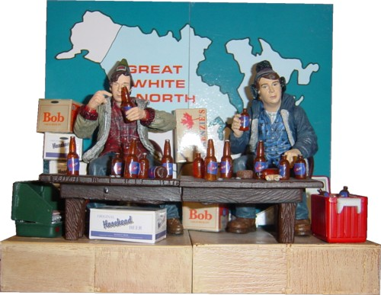
Notes:
Now … you may ask … Was it not something about beer that we were going to talk about here in the Great White North ?

Slide 3
Outline
Introduction
  Fermentation Overview
Flocculation
    Why? ….Too much/Too little
  Theories
  PYF
  Measurement
Other notes
Summary

Slide 4
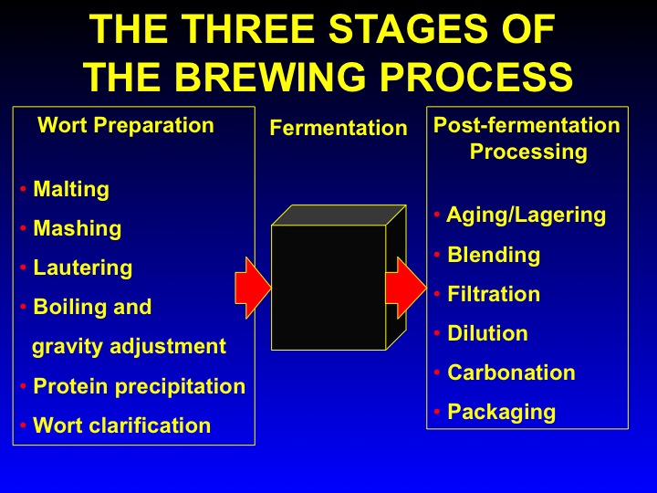
Stewart, G.G. and Russell, I. 1993
Fermentation - the "black box" of the brewing process.
MBAA TQ. 30, 159-168.

Slide 5
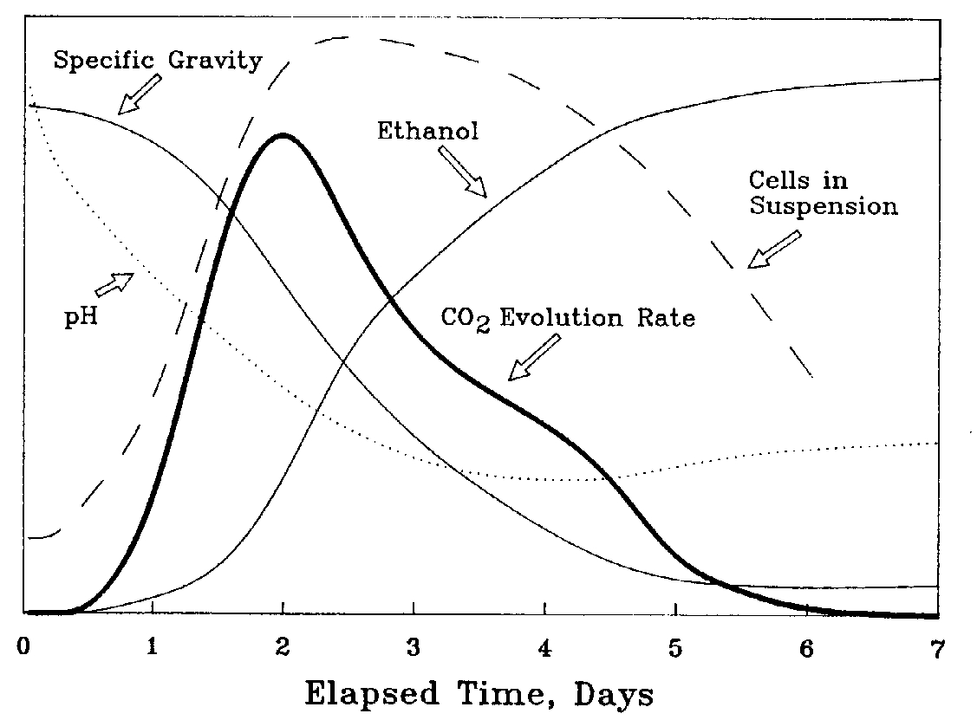
Typical Fermentation
(Munroe, Handbook of Brewing)
Fermentability
Flocculation

Slide 6
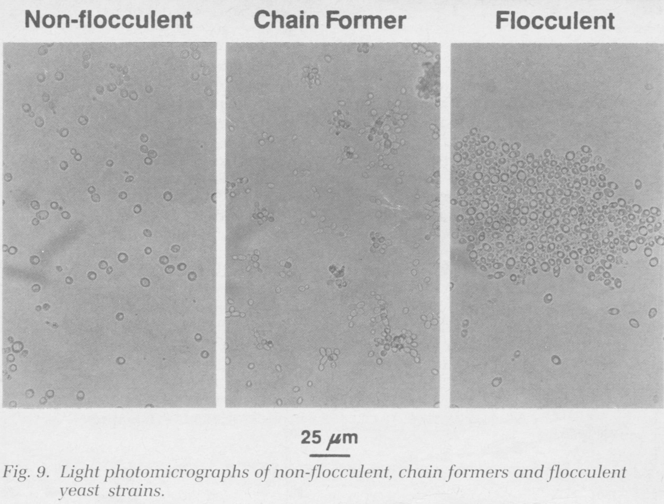
Flocculation
From G.G. Stewart, 1999 Factors influencing yeast performance during beer and industrial ethanol production. Ferment. 2:59-65.

Slide 7
Flocculation Definition
". . . the phenomenon wherein yeast cells adhere in clumps and either sediment rapidly from the medium in which they are suspended or rise to the medium's surface †".
The process needs a micro-amount of Ca and is reversible with addition of sugars or EDTA
†Stewart, G. G. & Russell, 1981. Chap. 2. Brewing Science. Academic Press.
Notes:
http://www.alfalaval.com/thermal/customers/thbca1r.htm

Slide 8

Flocculation Literature

Slide 9
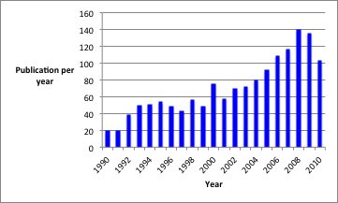
Flocculation Publication rates
1970-1990 ~5/y
Google Scholar search for ‘brewing yeast flocculation’

Slide 10
Flocculation Factors
Sugars,
CO₂/Turbulence,
cell size,
Cell age??
Fimbriae
Temperature
CSH,
pH,
Ethanol,
Ca²⁺
Oxygen,
Carbon,
Nitrogen
sources,
Temperature,
Ethanol &
other
end products.
FLO & other Cell Surface Genes
Zymolectins
Mannan
Oxylipins
Factors affecting
FLO/other gene activity
Factors affecting
cell to cell
interaction

Slide 11
Theories Explaining Flocculation
Biochemical
  Zymolectin binding
  Hydrophobic interactions
  CO₂ Shearing flow
  Surface charge
  Bridging factors PYF

Slide 12
Zymolectin Flocculation
S-S
Zymolectin receptor
(glucose-manose specific)
Glucose-mannose type
ligand
S-S
S-S
Mannose type ligand
S-S
Zymoectin receptor
(mannose specific)
S-S
Ca²⁺
S-S
S-S
S-S
Ca²⁺
S-S
S-S
S-S
Note: Complex e.g., FLO 11 hydrophobic & self-binding

Slide 13
Fermenter Flocculence

Slide 14
Cell Flocculence

Slide 15
Change of Cell Surface Hydrophobicity during Fermentation

Slide 16
Variation of Zymolectin Density during Fermentation

Slide 17
CO₂ Shearing/turbulence
  The majority of work has focused on the biochemistry and genetics of cell binding.
  However, for cells to floc, cells must first collide and then bind.
  Brownian motion is not important in flocculation - cells must collide in CO₂ driven shearing flow drives collisions and suspends flocs.
  - CO₂ is also important is suspending cells & flocs

Slide 18
Surface Charge During Fermentation
Just not that important!
Small decline related to pH
Might? be important in PYF

Slide 19
Normal Flocculation
Summary
Cells ready to floc in 24h (once hydrophobicity up ? Oxylipins?) as zymolectins always present.
Prevented from doing so from
  suspending shear (CO₂)
  sugar

Slide 20
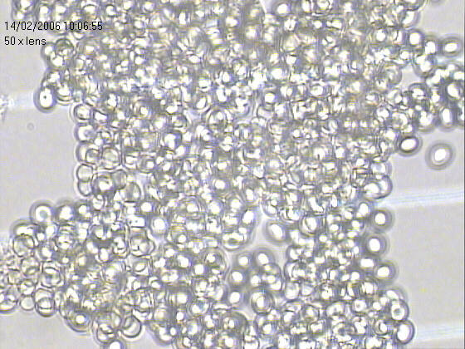
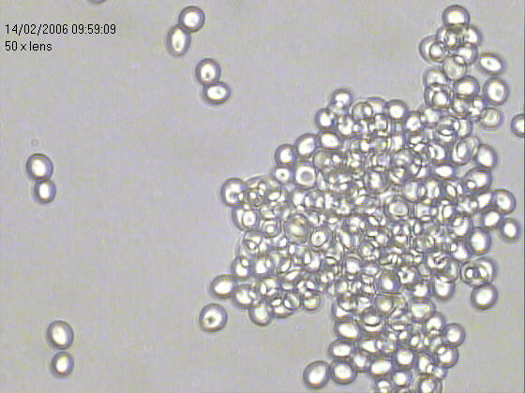
PYF Definition
Premature Yeast Flocculation (PYF)
  The early flocculation of fermenting yeast from the fermenting medium before all available fermentable sugars are consumed.
144 hr.
PYF
Control

Slide 21
PYF Fermentation
Cells in Suspension ⬇
CO₂⬇
Specific Gravity ⬆
Ethanol ⬇
From : J. Munroe, The Practical Brewer

Slide 22
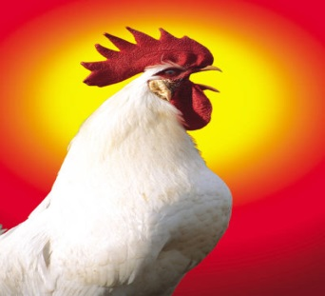
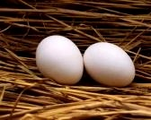
PYF or Attenuation?
PYF early flocculation of yeast preventing complete attenuation
NOT poor attenuation causing early flocculation
Define your terms and there will be no argument!
(some Greek?)
Define your assay and there will be no argument?
Defined as a chicken!

Slide 23
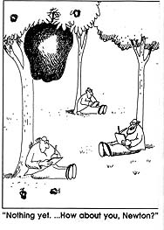

Notes:
At the same time that this is a tale heavily weighted in empirical observations and tenuous relationships – this was definitely not a version of the apple falling onto Sir Isaac Newton’s head while sitting under a tree.
There was no sudden epiphany around PYF malt – this is more a long slow tale of torture – of questioning everything you are doing – double check, triple check – track and compare – try to find relationships.

Slide 24
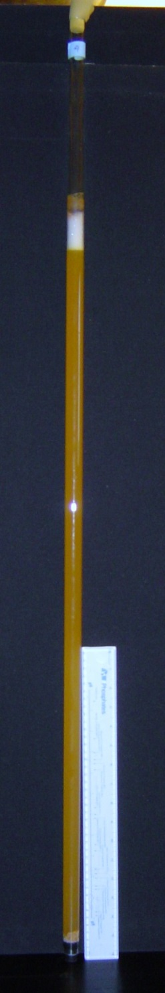
PYF Assay
Currently Formerly there was no way to determine PYF malt by physical or chemical means.
Industry ‘standard’ is was to conduct ~ seven day small scale fermentation.
  1-2 liter cylindrical glass tube fermentors down to test tube sized fermentors.
    Fermenting volumes ranging from 200mL-2L

Slide 25
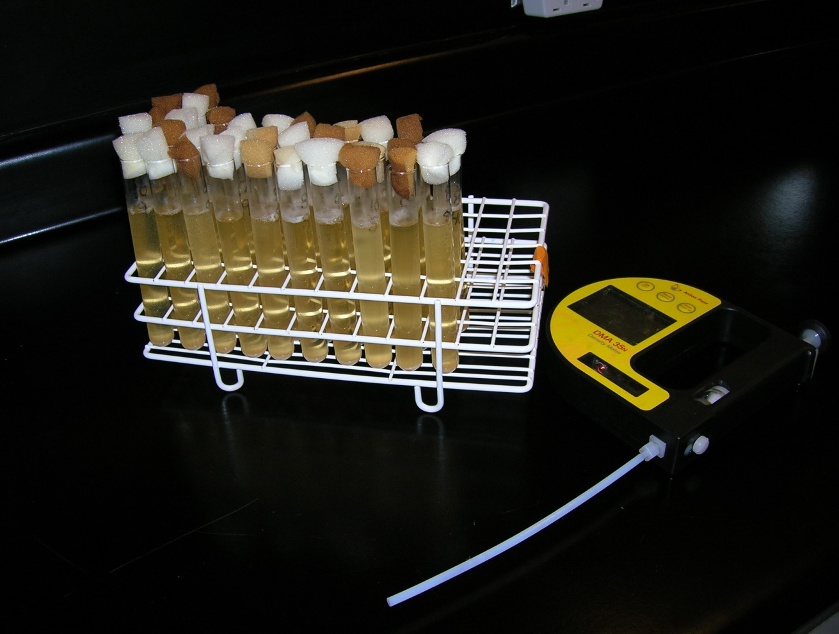
Mini-fermentation Method
Use 15 mL of wort
& 3 reps,
Turbidity/density measurements taken 10 x’s @ 21ºC over 75 h,
Subject of ASBC collaborative. First year sucessful.
Use entire dataset to get OE and AE->ADF

Slide 26
Modelling Fermentation
P_{t}= {(P_{i}-P_{e})/(1+e^{(-B*(t-M))})} + P_{e}
P_{i} – the initial asymptotic Plato value,
B – f (slope) at the inflection point,
M – the time at point B,
P_{e} – the equilibrium asymptotic Plato value.
⬇
OE – the Plato value at time t = 0,
AE - Apparent Extract-Plato value at time t = 75.
OE
P_{i}
15
12
9
6
3
B
ºP
AE’
AE
M
P_{e}
0 15 30 45 60 75
Time
26

Slide 27
Effect of Fungus on Barley -> Fermentation

Slide 28
Effect of Fungi on Barley ⁻> Fermentation
  Used two varieties – CDC Bold and AC Metcalf
  Treated with Net Bloch, Spot Bloch and F. graminearum in nurseries (CDC & AC)
  Malted @ CGC/Mashed Fermented @ Dalhousie

Slide 29
Summary:
PYF caused by compound 100 kDa or greater isolated through filtration,
Not associated with peptide,
Some surface charge and binding strength differences (other work)
Pure standards or arabinoxylan and beta-glucan did not produce PYF,
Arabinoxylan-peptide moiety?
ASBC Std. Assay exists.

Slide 30
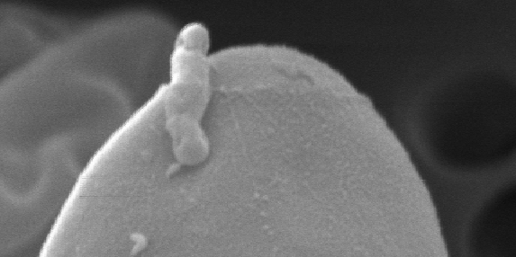
Other notes!
Notes:
http://www.alfalaval.com/thermal/customers/thbca1r.htm

Slide 31
Yeast Cell Fimbriae
Notes:
http://www.alfalaval.com/thermal/customers/thbca1r.htm

Slide 32
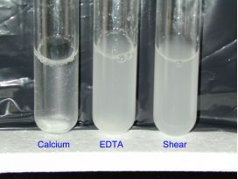
High shear effects
  http://www.alumni.ca/~bebbinm/
Notes:
http://www.alfalaval.com/thermal/customers/thbca1r.htm

Slide 33
Acknowledgements
NSERC, Scottish Enterprise
MBAA, IBD, ICBD
Canadian malting companies
Australian, Canadian and Scottish brewing companies
A. Macintosh and S. Murray

Slide 34
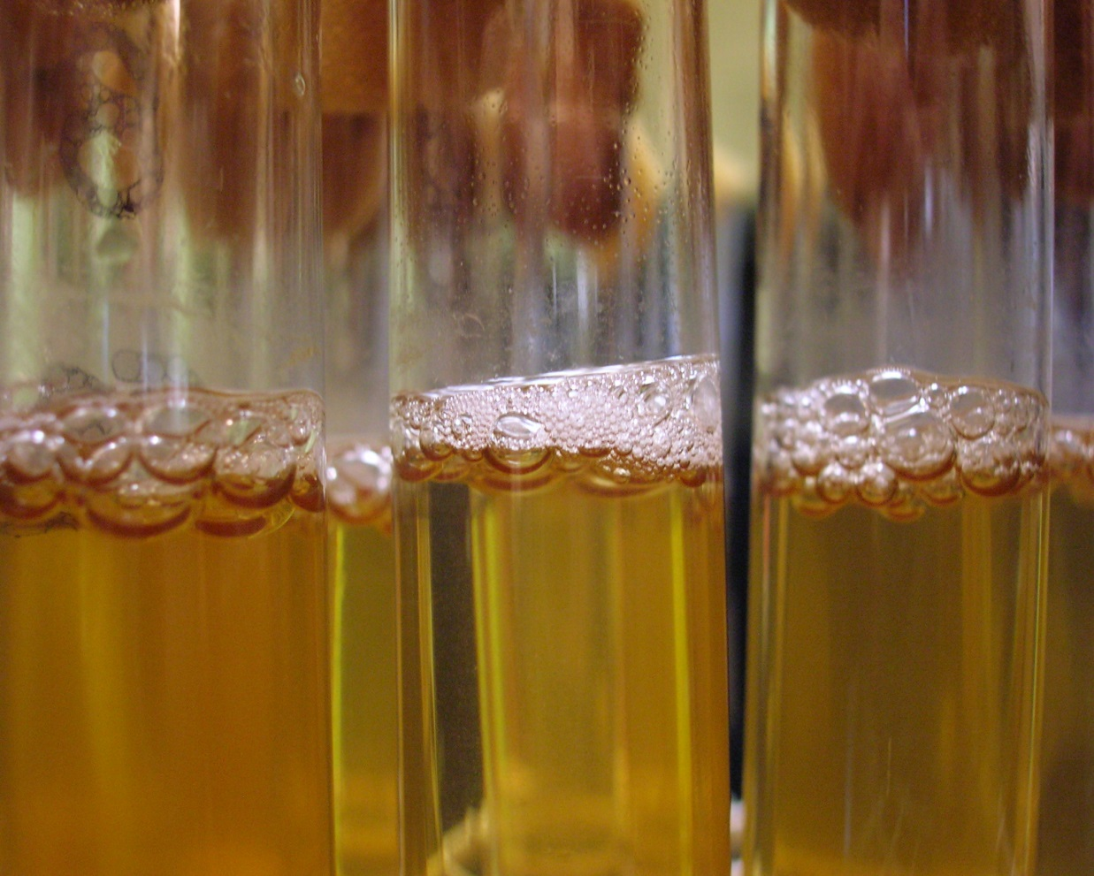
Questions?

Slide 35

And the Canadian and Scottish Taxpayers!
Notes:
http://www.alfalaval.com/thermal/customers/thbca1r.htm

Slide 36

Don’t worry it is all written down!
  A.Speers@HW.AC.UK>
Notes:
http://www.alfalaval.com/thermal/customers/thbca1r.htm

