Slide 1
What’s on the menu? Fundamentals of yeast nutrition
Dawn Maskell
International Centre for Brewing & Distilling
Heriot-Watt University
Edinburgh, UK

Slide 2
Yeast nutrition
What is it and why do we care?
Notes:
Without all the sources of nutrients yeast need the outcome will be a slow, sluggish fermentation. In an all malt wort, with appropriate levels of aeration, the nutrients naturally present should provide sufficient nutrition for healthy yeast.

Slide 3
Food, glorious food!
wort
yeast
beer
Notes:
Endogenous nutrients consumed while yeast adapts to new surroundings and nutrients
Oxygen present in wort used for membrane components
Cell growth and division restricted by oxygen depletion – cells become wholly fermentative, SG declines quickly
Small amount of cell growth continues during fermentation to maintain a healthy population – getting nutrients from the wort
Requirements are carbon, nitrogen, trace elements and vitamins

Slide 4
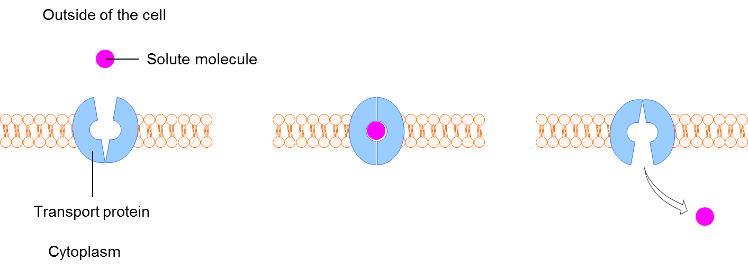
How do yeast eat?
Notes:
Have seen a detailed figure showing MT and MT3 uptake from GGS, so I wanted to show you how that transport might be occurring.
Membrane transport
Passive GLU/FRU
Active MT/MT3
Assimilation of C’hydes, N-compounds = highly regulated process
Are hydrophobic and therefore cannot pass through as hydrophilic compounds are able to. They require systems which will facilitate their transfer such as proteins and expression of enzymes. GLU and FRU transported by facilitated diffusion using common membrane carriers.
Active transport uses energy
Rates of uptake and influence of the environment (wort) on the expression of genes by the yeast

Slide 5
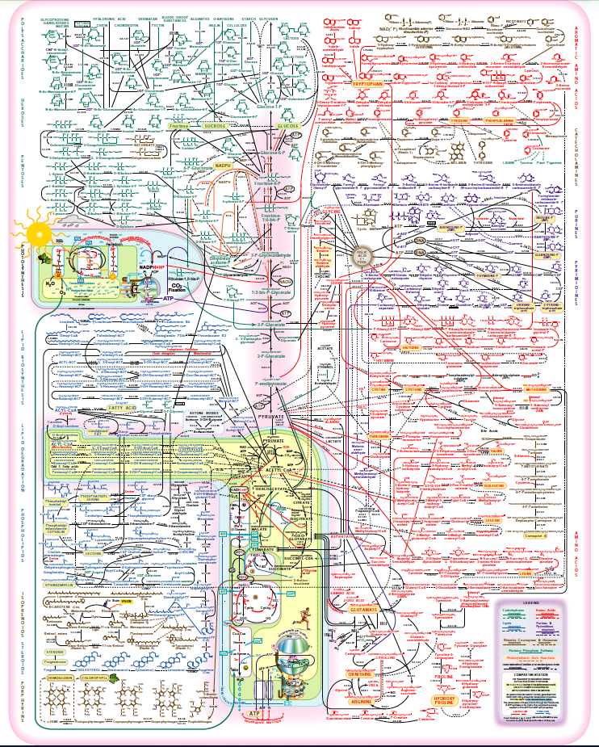
How does yeast
make alcohol?
Notes:
Metabolism happening within the cell, fuelled by the nutrients present in the wort

Slide 6
Yeast diet: the essentials

Slide 7
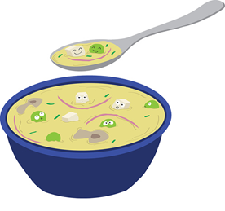
Brewers’ wort
Carbohydrates
Glucose
Fructose
Sucrose
Maltose
Maltotriose
Maltotetraose and larger dextrins
Vitamins
Nucleic acids
Hop components
Free Amino Nitrogen (FAN)
Amino acids
Ammonia
Small peptides
Glycopeptides and proteins
Water
Ions
Melanoidins
Notes:
Repeating the information you had from Graham Stewart already – but what are the essentials for yeast?

Slide 8
Carbohydrates
Uptake Of Wort Sugars
Wort Fermentable Sugars
Fructose ~ 2 %
Glucose ~ 8 %
Sucrose ~ 6 %
Maltose ~ 45 %
Maltotriose ~ 10 %
Notes:
Structural element of yeast
1 molecule of GLU to 2 PYRUVATE, to 2 ACETALDEHYDE to 2 ETHANOL plus ATP (energy)
Also source of hydrogen
GLU repress uptake of other CHO
FRU slower than GLU, FRU may remain = sweetness to beer
The remaining 29 percent of carbohydrate in wort comprises dextrins which are unfermentable by brewers yeast.
Dextrins contribute to beer flavour by imparting to the fullness.
Can add enzymes to break down dextrins so they can be fermented, but this will have implications for the final flavour of the beer.
Some variability between strains

Slide 9
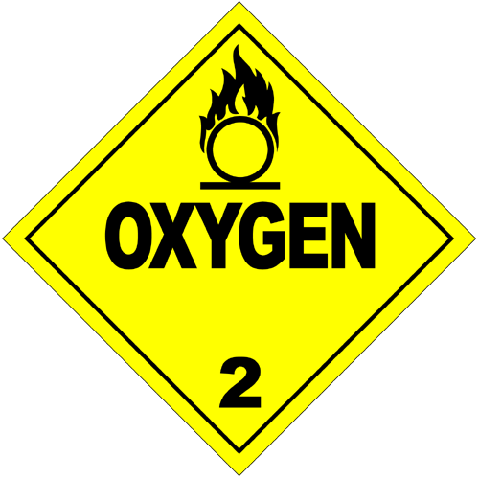
Oxygen: opportunity and threat
Absence of oxygen – only fermentative growth
Synthesis of sterols and UFA’s (biomass – membrane components essential for growth)
Oxygen depleted – division and growth restricted – become fully fermentative
Notes:
Requirement is strain dependent
Proportion used for lipid biosynthesis small (about 30%)
Rest must be consumed by other pathways
Sterols and UFA’s vital to structure and function of yeast plasma membrane
Amount of O₂ required for sterol synthesis is strain dependent
Amount of O₂ required can be reduced if supplied in increments.
About 30% of available O2 used for lipid synthesis

Slide 10
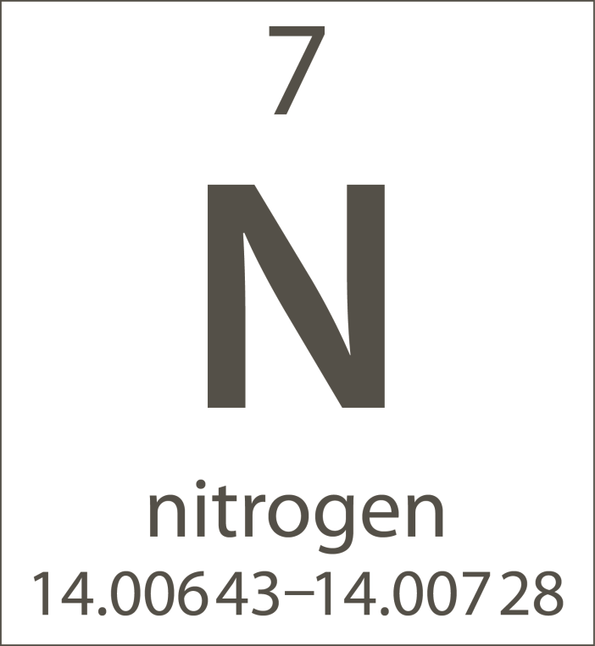
Free Amino Nitrogen
Source of nitrogen
Levels?
Ale yeast higher FAN needs than lager
Protein stand/rest
Notes:
In wort N comes from amino acids and low mw peptides
Below 100 mg/l of FAN – growth is N dependent
>100 mg/l FAN - less dependent
>220 mg/l FAN – growth not dependent on N levels
AA’s taken up in specific order – involved in production of higher alcohols and esters
Get little ester production in cells starved of FAN or O₂.
Protein stand – stage temp. prog. Mashing, conditions controlled to favour activity of proteases (heat labile ezy that break down larger proteins into accessible smaller peptides and amino acids for the yeast) – especially with under modified malt

Slide 11
Valine: the villain of the piece?
Vicinal diketones – by-products of valine and isoleucine
Supplementation reduces diacetyl formation!
Notes:
Valine and isoleucine metabolised to by-products which can then form diacetyl
Valine – reduces diacetyl formation and levels at end of fermentation
Valine involved in feedback inhibition of enzymes controlling formation of these diacetyl pre-cursors.

Slide 12
Proteins: friend or foe?
Nutrition
But only as amino acids or small peptides
Cell structures
Higher alcohols
Haze
Protein-polyphenol complexes forming permanent or non-permanent hazes
Foam
Foam positive proteins contribute to head formation
Notes:
Depends on the size and function!

Slide 13
something in the water?
The role of micronutrients

Slide 14
The need for ions
Ion | Function
Zinc | Essential for growth, enzyme co-factor, stress protectant against ethanol toxicity
Manganese | Enzyme co-factor, cell and organelle structure
Magnesium | Essential in many enzymes involving ATP, cell and organelle structure
Calcium | Stimulates growth, depresses wort pH, and has a role in flocculation
Copper | Enzyme co-factor, binds to some proteins
Potassium | Component of transport system for nutrient uptake
Phosphate | Synthesis of organic phosphorus containing compounds
Sulphate | Synthesis of S – containing compounds
Notes:
Required for optimum growth and fermentation
Mainly derived from the brewing water, also from some raw materials
Exact requirements of yeast will be strain specific, dependent on ionic interactions and the wort itself, and the influence this itself has on the yeast.
Selected highlights – covered in great depth in many of the common brewing text books

Slide 15
Other roles of ions
Zinc | Protect against ethanol stress
Magnesium | Stabilising membrane, inhibit stress induced proteins
Calcium | Flocculation at end of fermentation, protect against ethanol stress
Copper | Eliminate H₂S from beer as insoluble hydrogen sulfide
Chloride | Inhibitory at high concentrations
Iron | Toxic to yeast
Notes:
Calcium Inhibits extraction of hop resins at high concentration (therefore need to be careful when using as a supplement).
Zinc (protectant against ethanol stress)
Magnesium (leaks under temperature or ethanol stress)

Slide 16
vitamins
Notes:
Requirements are very strain specific

Slide 17
Vitamins
Many essential vitamins cannot be synthesised by yeast
Biotin
Pantothenic acid
Nicotinic acid
Thiamine (Vitamin B)
Notes:
Required at µM concentrations by yeast
Biotin and pantothenate required by virtually all strains of S. cerevisiae
Biotin – used by carboxylase enzymes, essential for lipid synthesis, possibly most important due to function in ezys responsible for producing yeast structural components
Pantothenate – component in coenzyme A, carbohydrate and lipid metabolism as well as synthesis of S containing AA’s
Nicotinic acid – as nicotinamide which is involved in redox reactions
Pyridoxine – top fermenting yeast only – carbohydrate fermentation
Inositol – component of phospholipids sometimes required
Thiamine – top fermenting yeast only – AA metabolism
Vitamin C – additive to eliminate O2 introduced during packaging

Slide 18
Not all nutrition is equal

Slide 19
Wort Soup
Nutritional variation
Strain specific
Between breweries (same strain)
Water supply
Grist composition and adjunct use
Brewhouse design
Environmental conditions
Brew length and type of beer produced
Yeast ignores
Dextrins
β-glucans
Pentosans
Large proteins
Phenolics
Notes:
Environmental – temperature and humidity
Well oxygenated all malt wort provides all the requirements for yeast growth
Problems usually only when high levels of adjuncts are used – due to dilution of N, vitamins and ions (HGB – also additional stresses, [O2], high C:N ratio, growth factors, ions limited – EtOH stress @ EoF)
May be necessary to supplement with yeast foods
Propagation
Can propagate at laboratory scale using simple media
More complex media are available
Higher oxygen requirement
Storage
Opportunity to supplement with micronutrients to maintain yeast health and viability
Fermentation
Low O₂ – EtOH (not biomass), enough FAN that not limiting, micronutrients,

Slide 20
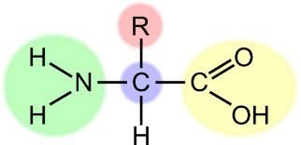
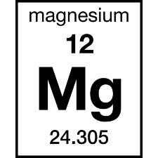
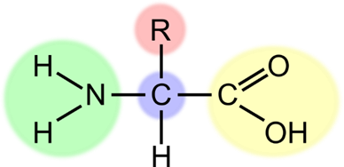
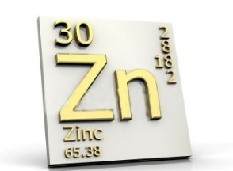
Yeast Food
Prevent slow fermentations
Useful for high adjuncts/low nitrogen worts
Consistent fermentations
Notes:
Advertised as ‘formulated to correct nutrient deficiencies in wort
Speed up fermentation
Stimulation of yeast
Decrease fermentation time
Consistent flavour profile
Yeast extract contains inorganic salts, vitamins, amino acids and trace elements
Extract products – improve fermentation rate, improve viability and oxidative stress protection
Mix of non-peptide and peptide N better as yeast food than simple sources, organic or inorganic N
Ethyl carbamate – don’t supplement with urea!
Amino acids
Adding aspartate speed up fermentation (organic/inorganic no effect)
L-methionine – inhibits yeast (96 – 103 hours), prevents uptake of group C AA’s, less VDK, less total growth
Lysine – stimulates yeast, decrease fermentation time (96 – 48 h), more VDK, higher cell growth
Lys and His supplementations improved yeast growth, wort fermentability, ethanol yield and the formation of flavor volatiles
YPC – stimulate fermentation rate, improve attenuation of wort, influence persists during successive fermentations of HG wort
Protects against ethanol stress
Might act like insulin in mammalian cells

Slide 21
Practical considerations

Slide 22
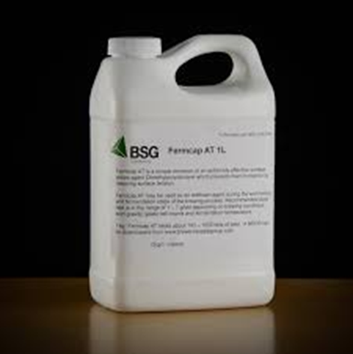
Practical considerations
Ethanol stress
Using antifoams
Use of stabilisation products
Notes:
EtOH stress
EtOH inhibits growth and fermentation in a non-competitive fashion, inhibits transport of some nutrients (GLU, MT, NH₃ and some AA’s)
Ale yeasts less tolerant than lager
Yeasts with membranes enriched in UFA’s are more able to withstand EtOH stress
HGB
poor viability/stuck fermentations overcome by supplying extra N compounds, sterols and UFA’s – enable >16% abv beers to be produced – at the expense of additional yeast growth.
Extra Mg and Ca ions increase EtOH yield in high gravity fermentation
Antifoam prevents foam being a problem – defoamer reduces foam which has already been formed
Air and agitation
If coat cells will prevent metabolism (CHO uptake)
Fermentation – keeps hydrophobic proteins in the fermenting wort, rather than moving up into foam/headspace – esp. if using top fermenting yeast
Canola oil antifoam – increase cell count – UFA’s from oil – metabolised into cell wall components
Fermcap AT?
Yeast/fermentation supplements marketed as ‘stabilisation products’ as produce more consistent fermentations
Colloidal stabilisation – removal of large proteins – but happens post fermentation, not a consideration for yeast nutrition
Foam stabilisers – post fermentation – can be made from yeast extract material – would supply nutrients – not consideration

Slide 23
The Yeast menu
The fundamental takeaway messages

Slide 24
Takeaway menu
The diversity of yeast nutritional needs
What can be essential can also be toxic in excess
Supplementation can make up for deficiencies

Slide 25
Thank you
Any questions?

