Slide 1
Traditional and Alternative Fermentation Techniques
Travis Audet
Anheuser-Busch
October 8, 2015

Slide 2
The Absolutes of Fermentation
1)

Slide 3
The Absolutes of Fermentation
1) There are no absolutes in fermentation

Slide 4
The Absolutes of Fermentation
1) There are no absolutes in fermentation
2) See rule number #1

Slide 5
The Non-Absolutes of Fermentation
Why no absolutes?
Difference between ale, lager and other yeasts
Differences between yeasts in in the same family
Not all lager behave the same and not all ales etc.
Absolutes don’t indicate degree of impact
Other variables are not the same as the one reference
Estery yeast or low ester yeast?
Fermenting standard gravity or ferment high gravity?
Low attenuation or highly attenuated beer?
Standard fermentation rate or rapid?
Yeast flocculation characteristics of particular yeast?
The inherent genetic stability of a strain?
Fermentation more complex than one parameter causing one result

Slide 6
Fermentation Good Practices - Temperature
fermentor full temperature should be a degree below fermentation temperature
This prevents cooling coming on before fermentation is vigorous
Early cooling creates localized temperature gradients before fermentation is robust
Early cooling can shock yeast
Early cooling can prolong fermentation

Slide 7
Fermentation Good Practices – Fill Time
Long fermentor fill times should be avoided
Track and control hours from yeast/oxygen addition to fermentor fill as a critical control parameter
Depending on aeration/oxygenation rates and fill frequencies yeast can move in and out of anaerobic condition
Yeast growth can be excessive
Stratification of tank can become an issue
If long fill times cannot be avoided then:
Aerate instead of oxygenation to aid in mixing
Don’t add yeast on early brews
Always aerate the final brew

Slide 8
fermentor Fills
Fill number maximum typical 4 brews single brew lane or 8 brews for double brew lanes
Single brew lane fills every 2hrs – Total time 4 brews = 8hrs
Double brew lanes fill every 1hrs – Total time 8 brews = 8hrs

Slide 9
Fermentation Good Practices
Avoid growing too much yeast
Typical peak cell count is 80 – 100 million cells/ml depending on original gravity
Greater peak cell counts can lead to loss of beer yield
Greater peak cell counts can lead to autolysing yeast if not removed mechanically
Greater peak cell counts can lead to greater peak diacetyl
Use of FAN beyond valine produces more diacetyl
Greater peak cell counts can lead to poor yeast health in beers brewed with higher proportions of adjuncts

Slide 10
Fermentation Good Practices
Avoid high hydrostatic pressures
Some yeast sensitive to CO₂ in solution
Large tank ratios 2:1 Height to Diameter max
Greater the pressure then lower the ester formation
Avoid temperature shocking yeast
Gentle cooling preferably with proportional control valves
1 degree per hour cooling programs
Final cooling of fermentor should be based on VDK analysis
Never adjust attenuation level through cooling instead fermentability needs to be controlled through mashing scheme

Slide 11
Yeast Metabolism and Flavor Active Compounds
FEMS Yeast Research Volume 8, Issue 7, pages 1018-1036, 15 SEP 2008 DOI: 10.1111/j.1567-1364.2008.00433.x http://onlinelibrary.wiley.com/doi/10.1111/j.1567-1364.2008.00433.x/full#f3

Slide 12
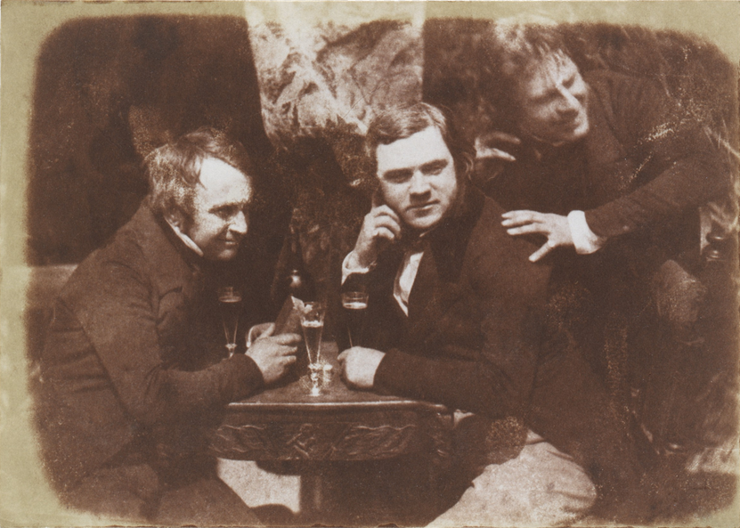
General Fermentation Schemes
Perhaps the first photograph of men drinking beer, circa 1844 in Scotland, by Hill & Adamson

Slide 13
General Fermentation Schemes – 2 Vessel
Traditional approach is 2 vessel fermentation
Ferment 80 – 90% of extract and then transfer to a second vessel
Advantages:
re-suspend yeast for finishing beer more quickly
blending opportunities
greater throughput for initial vessel
Maximize tank capacity of second vessel
Disadvantages:
Additional transfer and losses, additional utilities to support secondary tanks

Slide 14
General Fermentation Schemes – 2 Vessel with Krausening
Similar to the two vessel system but with fresh wort added
What is krausening?
Add fresh wort at a rate of 10-20% and typically fresh yeast and air/oxygen when 80% of fermentation is complete
Fresh wort, yeast and air/oxygen is added at time of transfer of primary fermentor
Why krausen?
Fresh wort and yeast re-invigorates fermentation to help drive completion of the fermentation and VDK reduction in a shorter amount of time
Good for yeasts that tend to settle out

Slide 15
General Fermentation Schemes – 2 Vessel with Krausening
Advantages
Faster fermentation
Disadvantages
Added complexity
The krausen brews need to be planned for addition at the right time
Possibility of a wort holding tank
Added risk of microbiological contamination
Vessel utilization is lower as freeboard is needed in second vessel

Slide 16
General Fermentation Schemes – Conical fermentor Two Vessel System
A conical fermentor is a vertical fermentor with a cone that allows cone collecting yeast (AKA Cylindro Conical Vessel CCV)
It can be used as a two vessel system
Advantages
Same as two vessel system already described
Additionally yeast harvest can be collected from cone avoiding stress of centrifuge collection
Yeast can be collected earlier in process so presumably healthier
If used as only primary fermenting vessel does not need to be pressure rated
Disadvantages
Same as two vessel system already described
Need flocculent yeast

Slide 17
General Fermentation Schemes – Conical fermentor Single Vessel System
More recent approach is to use a single vessel for fermentation and maturation (also known as Uni-Tank )
Ferment all extract, reduce VDK’s, settle/collect yeast and age beer all in one tank
Advantages
Less tank movements and loses
Less CIP’s
Lower contamination risk
Multiple yeast removals lowering downstream loading
Disadvantages
Lower capacity utilization
Limited to flocculent yeast varieties
Vessels are more expensive (need pressure rated vessels)
Lower downstream blending opurtunities

Slide 18
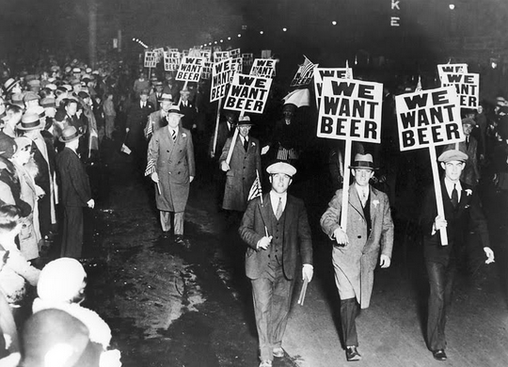
Lager Fermentation

Slide 19
Traditional Lager Fermentation
Cool in at 6-7C (43-45F) and free rise to 9C (48F)
Hold until entire fermentation is complete
Primary 6-8 days but secondary can be an additional 14 days or longer
Advantages
Reduced higher alcohol production
Reduced ester production
Reduced protease activity so better head retention in final beer
Disadvantages
Slow

Slide 20
“Warmer” Lager Fermentations
Cool in at 9C (48F) and free rise to 11C (52F)
Hold until entire fermentation is complete
Primary 6-8 days but secondary can be an additional 10 days or longer
Advantages
Lower higher alcohol production
Lower ester production
Lower protease activity so better head retention in final beer
Slightly faster
Disadvantages

Slide 21
“Warmer” Lager Fermentations
Cool in at 9C (48F) and free rise to 11C (52F)
Hold until entire fermentation is complete
Primary 6-8 days but secondary can be an additional 10 days or longer
Advantages
Lower higher alcohol production
Lower ester production
Lower protease activity so better head retention in final beer
Slightly faster
Disadvantages
Still slow

Slide 22
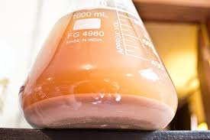
Rapid Lager Fermentation
Push lager fermentation to fastest possible rate while maintaining sensory profile and yeast health
Esters are formed during yeast growth phase and set at peak cell count
Concept is to allow fermentation to warm after peak cell count
Free rise fermentations allow for rapid reduction of diacetyl to acetoin

Slide 23
Rapid Lager Fermentation
J. Inst. Brew., September-October, 1990, Vol. 96, pp. 327-331
ESTER FORMATION IN BREWERY FERMENTATIONS
By Hilary A. B. Peddie

Slide 24
Rapid Lager Fermentation
Starting temperature = ?
Depends of ester profile, yeast and sensory match to be achieved
Free rise initiation = end of cell growth
Free rise temperature = ?
Temperature depends on yeast strain and ability to handle fermentation at higher temperatures
Cooling on at end of fermentation
Typically when VDK is in specification

Slide 25
Rapid Lager Fermentation
Advantages
Faster overall fermentation time
Better vessel utilization
Disadvantages
Greater foaming and need for lower percentage fills of fermentor or anti-foams to maintain fill levels
More stressful on yeast but yeast dependent
Protease enzyme is more active at warmer temperatures and can reduce foam stability in the final beer.

Slide 26
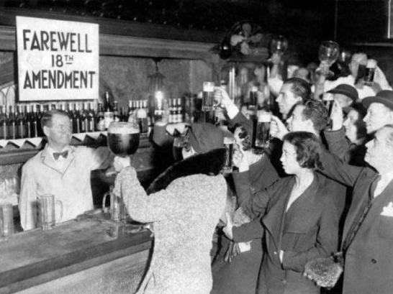
Ale Fermentation

Slide 27
Ale Fermentations
Typical ale fermentations 1million cells/ml per degree plato
Oxygen requirement tends to be lower than lagers
~0.75ppm oxygen per degree plato
i.e standard 12 plato is 9ppm
i.e. high gravity wort at 17.5 plato 13ppm
Typical ale starts warmer than lager and free rises to a warmer temperature
Typical starting is 18 - 19C (64 - 66)
Typical free rise is 20C (68 F)

Slide 28
Ale Fermentations
Ales tend to be flocculent
Keeping yeast in suspension can be a challenge with some yeasts
Lower yeast in suspension at the end of fermentation the slower the diacetyl reduction is
Opportunity for a two vessel system to help rouse the yeast
For open vessel fermentations rousing goosenecks can be used to help re-suspend yeast
Some ales are top cropping others are bottom cropping
Bottom cropping can be collected the same as lager
Top cropping yeasts need to be collected from the top of the vessel either with scoops or funnel device

Slide 29
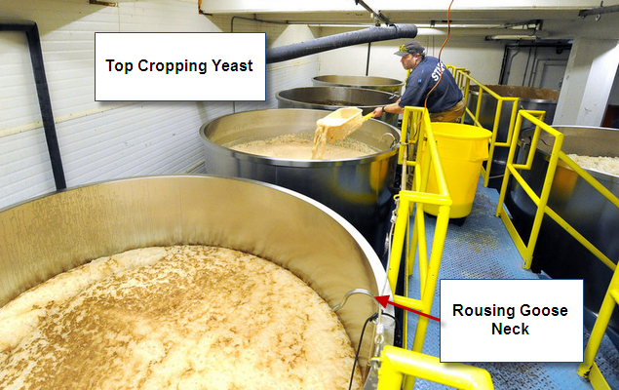
Ale Fermentations

Slide 30
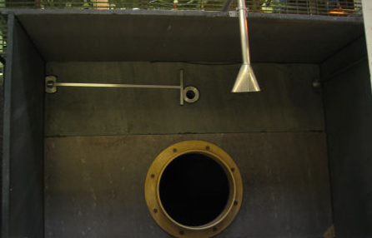
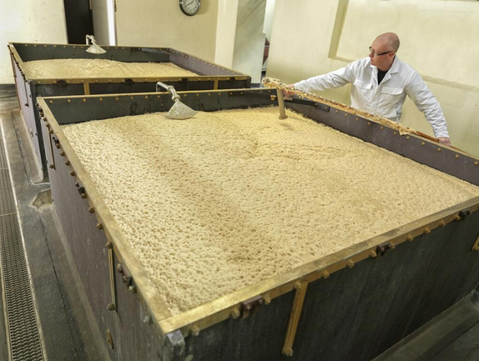
Yorkshire Squares
Two floored vessel to aid in top cropping yeast

Slide 31
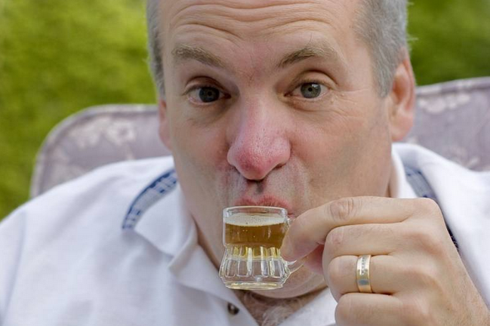
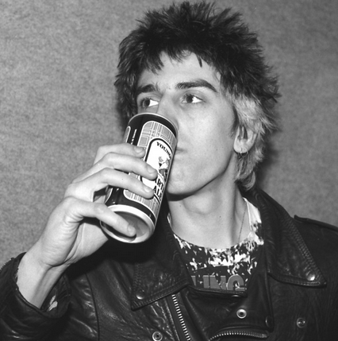
So Bring on the Alternative!

Slide 32
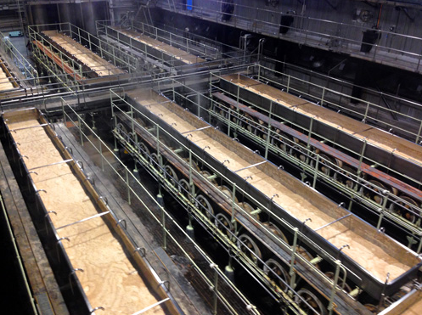
Burton Union System

Slide 33
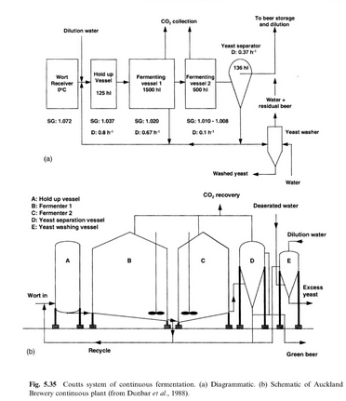
Continuous Fermentation

Slide 34
Alternative Aeration Timing
Testing of VHG 22 Plato worts found it is better to oxygenate 12hrs after pitching wort with yeast rather than at time of filling
33% reduction in fermentation time with good VDK & ester results
Oxygen levels reached = 25ppm through fermentor oxygenation
Inline only capable of 9ppm
J. Inst. Brew. 113(2), 168–184, 2007
The Combined Effects of Oxygen Supply Strategy, Inoculum Size and Temperature Profile on Very-High-Gravity Beer Fermentation by Saccharomyces cerevisiae By Heather Jones

Slide 35
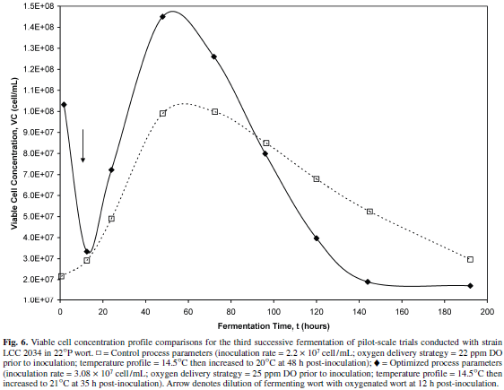
Fermentation Good Practices- Alternative Aeration Timing

Slide 36
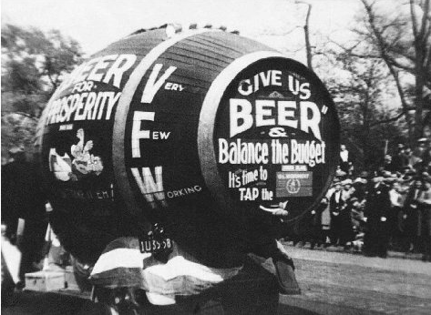
Closing
Thanks to:
All brewers that contribute and share knowledge of the art and science of brewing
MBAA
Anheuser-Busch for their support in presenting today

Slide 37
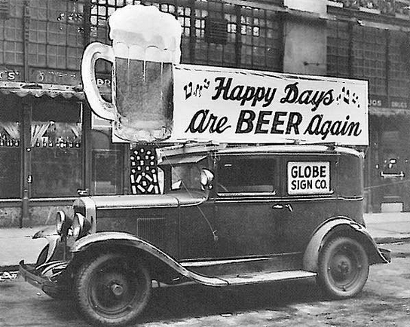
Thank You

