Slide 1
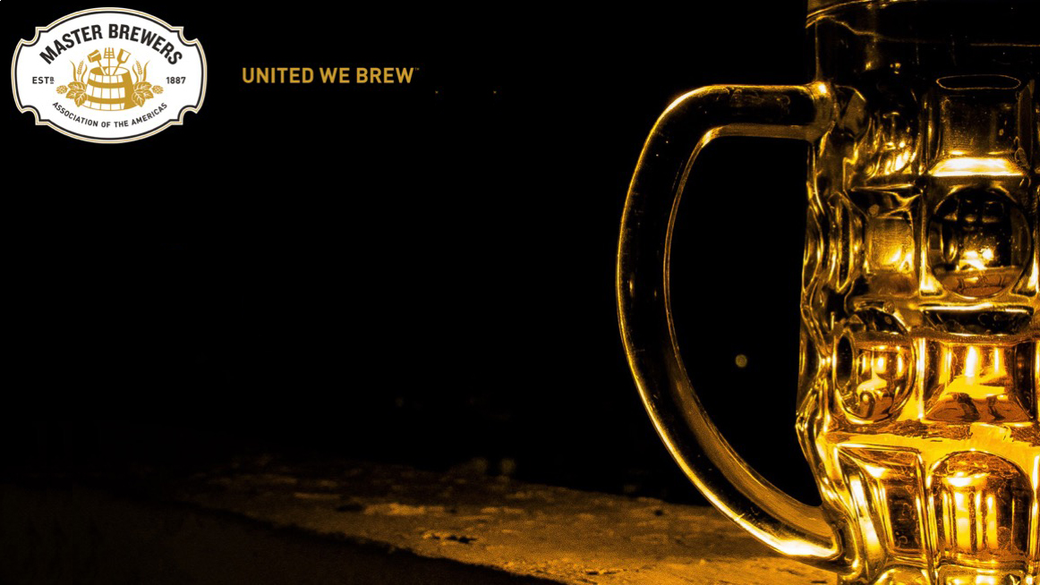


Slide 1:
To Congress,
or not to Congress?
A discussion of the choice of mash
protocol for malt quality testing
Dan Carey
New Glarus Brewing
Wisconsin, USA
Evan Evans
The Tassie Beer Dr
Tasmania, Australia
Barley Malting Quality … from Grass to Glass.
Notes:
This webinar has been designed to compliment and extend Prof Glen Fox and Mary-Jane Maurice’s MBAA webinar on 8th of February 2021, “Reconsidering the Congress Mash”
Could you please ensure you have these slides/handouts down loaded while you listen to the Webinar so you can easily and accurately follow the the discussion.

Slide 2

Slide 2:
Malt quality testing
“Malts however, are often purchased with similar
analyses that behave completely differently
on brewing”.
Axcell et al., MBAA TQ , 21:101-106, 1984
2. “Why is it that malt analysis is still universally used
if it gives such limited information?”
Axcell, MBAA TQ, 35: 28-30, 1998..
Prof Barry Axcell
Former Chief Brewer SAB – SABMiller
IBD Horace Brown Award 2017
Small-scale mash protocol is the
key choice for malt quality testing
(extract, AAL, FAN, KI, wort β-glucan, viscosity, pH, color)
Notes:
In this webinar we are seeking to push the boundaries a little to better understand what the malt Certificate of Analysis (COA) tells us about malt quality, and highlight how brewers could tweak their mashes to achieve different outcomes.
Prof Barry Axcell, one of the more forthright of the “big brewmasters” had these two pithy comments in the Technical quarterly
“Why is it that malt analysis is still universally used if it gives such limited information?” Axcell, 1998
“Malts however, are often purchased with similar analyses that behave completely differently on brewing”. Axcell et al., 1984.
The key influencer of the malt quality report is the mash protocol used.
It influences, extract, AAL, KI, wort FAN, β-glucan, color, pH etc

Slide 3
Slide 3:
Discussion 1:
Next Section:
Malt enzymes determine malt quality
Notes:
Briefly comment on previous statements, particularly from a practical perspective

Slide 4
Slide 4:
The three key enzymatic stages of ‘brewing’
1. Malting - major enzyme synthesis and hydrolytic activity
- protein hydrolysis and FAN generation
- cell wall hydrolysis (β-glucan & arabinoxylan)
2. Mashing – starch hydrolysis into fermentable sugars, dextrins & limit dextrins
3. Fermentation – Yeast growth and metabolism
- assimilation of amino acids by yeast
- fermentable sugar conversion into alcohol and CO₂
Notes:
There are three key primary enzymatic stages in the the brewing process.
Malting
Mashing
Fermentation

Slide 5
Slide 5:
Summary of key malt enzyme contributions to the brewing process
Mostly
Mashing
Mostly
Malting
Both?
Notes:
Mashing is about providing the optimal environment for malt enzymes to do their job to produce the wort quality that the brewmaster intends.
The key determinant is thermostability of the DP enzymes (α-amylase, beta-amylase, limit dextrinase) to persist at a temperature (~65°C) at which starch is gelatinized to enable rapid and efficient hydrolysis into fermentable sugars (maltose, glucose, maltotriose, etc).
Some might be surprised to see that Glen Fox and I have recently observed the thermostability of beta-amylase, limit dextrinase to be approximately 65°C under conditions similar to commercial mashing.
Cell wall degrading and proteolytic enzymes have largely done their job by the end of malting in modern pneumatic malts.
Lipoxygenase is a bit of an unknown quality. Mash temperatures at ~65°C rapidly deactivate LOX research shows that some LOX activity is still present at 5min into a 65°C mash. How much LOX activity is required to cause damage to beer flavor and its stability

Slide 6
Slide 6:
Discussion 2:
Next Section:
Mashing protocols
Notes:
Briefly comment on previous two slides.

Slide 7
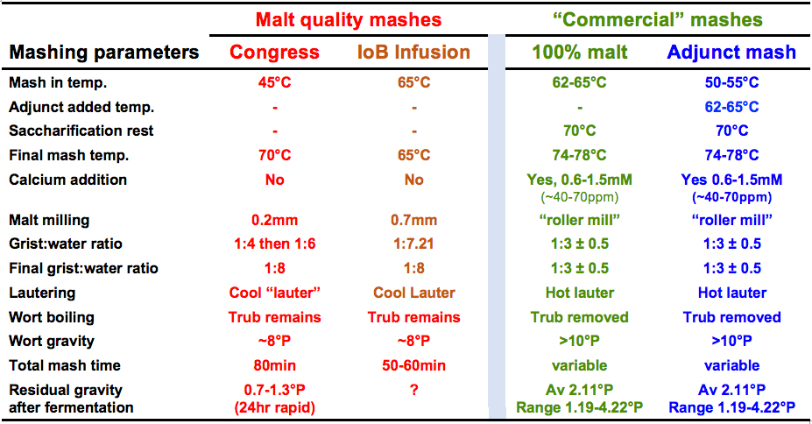
Slide 7:
Mashing protocols
Notes:
Over the past Century or so the Congress (EBC) programmed mash (Vienna, 1815), and to a lessor extent the IoB infusion mash at 65°C, have been the main mashes used for malt quality testing.
However current commercial mashing practice is very different to the small scale laboratory mashes.
Mash in Temperature
Malt milling fineness
Grist to water ratio.
The recently accepted 65°C isothermal mash (EBC/MEBAK) is very similar to the IoB 65°C infusion mash except the malt is milling at 0.2mm (fine) rather than 0.7mm (course).
Essentially in commercial brewing two two type of mash being practice are:
The 100% malt mash and
The widely used adjunct mash with cereal cooker.

Slide 8
Slide 8:
Discussion 3:
Next Section:
How mash parameters
impact mash outcomes?
Notes:
Briefly comment on previous slide.

Slide 9
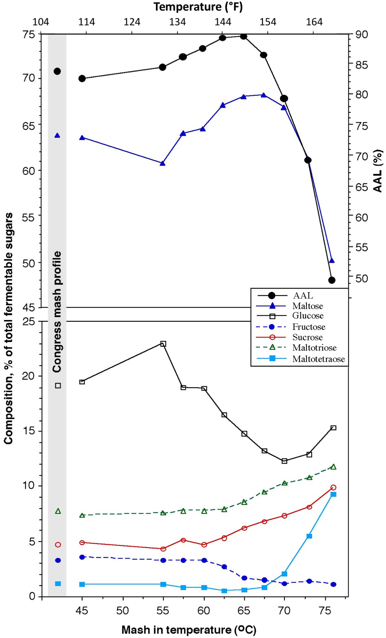
Slide 9:
The influence of mash in temperature on wort fermentability and sugar composition
Grist 0.2mm (fine), 1:4 grist : water ratio
Mash in at temperature, with 30 min rest,
Then up to 70ºC at 2.5ºC/min
Ratio Maltose:Glucose
Flavor implications
Acetate esters increase as
wort maltose level decreases
See: Evans, E, Collins, H, Eglinton, J, & Wilhelmson A (2005).
J. Am. Soc. Brew. Chem., 63: 185-198.
Notes:
The next eight slides are critical to discussing the influence of mash parameters on resultant wort quality. In addition, modifying these parameters are potentially practical options for brewers to modify their mashing outcomes.
Mashing in temperature has a significant impact on:
Fermentability – 62.5 °C – 65°C
- optimum between starch gelatinization and beta-amylase/LD persistence
Mash in temperature substantially changes maltose : glucose ratio
- flavor implications
For a small scale mash, 65°C was selected as typical of many modern commercial mashes and potentially indicated the maximum fermentability.

Slide 10
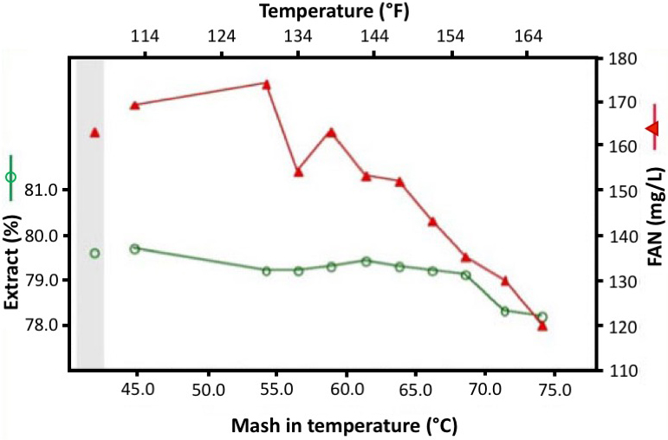
Slide 10:
The influence of mash in temperature on Extract and FAN
Grist 0.2mm (fine), 1:4 grist : water ratio
Lower FAN may reduce synthesis of yeast volatile flavor esters
such as ethyl and iso-amyl acetate.
Notes:
In the same mashing in temperature experiment as shown in the previous slide:
FAN production is maximal at 55°C but is also significant at 65°C
Extract yield is little impacted until temperatures >70°C where it decreases

Slide 11
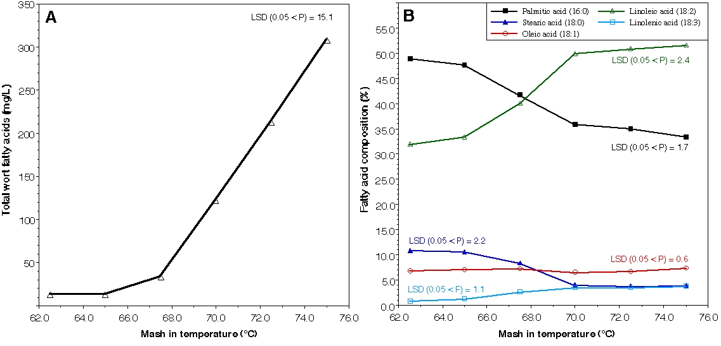
Slide 11:
Impact of mash in temperature on wort lipids.
Average of 8 samples/varieties
Grist 0.7mm (course), 1:3 grist : water ratio
Mash in at temperature, with 30 min rest, Then up to 75ºC at 2.5ºC/min
16:0
18:2
18:0
18:1
18:3
Ratio C18:2/C16:0 may reduce synthesis of yeast volatile
flavor esters such as ethyl and iso-amyl acetate.
Evans et al., 2012 J Am Soc Brew Chem, 69: 13-27
Notes:
For those looking to make low alcohol beer or increase mouthfeel, this slide maybe of interest. Again this is a mashing in temperature experiment:
Temperatures greater than 65°C result in an exponential rise in wort lipid content
- not wort boiling removes most but not all of those lipids
- consequences ~ yeast more vigorous, but potential for off flavors/staling?
Higher mashing in temperature results in an inversion in lipid palmitic (16:0) and linoleic (18:2) acid levels
- potential for auto oxidation increased – staling
- yeast likes linoleic acid (can not auto synthesize)
- again will change resultant beer flavor

Slide 12
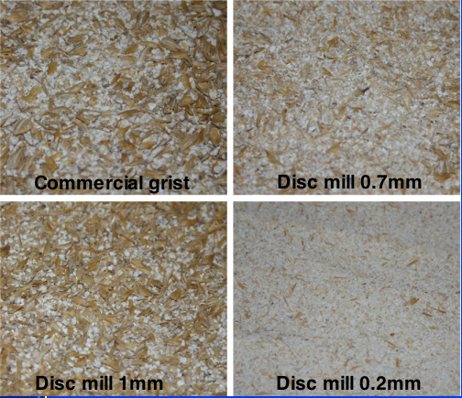
Slide 12:
Grist grinding - disc mill vs 6 roller mill
Conclusion: Brewers consider 0.7mm grind
“closer” to reality
Notes:
For comparison here is a picture of grists prepared four different ways and the sieve or classification proportions of these grists.
The gold standard is of course grist produced by a 6 roller mill.
6 roller mill has a binomial distribution of fine and course (~ intact husks)
0.2mm disc milling – too fine
1mm disc milling – too course
0.7mm disc milling – a compromise between too course and too fine at lab scale.
- many brewers and maltsters consider that there are advantages in using the 0.7mm grind – Mary-Jane is one of those.

Slide 13
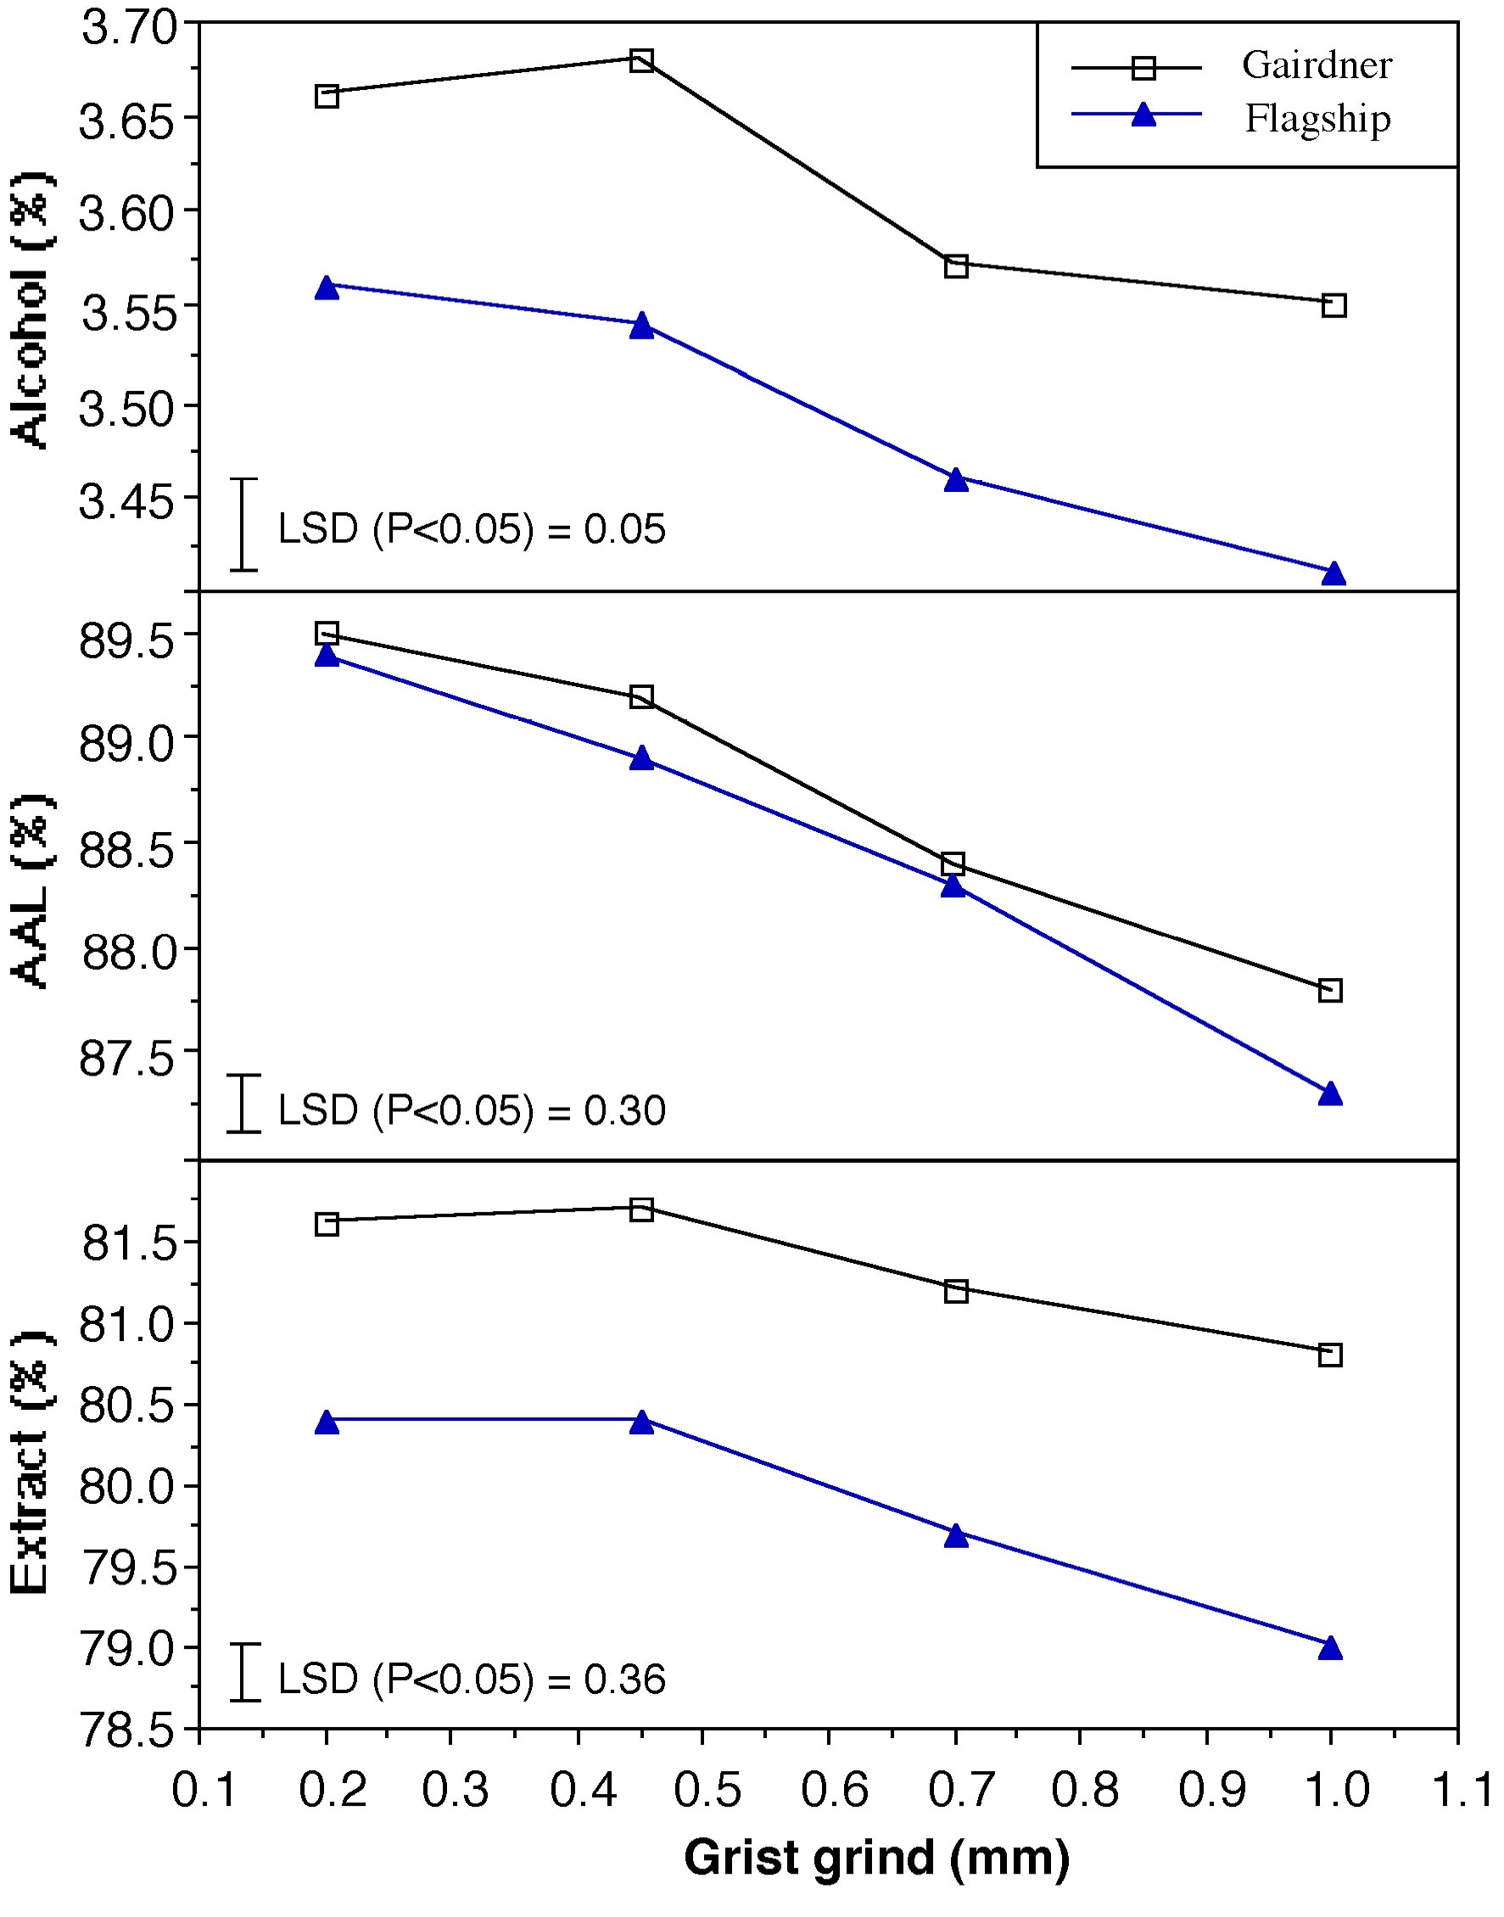
Slide 13:
Grist Milling
Mash in 65ºC 50 min,
1:4 ratio, finish 74ºC,
0.22mM CaSO₄
Conclusion:
Substantial impact,
select 0.7mm as closer
to brewers reality
Notes:
Practically, what is the result of modifying disc milling fineness in the mash
Extract is stable to a 0.45mm grind then declines
Mash AAL increases with increasing grist fineness
- finer grist = greater solute/osmolyte concentrations in mash which better protects thermolabile enzymes such as beta-amylase and limit dextrinase
Valued judgement: 0.7mm grist grind closer to brewers reality for a laboratory mash?

Slide 14
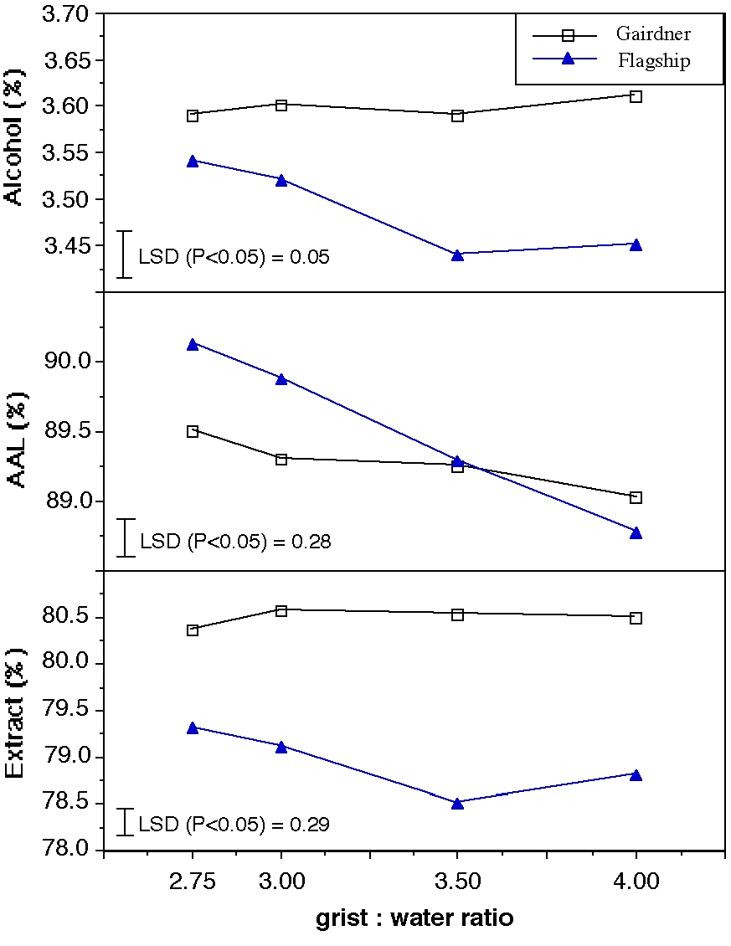
Slide 14:
Grist to water ratio
Mash in 65ºC 50 min,
0.7mm grind, finish 74ºC
0.22-0.3 mM CaSO₄
Conclusion:
Grist : water important,
choose 1:3 as closer to
commercial practice
Protects enzyme activity!
Notes:
Grist to water ration of commercial mashes ranges between 1:2.1 and 1:4, typically 1:2.5 for modern breweries with 1:1.21 being the limit.
Grist to water ratio appears to have a minor effect on extract overall but in some malt samples it may be small but significant?
Lower grist to water ratios result in higher fermentability, sample dependant
- again a result of solute/osmolyte concentration preserving thermolabile enzymes
For a small scale mash, 1:3 ratio selected as it is midway in the commercial range.

Slide 15
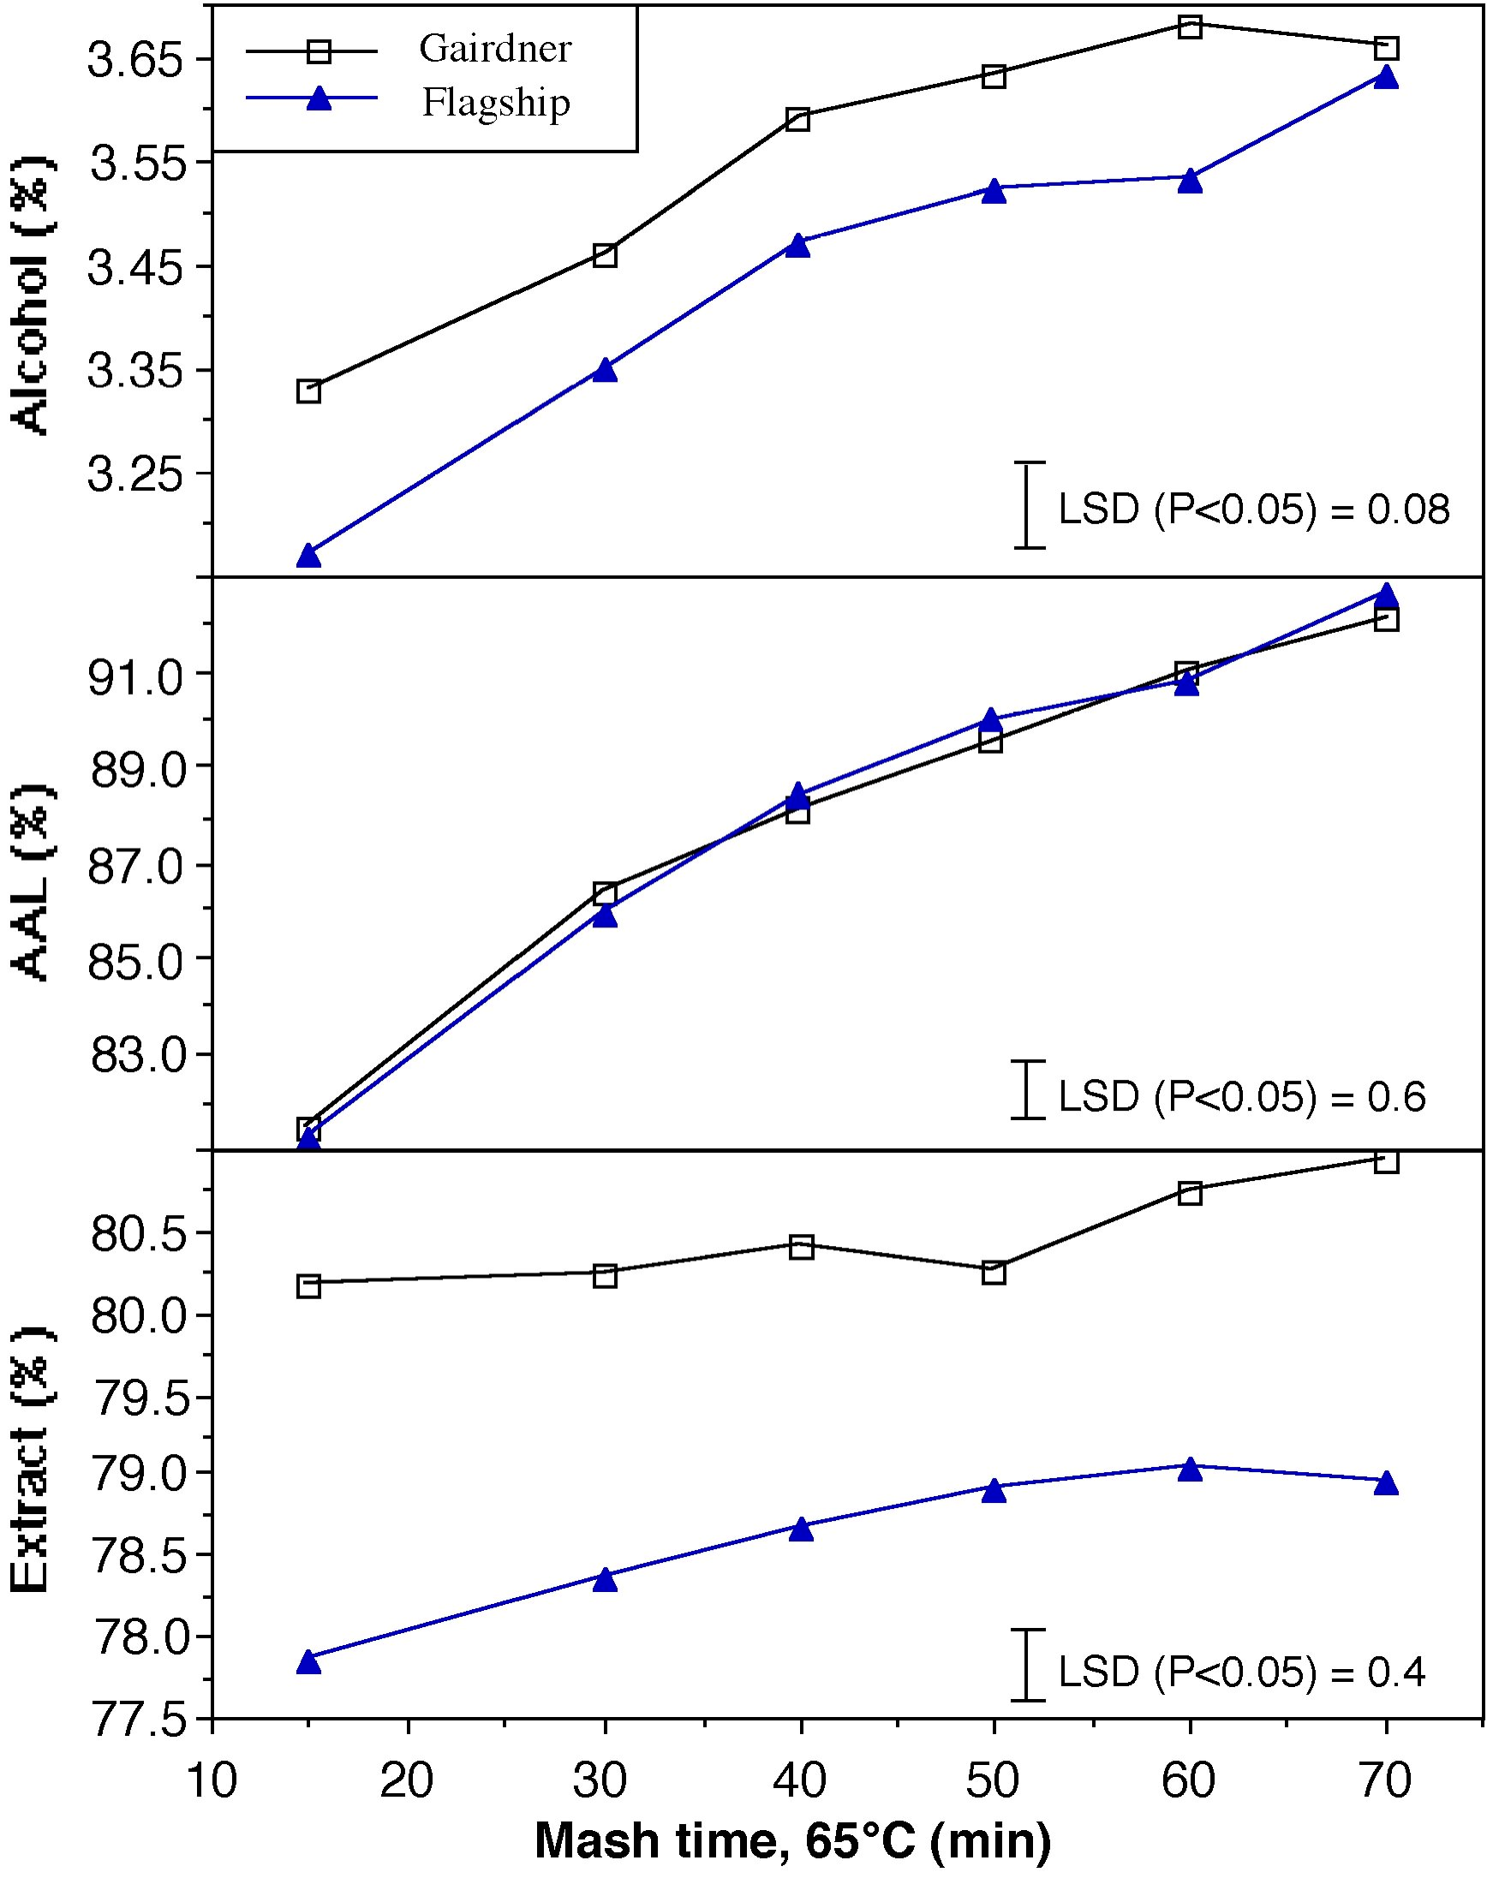
Slide 15:
Mash duration
Mash in 65ºC, 1:3 ratio
0.7mm grind, finish 74ºC
0.3 mM CaSO₄
Conclusion:
Mash duration important.
use 60min as this gives
close to max fermentability
Notes:
Mash duration
Maximal extract reached at ~60 min
- but after 15 min only ~2% extra extract is yielded (55min)
Fermentbility increases up to 60-70min where it is flattening out.
- but at 15min AAL is ~82% so that only an extra 10% AAL is yielded over the next 55min.
- that is most of the starch hydrolysis is done in the first 15 min.
For a laboratory mash, 60min was selected as most of maximal extract and fermentability was yielded.

Slide 16
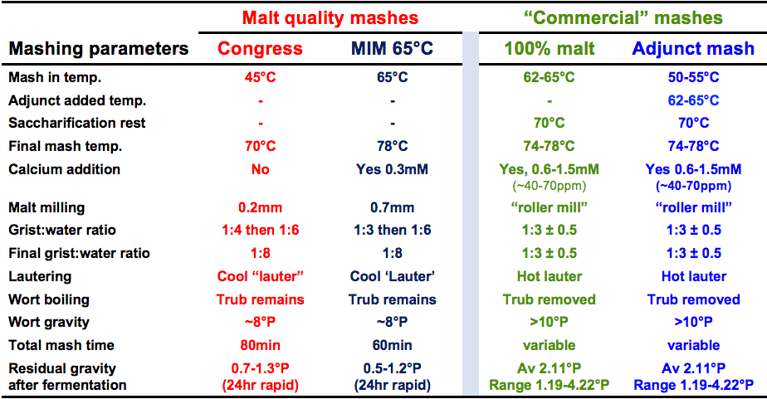
Slide 16:
Mashing protocol:
Modified Infusion Mash 65ºC (MIM 65ºC)
See: Evans, Goldsmith, Dambergs & Nischwitz(2011). "A comprehensive reevaluation of the small-scale Congress mash protocol parameters for determination of extract and fermentability." JASBC 69:13-27.
Notes:
Discuss mashing protocols with respect to the previous slides.
What is the best compromise?

Slide 17
Slide 17:
Discussion 4:
Next Section:
Comparing Mash protocol results

Slide 18
Slide 18:
Comparison of Congress and MIM 65ºC protocols
29 Australian commercial malts used for comparison
MIM 65ºC
MIM 65ºC
MIM 65ºC
MIM 65ºC
MIM 65ºC
See: Evans, Goldsmith, Dambergs & Nischwitz (2011). JASBC. 69: 13-27
Notes:
Compare Congress and the MIM 65°C mash
Extract 1.1% higher for Congress – fine grind
AAL 6.5% higher for MIM 65°C mash - grist to water ratio, mashing in temperature
FAN Congress slightly higher but not much.
Bradford protein (foam) marginally higher Congress
β-Glucan almost the same.
These results confirm that modern malts do not really require a 45-50°C mash.

Slide 19
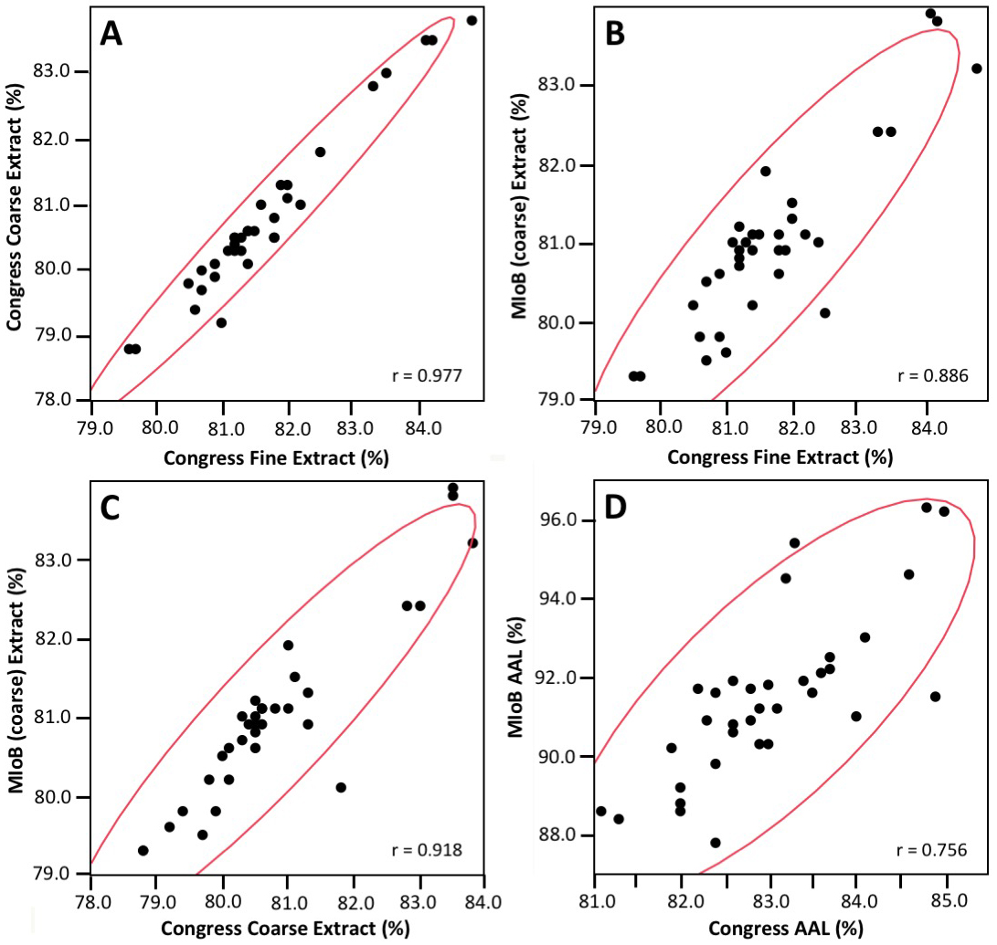
Slide 18:
Comparing Congress
& MIM 65ºC
Extract and AAL
(n = 33, IFBM malts)
MIM 65°C (course) extract (%)
MIM 65°C (course) extract (%)
MIM 65°C AAL (%)
See: Cornaggia et al., (2019)
JIoB, 125(3): 294-309
Notes:
Compare correlations between Congress and MIM 65°C
Extract, although 1.1% higher for Congress, reasonably good, however
- small impact for malt grinding (C, B)
- small impact for grist to water ratio (C)
Fermentability has much wider divergence
Particularly important in malt sample or variety ranking in a breeding program!

Slide 20
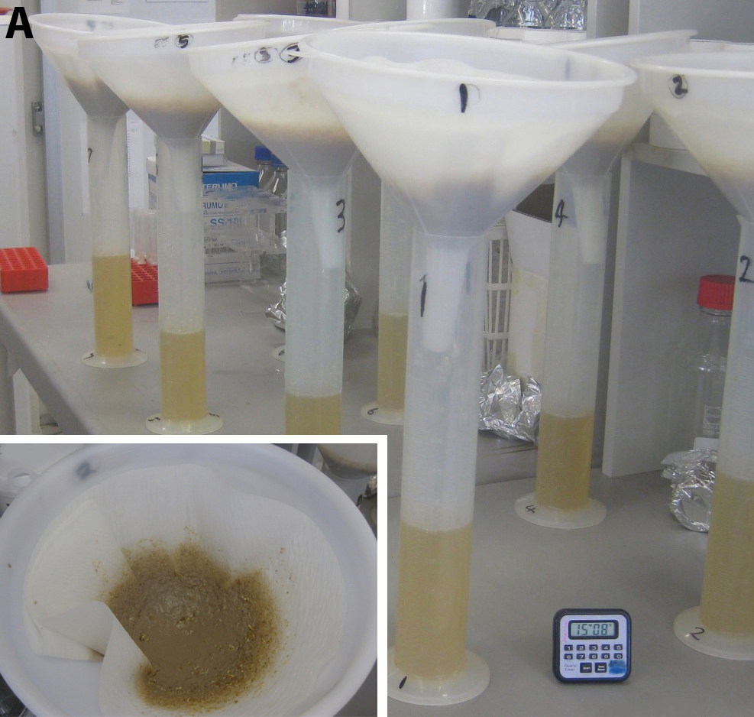
Slide 19:
Mash Lautering?
Simple
Bolt-on to extract protocol
No new mash
Filter paper, Machery-Nagle MN722
fast flow, durable
See: Evans, Goldsmith, Dambergs & Nischwitz(2011). "A comprehensive reevaluation of the small-scale Congress mash protocol parameters for determination of extract and fermentability." JASBC 69:13-27.
Notes:
Describe simple small scale mashing test

Slide 21
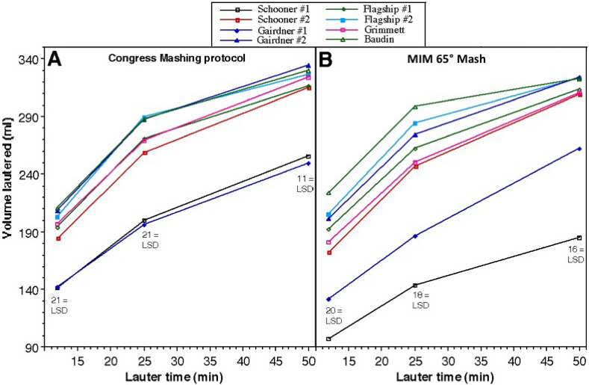
Slide 20:
Lautering Performance Impacted by
Mashing Protocol used.
See: Evans, Goldsmith, Dambergs & Nischwitz (2011). "A comprehensive revaluation of the small-scale Congress mash protocol parameters for determination of extract and fermentability." JASBC 69: 13-27
Notes:
Compare Congress with MIM 65°C in lautering test
- Improved resolution for poorer malts with the MIM 65°C
- MIM 65°C is a more stringent comparison
- greater likelihood of identifying troublesome malts.

Slide 22
Slide 21:
Concluding Discussion 5:

Slide 23
Slide 23:
Key Background References:
Axcell, B. C., Morrall, P., Tulej, R., and Murray, J. (1984). "Malt quality specifications - A safeguard or restriction on quality." MBAA TQ 21: 101-106.
Axcell, B. C. (1998). "Malt analysis – prediction or predicament." MBAA TQ 35: 28-30.
Axcell, B.C. (2018). Don’t let sleeping dogmas lie - a personal journey in brewing. Brew. Distiller Intl 14(4): 28-33.
Back, W., and Narziss, L. (1997). "Malt parameters and beer quality." Brauwelt International 15: 29-37.
Evans, D. E., Collins, H.M., Eglinton, J.K., and Wilhelmson, A. (2005). " Assessing the impact of the level of diastatic power enzymes and their thermostability on the hydrolysis of starch during wort production to predict malt fermentability." JASBC 63: 185-198.
Evans, D. E., and Fox, G.P. (2017). "The comparison of DP enzyme release and persistence with the production of yeast fermentable sugars during modified IoB 65 °C and Congress programmed mashes JASBC 75(4): 302-311.
Evans, D.E., Goldsmith, Dambergs & Nischwitz (2011). "A comprehensive revaluation of the small-scale Congress mash protocol parameters for determination of extract and fermentability." JASBC 69: 13-27
Evans, D. E., Goldsmith, M., Redd, K.S., Nischwitz, R., and Lentini, A. (2012). "Impact of mashing conditions on extract and its fermentability, and the level of wort free amino nitrogen (FAN), β-glucan and lipids " JASBC 70: 39-49.
Evans, D. E., Redd, K., Harysamow, S., Elvig, N., and Koutoulis, A. (2014). "Small scale comparison of the influence of malt quality on malt brewing with barley quality on barley brewing using Ondea Pro." JASBC 72: 192-207.
Gastl, M., Knofel, T., and Becker, T. (2014). "Conversion of isothermal 65°C mash-measurement of quality characteristics." Brauwelt 154: 274-276.
Look out for new MBAA/ASBC book:
Evans, D. E. (2021). ‘Mashing.’ Pilot Knob, Minneapolis, MN, American Society of Brewing Chemists and Master Brewers of the Americas.

Slide 24
