Slide 1
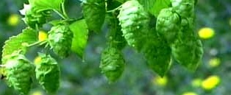
Getting started in hops

Slide 2
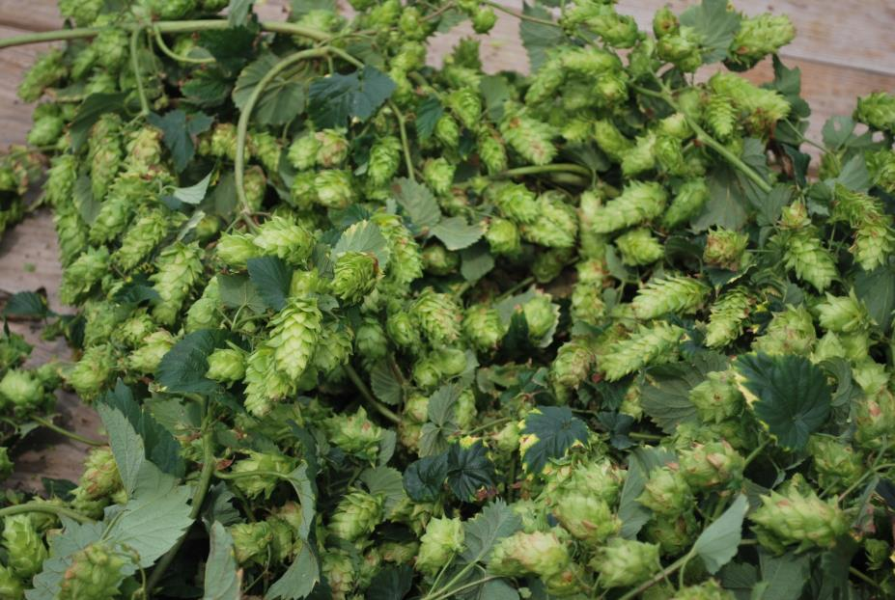

Slide 3
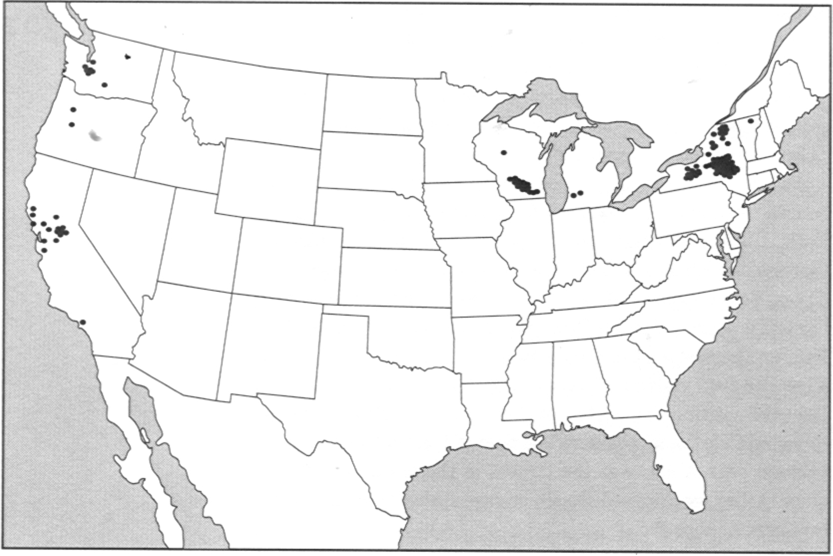
Rise
1880’s - NYS produces 90% of the nation’s supply of hops.

Slide 4
The Final Blow
1920-1933

Slide 5
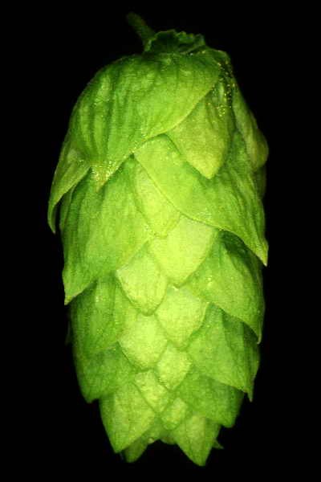
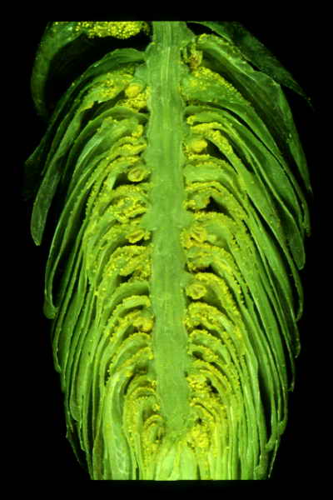

Slide 6
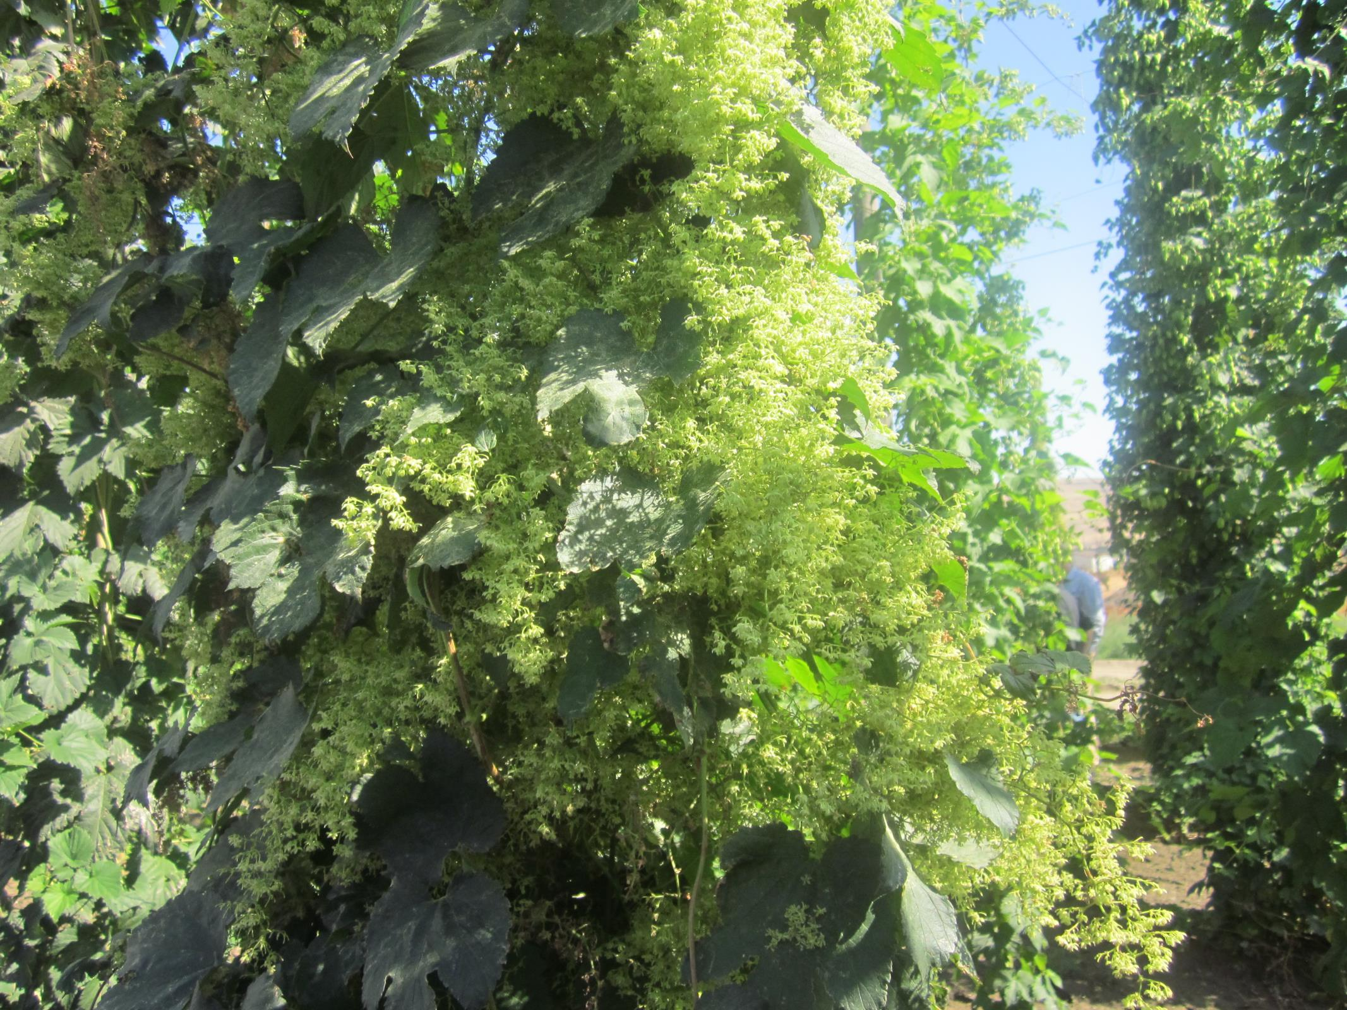

Slide 7
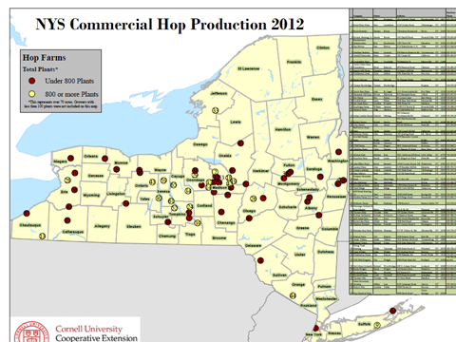

Slide 8
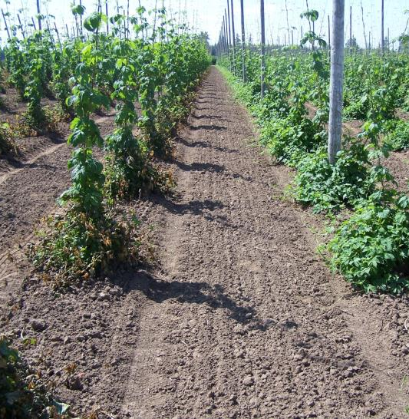
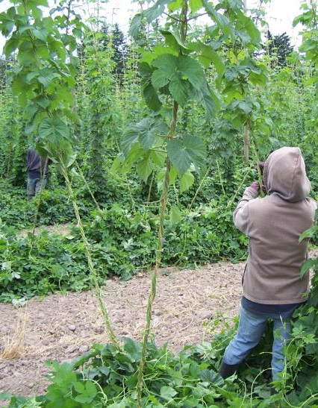
Basal Foliage Removal and Stripping of Lower Leaves

Slide 9
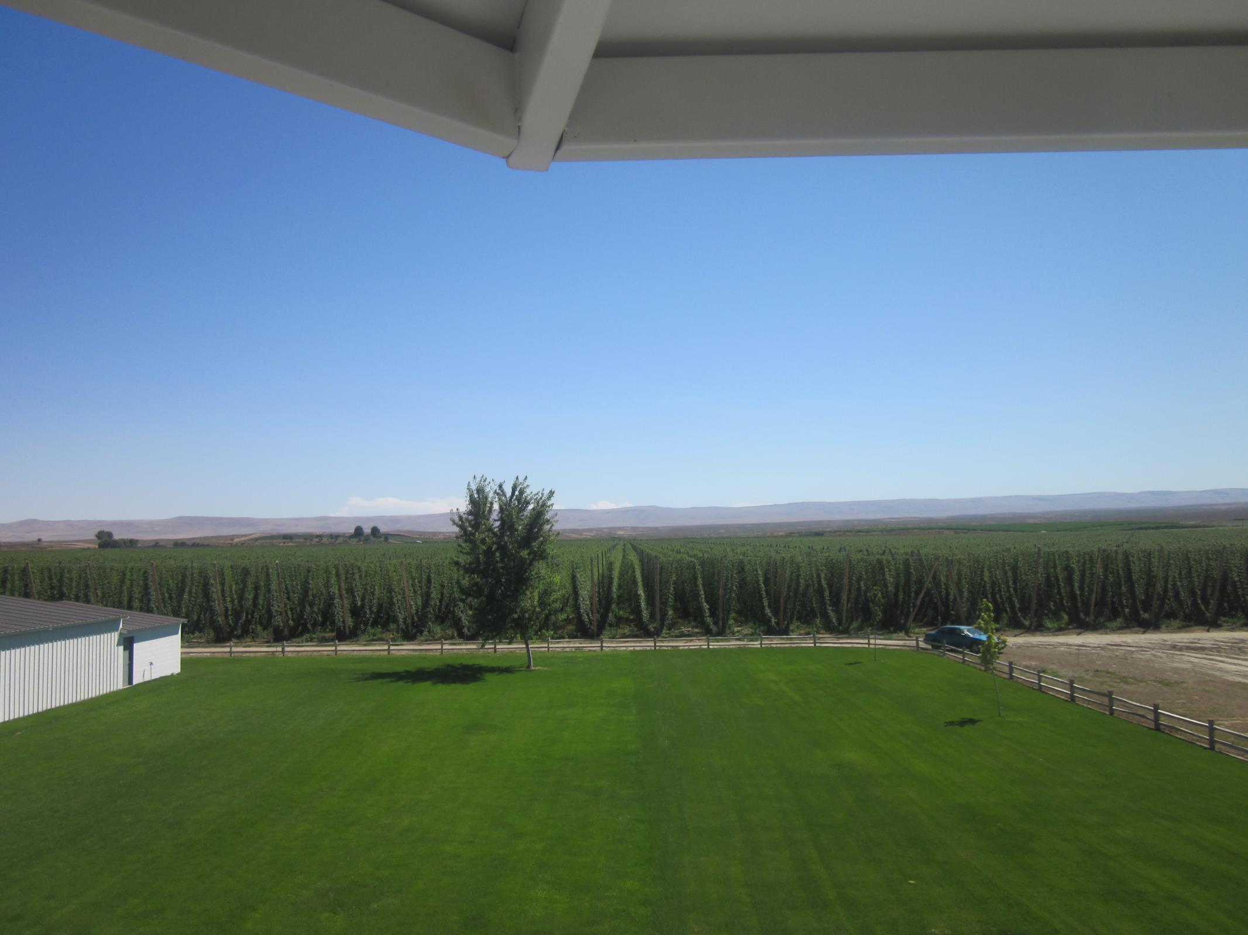

Slide 10
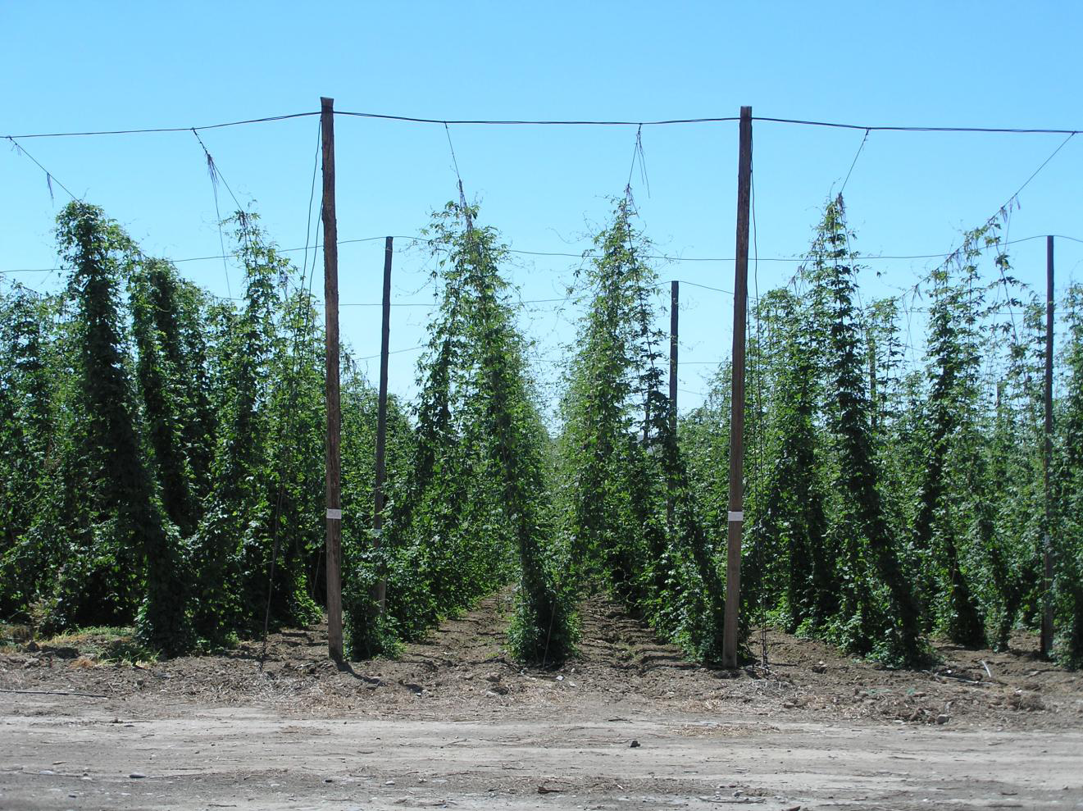

Slide 11
Cedar and Tamarack poles 20 to 22 ft X 6 in.
65 @$30-60 each, have seen them for $25

Slide 12
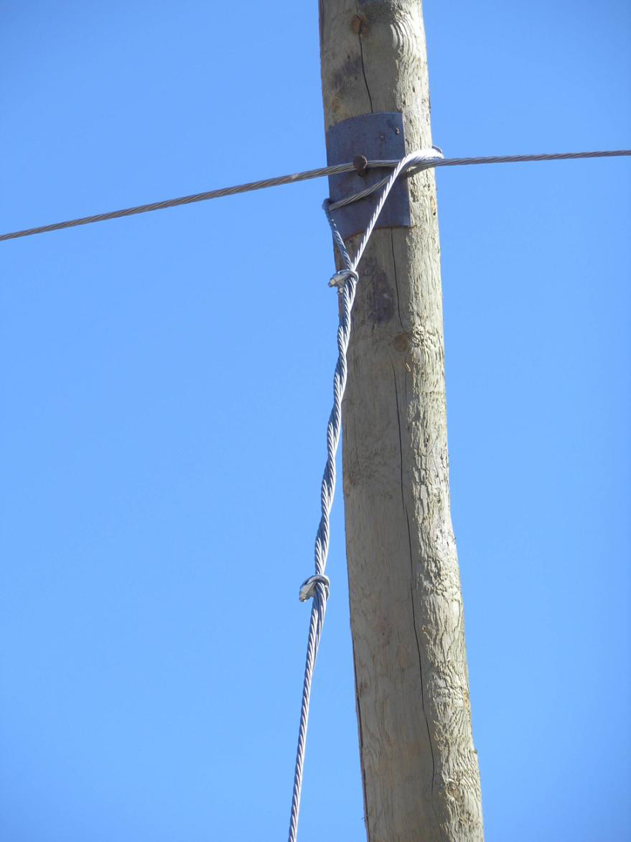

Slide 13
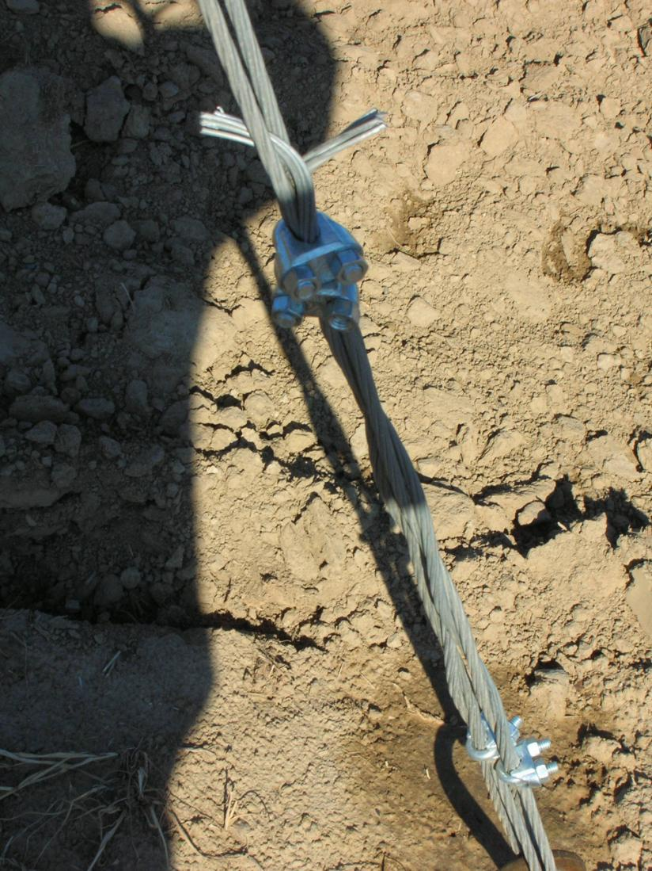

Slide 15
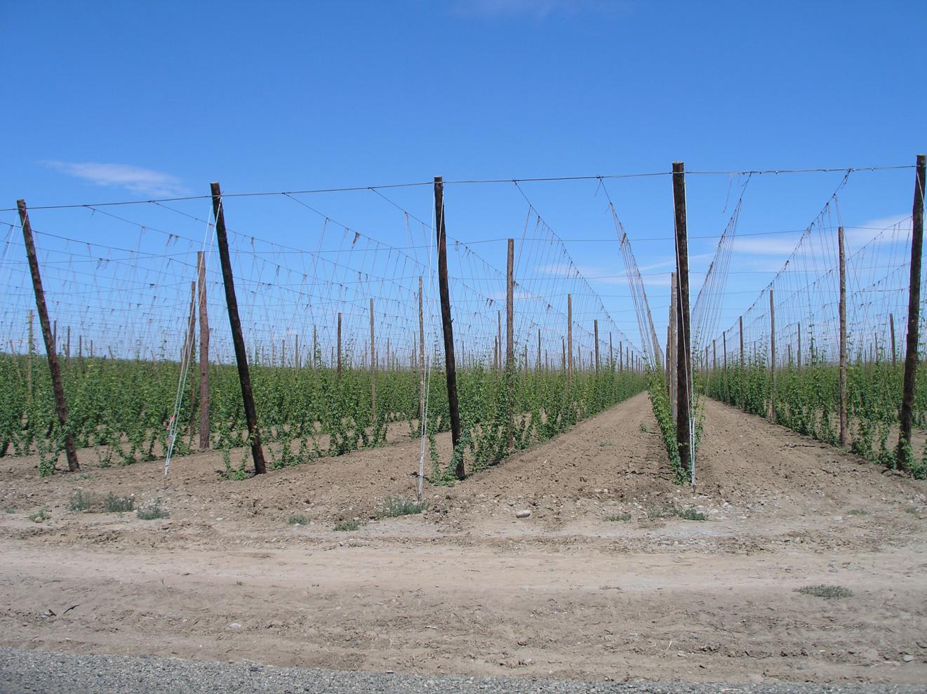

Slide 16
Estimated costs per Acre
Trellis establishment $5-6,000
Drip Irrigation system $1,200
(not including source)
Rhizomes or plants $2-4,000
Land Prep (fert.,seed,coir) $1,000
Labor $3-4,000
Total $12-16,000/A

Slide 17
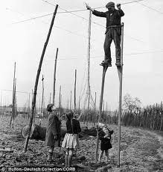

Slide 18
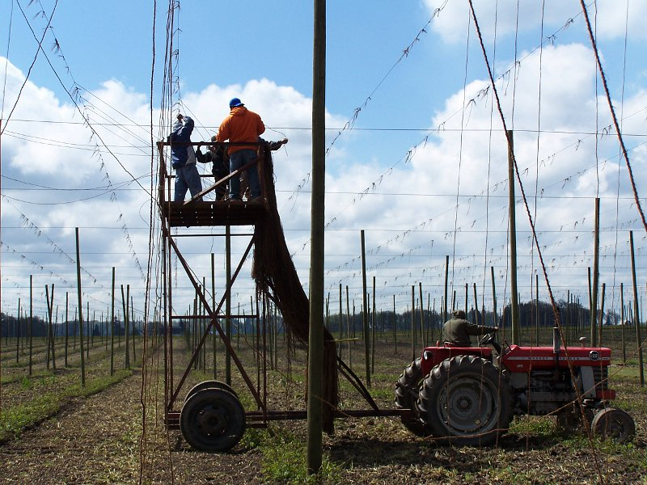
Notes:
18

Slide 19
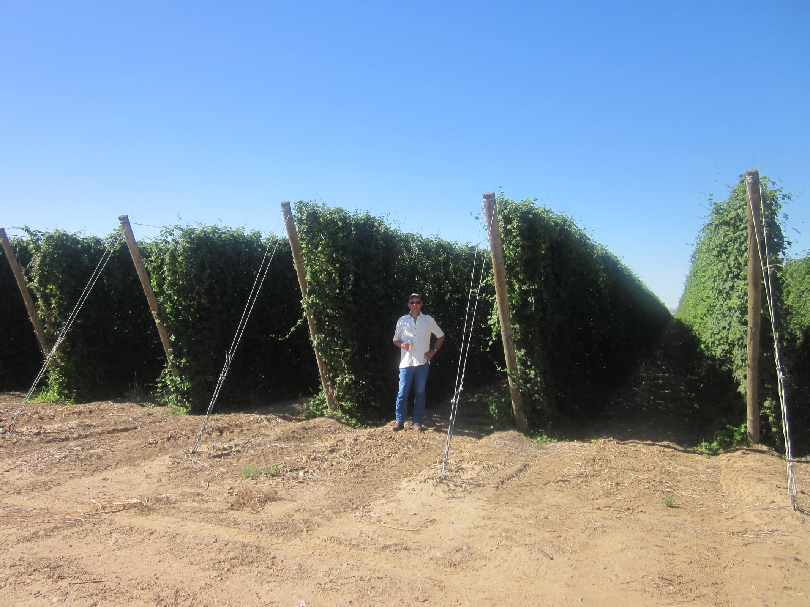

Slide 20
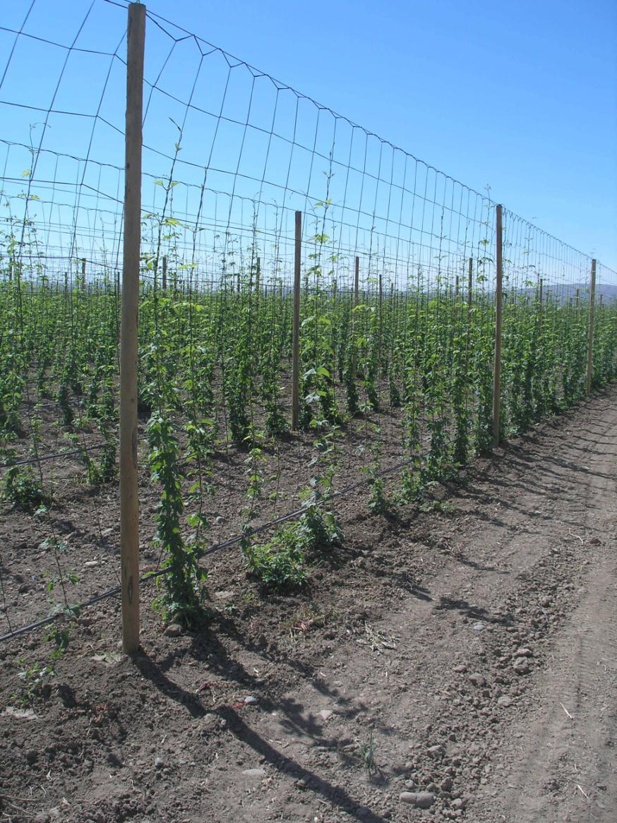

Slide 21
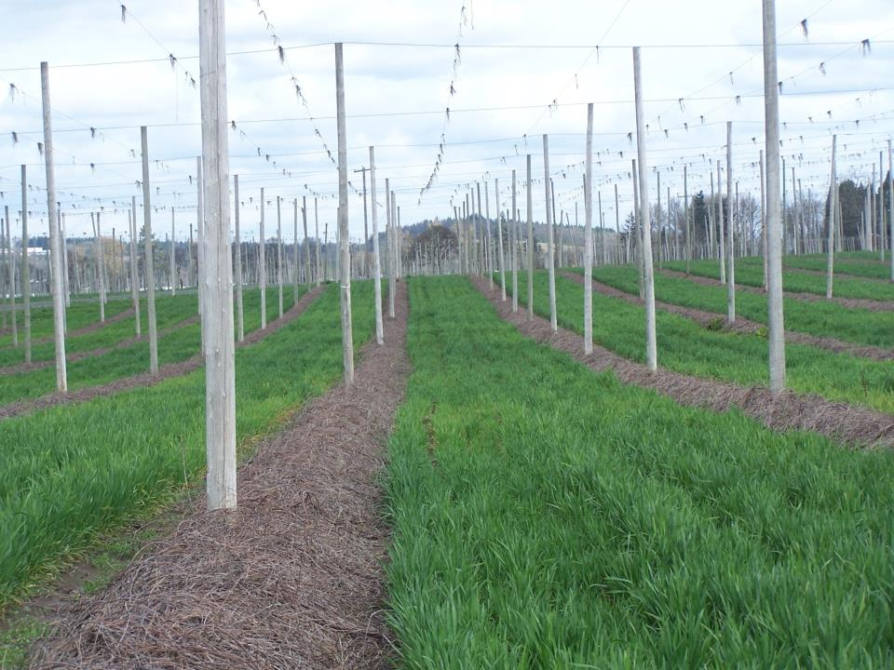

Slide 22
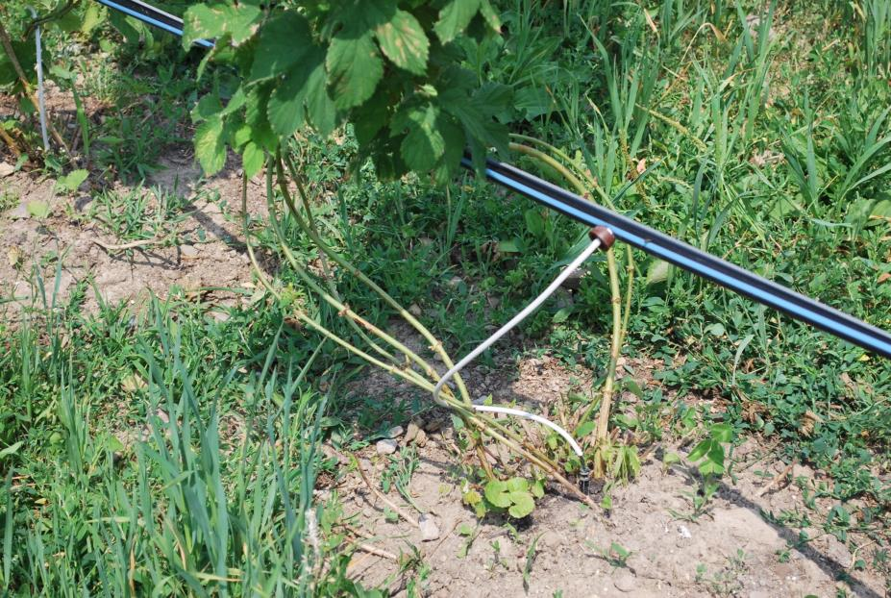

Slide 23
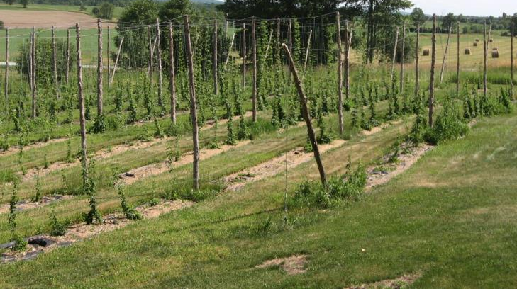
Site Selection
Soil type
Well-drained
Depth to bed rock
Full sun
Close to water
Weed-free!

Slide 24
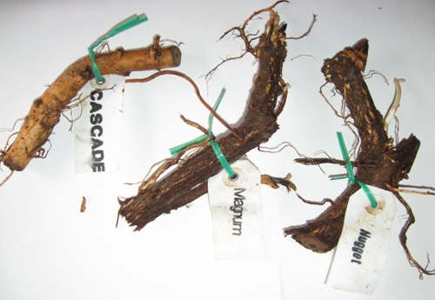

Slide 25
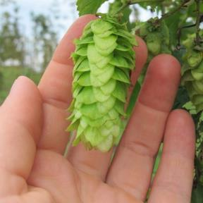
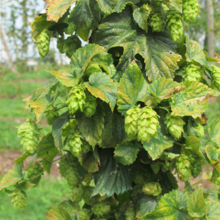
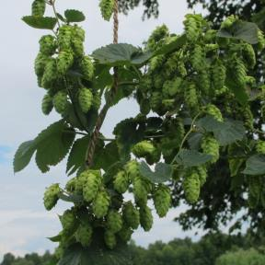
Variety Selection
www.uvm.edu/extension/cropsoil/hops
Talk to your brewer
Aroma vs bittering
Disease resistance
See our websites for variety updates
Cluster
Perle
Cascade

Slide 26
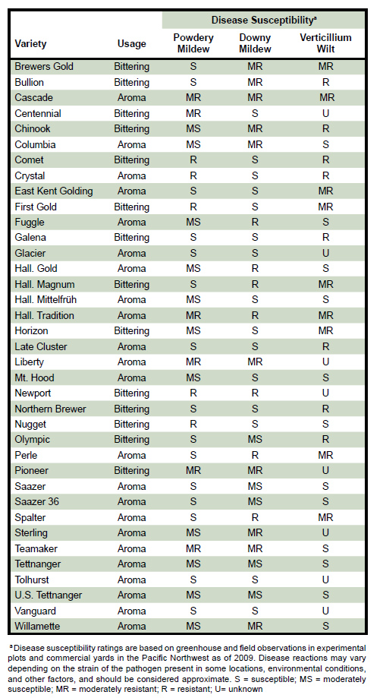

Slide 27
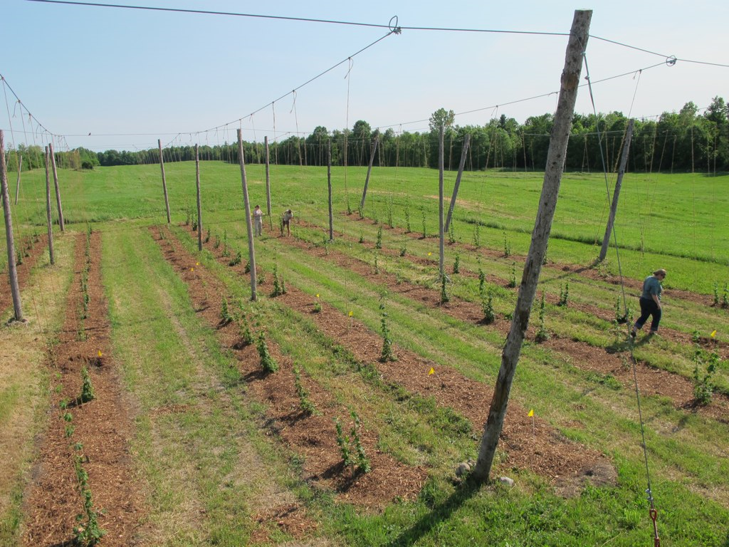
Cascade
Centennial
Chinook
Cluster
Crystal
Fuggle
Galena
Glacier
Hallertau
Liberty
Mt Hood
Newport
Nugget
Perle
Saaz
Santiam
Sterling
Tettnang
Vanguard
Willamette
Plus some exciting new varieties from the USDA – ARS breeding program, courtesy of Dr. John Henning!!!

Slide 28
Local Propagation of virus free hop plants

Slide 29
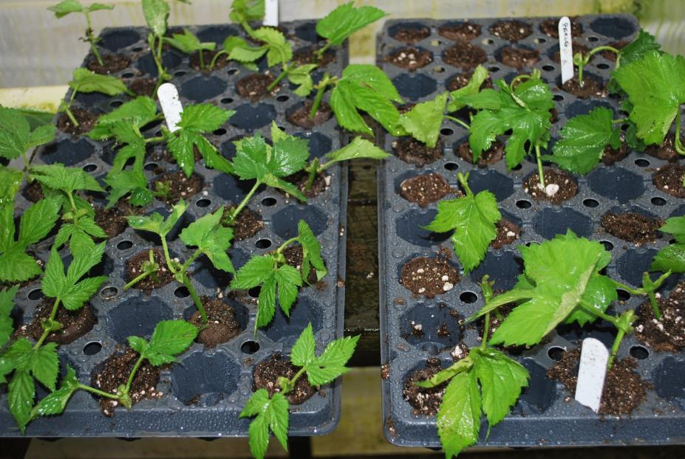

Slide 30
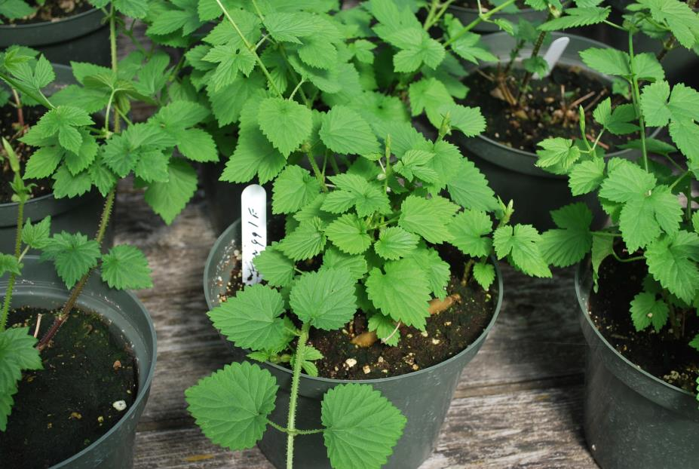

Slide 31
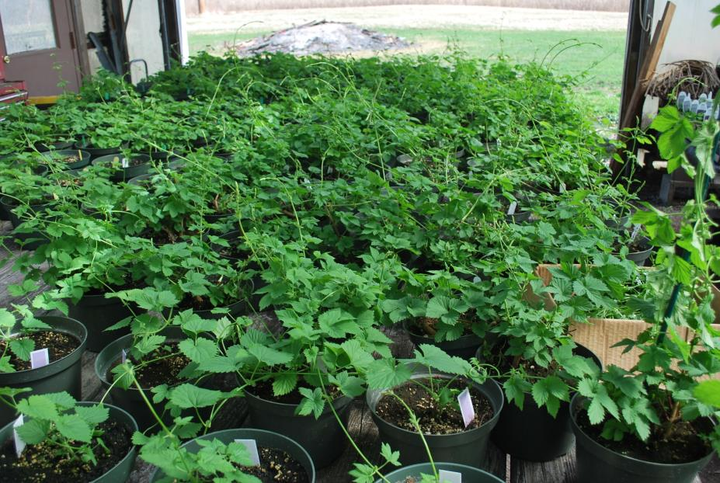

Slide 32
Major Pests
Downy mildew
Powdery mildew
2 spotted spider mite
Hop aphid
weeds

Slide 33
Download free of charge from:
USAhops.org

Slide 34
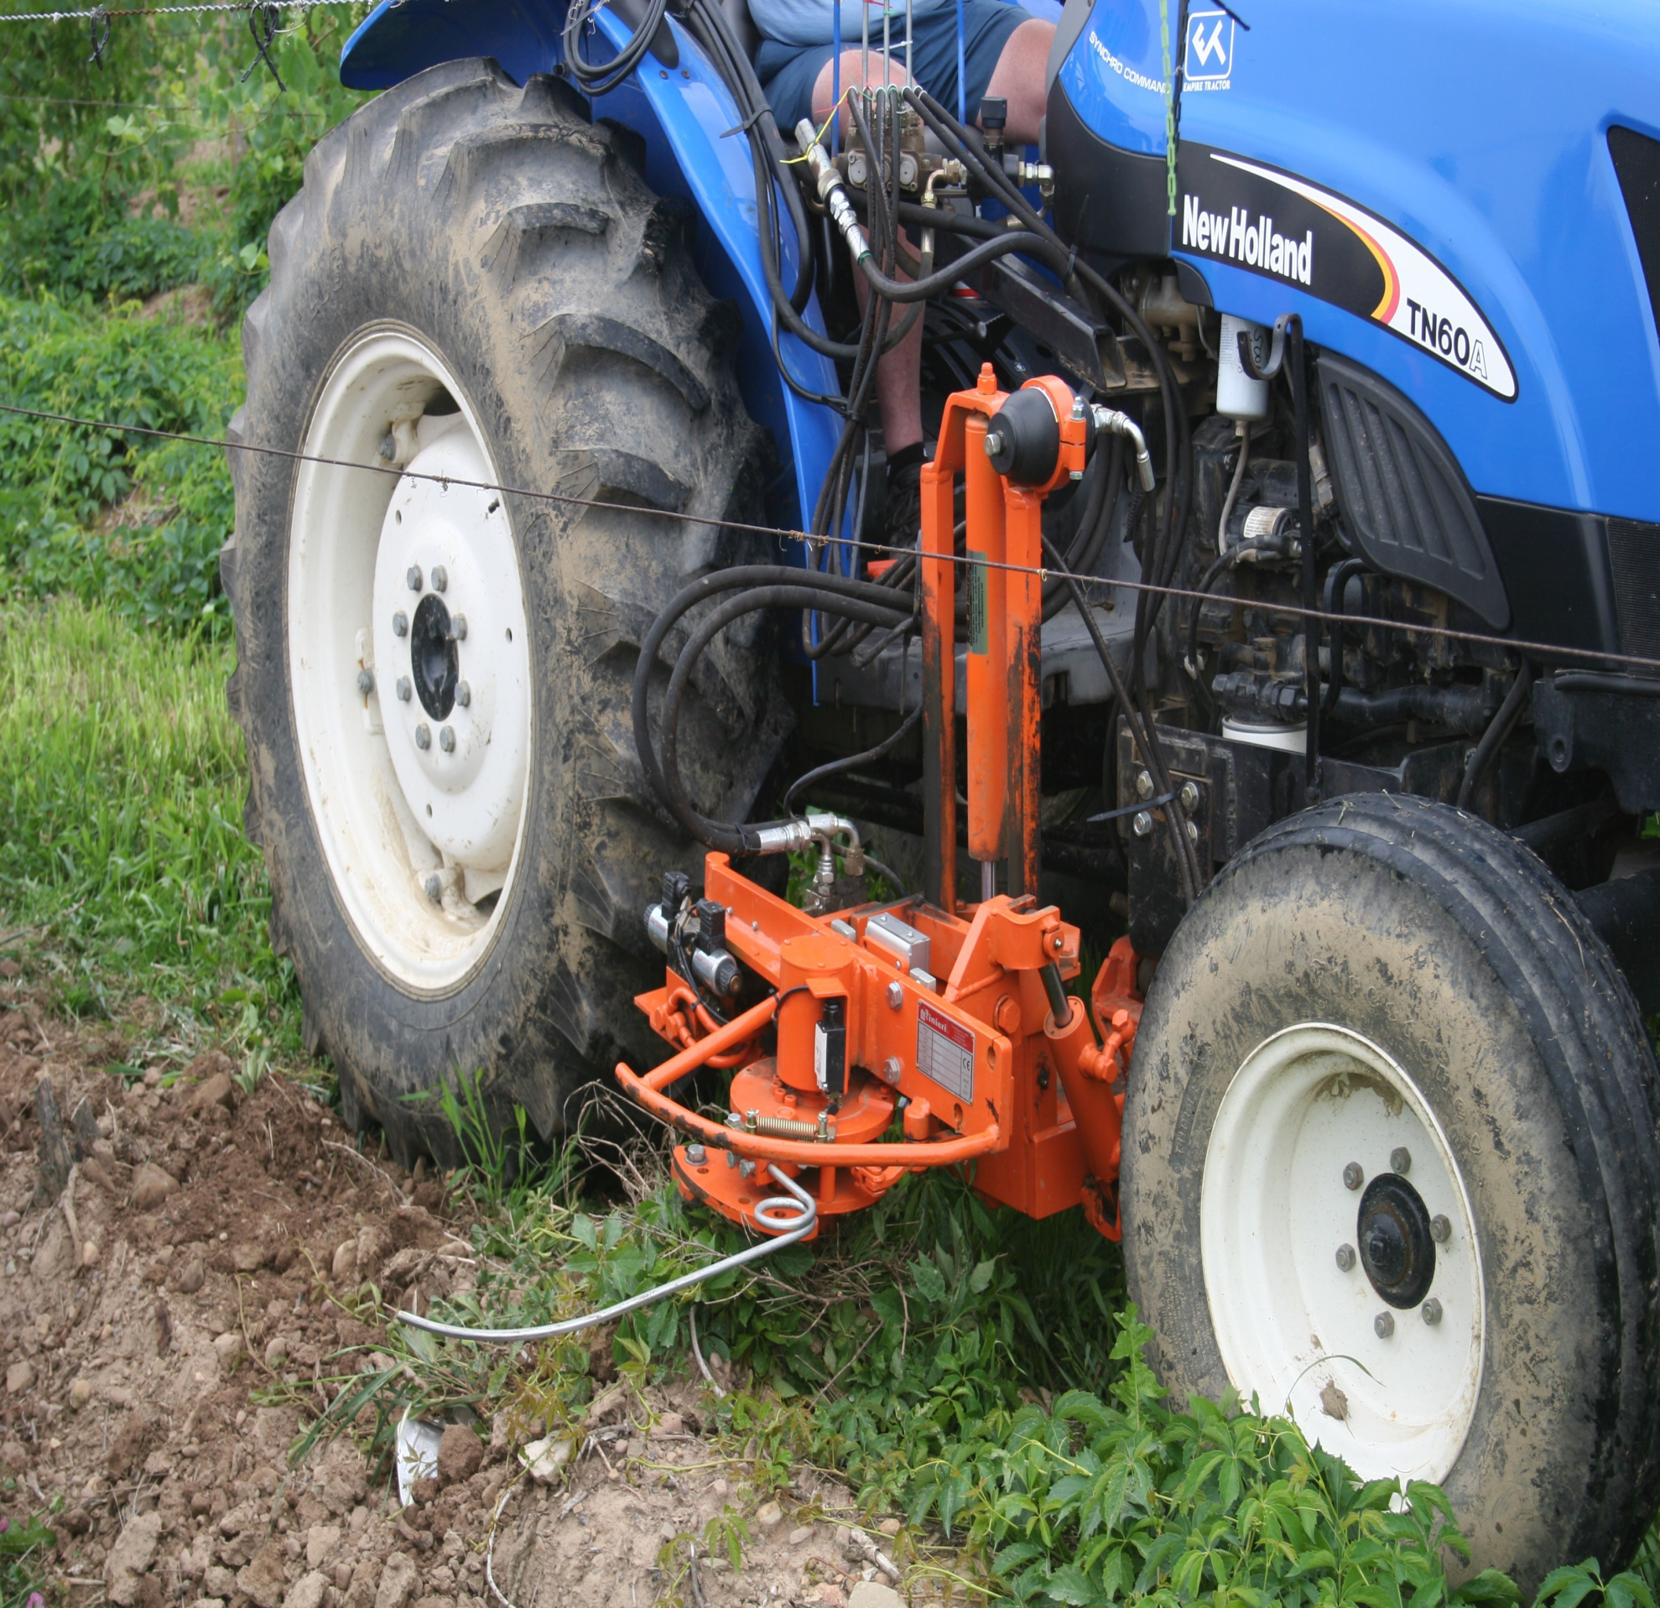

Slide 35
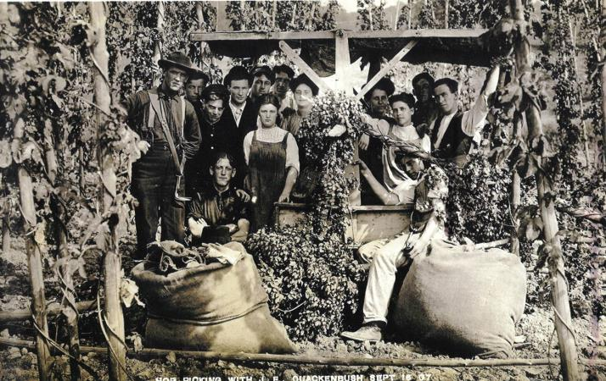
Harvesting
Quackenbush Farm, Stockbridge

Slide 36
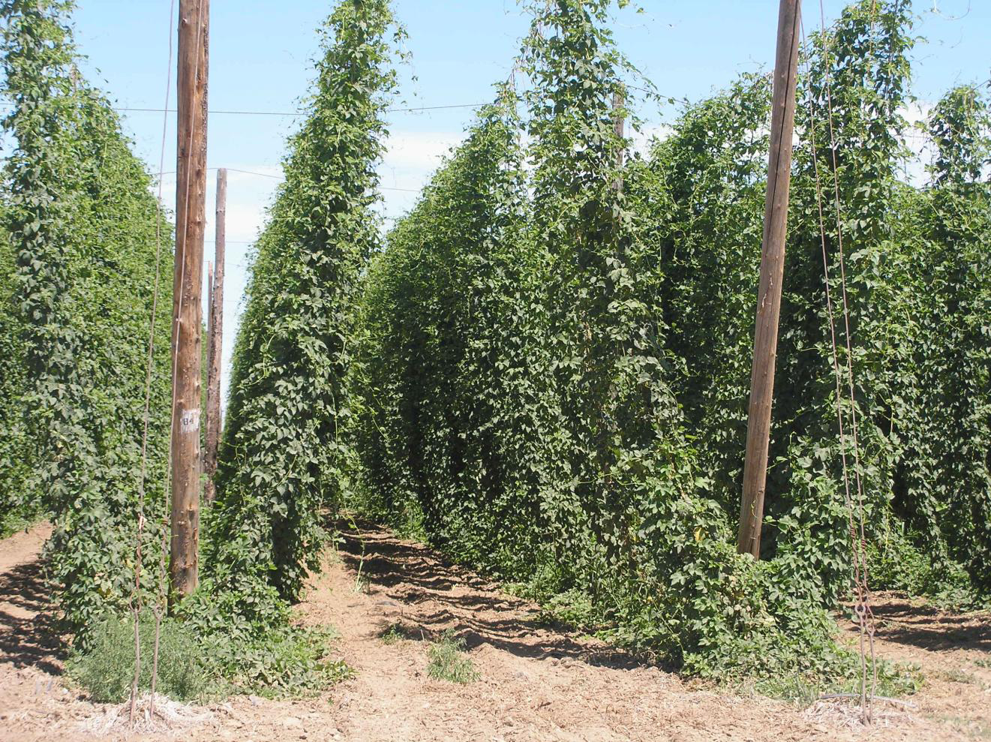

Slide 37
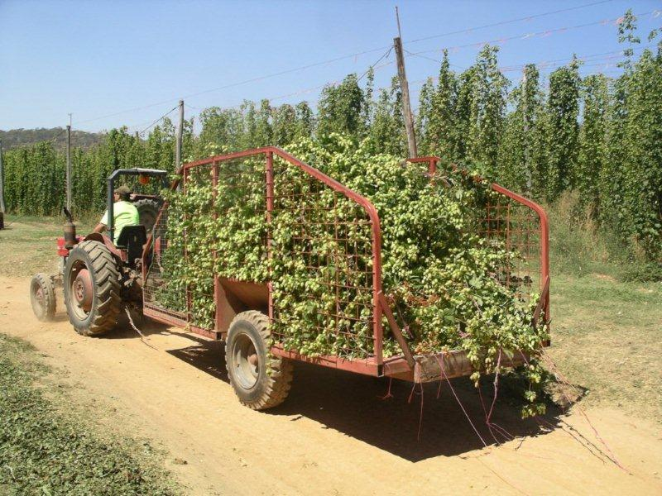

Slide 38
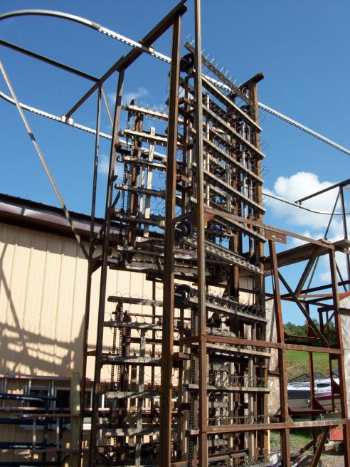

Slide 39
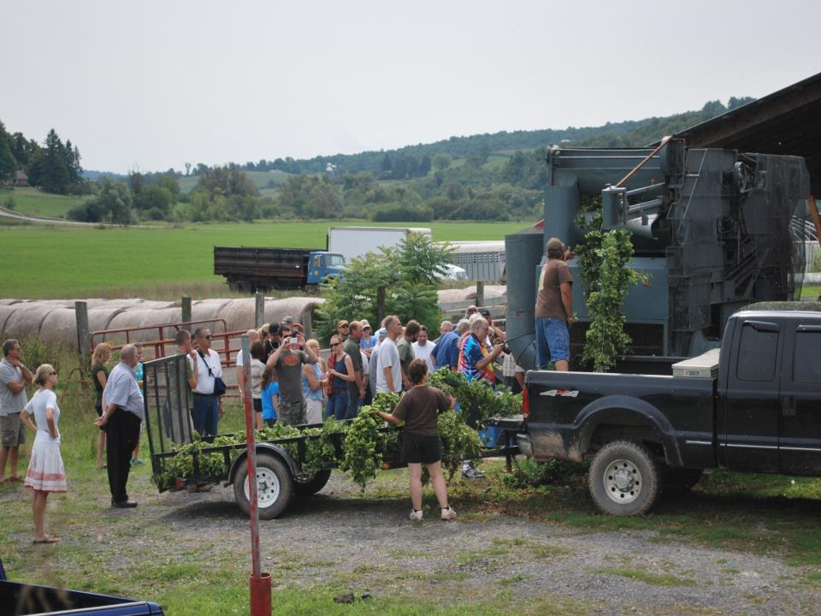

Slide 40
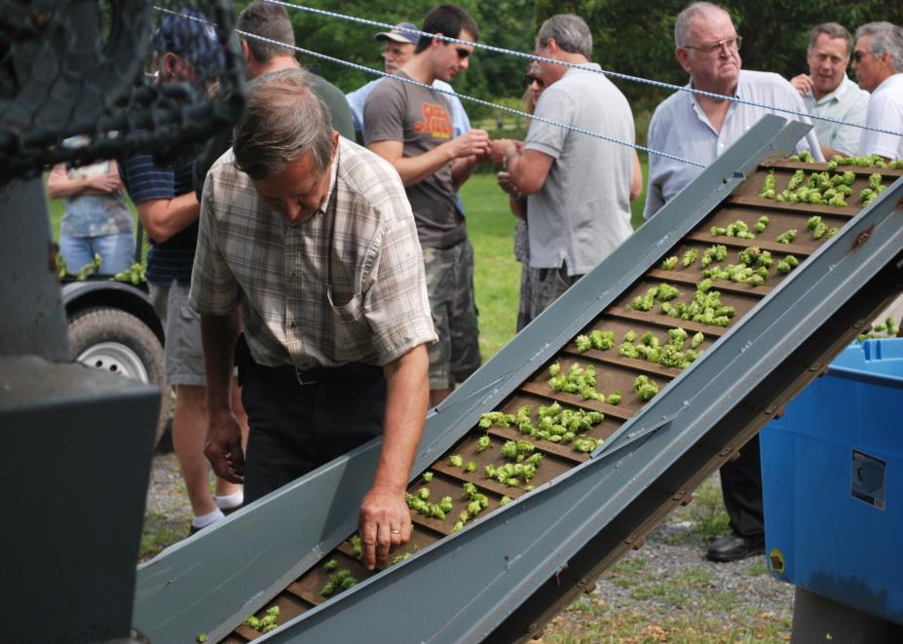

Slide 41
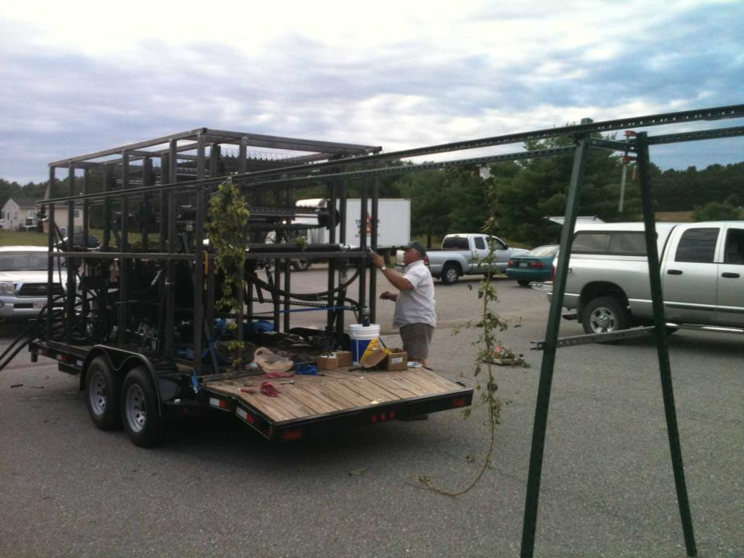
Mobile Hop Picker
A project of University of Vermont Extension, Vermont Agency of Agriculture and Massachusetts Department of Agricultural Resources through the USDA Specialty Crops Block Grants Program.

Slide 42
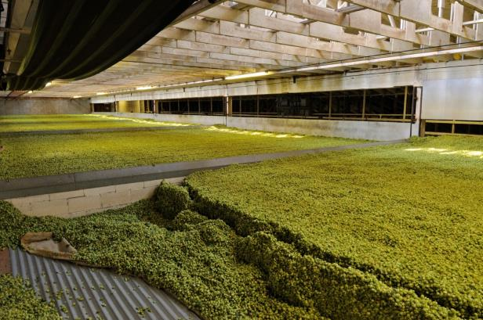

Slide 43
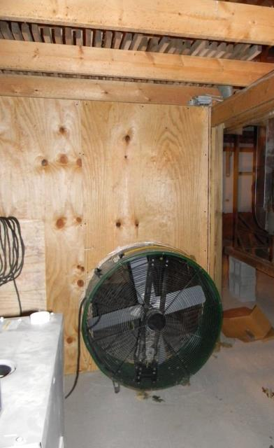
Oast – A Matter of Scale

Slide 44
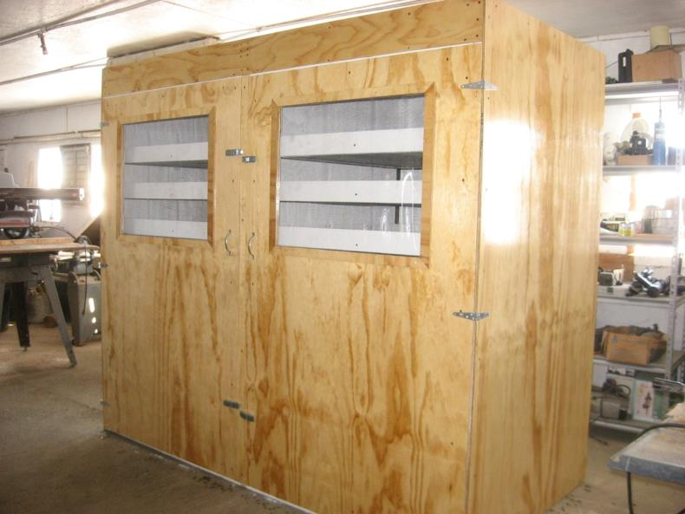
Dry 800 lbs wet cones per day
4’x8’x7’

Slide 45
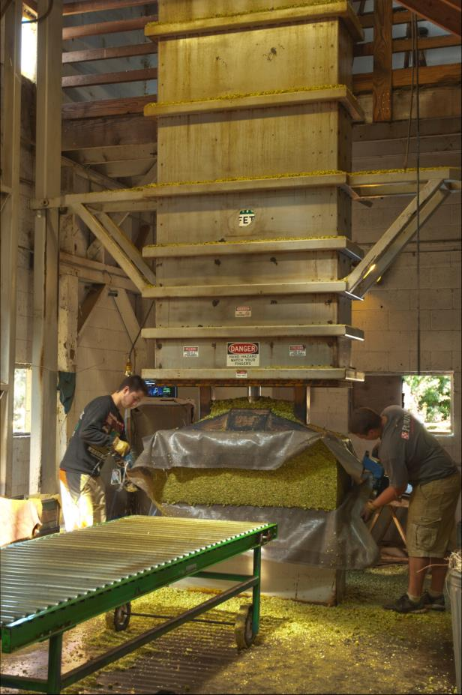

Slide 46
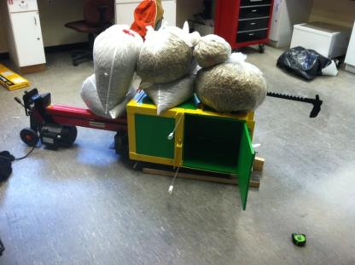
UVM Extension Hops Balers
University of Vermont SEED Program

Slide 47
What else?
Grower Map and contacts on NeHA website
4 new malt houses
Need for several thousand acres of malting barley
New manufacturer for harvesters
Hop pelleting/processing Kendall, NY
Lab testing

Slide 48
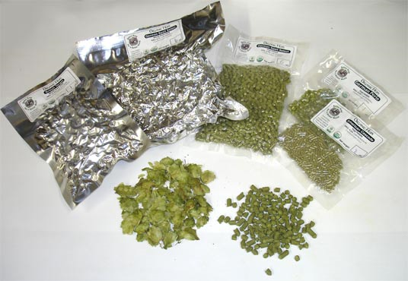
Pelletizing

Slide 49
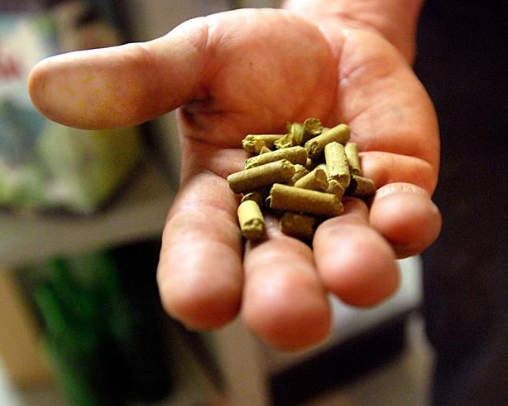
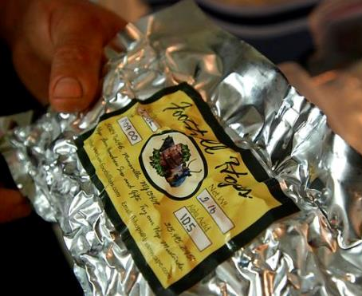

Slide 50
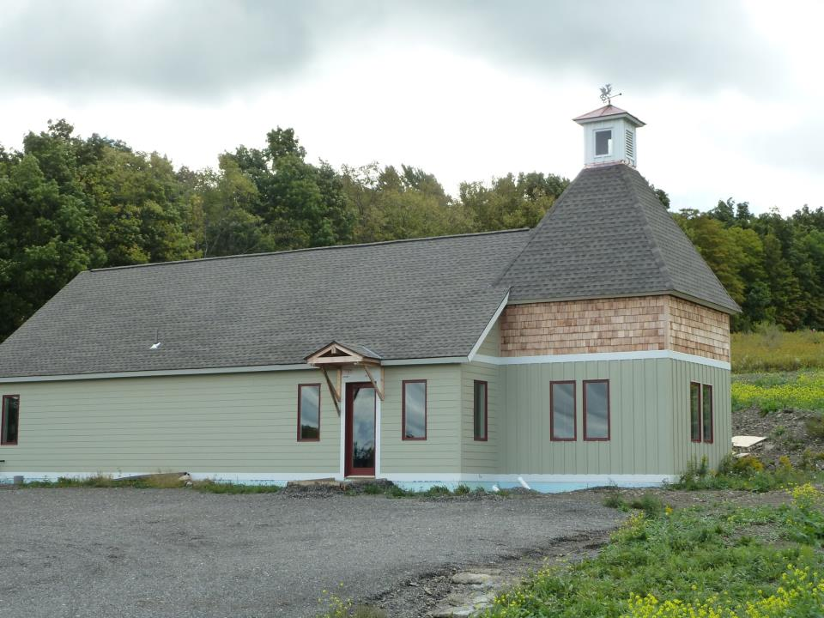

Slide 51
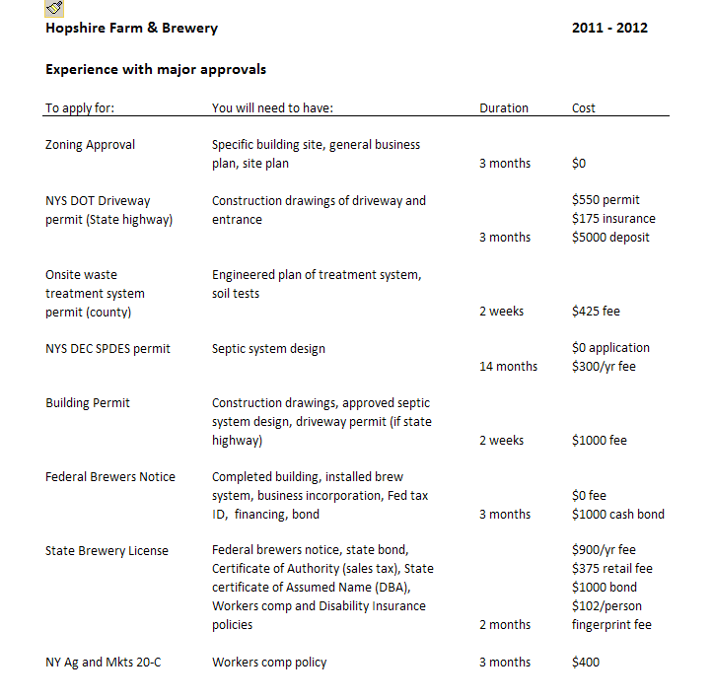

Slide 52
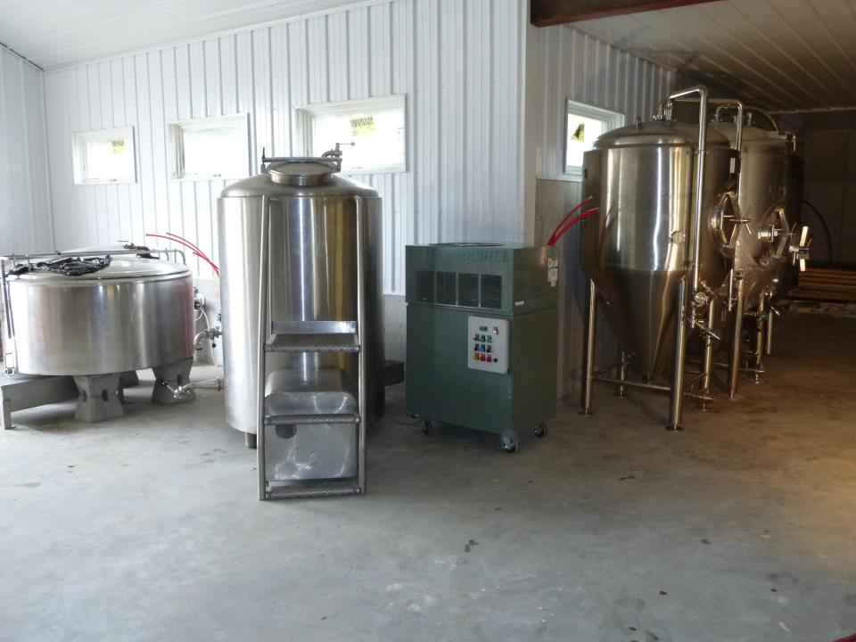

Slide 53
From Farm to Foam
Approvals
Zoning 6 months
County Health Dept 1 week
NY DOT for driveway 3 months
DEC for SPDES permit 14 months
Federal TTB brewers notice 3 months
NY SLA brewery license 2 months
NY Ag and Markets food processing 2 months+

Slide 54
What can I sell?
NY farm beers, wines, spirits, and ciders
On site and at farmers markets
Can have a tasting room and sell by the pint, bottle or keg

Slide 55
NY Farm Brewery Law 2013
Do not have to be on a farm
Must use at least 20% NY grown hops
Must use at least 20% NY grown barley , etc
These increase to 60%after 2018
And 90% after 2023

Slide 56
Who do I contact ?
Sam Filler Empire State Development Corp
625 Broadway 8th floor
Albany, NY 12207
518 292-5366
sfiller@esd.ny.gov

Slide 57
Can we have “NY “Varieties? Locating New and Old Varieties for the East

Slide 58
How much does a plant breeding program cost?
$250,000/yr for 8-10 years to bring new varieties to market

Slide 59
geohopping.crowdmap.com Smart phone technology
Locate with GPS
Evaluate for disease
Photograph and sample

Slide 61
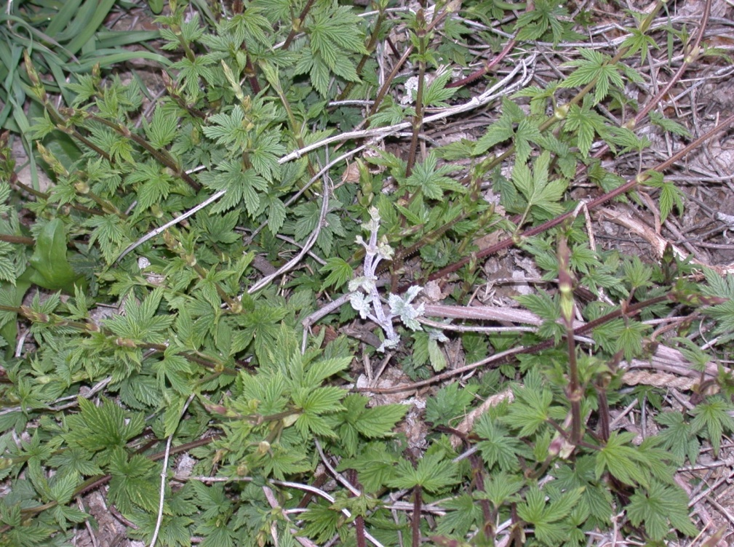

Slide 62
Viroid diseases Hop stunt viroid
Testing:
Availability of testing limited; Washington State University or other university clinics
Management:
Plant viroid free rootstock (Hop Clean Plant Network)
Kill and eliminate volunteer hop plants before replanting a hop yard
Remove infected plants
In Japan, if >10% of plants infected, replanting yard suggested
Clean equipment and knives between fields
Chemical instead of mechanical pruning may reduce rate of spread

Slide 64
What about research?
Cleral hop yard in Portland NY
Gov Cuomo has $ for research yard at Geneva
Brewery in NY will be providing $ for research

Slide 65
Hop stunt viroid
Viroid-free
Viroid-infected
K. Eastwell

Slide 66
Viroids
Hop Latent Viroid - Thought to be ubiquitous in the US.
most cultivars are symptomless
Can suppress yield, reduce alpha acids content by 20%, and increases myrcene content in some varieties
Hop Stunt Viroid - Relatively new disease that causes plant stunting, yield reduction (33%), loss of alpha acids (33%), and earlier maturation (8-10 days earlier than uninfected plants)
Wilson et al., 2009
Notes:
66

Slide 67
Apple Mosaic Virus – Can reduce cone weight by 50%, and reduce alpha acids content (10%)
Hop Mosaic Virus – Has been shown to reduce yield by 62% and alpha acids content by 18%
Hop Latent Virus - Has been shown to reduce yield by 70% and alpha acids content by 44%
American Hop Latent Virus - Has been shown to reduce yield by 14% and alpha acids content by 12%
Wilson et al., 2009
Notes:
67

Slide 72
Sheep doing their job at Sierra Nevada’s new hopyard in Chico, California

