Slide 1
The Industry Bottle in Canada
Friday, January 30, 2015
Ontario MBAA Technical Conference
The Westin Bristol Place Hotel
Toronto, On

Slide 2
Presentation Outline
Beer Canada Overview
The Industry Bottle in Canada

Slide 3
1. Beer Canada Overview
Who We Are
Formerly the Brewers Association of Canada
The only national voice for Canadian brewers
Located in Ottawa, Ontario
72 years of service
28 members, with 40 facilities
Members account for 90% of Canadian-made beer
Vision: “Beer is a celebrated part of Canada’s culture and brewers operate in a healthy regulatory environment”

Slide 4
1. Beer Canada Overview
What We Do
SHAPE
Inoculate efforts to de-normalize beer
Protect beer’s competitive tax structure
UNIFY
Connect all members, Canadian brewers and industry stakeholders
OPERATE
Connect national & regional agendas
Ensure lawmakers & officials address industry demands
Forum for identifying and managing risks to the beer category
Coordinate technical and public affairs initiatives
Center point for market intelligence & economic impact knowledge
Communicate the industry’s vision
Promote beer’s lifestyle & health benefits
Collaborate & engage on international files
Maintain situational awareness on regulatory initiatives

Slide 5
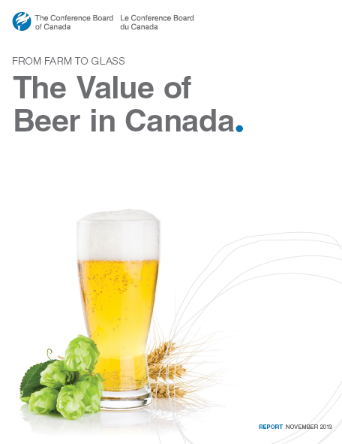
1. Beer Canada Overview
2013 Economic Impact Study
86% of the beer sold in Canada is made in Canada
1 out of 100 Canadian jobs supported by beer
$5.8 billion in taxes generated by beer sales
Beer has 3.5X GDP impact of wine & spirits combined
Every $10 million in beer exports generates 70 FT jobs

Slide 6
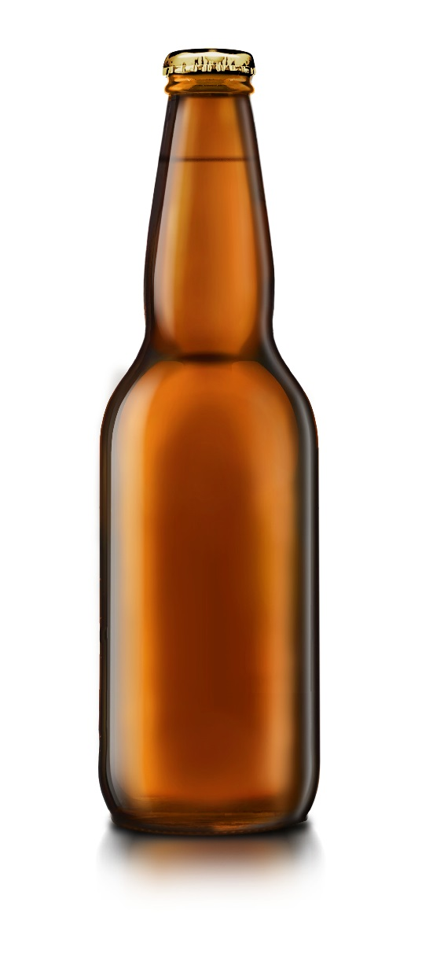
The Industry Bottle in Canada

Slide 7
The Industry Bottle
History
1992 Labatt and Molson reach their own agreement
Other companies negotiate directly with them
By 1997 serious issues began to emerge
Float contamination
Lack of methodology to determine required float size in each region
Ad hoc procedures for float allocation and replenishments
No objective process for resolving disputes
Increasing number of new brewers opting to introduce private mould floats
Violations in the standard float

Slide 8
The Industry Bottle
History
The Standard Mould Bottle Agreement emerges in 2001.
The framework for the 2001 Agreement was based on:
Objectivity
Transparency
Fairness
Signatories agree to use only the Standard bottle for malt-based beverages it manufactures for distribution or sale in Canada in non-metal containers of less than 600ml
Prior to the 2001 Agreement, there were was no formal system in place for enforcing rules and dealing with violations and complaints that come from users of the industry bottle.
40 domestic brewing companies signed on to the original Agreement.

Slide 9
The Industry Bottle
Beer Canada’s Role
Management of the 2001 agreement transferred to Beer Canada
Provide brewers with information on the agreement
Track the regional float situation in Canada
Deal with Label-drop off complaints
10 complaints logged in 2014
Secretary to the Standard Mould Bottle Technical Committee
Responsible for bottle specifications, supplier qualifications, quality assurance
Recommends industry best practices to minimize damage

Slide 10
The Industry Bottle
Today
Nearing 15 years in existence
48 Canadian breweries are signatories to the agreement and use the industry bottle
Technical Committee working on projects to benefit users of the industry bottle:
Secondary supplier, Grupo Vical, approved to manufacture and sell the ISB to 48 signatories.
Qualifying the use of the Narrow Neck Press and Blow manufacturing process to replace the outdated Blow and Blow process.
The NNPB process provides an opportunity to explore light weighting.

Slide 11
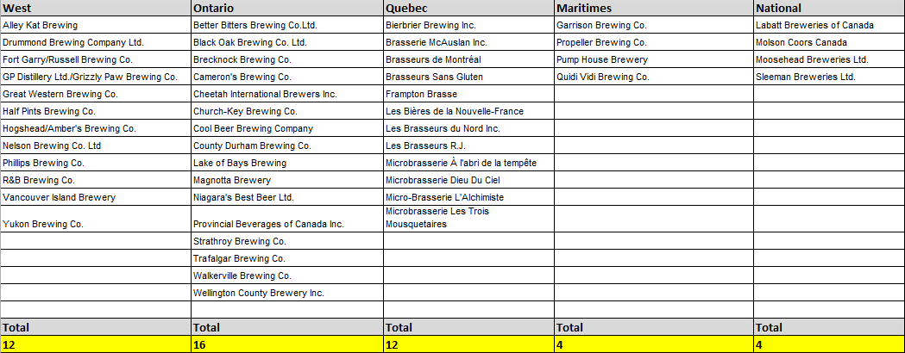
The Industry Bottle
Signatories by Region

Slide 12
The Industry Bottle
Benefits
Sidestep Provincial environmental levy’s for non-refillables
British Columbia: $0.10 for non refillable glass < 1 litre
Ontario: $0.0893 per can and for other non-reusable containers
Québec: indemnity’s must be paid after a registrant goes over 37.5% of non-refillable containers.
Industry bottles are reused on average 15-20 times
Supply security
Secondary supplier approved to manufacture and sell the industry bottle
Savings over custom bottles
Standard packaging improves pallet loading, warehousing efficiency, transportation costs
Great environmental story to tell
Notes:
Sidestep Provincial environmental levy’s for non-refillables
British Columbia: $0.10 for non refillable glass < 1 litre
Ontario: $0.0893 per can and for other non-reusable containers
Québec: indemnity’s must be paid after a registrant goes over 37.5% of non-refillable containers.

Slide 13
The Industry Bottle
The Future

Slide 14
The Industry Bottle
The Future
Notes:
Year 2000: Bottles = 70% Cans = 19% Draught = 11%
Year 2013: Bottles = 43% Cans = 47% Draught = 9%

Slide 15
The Industry Bottle
Evolving the Agreement
Challenges:
500ml bottles becoming increasingly popular
Consumers switching to cans
Increase in imports
Increased competition, increased packaging diversity
2006 = 248 licensed breweries, 2013 = 430 licensed breweries
How do we balance changes in the market with the benefits of the Industry Bottle?

Slide 16
Questions

