Slide 1
2023 Member Referral Program
Notes:
Master Brewers has been leveraging the collective resources of the brewing, fermentation, and allied industries community to continually improve the process, procedures​, and products of our members since 1887. No other professional group offers as many brewer focused benefits.

Slide 2
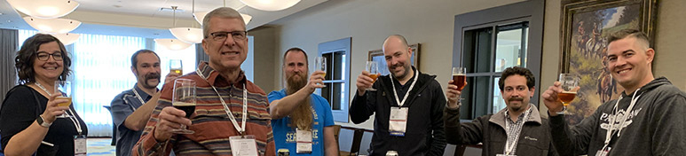
UNITED WE BREWTM
Two things you know:
The value of your Master Brewers membership
Other people in the brewing industry
Notes:
As a Master Brewers member, you'll receive access to educational resources, peer advice in forums, courses on issues including brewery packaging and brewing and malting science, free webinars and podcasts on trending topics, the Technical Quarterly, and more. Membership helps you gain access to resources, insights, and a global network to help you brew the best beer.

Slide 3
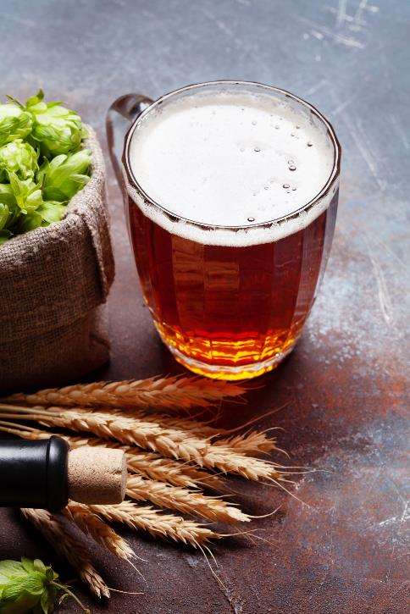
Member referral program
Share Master Brewers with your peers & earn a discount on your membership dues when they join!
Receive 20% discount on your membership for each new member your get to join
Refer 5 new members, and your dues at renewal are free
Notes:
Maximum discount of 100% (for up to 5 new member referrals) applies only to Professional Membership dues. An additional incentive will be awarded for anyone that receives more than 5 new member referrals. District dues are exempt from this offer. Applicants must be first-time Master Brewers members for you to receive a 20% discount. Discounts will not be awarded for lapsed or renewing members.

Slide 4
Getting rewarded is simple
Tell your nonmember colleagues about Master Brewers
Share the 20% discount code NewBrew23 with them, which they can use to earn a discount on their first-year dues
Have them list your name as the “Referring Member” on their application
MBAA HQ will track your referrals, & when you renew your membership, we’ll automatically discount your dues based on the number of your referrals that joined

Slide 5
September-December contest
Grand prize-the district with the highest year to date increase in membership at the end of the year will be awarded $500 to be used towards speaker travel for a district meeting
Monthly District winner will be featured on the MBAA homepage
  District winners will be announced the beginning of Oct, Nov, Dec and Jan for the Districts that had the highest percent increase in membership the prior month
Individual monthly winner (does not have to be from the winning district) will be awarded with MBAA swag and a Visa gift card
  Refer a new member and be entered into the monthly prize drawing. Refer multiple members, earn multiple entries into the drawing!

Slide 6
Member referral program
Resources available online to share
Questions? Contact our membership team at mbaa@mbaa.com

Slide 7

UNITED WE BREWTM

