Slide 1
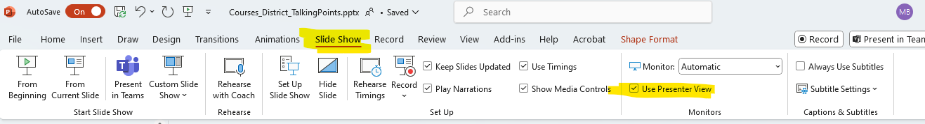
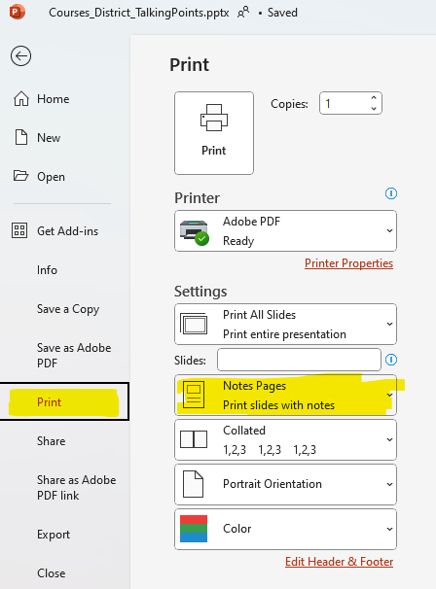
How to use this deck
Please use the speaker script provided in the “notes” under each slide.
  If you don’t see the script, be sure to open the notes panel at the bottom.
  When you’re ready to present, select “presenter view” so you can see the script while you present.
  Alternatively, you can print the script

Slide 2
How to use this deck
On slide 9 there is a spot to add information about a district scholarship if your district has one. If not, you can delete that part.
In the script on slide 8 there is a spot to invite past course participants to speak to their experience if they want.
Note: We also encourage you to reach out to past course participants to share their learning with your district by presenting their capstone projects. We have provided a list of course participants from your district from the last 2 years.

Slide 3
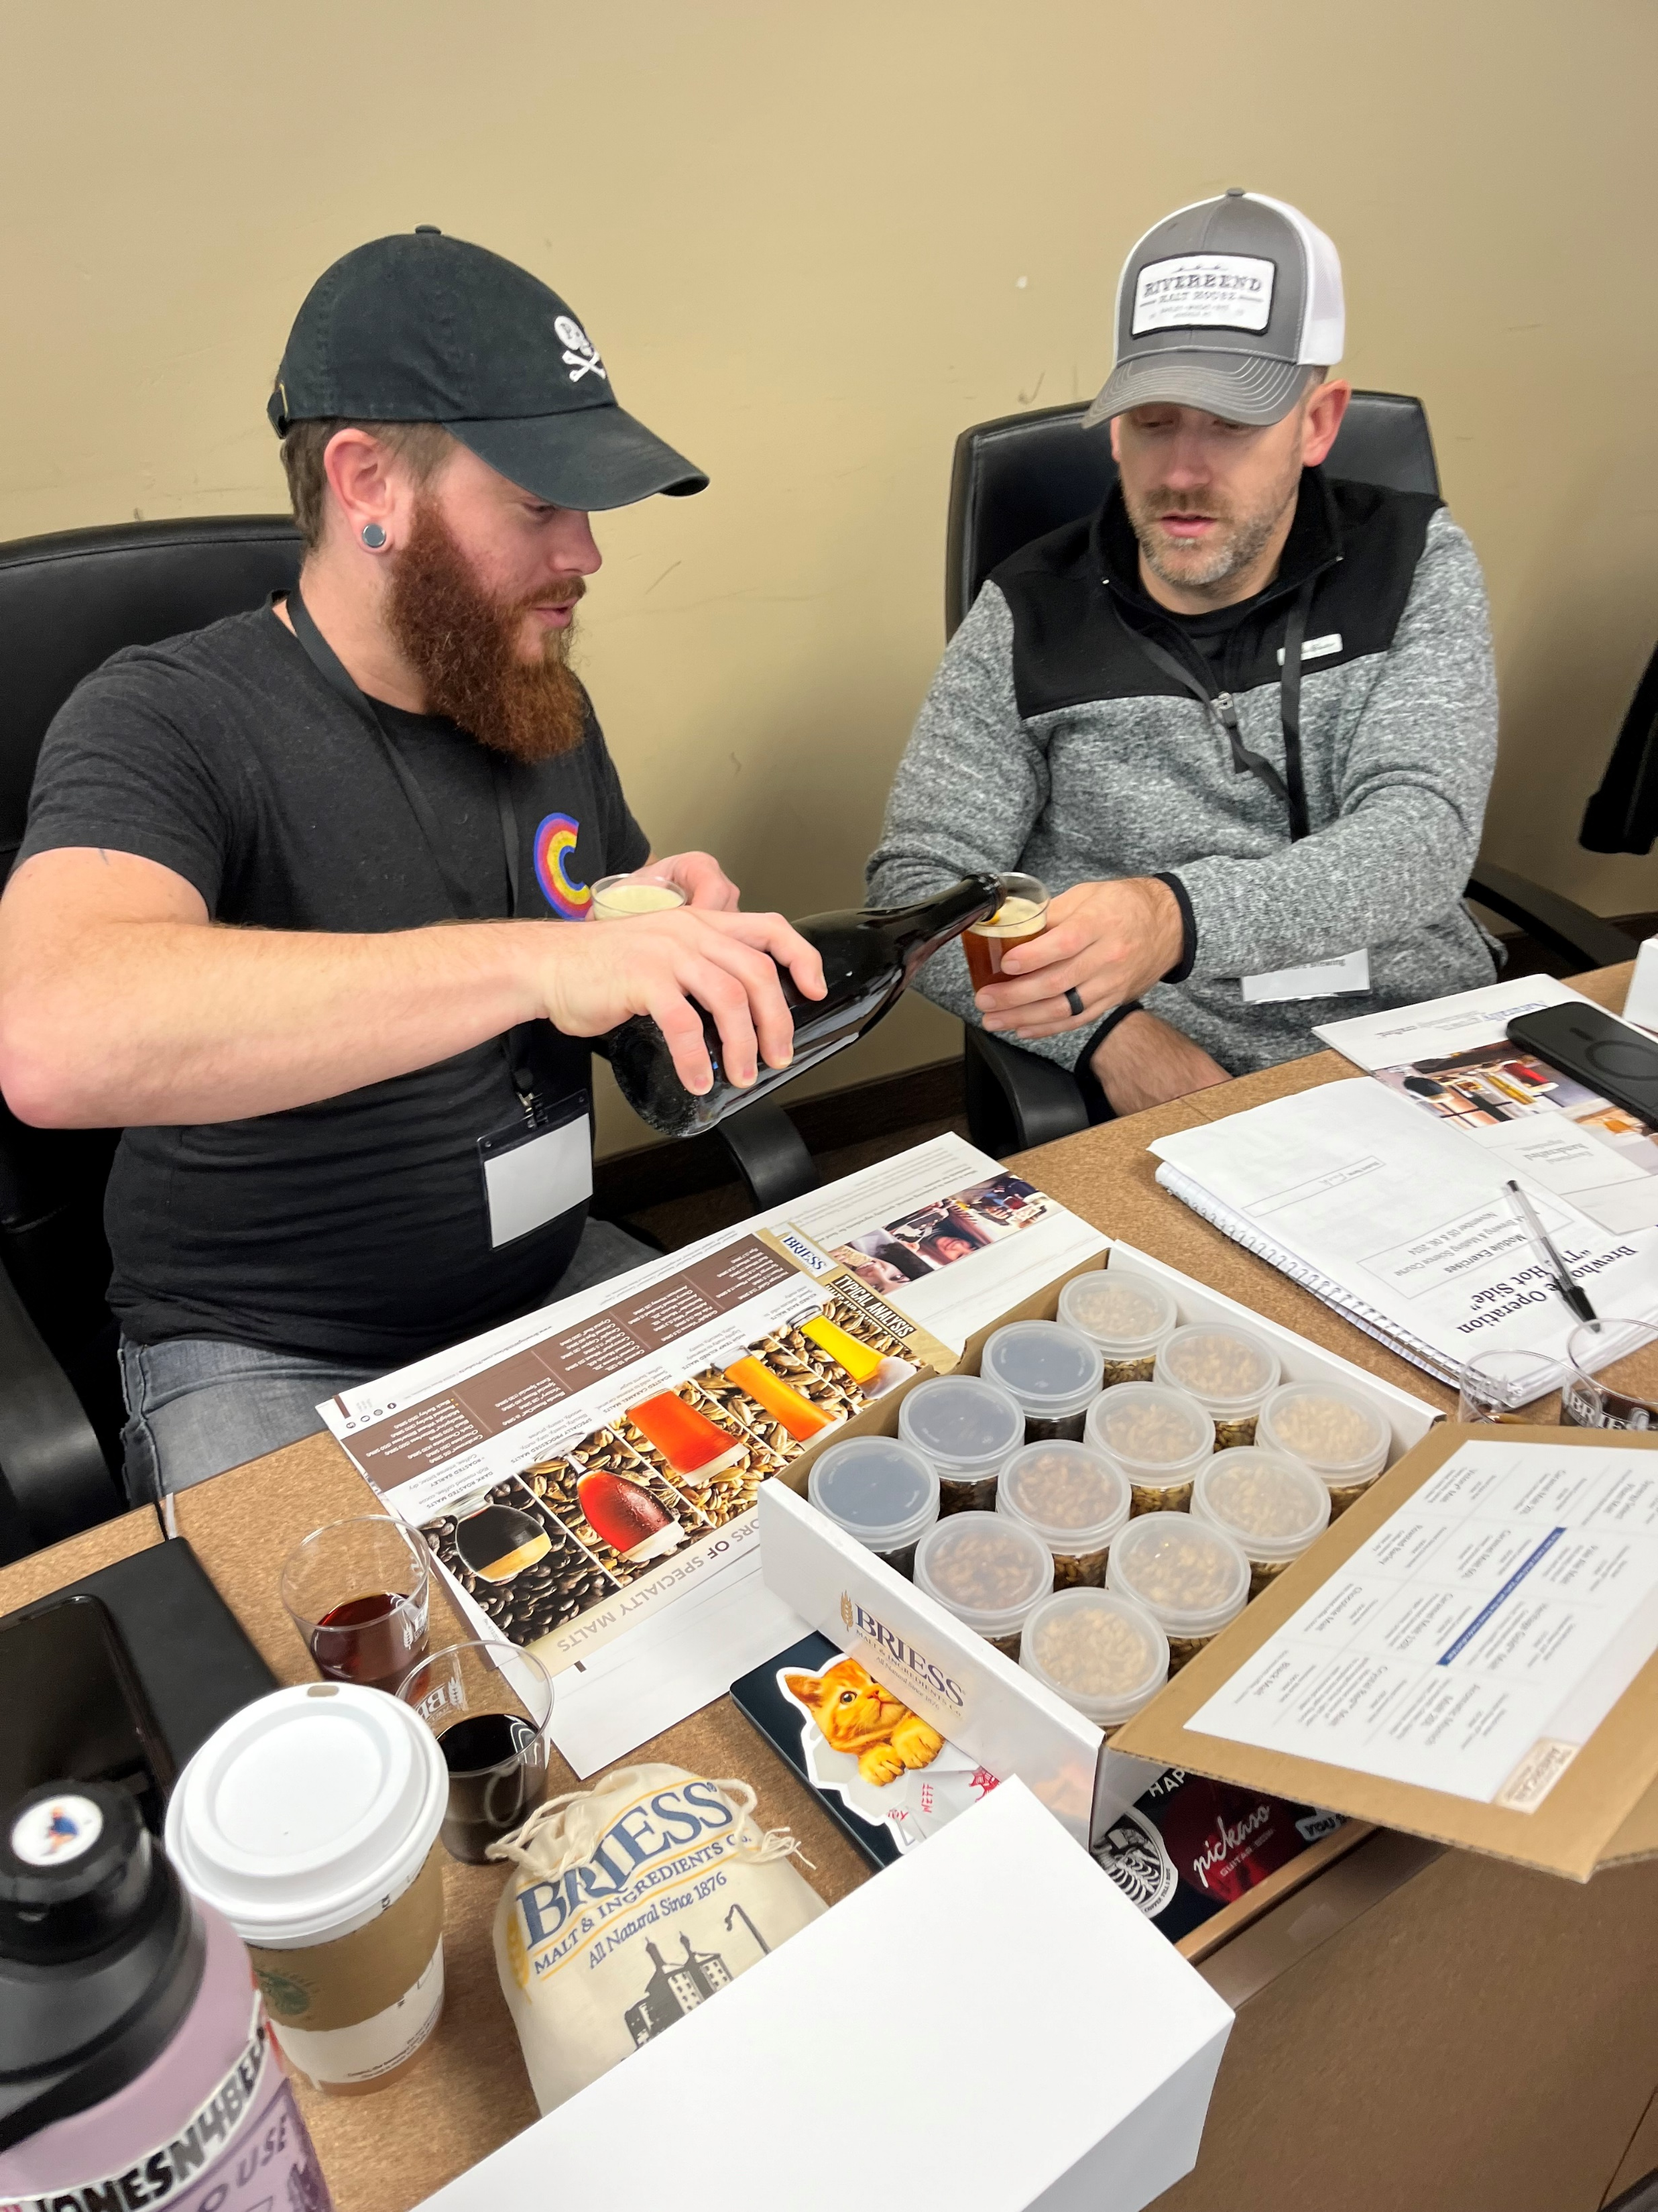
Master Brewers Courses
Updates and Opportunities
mbaa.com/courses
Notes:
The Master Brewers courses have undergone significant updates in recent years, making them some of the most exceptional learning experiences in the brewing industry. We also continue to add to the Master Brewers course catalog with exciting new, fully virtual options.
In this overview, we’ll highlight what these courses offer and provide information on available scholarship opportunities to help you attend.

Slide 4
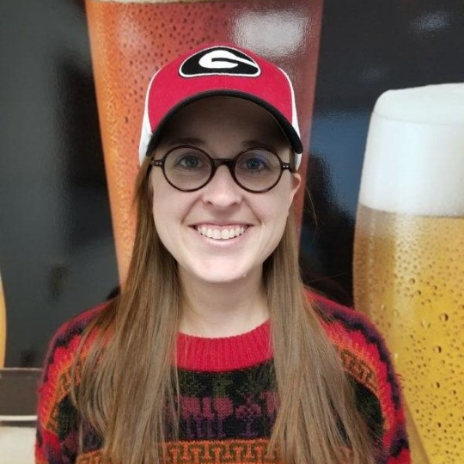

2025 Full Courses
Brewery Maintenance Systems
Begins May 22
Course Director: Katrina Bruner
"I learned much more than I anticipated and walked away with a well-rounded perspective on equipment maintenance. I would highly recommend this course for anyone looking to broaden their knowledge of these topics."
- Daniel Anderson, Pinthouse Brewing
2024 Course Participant
mbaa.com/courses
Notes:
In 2025 we will be offering both the Brewery Maintenance Systems and Brewing and Malting Sciences “full” courses. Brewery Maintenance Systems starts in May and is directed by Katrina Bruner, Assistant Brewmaster @ AB InBev.
Click on the slide or the forward button to play the audio from Katrina.

Slide 5
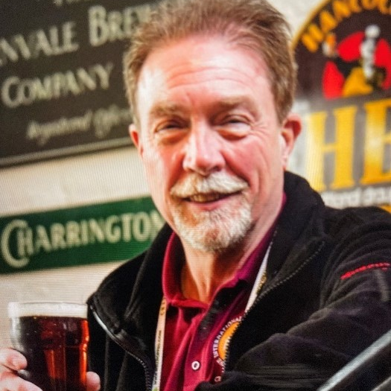
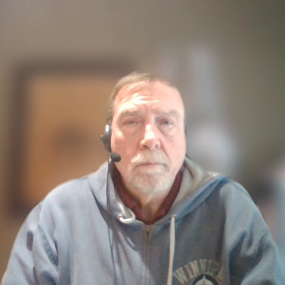
2025 Full Courses
Brewing and Malting Sciences
Begins August 21
Course Director: Rob McCaig
"I would not second-guess the opportunity to take this course, or any others offered by MBAA. This course is an experience of a lifetime!"
- Steve Greene, Molson Coors
2024 Course Participant
mbaa.com/courses
Notes:
The Brewing and Malting Sciences course begins in August 21 and is directed by Rob McCaig, former Master Brewers President with 40+ years of hands-on experience in international malting and brewing operations including product and process development.
Click on the slide or the forward button to play the audio from Rob.

Slide 6
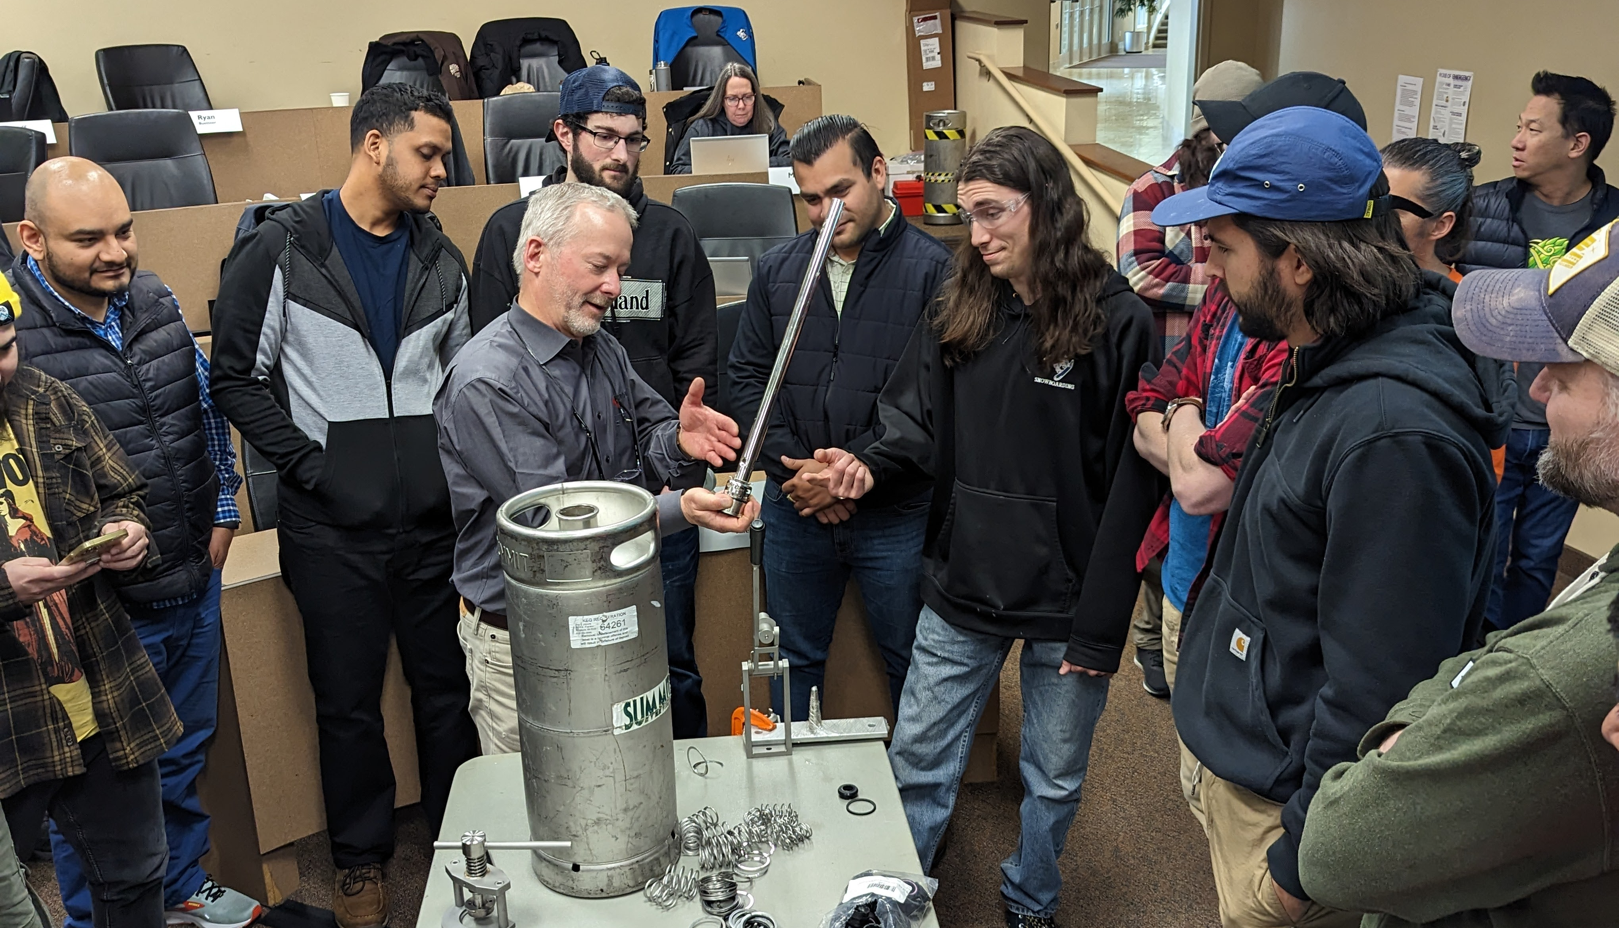
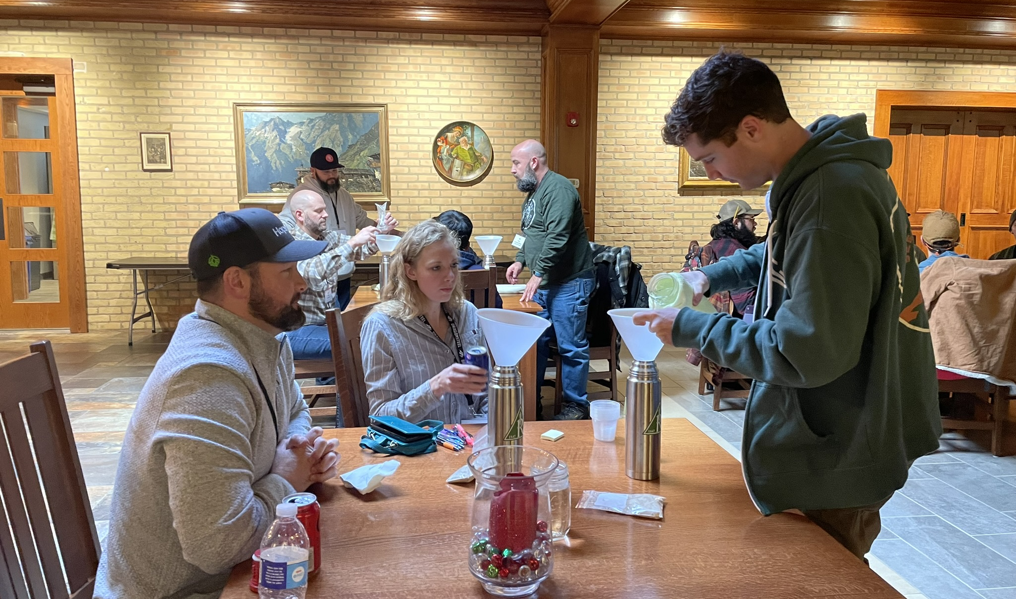

What to Expect
Learn from the best!
20+ subject matter experts
Share your experience and learn from peers
Flexible learning with a focus on collaboration and networking
6 weeks virtual + 4-5 days on-site
Weekly live Q&A sessions
Online discussion forum
Hands-on practice and live demonstrations
Pre-recorded lesson materials
mbaa.com/courses
Notes:
These courses tap into the extensive Master Brewers network, bringing together an exceptional lineup of industry-leading subject matter experts. As a participant, you'll have the opportunity to learn from over 20 top professionals. Master Brewers also values the collective wisdom of all participants, offering ample opportunities to share your experiences and gain insights from others.
The course format blends the flexibility of online learning with the collaborative energy of in-person experiences. Participants will engage in six weeks of virtual coursework, followed by approximately one week of in-person learning.
Each week of the virtual portion involves 4-5 hours of independent study, followed by a live Q&A/Discussion session. Additionally, participants can interact and exchange ideas in the online community, posting questions and sharing resources related to that week’s lesson topics.
The in-person portion of the course focuses on topics that are best learned through direct experience—those with hands-on or sensory elements, live demonstrations, practical exercises, and applications in local facilities.

Slide 7
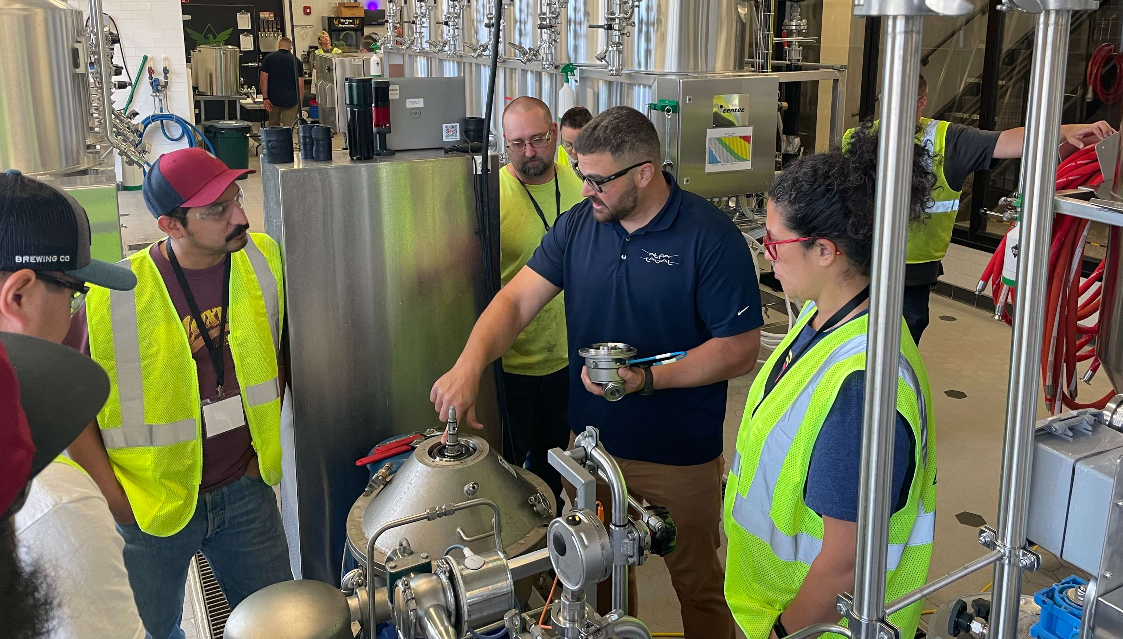
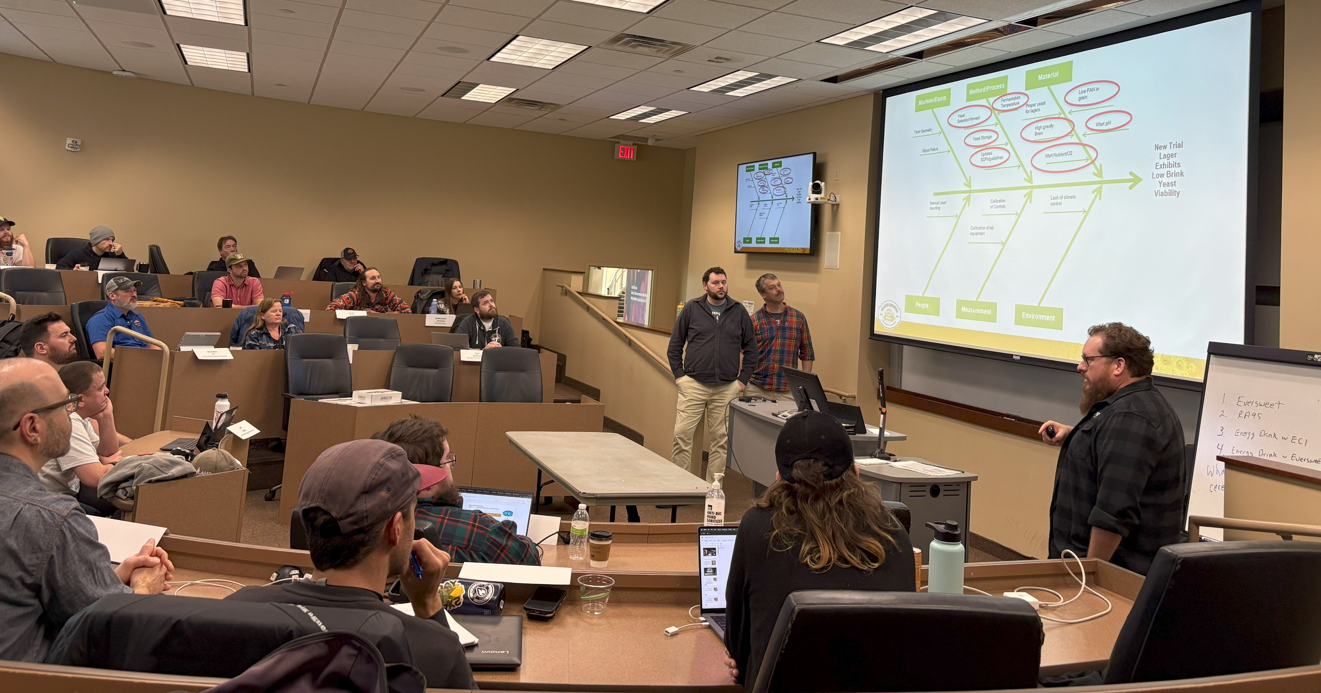
Go home with...
Immediately applicable skills and tools
Job aids
Capstone projects
Synthesize and apply what you learned to solve a problem in YOUR brewery
Expert advice: Best practices, tips & tricks, troubleshooting techniques
A network of peers and experts
Bring home a ready-to-use plan to save time & money
mbaa.com/courses
Notes:
Course participants go home with a deep network of industry peers and experts, job aids, and resources to reference for future projects.
The capstone projects offer each participant the opportunity to apply their learning to solve real challenges within their own company. With expert guidance and peer feedback, they leave with a tailored improvement plan, ready for implementation to address their unique needs and challenges.

Slide 8
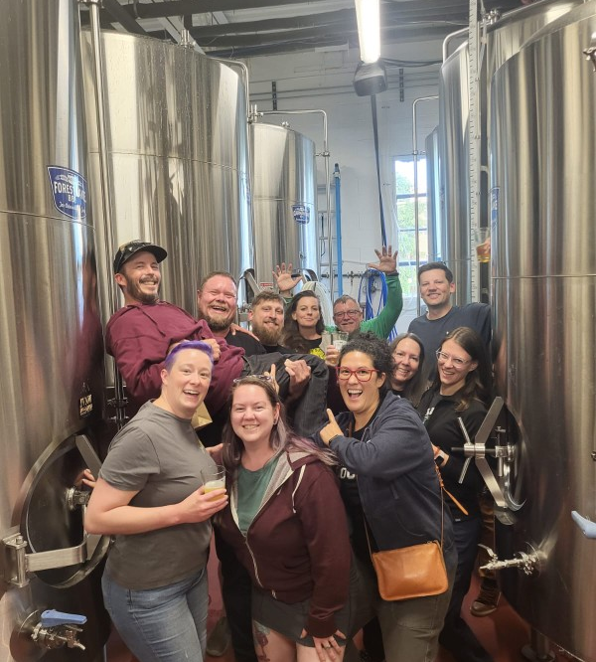
What are participants saying?
“…the interactions with fellow students and contacts/friends made is worth more than you can imagine.”
2024 Maintenance course participant
“This course is essential to understanding brewing from multiple facets. A true grain to glass overview.”
2024 Brewing and Malting course participant
“Do it! This was the most engaging and fun course I have ever been to.”
2023 Brewing & Malting course participant
“... the course was so well thought out and is geared towards people in many different roles at breweries of all sizes.”
2024 Maintenance course participant
mbaa.com/courses
Notes:
Past course participants have a lot to say about the value of these in-depth learning opportunities. The statements on this slide are representative of what we hear about the courses every year: Invaluable networking, in-depth analysis of a wide range of topics, and the immediately applicable tools and tips are some of the most common themes.
You don’t have to look too deep in our district roster to find someone who has benefited from them. [Insert names here if desired]
Note only: Consider inviting past participants to say something or present their capstone project if they are in attendance.

Slide 9




Scholarship Opportunities
Free Money – Apply Today!
Master Brewers National Scholarships
mbaa.com/scholarships
District Scholarship Opportunities
mbaa.com/courses
Notes:
There are a 4 different scholarship opportunities available through Master Brewers National. It is easy to apply and they help ease or, in some cases, entirely cover the costs of the course.
[Insert information about the district scholarship if there is one].

Slide 10


Brewery Packaging Technology – Returning in 2026
*NEW* Brewery Packaging Light Course available now
Fully on-demand! Learn at your own pace.
Key topics from the “full” Brewery Packaging Technology Course
mbaa.com/packaginglight
mbaa.com/courses
Notes:
A note about the Brewery Packaging Technology course: it is not running in its “full” form this year, but it WILL be returning in 2026. The NEW Brewery Packaging Light course covers several of the same topics in a fully on-demand format and is open for registration now.

Slide 11



*NEW*Course: Brewery Calculations Basics
Begins April 1, 2025
Registration opens Feb 18
James
Moriarty
mbaa.com/brewcalcs
5 weeks of virtual learning: Recorded lessons, readings and practice
Weekly live discussion/ Q&A
Build a spreadsheet calculation tool tailored to your specific needs
Textbook: A Handbook of Basic Brewing Calculations by Stephen R. Holle
Weston
Barkley
mbaa.com/courses
Notes:
A brand-new, fully virtual course begins on April 1! Instructors James Moriarty and Weston Barkley will guide participants through the essential brewery calculations required to develop recipes. Attendees will not only learn the "why" and "how" behind these calculations but also build a practical spreadsheet tool to integrate the formulas and apply them to various brewing processes. Registration opens in February.

