Slide 1
B Corp Certification for Craft Breweries
Sustainability & Environment Session

Slide 2
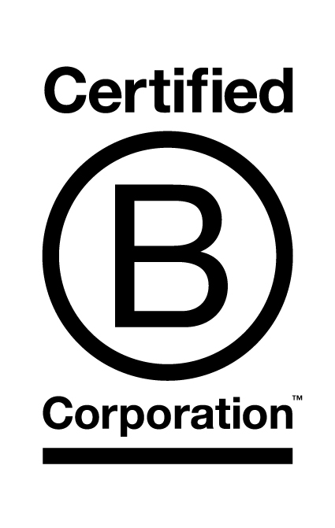
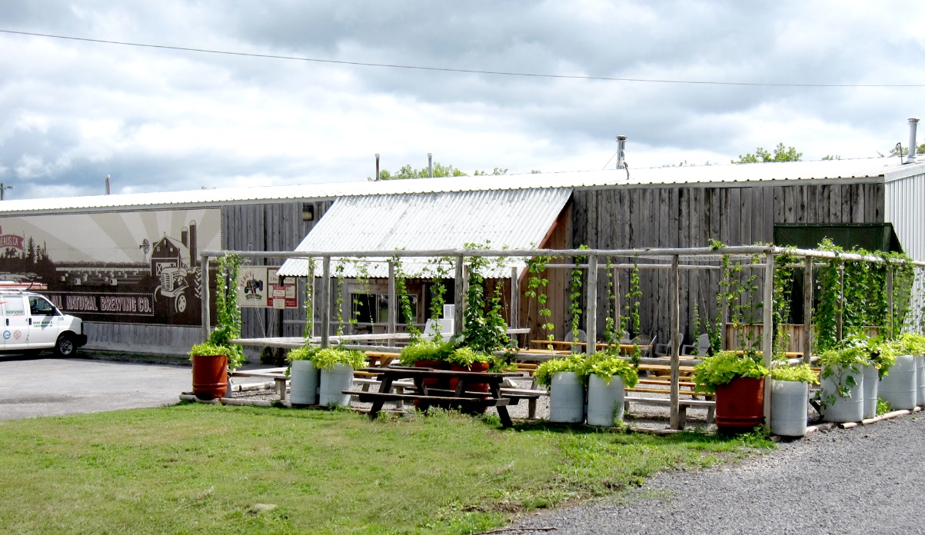
Sustainability &
Making Craft Beer

Slide 3
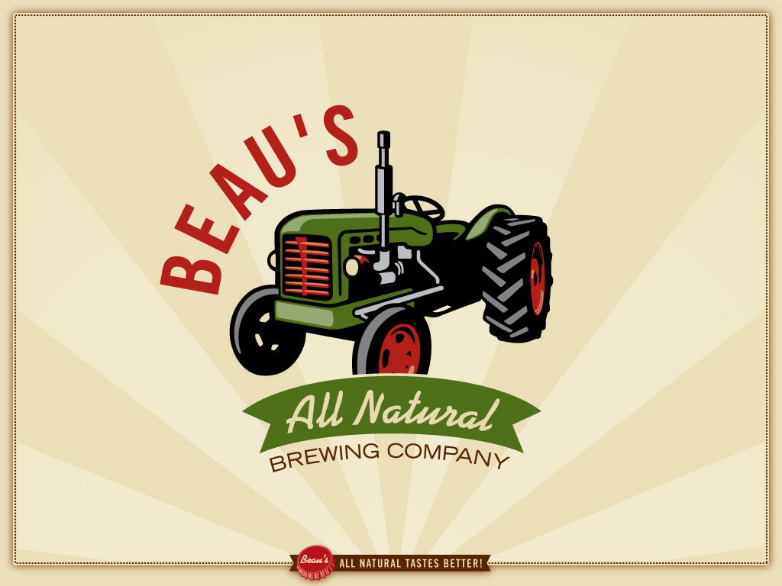
Photo Album
by Jennifer

Slide 4
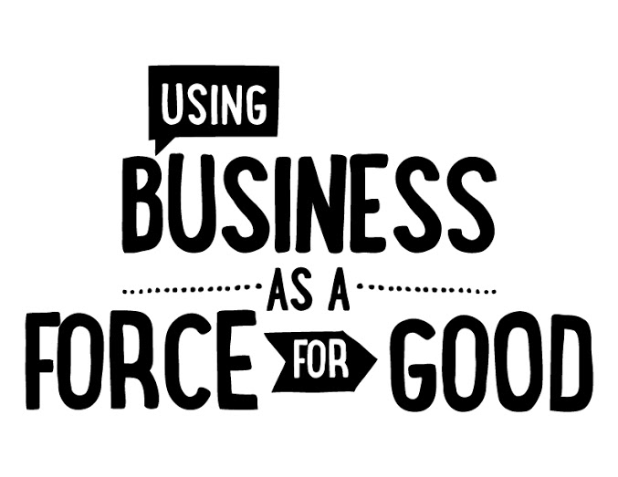
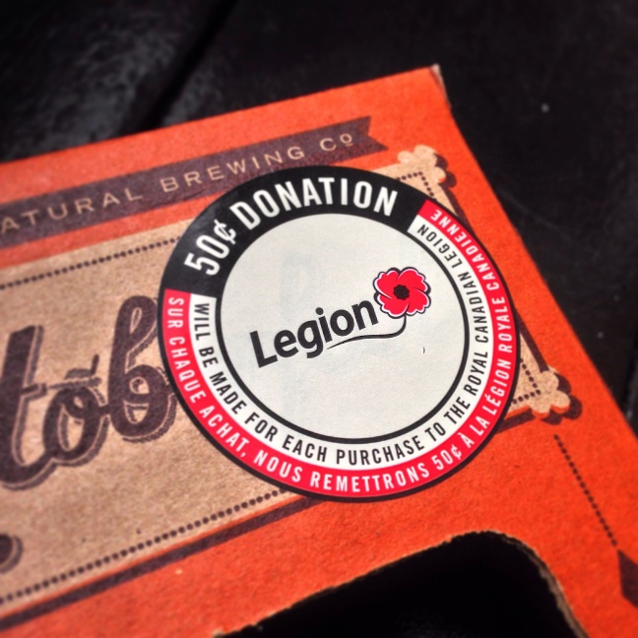

Slide 5
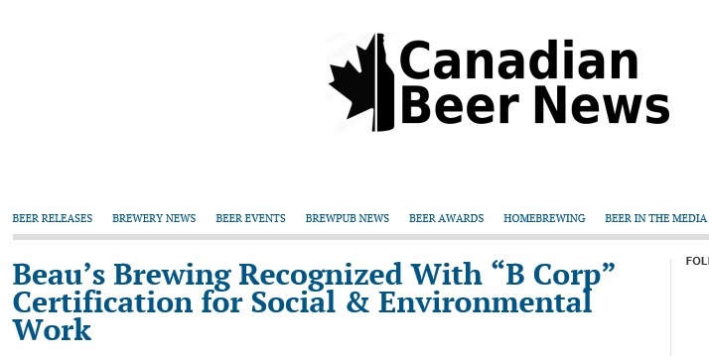
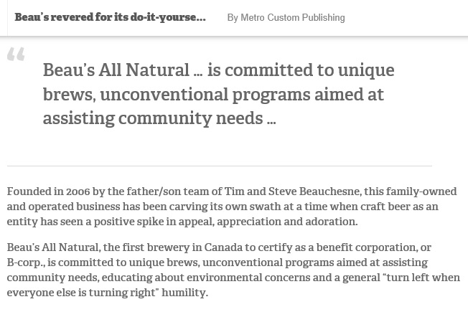
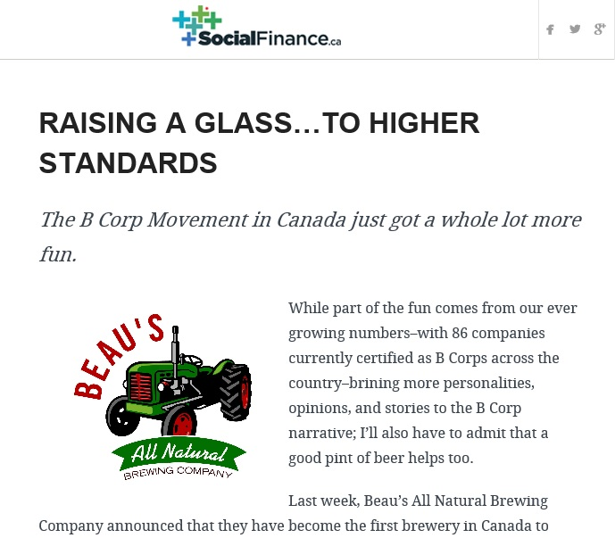
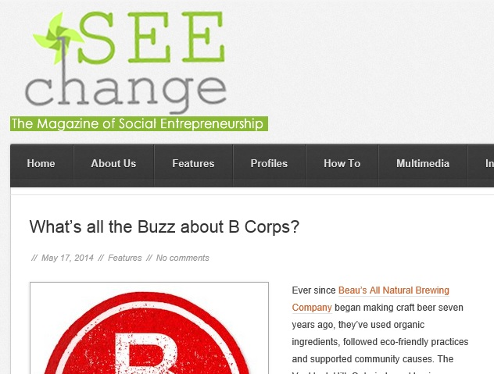

Slide 6
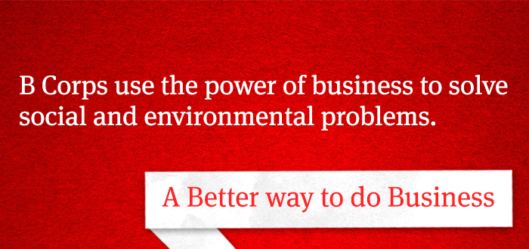
What is a B Corporation?
B Corp certification is to sustainable business what Fair Trade certification is to coffee or Organic certification is to milk.
B Corps are certified by the nonprofit B Lab to meet rigorous standards of social and environmental performance, accountability, and transparency.

Slide 7
How does a company become certified?
Step 1: Meet Performance Requirement
Complete the B Impact Assessment and earn a reviewed minimum score of 80 out
of 200 points
Step 2: Meet Legal Requirement
Determine the path for your corporate structure and state of incorporation
Step 3: Make it Official
Sign the Declaration of Interdependence

Slide 8
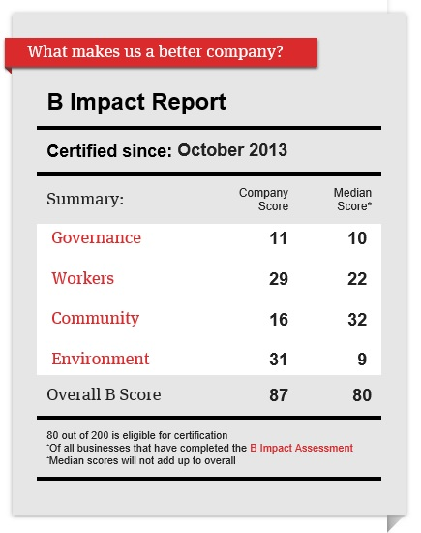
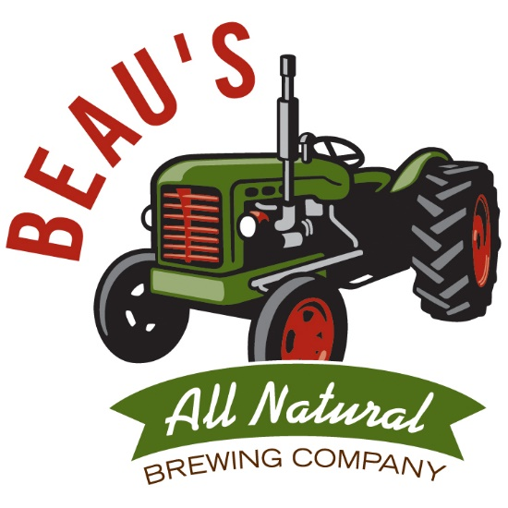

Slide 9
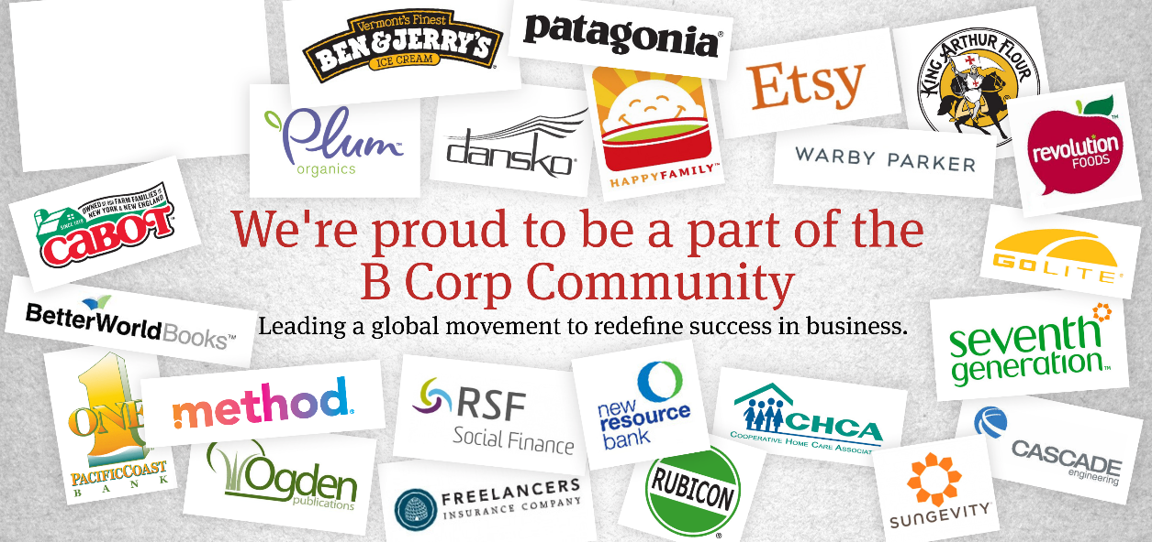
B
1,200 B Corps worldwide
125 in Food and Beverage
6 Breweries

Slide 10
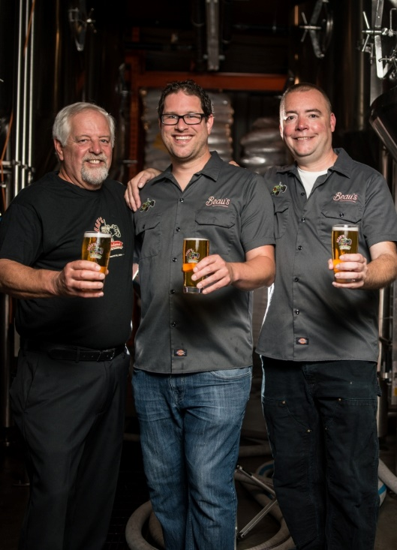

Slide 12
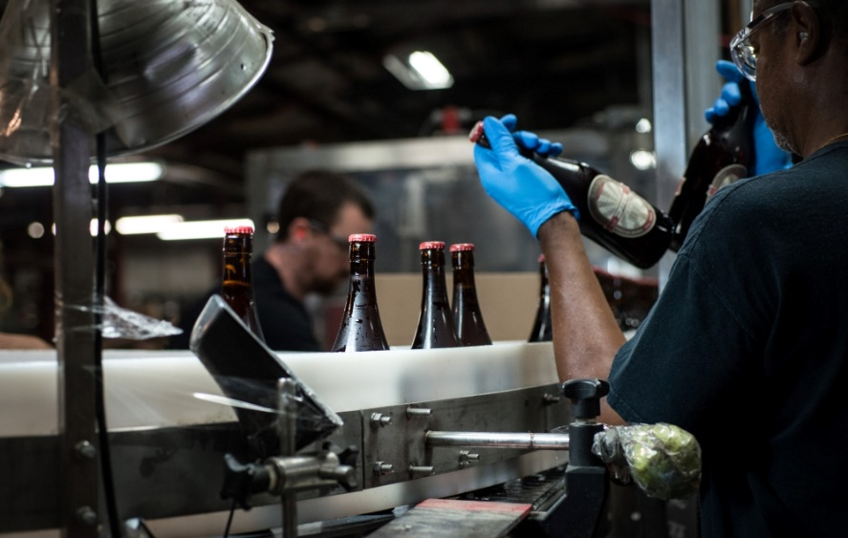
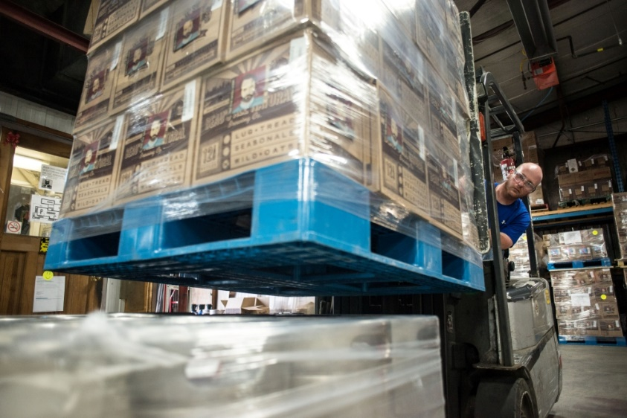
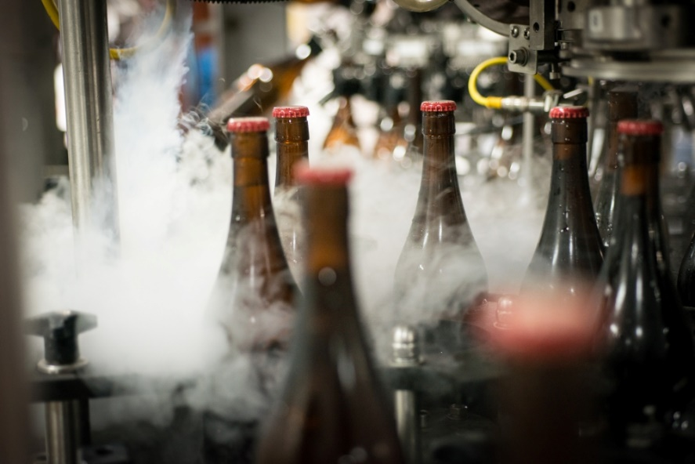
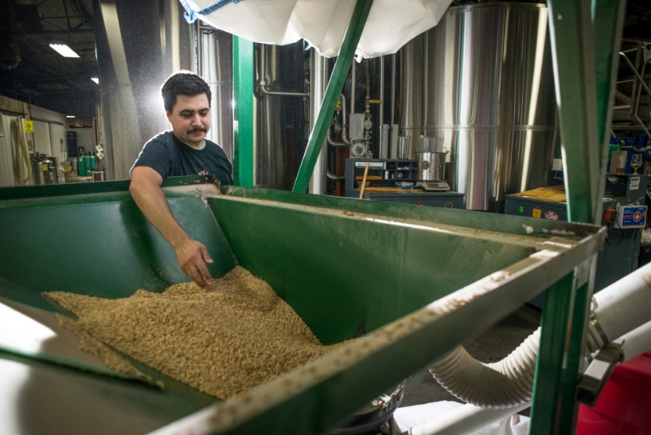

Slide 13
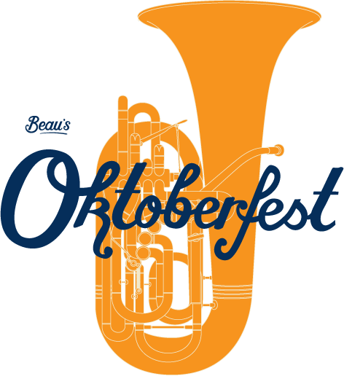
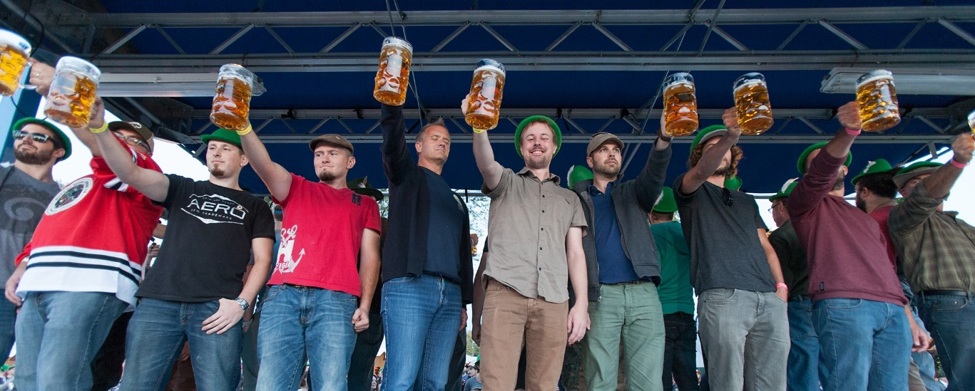

Slide 14
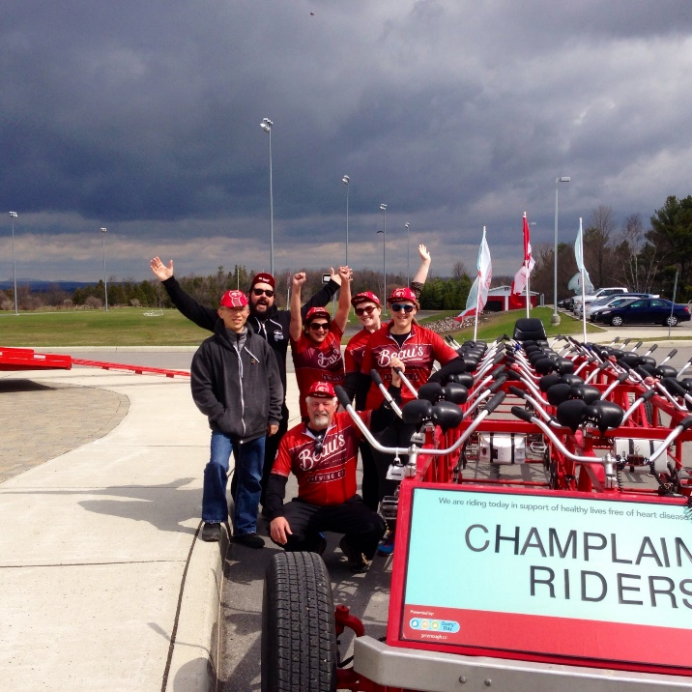
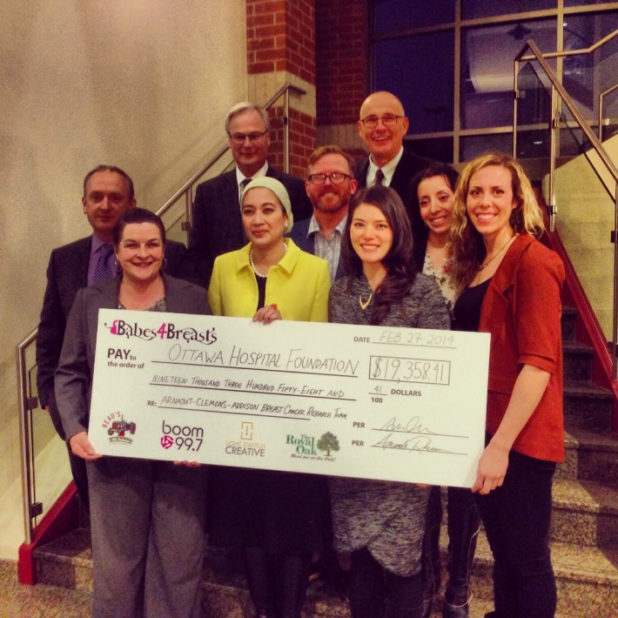
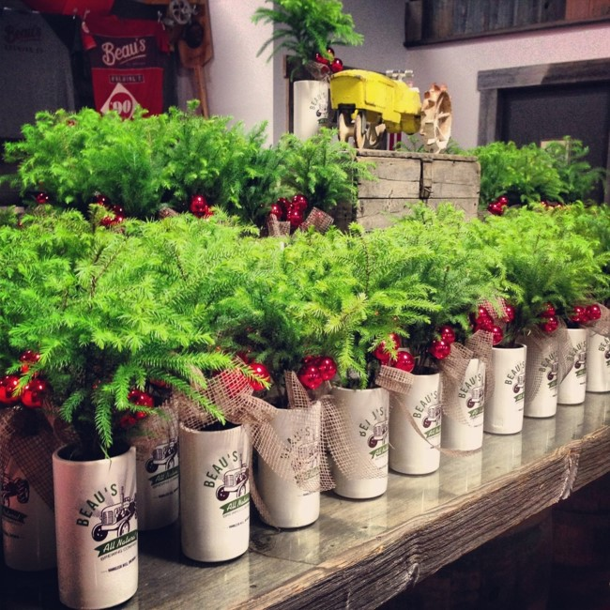
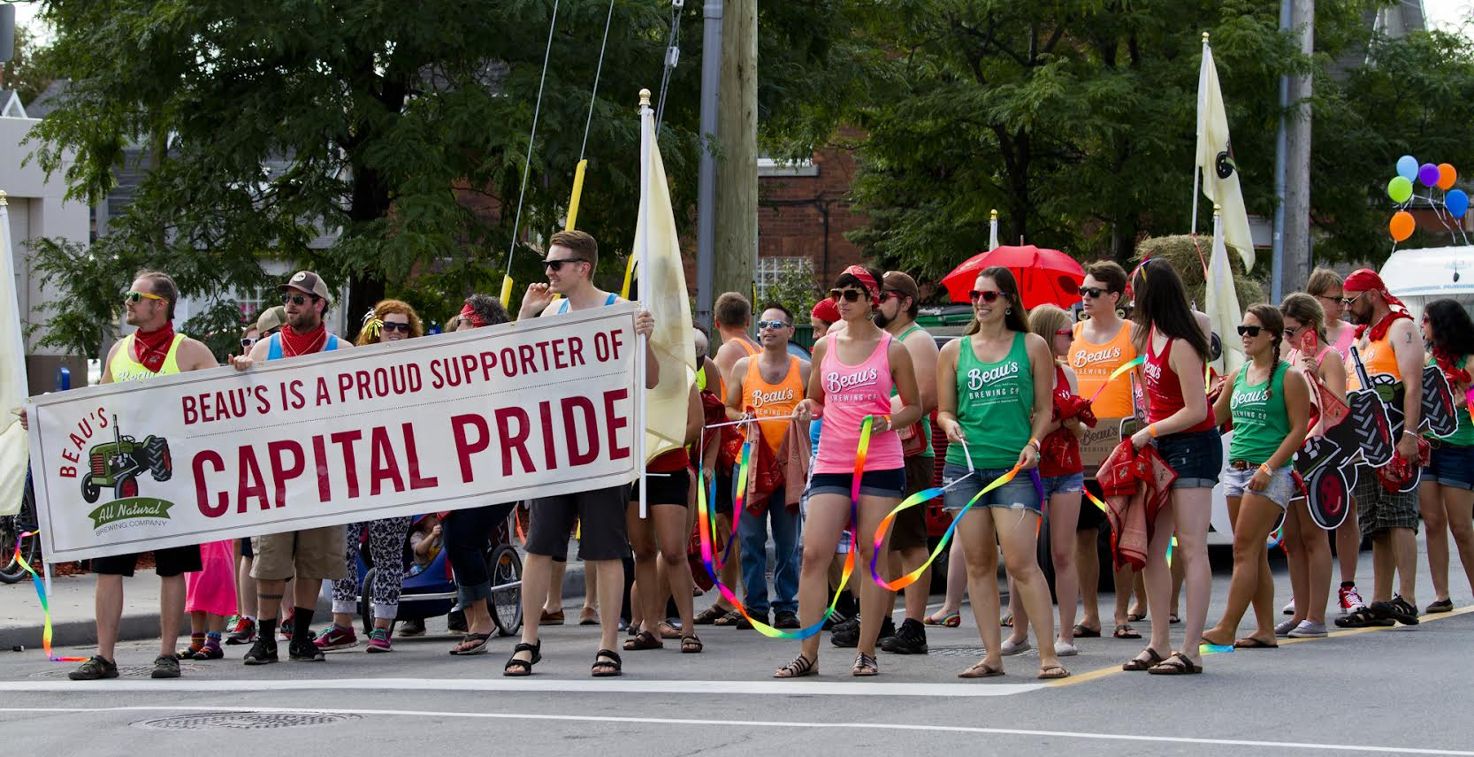

Slide 15
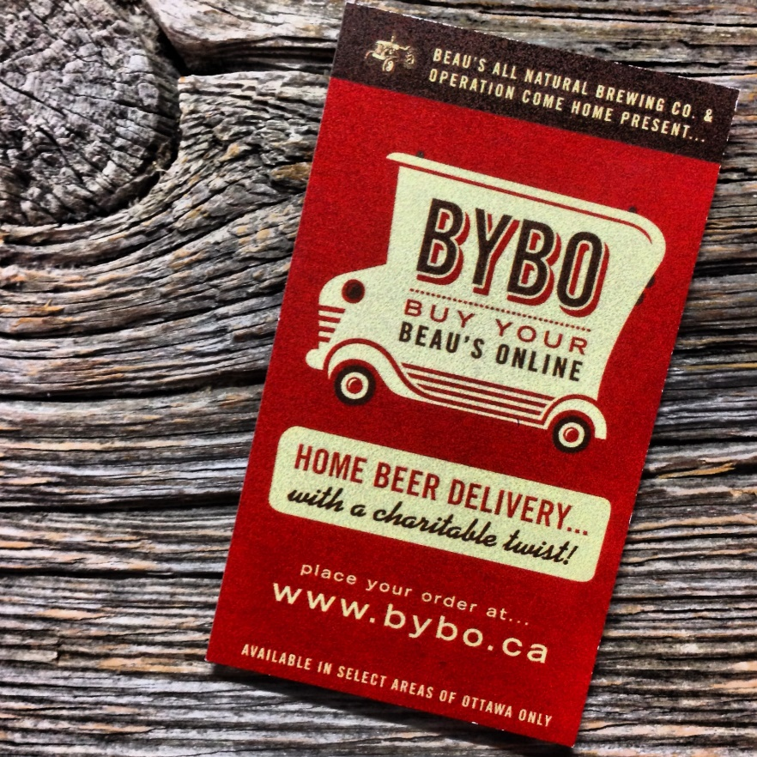
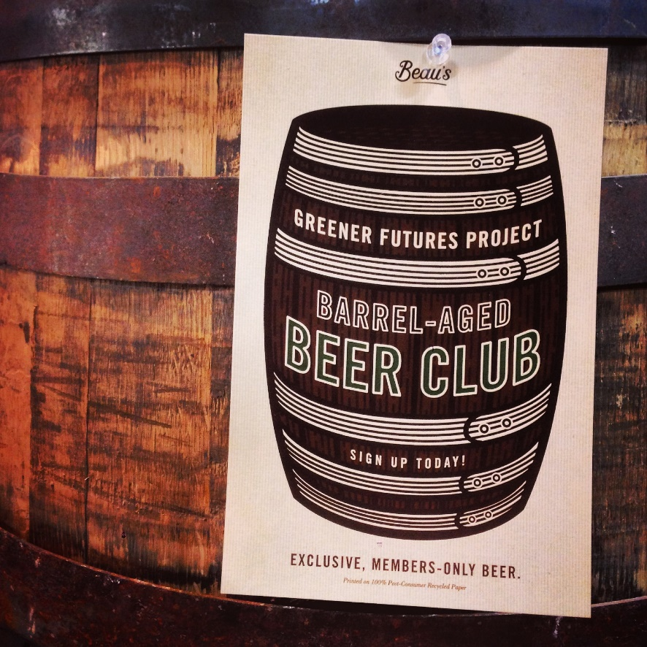

Slide 16
What You Need to Get Started
Basic financials (Revenue, net income, non-labour expenses)
Written mission statement
Number of employees (FT/PT), retention and turnover data, diversity metrics
Job creation & wages metrics
Total company energy use (kWh) & % from renewable resources
Total greenhouse gas emissions (metric tonnes of CO2 equivalent)
Total water use
Supplier data – significant suppliers & value of purchases from them, audit of their environmental/social practices and certifications
# and overall % of Local suppliers (200 miles or 322 km)
Community service hours contributed, charitable giving total & list of charities

Slide 17
Cost of B-Corp Certification
Brewery’s Annual Sales | Annual Fee
$0-$999,999 | $500
$1 MM - $4,999,999 | $1,000
$5 MM - $9,999,999 | $2,500
$10 MM - $19,999,999 | $5,000
$20 MM - $49,999,999 | $10,000
$50 MM - $99,999,999 | $15,000
$100 MM+ | $25,000

Slide 18
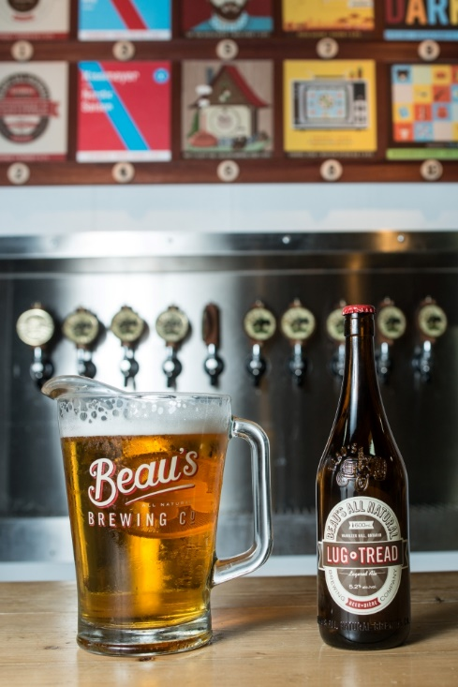

Slide 21
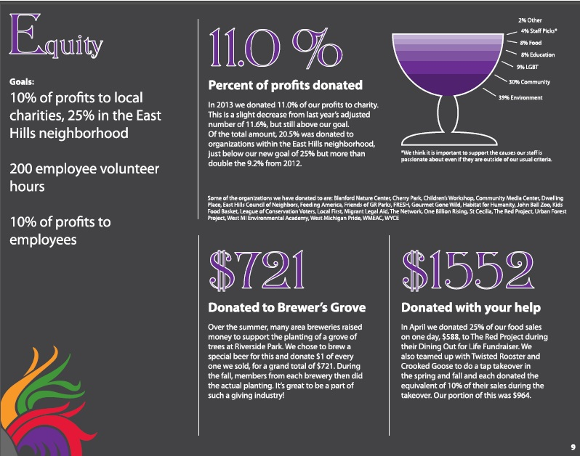

Slide 23
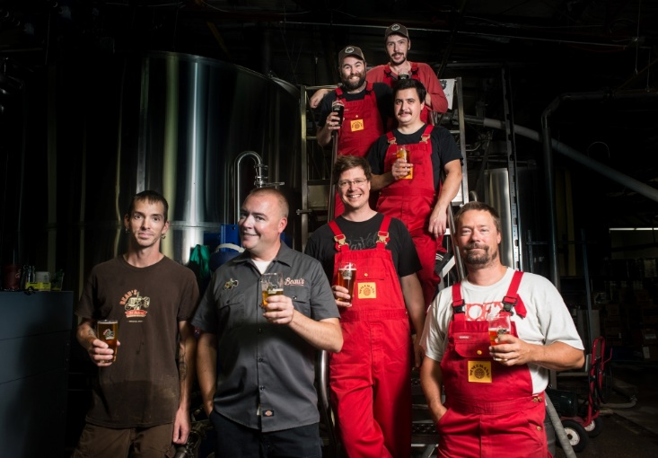

Slide 24
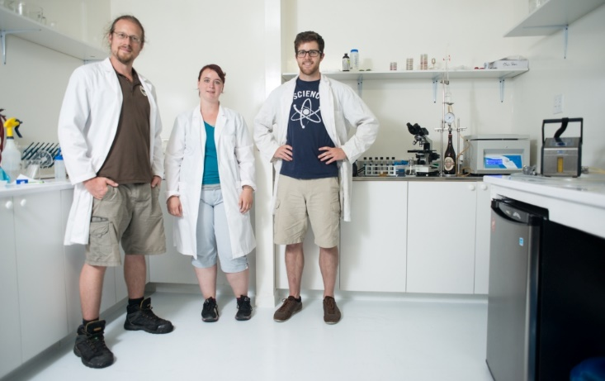

Slide 25
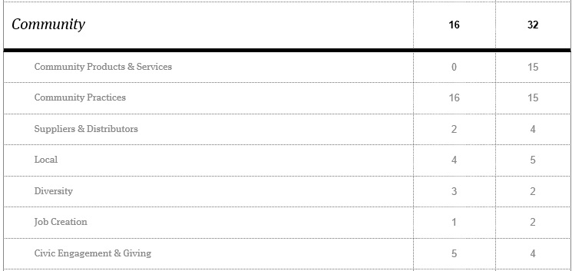

Slide 26
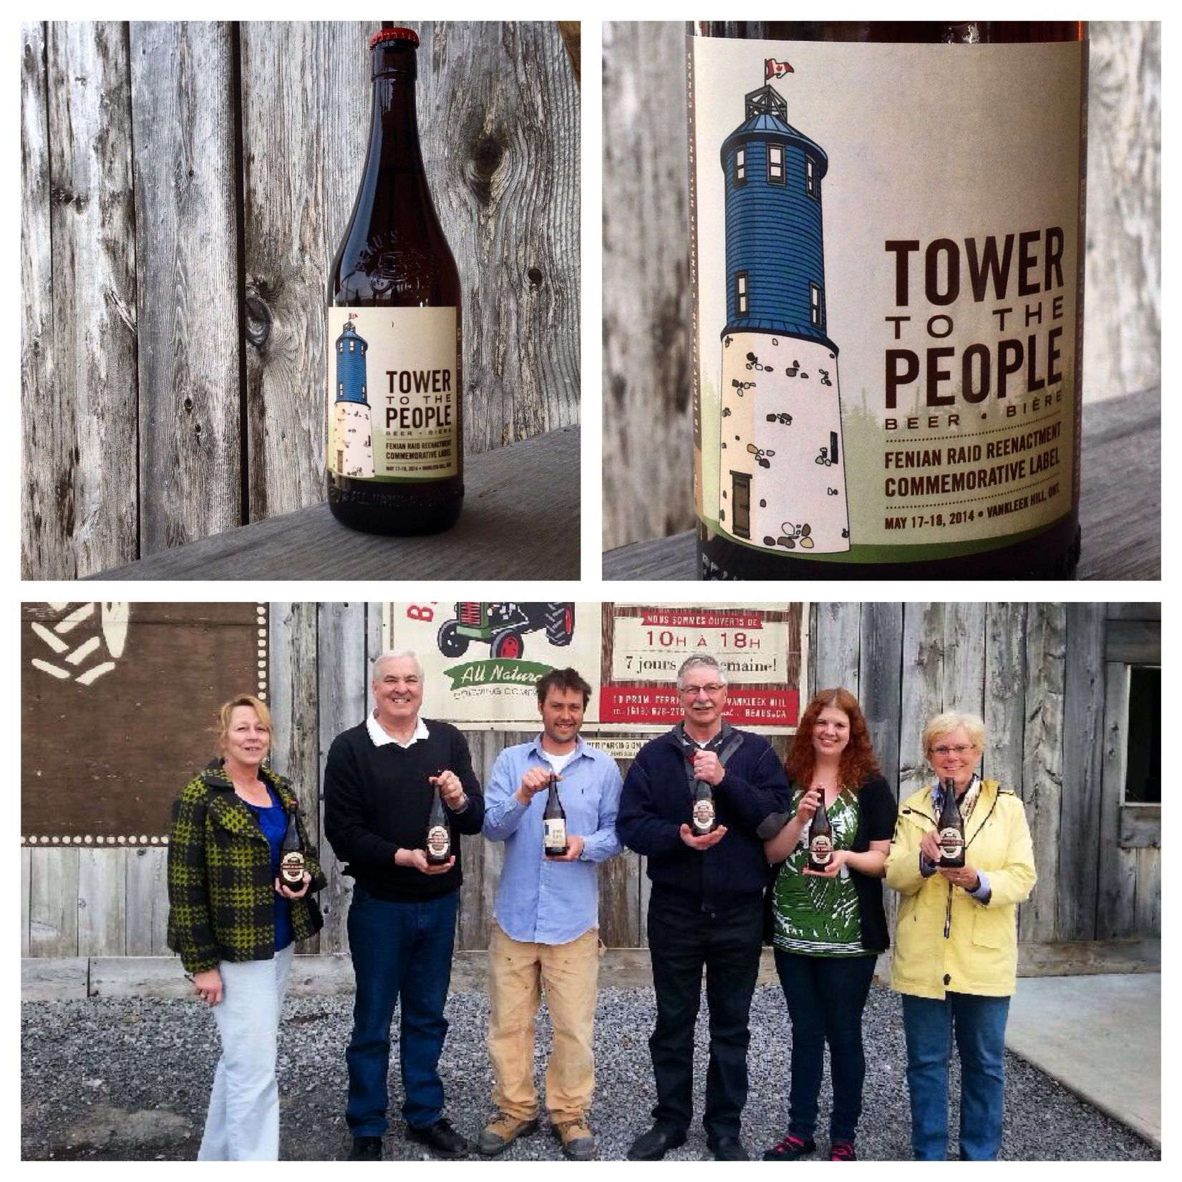

Slide 27
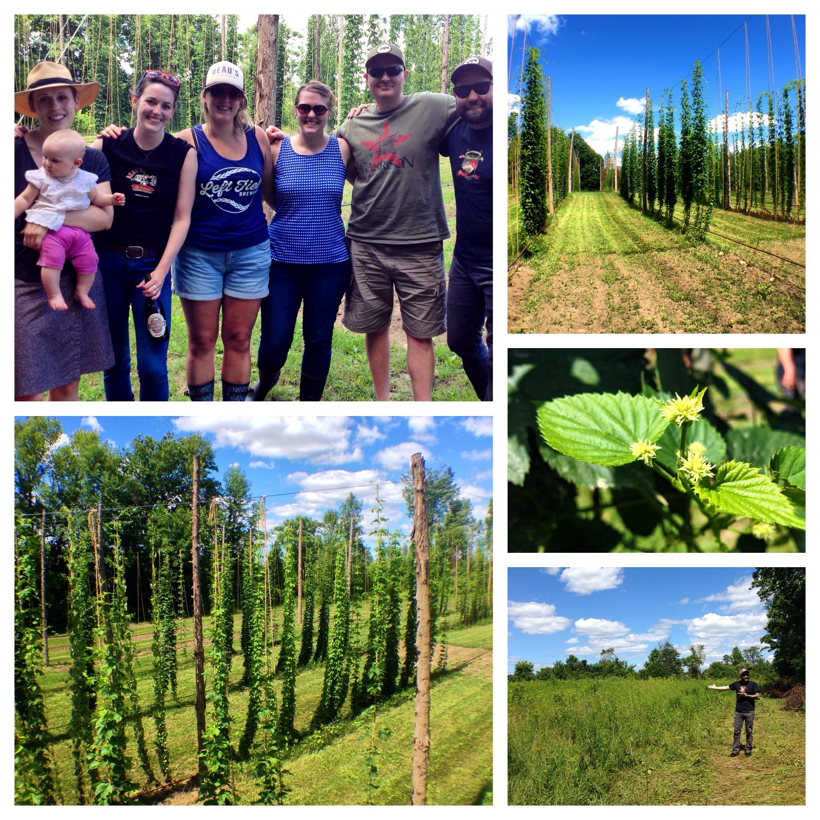

Slide 28
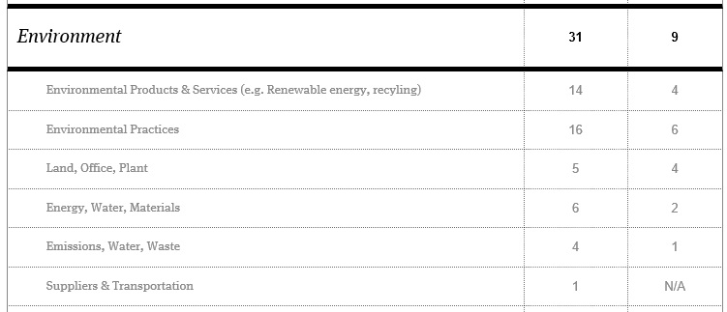

Slide 29
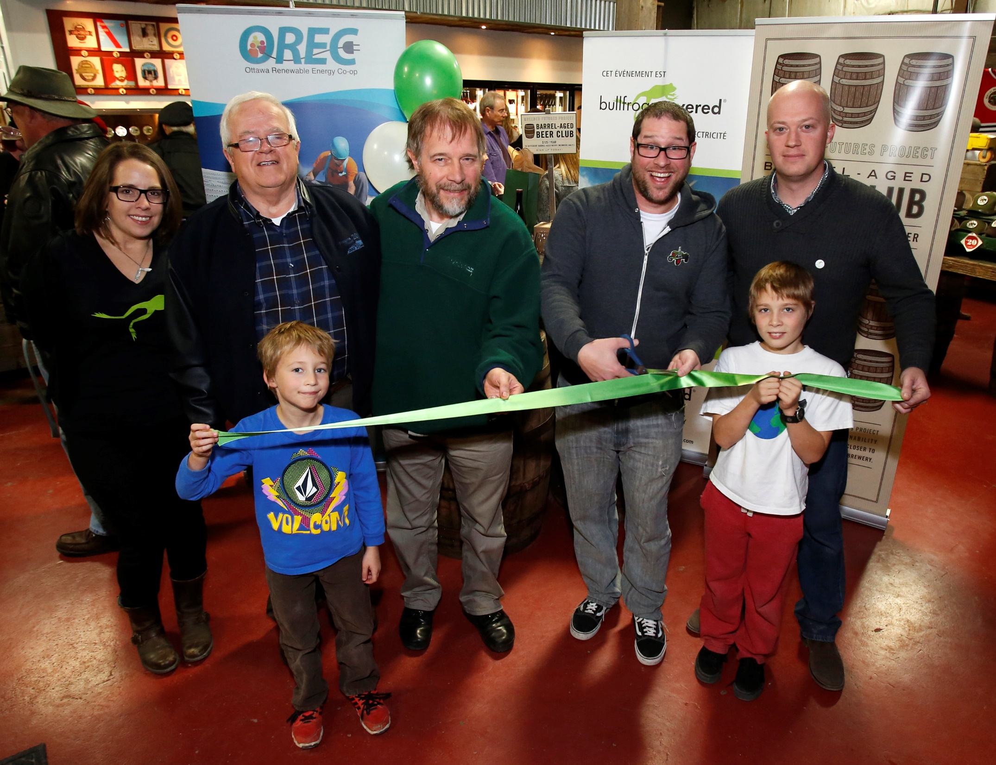

Slide 30
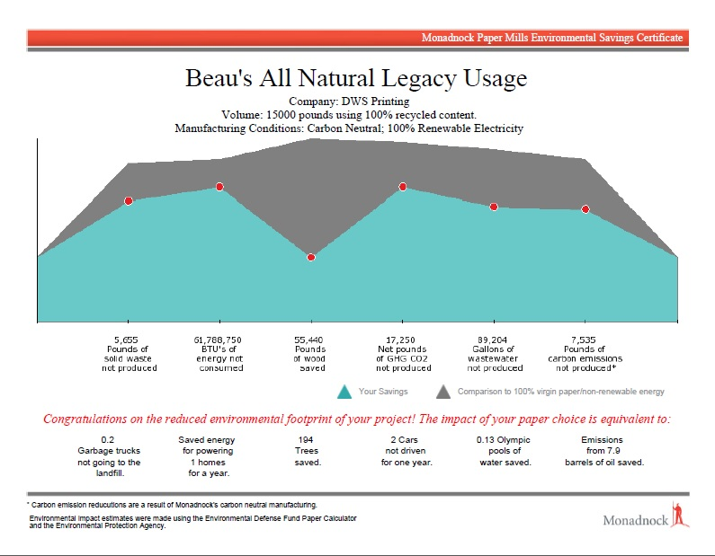

Slide 31
BREWERY | SCORE
New Belgium | 120
Bison | 93
Picaroons | 92
Bull City Burger and Brewery | 90
Beau’s | 87
Brewing Vivant | 86

Slide 32
Why Become a B Corp?
B Corps want to be part of something bigger than themselves, but for many, becoming a B Corp also has to make business sense. B Corp Certification helps companies:
Differentiate from Pretenders
Generate press
Attract Investors
Benchmark performance
Attract and Engage Talent
Save Money and Access Services
Partner with Peers

Slide 33
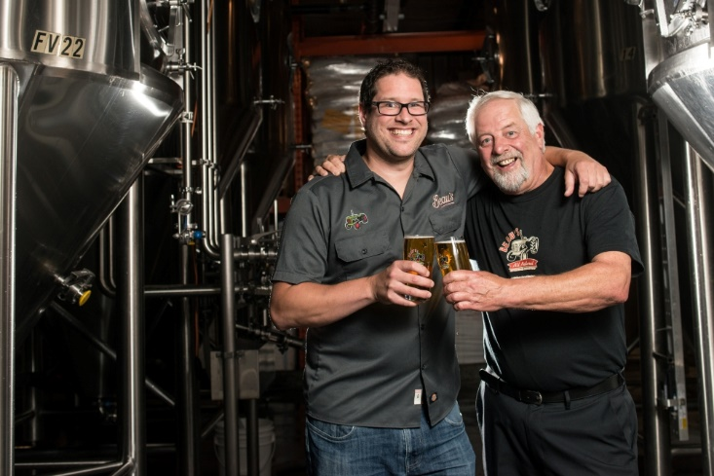

Slide 34
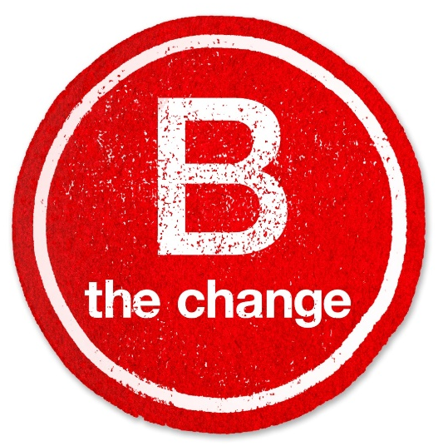
Further Resources
Me! Steve Beauchesne, Beau’s All Natural Brewing steve@beaus.ca
B Corp Handbook (2014) by Ryan Honeyman, Available from Amazon.ca
Quick Assessment Tool from B Lab (20 minutes): www.bcorporation.net
Provision Coalition (KPIs and other tools): www.provisioncoalition.com

