Slide 1
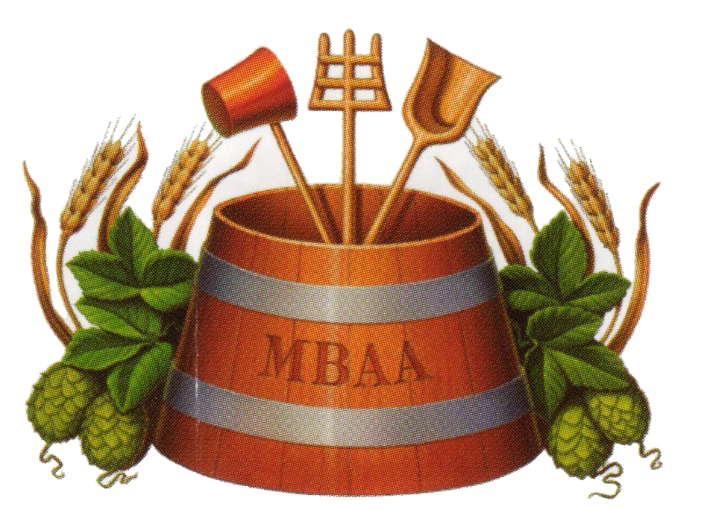
Adapting Beer Recipes Between Breweries

Slide 2
The Contract Brewer Perspective

Slide 3
1,800 BC
The earliest known recipe for beer is recorded.
Notes:
Written as a hymn to the Sumerian goddess Ninkasi
The eleven-verse hymn has been described as a linear description of brewing.
This

Slide 4
Two perspectives

Slide 5
Two perspectives

Slide 6
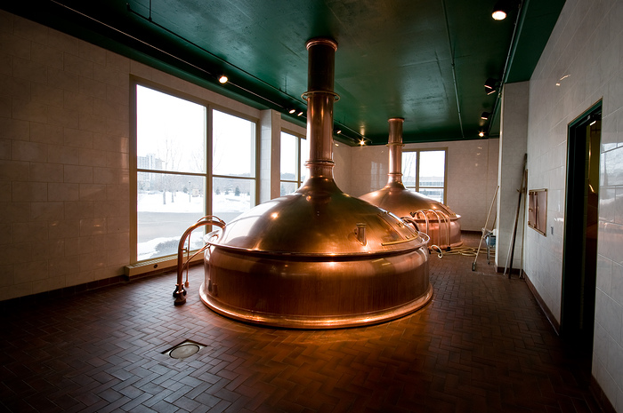
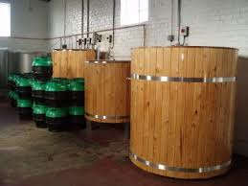
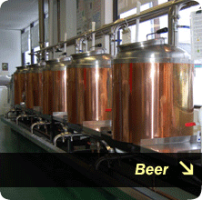

Slide 7
Challenges
As a contract brewer there is limited control over raw materials
Yeast availability may vary
Invariably there is a different water profile
Invariably the brewing equipment is different

Slide 8
Water
Water is the terroir of beer. Not only do you have typical water profiles for your various products but each brewery may have very different water profiles.
There is only so much you can do at a craft brewery level. Unless you are using reverse osmosis water you can only approximate the profile you want

Slide 9
Malt
If your host brewery uses bulk malt you are likely stuck with whatever supplier they have.
Specialty malt may be something you can order or in some cases you will have to find substitutions from the supplier your other brewery uses.

Slide 10
Hops
Your second brewery may already have hop contracts that don’t include your preferred hop varieties.
If you have hop contracts yourself you can ensure the same hops for each brewery.

Slide 11
Yeast
My experience is that breweries willing to do contract work have particular house strains they want to use and are reluctant to introduce new strains.
You may have to modify the recipe to account for different attenuations or different ester contributions.

Slide 12
Equipment
Mash tun efficiencies
Evaporation at boil – hop efficiency
Fermenter configuration

Slide 13
Tools at your disposal
Few breweries will have analytical tools for alcohol, IBUs, etc
Most will be able to measure carbonation levels.
Your most reliable tool is your taste.

Slide 14
Software tools

Slide 15
Sample recipe

Slide 16
You can establish the units you wish to use

Slide 17
Choose water profiles.
Establish a preferred water profile for your beer

Slide 18
Tools for various calculations of colour, gravity, etc.

Slide 19
Calculations for utilization

Slide 20
Colour calculations

Slide 21
And most useful – a tool to scale a recipe taking into account the efficiency of the second or third brewery

Slide 22
How close can you get
Close
Contract brewing out of more than one brewery is basically to brew in various regions and eliminate shipping.
As such the product is not often sold in the same geographic area – limiting comparisons

