Slide 1
Brewery Wastewater Management: Why, What and How
Ontario Technical Conference – 2015
Master Brewers’ Association of Canada

Slide 2
Discussion Topics
BLOOM and our work with OCB
Why – the emerging issue of Wastewater Management
Municipal Perspective
Brewery Perspective
How to move ahead with Wastewater Management
Now
Future
Ongoing BLOOM brewing activities

Slide 3
About BLOOM
Change agent, acting as a “connecting bridge” between market demand, innovative solutions and public policy
Understand that solutions involve trade-offs
Will change as the business changes
Finding the right business balance that supports forward progress

Slide 4
BLOOM Approach
Simple and Pragmatic
First understand the issues and needs of the sector and its participants
Uncover opportunities and explore pragmatic solutions
Support adoption of solutions to drive tangible and measurable results

Slide 5
Project Background
Broad variation between craft brewery operations – influences their water and wastewater situation.
To shift from the status quo …
Now, Why and Where
Can then be strategic
What, How and When
FUTURE
TODAY

Slide 6
Project Description
Purpose - Support the improvement of water and wastewater management practices in the Ontario craft brewing industry
Outputs - Information and guidance necessary for breweries to plan and implement water and wastewater solutions within their operations
Success - Will be measured through meaningful business, operational and environmental improvements - both in the short and long-term

Slide 7
The Status Quo is Comfortable
Water consumption and wastewater management are lurking business issues for breweries – not yet impacting the bottom-line
Perceived abundance of quality, affordable water in Ontario – as well as easy, low-cost wastewater disposal
“Off the radar” versus other business issues

Slide 8
Why Change Now?
Emerging meaningful business risks and impacts associated with wastewater
Integrate it into your business strategy – not the other way around
Get ahead of the curve – when … not if
Control your own strategy and implementation timeline

Slide 9
Why – Risks & Impacts?
Direct costs tied to wastewater volume and strength
Sewer charges
Over-strength surcharges
Unplanned for and expensive compliance costs
“end of pipe” and not optimized
Growth restrictions
Embedded “Lost” value – products and by-products
Community and customer relations

Slide 10
Why
Take a moment to discuss one of your biggest “unintentional” single customers

Slide 11
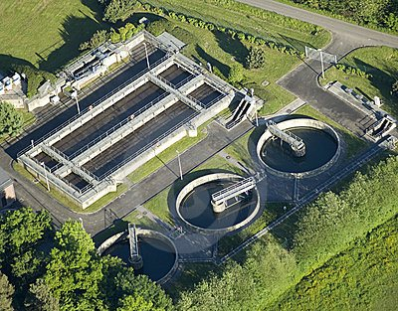
Why
Take a moment to discuss one of your biggest “unintentional” single customers

Slide 12
Why – Municipal Treatment
ORGANISMS
O2
FOOD
ORGANIC MATTER
CO2
ORGANISMS
Generally 4 phases – Preliminary, Primary, Secondary and Tertiary
Balancing act of physical, biological and chemical action to reduce or remove wastewater pollutants
Notes:
Preliminary - A treatment process consisting of screening and grit removal before the wastewater flows
on to other treatment processes.
Primary - A treatment process that usually consists of clarification by solid-liquid separation that
removes a substantial amount of suspended and floating matter.
Secondary - A treatment process that uses biological processes utilizing bacteria to remove pollutants, followed by clarification.
Tertiary - A treatment process that uses physical, chemical, or biological processes to remove
suspended solids and nutrients in wastewater to accomplish a level of treatment greater
than what can be achieved by secondary treatment.

Slide 13
Why – Balancing Act
System limits – flow and strength
Too much organic Loading (BOD)
Drive up cost of adding O2 – a max limit to O2 saturation
Could kill bugs and wipe out system
Excess sludge
Too much flowrate
Could reduce treatment time and cause safety issue
TSS and other parameters – i.e., P and TKN
Excess sludge production
Foaming and fouling
What is your impact?

Slide 14
Why – Surcharges
Municipal Discretion to recoup costs of over strength
Model Sewer Use Bylaw (MOE 1988)
Implement, revise or ignore
Typical surcharge parameters include BOD₅ (300), TSS (350), TP (10) and TKN (100)
Additional surcharge parameters could include phenols, FOG, and sulphate

Slide 15
Why – Surcharges
Example Cost Equation
Surcharge can be additive for each parameter or only for the most out of compliance
Over Strength Surcharge Review for Toronto Water, City of Toronto - June 2012 - Stantec
(Over Concentration x Volume x Parameter Cost Factor) = $

Slide 16
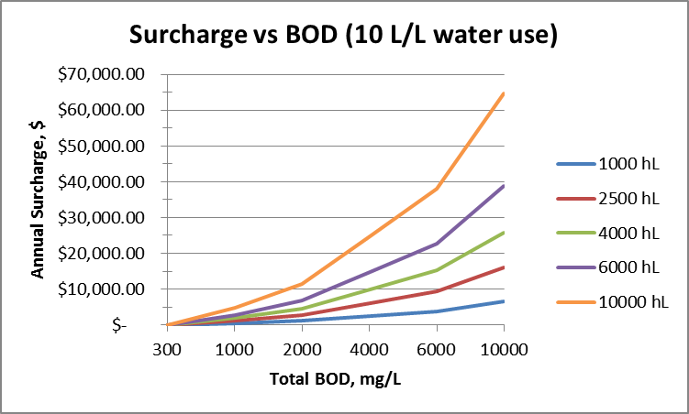
Why – Effect of Volume & Concentration
Brewery Size

Slide 17
Why – Effect of Volume & Concentration
Brewery Size

Slide 18
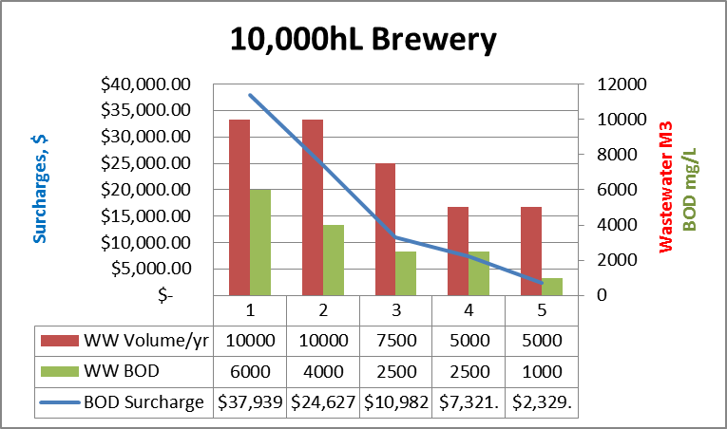
Why – Effect of Volume & Concentration

Slide 19
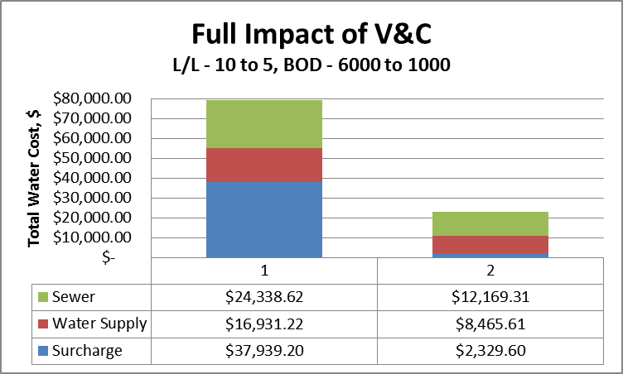
Why – Full Water Cost
$56,000 (71%)

Slide 20
Brewery Wastewater
What is in it?
Component | BOD (mg/L) | TSS (mg/L)
Purchased Water (less what is in beer)
Lost Beer | 90,000-100,000 | 30
Spent Grains and Trub | 85,000 | 35,000
Yeast and beer | 140,000 | Approx. 10% dry solids (50% wet volume)
Cleaning/Filter Aids | 135,000 | 60,000
Labels | Paper pulp, ink and adhesive
Energy | Wasted heat
Notes:
The total volume of surplus
yeast represents about 2 to 3 % of a brewery‘s output.
Approximately
50 % of the volume of surplus yeast is beer, which
is lost to the brewery if the slurry is sent untreated to farms
or food producers. If yeast is discharged into the sewerage
system, very high treatment charges arise because of the
very high biological oxygen demand. The average B.O.D. value
is around 140,000 mg/kg.

Slide 21
What – Brewery Wastewater
Must address both are volume AND strength
Source | Volume | BOD | Solids
Bottle Washer | Very high | Medium | Medium
Fillers | High | Low | Very Low
Pasteurizer | High | Low | Very Low
Fermentation | High | Very High | Very High
Filtration | Very low | Low | Very High
Brewhouse | low | Very High (Trub) Very High (Lauter Tun) | Very High (Trub) Very High (Lauter Tun)

Slide 22
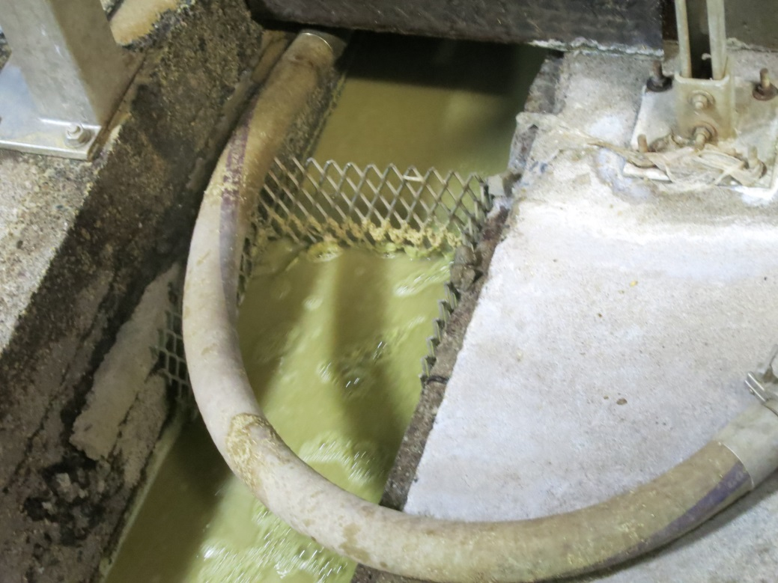
What – Not Down the Drain
Easy to say, but has its challenges
Volume – using 8-12 L/L beer
Common Practices
Trub
Residual spent grain
Yeast
Beer (~10%)
Others

Slide 23
How – Brewhouse
Spent Grains, Trub and Hops
Diligent getting them out of vessels – avoid rinsing to drain
Sweep them from floor – avoid rinsing to drain
Install fine enough screens in drains to catch before going into piping
Properly designed settling tank to catch before discharge to sewer
Divert to farmer and/or solid waste (as applicable)

Slide 24
How – Fermenter/Aging
Surplus Yeast
About 10% dry solids in fermenters
Approx. 50 - 60% (volume) Beer in fermenters
Options – Beer recovery or not
Enhanced settling (another tank, liquid to sewer and high % solids to farmer/solid waste)
Physical processing
Recover beer and divert high % solids (i.e., centrifuge)
Biodigest liquid and divert high % solids
Others?
Notes:
Centrifuges
Presses
Filtration – crossflow MF

Slide 25
How – Drains
Keep brewery drains separate from hospitality
Future Proof
Ensure access to sewer streams (don’t bury them)
Be able to collect and treat drain sources – without dealing with full volume
Sumps and/or diversion points
Balancing tank to smooth spikes/surges
Production
Cleaning / Sanitizing
Notes:
Centrifuges
Presses
Filtration – crossflow MF

Slide 26
Current Activities
Process level effluent sampling and analyses
Production
Cleaning/Sanitizing
Water Use Metering
To make a change, we need data on where it is being used and how
Solids Management
Diversion
Wastewater Management
Guidance and Tools

Slide 27
Brewery Guidance and Tools
Determining water use and wastewater composition within the brewery.
Regulatory factors
Appropriate solutions to reduce wastewater strength and volume
Performance and Business Case
“Business relevant” water metrics
Potential demonstration opportunities for on-site wastewater management solutions

Slide 28
Solution Providers
Provide feedback and insights to solution providers about the needs, expectations and constraints of Ontario’s craft breweries:
Wastewater composition and behaviour
Footprint
Modularity
Scalability
Mobility
Easy to utilize and operate

Slide 29
Final Thoughts
3 Change Components:
Start (Why)
End (Where)
Path (What and How)
Data and information:
Necessary to support business decisions, strategy and management
Performance AND Business Case
Solutions:
People AND Processes AND Technology

Slide 30
Stay Tuned

Slide 31
Contact Information
Michael Fagan
Senior Vice President
mfagan@bloomcentre.com
905.842.1115 x227

