Slide 1
Adapting Beer Recipes Between Breweries
Kevin Hryclik
Notes:
As a regional brand grows in popularity and distribution expands to other provinces or countries it won’t take long before someone in Operations suggests this brand be brewed in locations closer to the market. Considering that the cost per Hls of Logistics can be the same as brewing and packaging combined, there is a big economic incentive to achieving this goal.
However one must first overcome any potential blockades that your marketing group has put into this project path, as they may have highlighted the benefits of exclusively brewing the brand at this one location.
So the priority of brewing a commercially matched beer in the new brewery location is of paramount importance.
I hope this presentation can help outline some of the key areas to consider if one has to under take this project.

Slide 2
Discussion points:
Ingredients – What variability can you allow, if any, between sites?
Brewhouse – Where are the potential variables between operations?
Fermentation – Considerations for vessel types and yeast strains.
Aging and Filtration – What are the critical processes?
Beer Style considerations – which are the most challenging?
Sensory – What are the program considerations to help you achieve good product match between multiple breweries?
Notes:
Typically one does not have the luxury of being able to pick a new brewery location that has the identical brewing equipment as the current site where the brand is being brewed.
This slide outlines the main areas to focus on to achieve a commercial match on beer recipes brewed at multiple locations.

Slide 3
Ingredients
Water
Typically water is adjusted to give a consistent calcium concentration. This is achieved through the use of calcium chloride or calcium sulphate additions. Calcium will affect malt enzymes & yeast performance.
In regions with extreme water hardness ion exchange systems can be utilized.
Alkalinity may also play a role depending on the yeast strain; this is typically controlled via acidification of brewing water.
Notes:
So let’s start with ingredients.
The most critical one that makes up the largest contribution to the recipe is water.
You want to ensure you have the proper concentration of Calcium in your mash water. This can be achieved with Calcium Chloride or Calcium Sulphate additions. Depending on the brand these brewing salts may be interchangeable.
Hardness is a consideration.
Alkalinity can affect how yeast flocculate and as such can influence the fermentation performance.

Slide 4
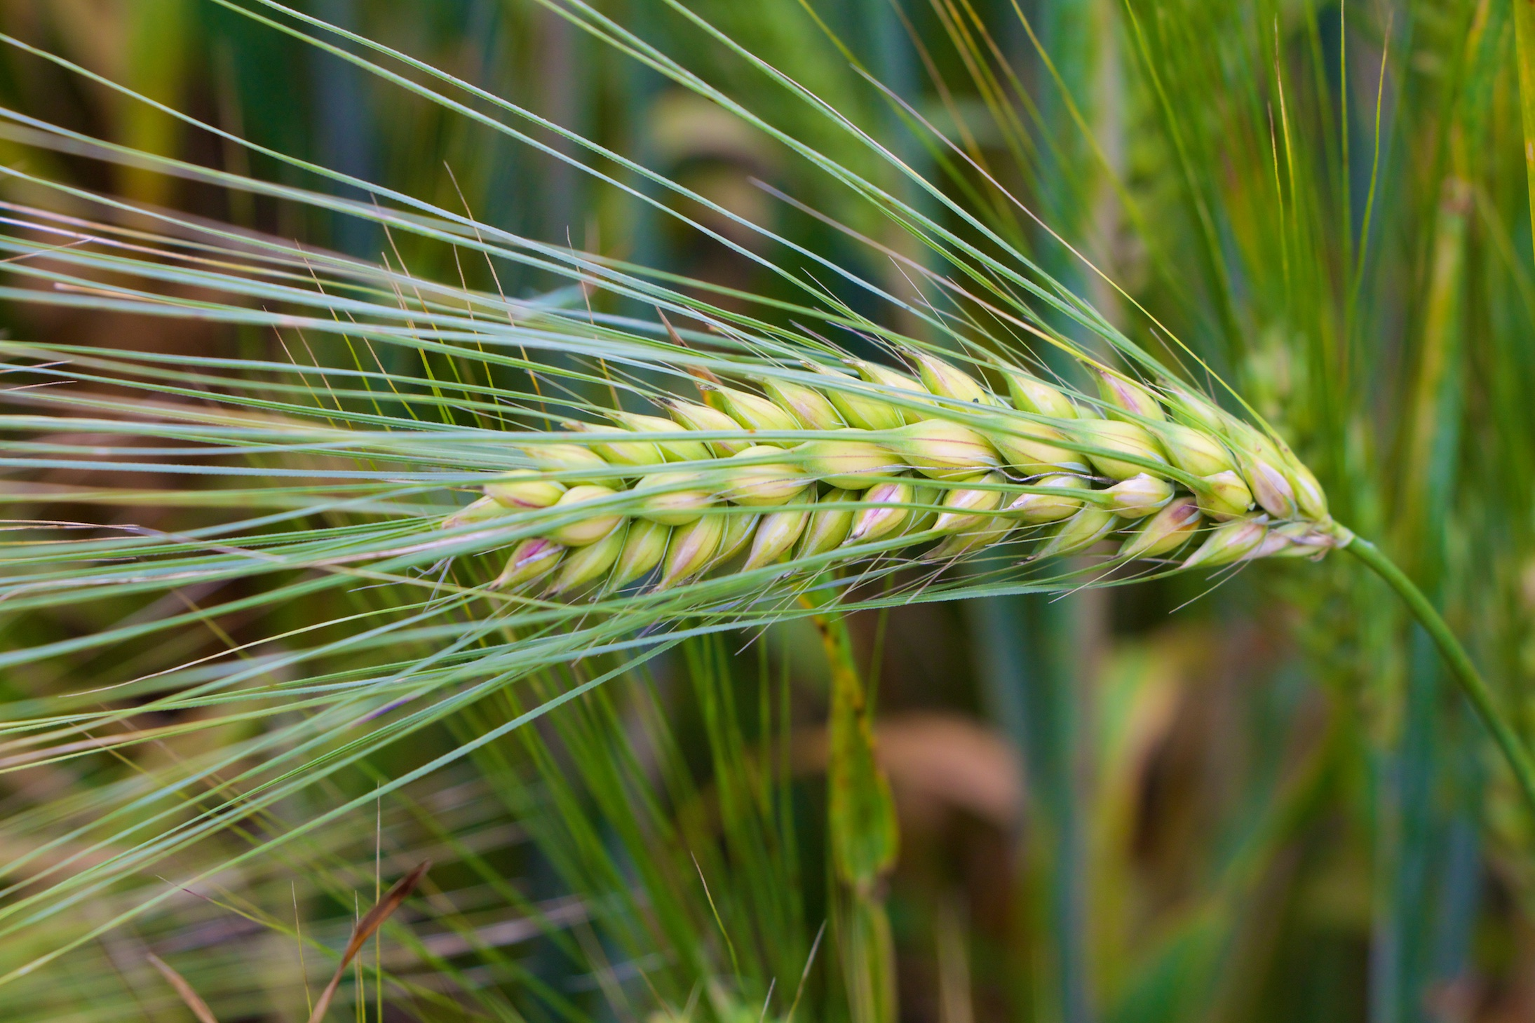
Ingredients
Malt
6 row vs 2 row malt blends
Some brewers use a blend of 6 row and 2 row malts in their brewing recipes.
Historically this was done to increase the overall enzymatic activity level since 6 row typically contributed a higher enzyme level than 2 row malt.
2 row malts have improved in terms of enzyme levels and the need to include 6 row is not required from a enzyme level perspective.
The blend requirements today are more driven by economics; recipe matches can be achieved with 100% 2 row malts vs. a blend of 2 row and 6 row malt.
Notes:
In some situations you may not have access to the same ingredients at the selected brewery where you want to expand production of the brand.
How important is it to get the exact duplicate blend of malt?
Some brewers use a blend of 6 row and 2 row malt.
Historically this was driven by the need to have good enzymatic activity, and one included 6 row malt to achieve this.
2 row malts have improved over the years and the need to include a blend of 6 row has diminished.
Other factors to consider then come down to overall malt performance which will have the brewer engage in discussion with the maltster on Beta Glucan levels, protein levels, extract, etc.

Slide 5
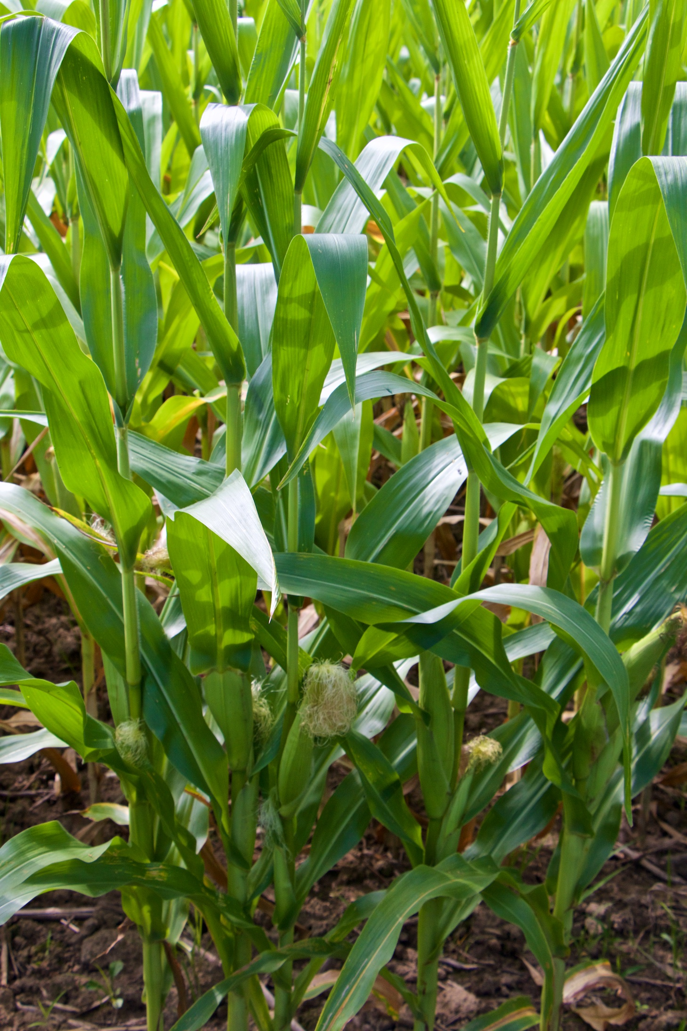
Ingredients
Adjuncts
If a recipe has a % of the extract derived from an adjunct such as corn or rice you will want to maintain this ratio vs. trying to match using a 100% malt derived extract source.
Corn grits vs. maltose (brewer’s blend) syrups can be used inter-changably. The decision to use which one is based on the equipment set up at the brewery (cereal cooker capability) and by economics.
Care must be used in determining the syrup type. Some yeast strains may be more susceptible to incomplete fermentations if high dextrose syrups are used. The yeast’s ability to bring in maltose for fermentation can be inhibited if dextrose (glucose) levels are high.
Notes:
Adjuncts are the extract portion of the recipe not derived from malt. Typical choices are corn or rice.
Some brewers will require that a particular type of adjunct is used. For most brewers you will find that the type is inter-changeable and typically economics will drive the choice.
The choice between using corn grits vs. brewers grade corn syrup is usually based on existing equipment capabilities.
One has to be careful on the make up of the brewer’s syrup if this is the choice of adjunct. Syrups too high in glucose can have a feedback effect on the yeast and could result in incomplete fermentations.

Slide 6
Ingredients
Hops
2 main considerations are the bittering and aroma hops
Bittering hops should be inter-changeable. One will just have to adjust the amount to compensate for alpha acid content differences and boiling extraction differences.
Aroma hops must not be changed since they are an integral component of the finished beer flavour. Adjustments on the timing of the aroma hop addition may be required due to the different kettle boiling characteristics. This may vary from 15 min before strike out right up to addition at strike out.
Notes:
As you are aware hops provide both a bittering component and an aroma component to beer.
My experience with bittering hops is that the varieties are inter-changeable. These are typically added at start of boil or kettle full and do not contribute appreciably to the aroma.
Aroma hops however, must be matched. The variable that you may need to play with is the timing of the aroma hop addition. This is due to the differences one can see between kettle boils. One kettle may drive off more aromatics than another.

Slide 7
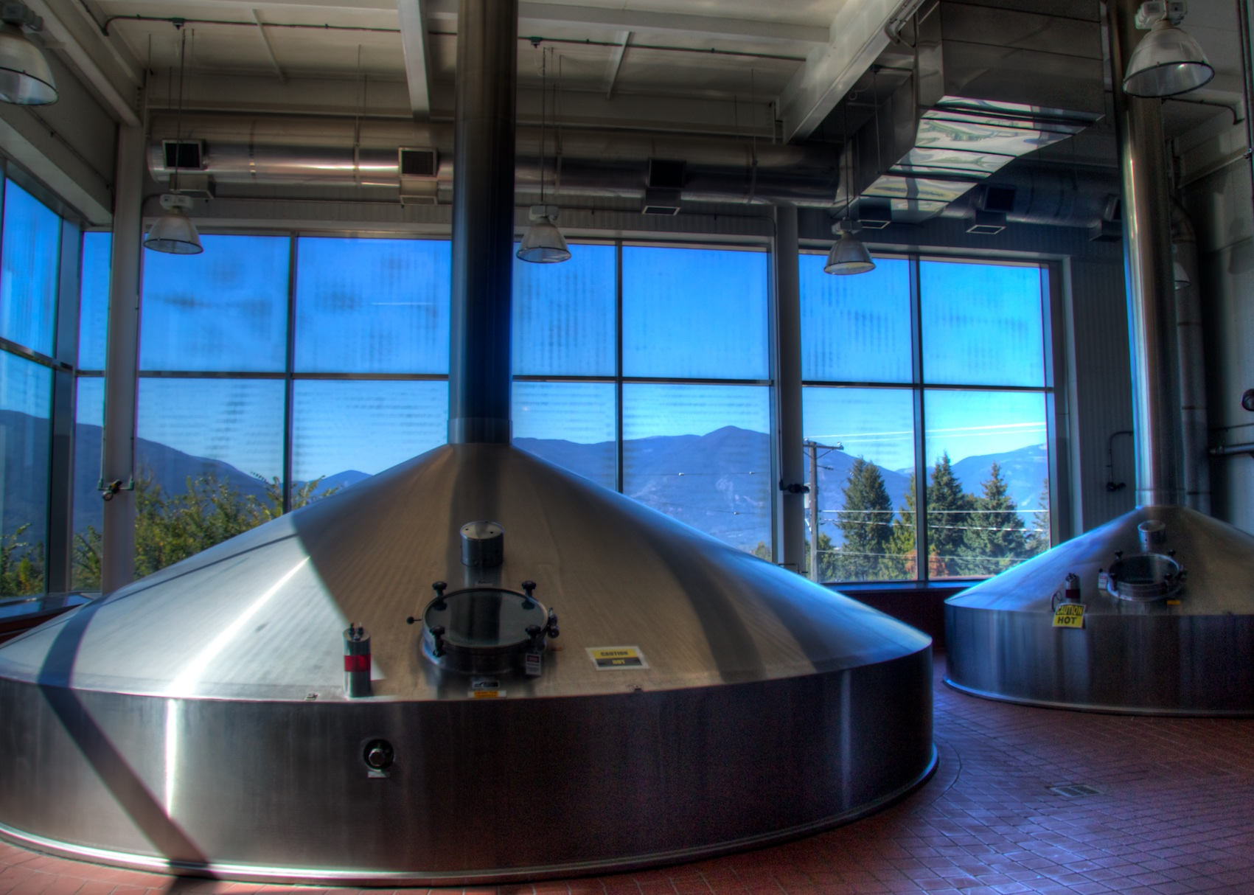
Brewing Vessels
Mash Mixer
Capabilities of mashing in with water addition at the same time (voremashing) vs. all water in first & malt dropped in on top, will have an effect on the wetting of the ground malt. More time at protein rest will be required if no voremasher is in use.
Different vessel configurations and heating surfaces will give varying rates of rise during the heating phases. Compensation for conversion will be required for both the rest temperature and time of rest.
Notes:
Now let’s move onto the equipment side of the challenge.
The 2 main vessels I want to comment on are the mash mixer and kettle. These will influence the recipe more than the lauter tun or whirlpool.
Not all mash mixers are identical in design. Malt addition systems can vary, heating surfaces may have more or less area, & mixer agitation can be different.
Understand what those differences are and adapt the recipe profile to compensate. You have control on the temperature set points, rest times and possibly agitator speed.

Slide 8
Kettles – boiling systems
Notes:
Moving on to the kettle.
This slide shows a 5 barrel percolator inside a kettle

Slide 9
Kettles – boiling systems
Notes:
Compare that to a kettle that is equipped with an external calandria and uses a pump to circulate the wort from the kettle through the heater and then back up the center of the kettle to a spreading plate as shown in this slide.

Slide 10
Brewing Vessels
Kettle
Many different kettle boiling systems exist. These include percs, coils, internal & external calandrias.
Boils need to achieve similar vigour and evaporation rates to give consistency.
Modifications to the steam feed will need to be reviewed to best match boiling characteristics.
Other considerations may be required such as open or closed door boiling.
As mentioned earlier, timing of the aroma hop addition may have to be altered to achieve the best product match.
Notes:
You may not have the luxury of finding an identical kettle boiling system in the brewery selected for brewing the brand.
You will have to know what rates of evaporation can be achieved and the ventilation draw up the kettle stack.
Compensation may need to be made to the steam controls and to the addition time of the aroma hop. In same cases you have have to extend or shorten boil times.

Slide 11
Fermenter Configuration
2 main types of fermentation vessels are in use today, horizontal and conical bottom vertical fermenters.
Adjustments in the main fermentation temperature at the initial phase of the fermentation may need to be adjusted to provide a flavour match to compensate for the type of vessel in use. The rate of fermentation can have an affect on the formation of flavour components such as esters and sulphur.
Timing for cooling on after the diacetyl reduction phase may need to be adjusted.
Notes:
Fermenter vessel types can play a role in the flavour produced during a fermentation.
2 main types of vessel configuration are Vertical Conical fermenters and horizontal “bread loaf” design fermenters.
The main control one has to influence fermentation is temperature.

Slide 12
Yeast Collection
The yeast strain being used may perform differently depending on vessel type. Yeast return ratios can be affected.
Notes:
Yeast return ratio refers to the amount of yeast one gets back once the fermentation has been complete vs. the amount initially pitched.
This can be difficult to control. Wort oxygenation, zinc addition and calcium levels are factors that will need to be reviewed.

Slide 13
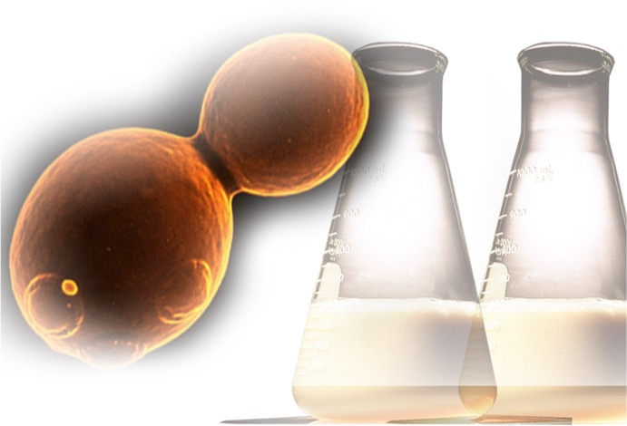
Yeast Strain Selection
Some beer types are very dependent on the yeast strain due to the flavours contributed by yeast during fermentation.
The decision on using alternate yeast strains can only be determined through trials and sensory evaluation.
Notes:
Some yeasts can contribute substantially to the finished product flavour and as such using an alternative yeast type is not an option.

Slide 14
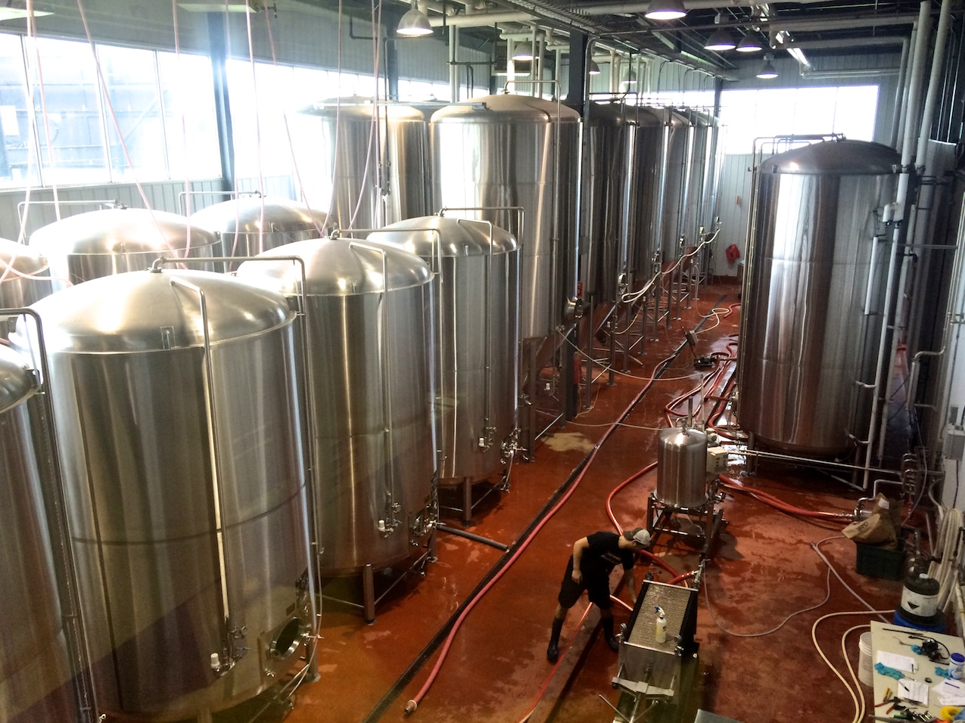
Aging
Good process control is required moving into aging to prevent off flavours from arising.
If centrifuges are being used, ensure these are operated with proper programing and controls in place to minimize oxygen pick up.
Establish consistent venting procedures on tank fillings and have a targeted CO₂ carbonation levels so consistent aromatic compounds are achieved.
Notes:
Moving onto Aging, the main factors to consider are good process control.
Primarily you want to eliminate the formation of off flavours such as oxidation
Sulphur aromas can be influenced by the control of CO2 levels and venting procedures during tank filling and storage.

Slide 15
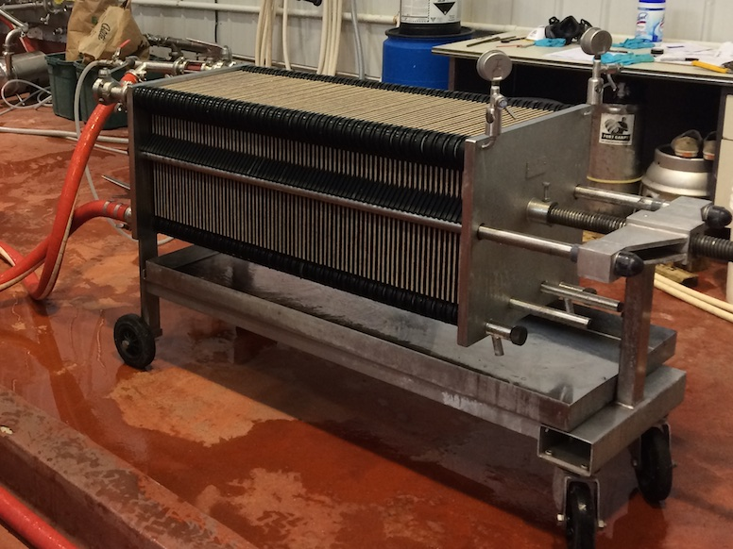
Filtration
Ensure best practices are in place to protect the beer as it is processed to bright beer.
These would include: line packing with low dissolved oxygen water, CO2 purging of pre-coat and body feed tanks.
The use of low dissolved oxygen water for the final alcohol adjustment (preferably added post filtration).
Notes:
Similar to Aging, this stage is again about good process control

Slide 16
Beer Style Considerations
What type of beer are you trying to make in multiple brewing sites?
Is the brand profile a subtle & light flavour or a robust, heavy flavour?
Your lighter brands will be the greater challenge.
Notes:
The biggest challenge you will have in matching recipes in multiple breweries is with light beers. When I say light I am referring to the overall flavour and not just about alcohol content.
Light beers are delicate and will show up flavour defects readily.
No great wisdom to pass on with this slide other than identifying that you will have to pay more attetion to detail if the brand you want to produce in multiple sites is a light beer.

Slide 17
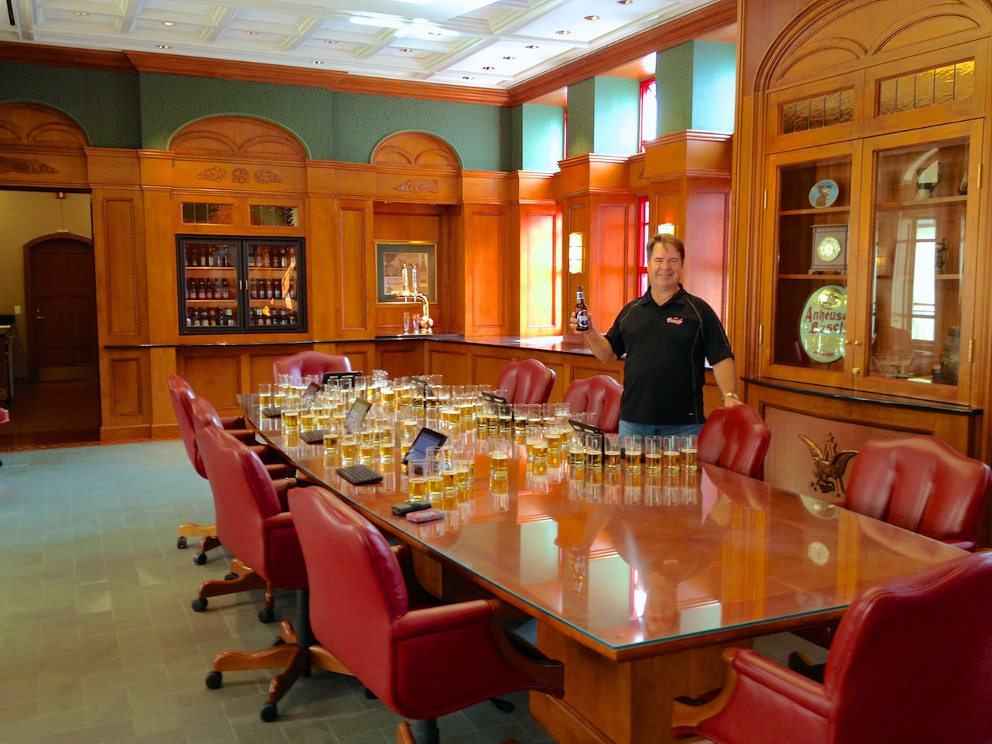
Sensory Program Requirements
To achieve product match from multiple brewing sites you need a disciplined sensory program.
Program requirements include:
Trained Sensory Panelists that have knowledge of flavour attribute and defect intensity training.
Understand how to describe and rate the flavour intensity in beers.
Develop a brand “True to Profile” map that describes the beer using product attributes and intensity levels. A beer should be mapped by highlighting the 7 to 10 main flavour characteristics of the beer.
Notes:
The goal is to have a commercial match on the same brand produced at multiple sites.
In order to achieve this you need to have a disciplined sensory program

Slide 18
Intensity Scale & Descriptors:
Notes:
The numerical scale I have experience with is from 0 to 9, where 0 describes that the flavour is not detectable up to the highest perceived level of very strong rated at a 9.
The use of this scale allows sensory panelists a common reference point to describe the beer they are evaluating.

Slide 19
Brand “True to Profile” Map
Notes:
This same scale can then be used to map out a brand’s “True to Profile” map. Sometimes referred to as a spider web plot.

Slide 20
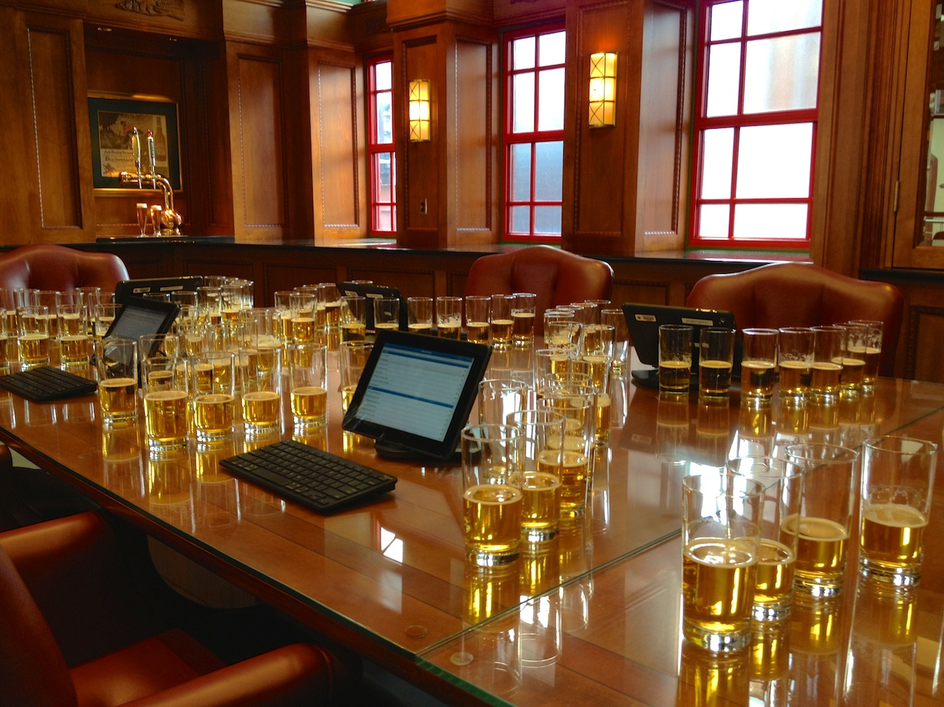
Sensory Panels:
Exchange samples between production sites on a weekly basis.
Conduct “True to Profile” panels and give an overall rating for the beer.
The panel scores will tell you if you are achieving a commercial match on the brand between multiple brewing sites.
Provide feedback to production sites on how their beer is performing and if there are particular trends being noted from the sensory panelists.
Notes:
It is critical that your panel meets to evaluate the product profile match on a frequent basis.
Panel scores will tell you if you are achieving a commercial match. We are not looking for perfect scores, but we are looking for consistency and if a scale of 0 to 9 is being used to rate the overall “Trueness to Profile” then if you are achieving a score of 7 or greater on a regular basis, one can conclude a commercial match is being achieved.

Slide 21
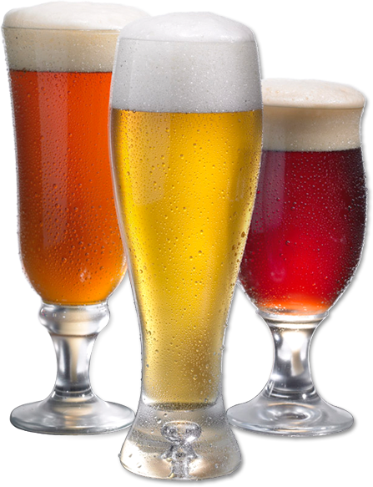
Summary
Many factors can be involved in matching beer recipes between brewing sites.
This will be influenced by the beer type, the yeast strain used, raw material selection and equipment designs.
You need to be aware of the factors that you must match and ones you have some ability to vary.

