Slide 1
Master Brewers’ Association of the Americas
District Ontario 2015 Annual General Meeting

Slide 2
Agenda
3pm-3:30pm: Hospitality
3:30pm – 4:15pm: Matthew Letki – Canada Malting
4:15pm – 4:45pm: Denis Blais - Ecolab
4:45pm – 5:45pm: Phil Taylor - MBAC AGM
6pm – 7pm: Dinner

Slide 3
Officers and Committees
Technical Chair Kaitlin Vandenbosch
President Phil Taylor
Past President Ueli Schrader
Vice President/Membership Bill Lawrence
Board of Governors Chris Williams
Secretary Jonathan Morse
Treasurer Debbie Mowat
Education Committee Joel Manning/Ed Bridge
Golf Committee Helen Knowles
Curling Committee Chris Williams
Recruitment Committee Joel Manning

Slide 4
District Financial Update
Debbie Mowat - Treasurer

Slide 5
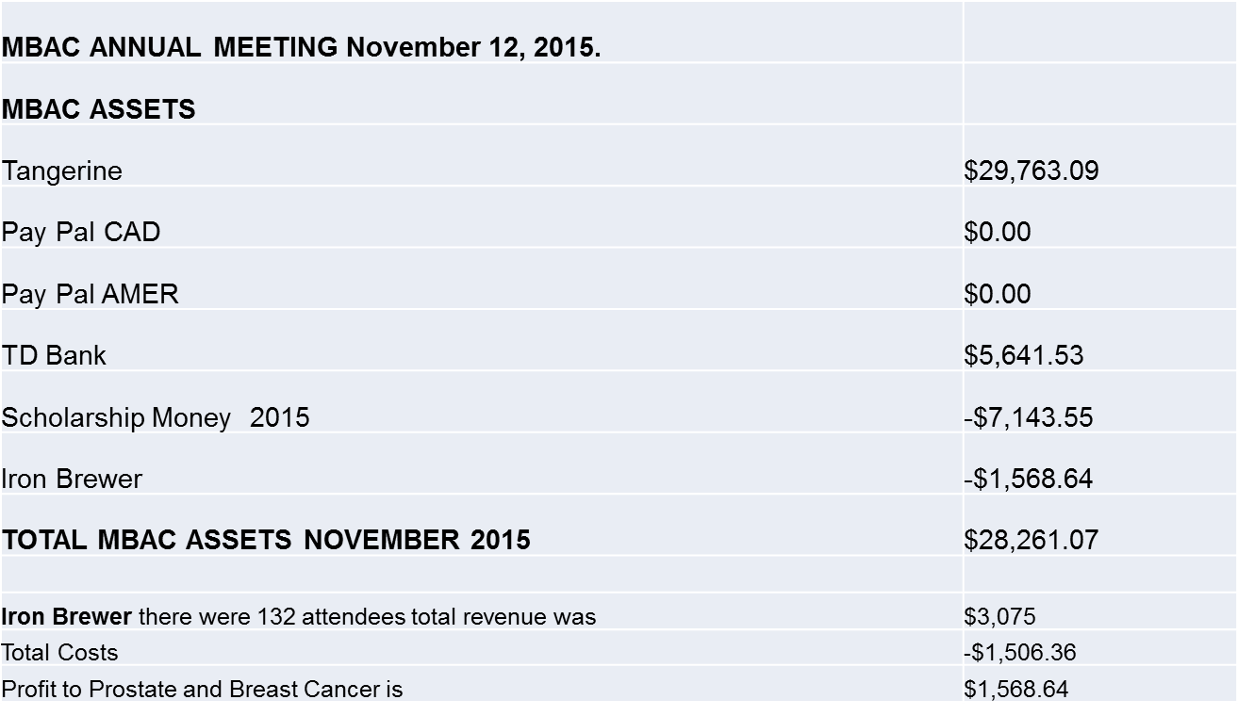
MBAA District Ontario 2015 Financial Update

Slide 6
District Membership Update
Bill Lawrence – Vice President

Slide 7
District Membership
Current membership is 263, up 7.3% from last year.
There are 11 memberships that have just expired and most will be renewed.
The figures in parentheses are from 2014
Category | 2015 Membership | 2014 Membership
Brewery: | 144 | 126
Allied: | 98 | 95
Student: | 2 | 7
Honorary/Retired: | 19 | 17

Slide 8
District Membership
A number of current members have 25 years or more of membership and will qualify for Retiree status when they retire.
If you want to know your status please contact me at blawrence@generalfiltration.com or give me a call.
You must maintain a Retiree membership to be kept on the membership list and be in the flow of information.

Slide 9
Education Committee Update
Ed Bridge

Slide 10
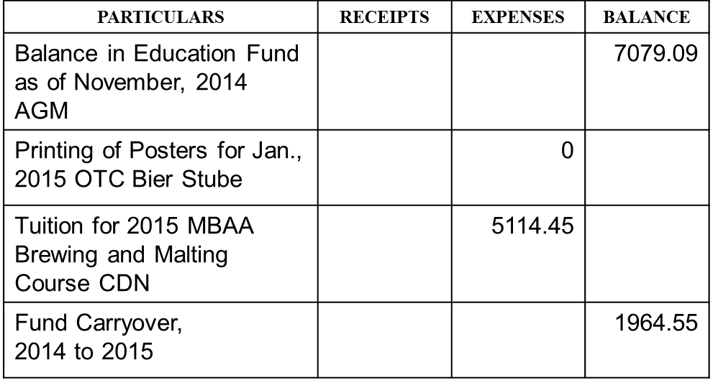
Education Committee Fiancials

Slide 11
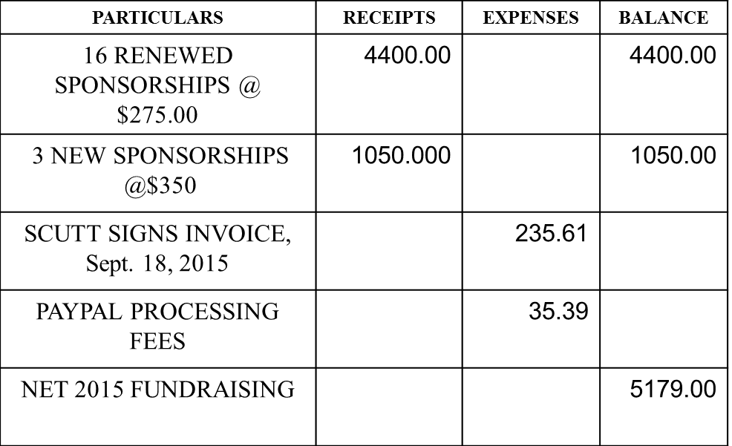
Golf Tournament Sponsorships

Slide 12
Education Committee Fund Summary
Balance in Education Fund pior to 2015 fundraising = $1,964.55
Net 2015 Fundraising = $5,179.00
Current Balance in Fund = $7,143.55

Slide 13
THE EDUCATION COMMITTEE AND THE MEMBERSHIP OF DISTRICT ONTARIO THANK THE FOLLOWING COMPANIES AND REPRESENTATIVES WHOSE SPONSORSHIPS OF HOLES AT THE 2015 GOLF TOURNAMENT HAVE CONTRIBUTED TO MAKING THE MBAC SCHOLARSHIP A SUCCESS:
BALL PACKAGING PRODUCTS CANADA DRAY SCURRY
BRUTECH PROCESS AND PACKAGING INC. JOHN BRUNNING
CANADA MALTING COMPANY LIMITED MATTHEW LETKI, ALLISON NIMIK
CARGILL MALTING AND CORN MILLING HOWARD LOW
CEMCORP STEVE HARKNESS
ECOLAB ROB HAY
GEA PAUL SCOTT & STEPHEN PAPPAS
HDP MACDONALD STEEL JOHN CRESSMAN
INGREDION CANADA INCORPORATED LANCE MACLEAN
KRONES MACHINERY CO. LTD. WAYNE CONFIANT
LAPORTE ENGINEERING INC. DAVE LALANCETTE
L.V. LOMAS LIMITED ALLEN SCHWARTZBERG
McRAE INTEGRATION ANDY BENTLEY
NOVABRӒU BY QUALTECH PADDY FINNEGAN & UELI SCHRADER
PROMINENT FLUID CONTROLS MIKE BUCKLEY
ROSS HARTRICK TANK LININGS GUY AND LEE ZACHARCZUK
SANI MARC FOOD & BEVERAGE BART SCHUURMAN HESS
SEALED AIR FOOD CARE TROY MATTEOTTI
TRAXXSIDE TRANSLOADING ROBERT HAVEKES

Slide 14
MBAC Education Committee Scholarship
A scholarship is to be awarded to any of the MBAA courses: Brewery Packaging Technology, Brewing and Malting Science, or Brewery Utilities and Engineering.
Applications are due by January 1st, 2016.
Application can be found at District Ontario tab on www.mbaa.com.
Application is the same as MBAA’s Hipp Scholarship, so be sure to apply to both.
Winner will be announced at the January, 2016 MBAC Ontario Technical Conference.

Slide 15
MBAC District Ontario Scholarship Previous Winners
2007 IAIN McOUSTRA AMSTERDAM
2008 ANDRE KLINKER AMSTERDAM
2009 CATE McFALLS SLEEMAN
2010 MARY ELIZABETH KEEFE THE GRANITE
2011 JAMES YII-JEN TIEN MUSKOKA
2012 SCOTT PETERS MILL STREET
2013 BRIDGID YOUNG MILL STREET
2014 MARTA HOROFKER MOLSON COORS
2015 SIOBHAN McPHERSON AMSTERDAM
Add your name to this distinguished list. Apply today!

Slide 16
Technical Committee Update
Kaitlin Vandenbosch – TechCommittee Chairperson

Slide 17
Technical Committee 2015 Members
Kevin Clark
Dave Coutts
Paul Dickey
Wakelin Fulford
Erica Graholm
Steve Harkness
Kevin Hryclik
Jonathan Morse
Vera Morton
Ueli Schrader
Phillipe Taylor
Elyse Vaile
Ivona Wojdyla
James Yii-Jen Tien

Slide 18
2015 Tech Committee Events
Technical Conference
Springfield Meeting
Barley Field Day
Hop Field Day
Iron Brewer
Annual General Meeting
Coming in 2016
Technical Conference January 28th and 29th

Slide 19
2015 Hop Field Day
The first ever Hop Field Day was held on August 12th at Bighead Hops, Meaford.
30 people attended this event. Wonderful weather and very educational and enjoyable field tour lead by Nicholas Schaut. Evan Elford, OMAFRA gave an overview on local crops and updates on current research projects.
Followed by tour at Side Launch Brewery with Michael Hancock who shared his love and passion for his beer & new brewery

Slide 20
Hop Field Day
Thanks to Bighead Hops and Side Launch Brewery for hosting this event.
Thanks to MacLean’s Ales Inc., Collingwood Brewery, Northwind Brewhouse & Eatery, Wellington Brewery and Stonehammer Brewing for beer donations.

Slide 21
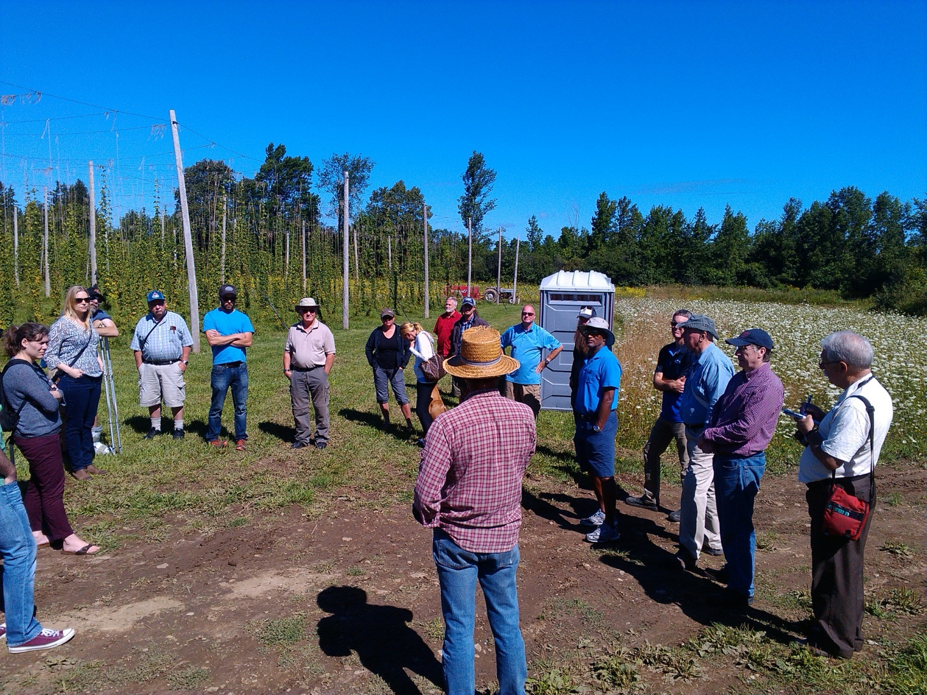

Slide 22
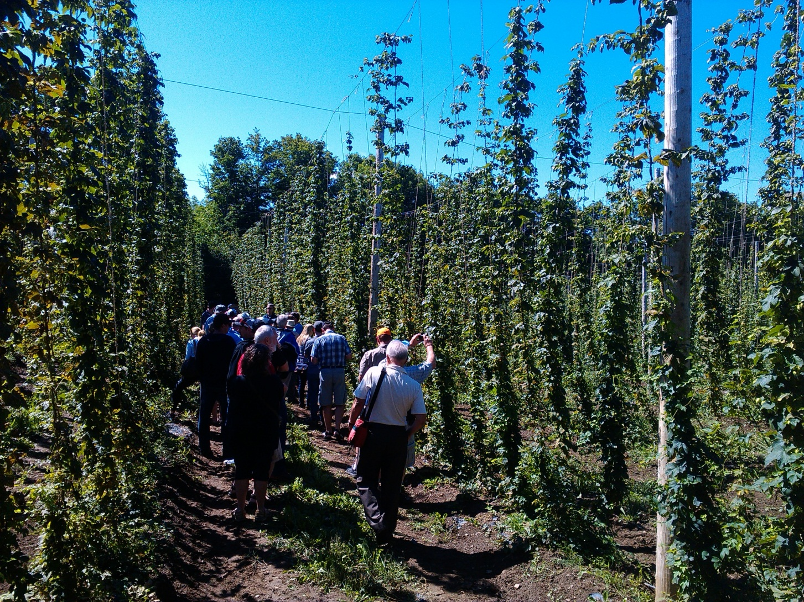

Slide 23
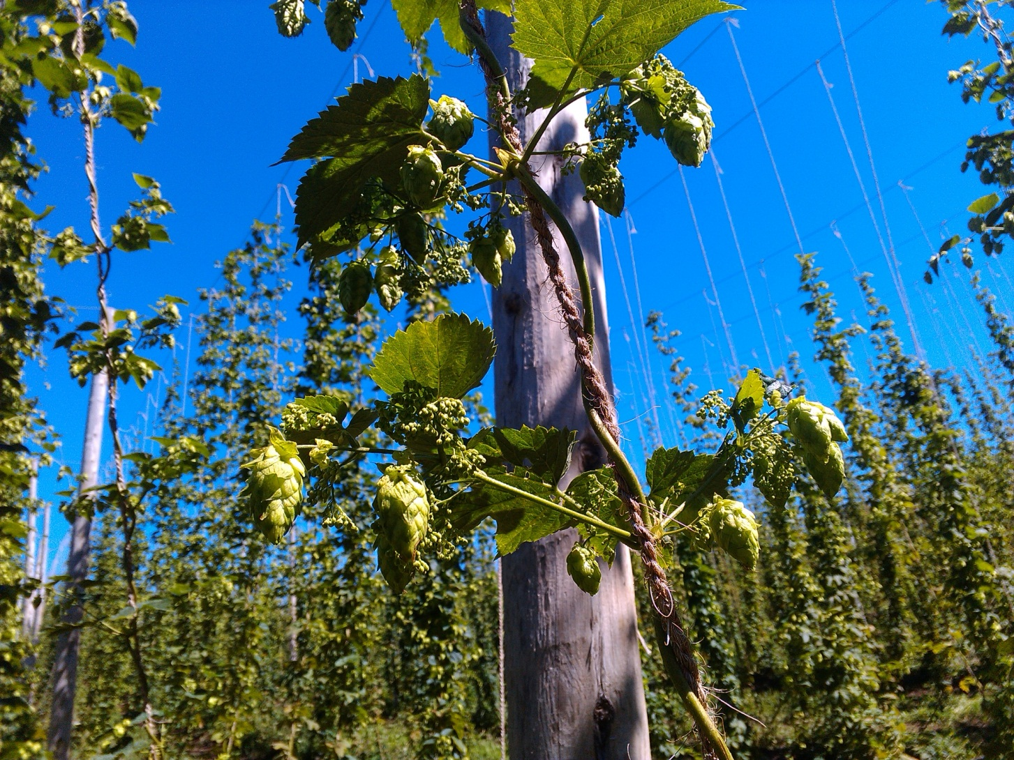

Slide 24
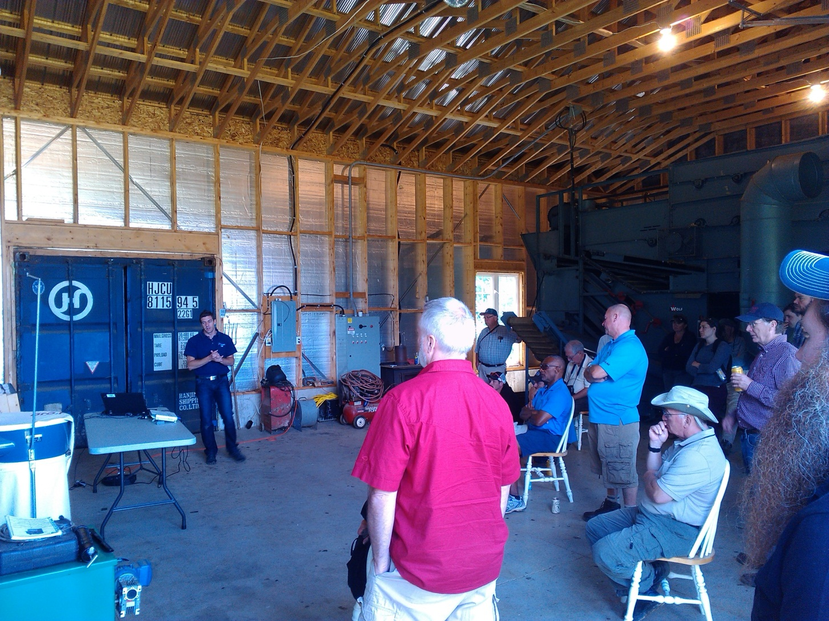

Slide 25
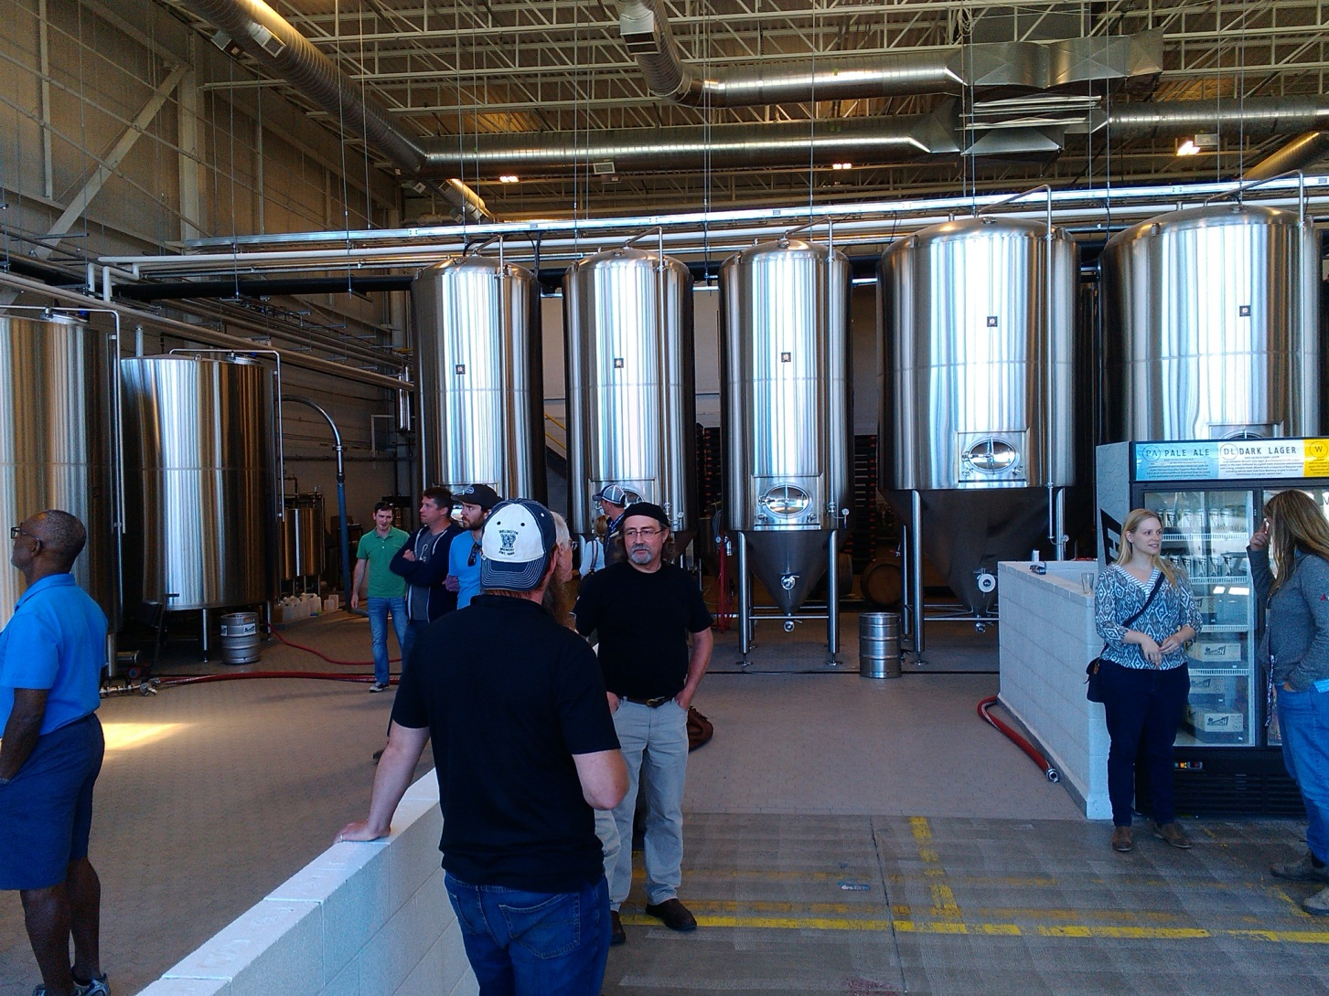

Slide 26
2015 Iron Brewer
All supplies were generously donated by Canada Malting/Country Malt, BGS Canada, Charles Faram Brewing Supplies, Harvest Hop & Malt, Winterbrook Farms & Scott Laboratories.
A big thanks to Mill Street for hosting the event.

Slide 27
2015 Iron Brewery
The Iron Brewer event was held on September 25th at the Mill Street Beer Hall in the Distillery District
Over 130 members and guests were in attendance to sample the creations of the 15 brewers.
A broad range of beers was presented by the participants. All were well-received and the voting for the favourite beer provided some challenges.

Slide 28
2015 Iron Brewer
2015 Iron Brewer included
Iron Brewer award
People’s choice certificate

Slide 29
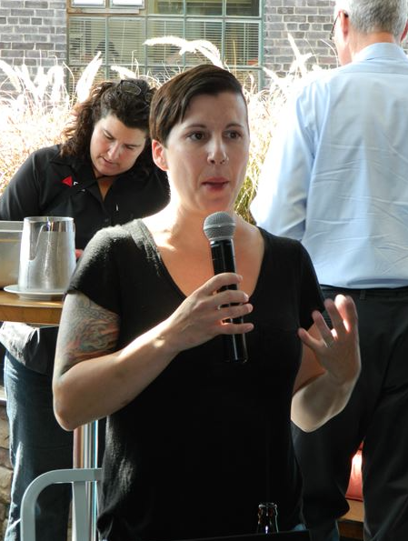
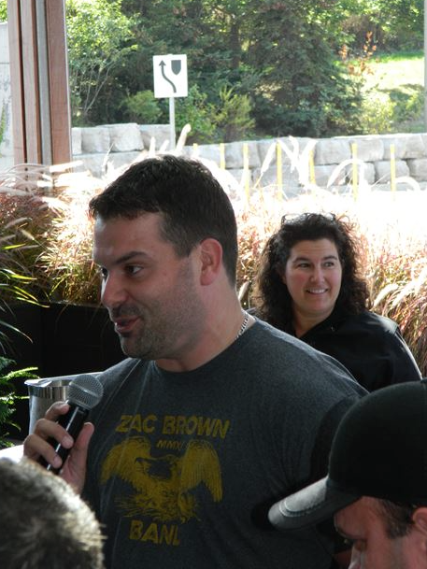
2015 Iron Brewer
People’s Choice
3rd place 2nd place
Erin Broadfoot Josh Bell

Slide 30
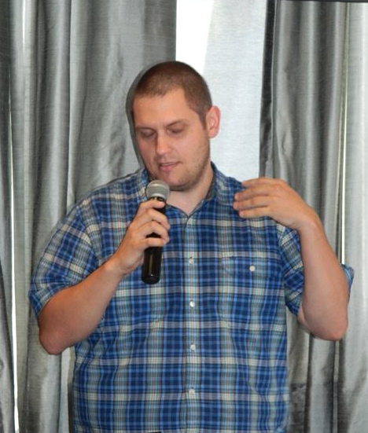
2015 iron Brewer
The People’s Choice
Nick Muzzin

Slide 31
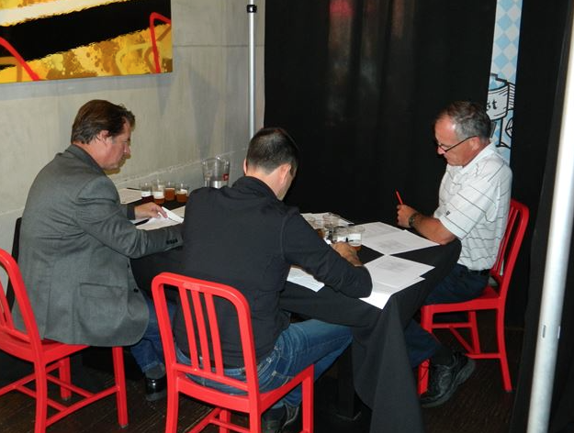
2015Iron Brewer
The Judges hard at work

Slide 32
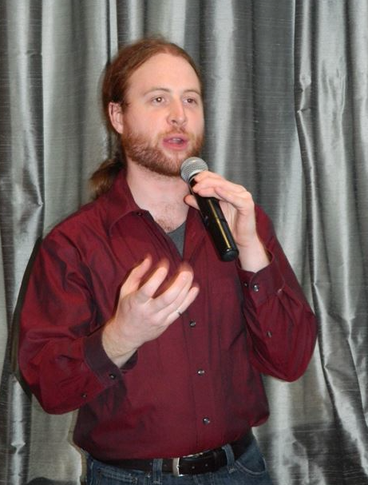
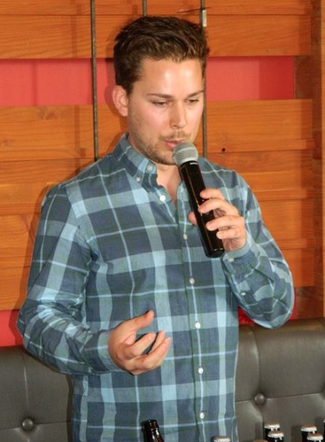
2015 Iron Brewer
The Iron Brewer
3rd Place 2nd Place
Kyle Smith Jordan Mills

Slide 33
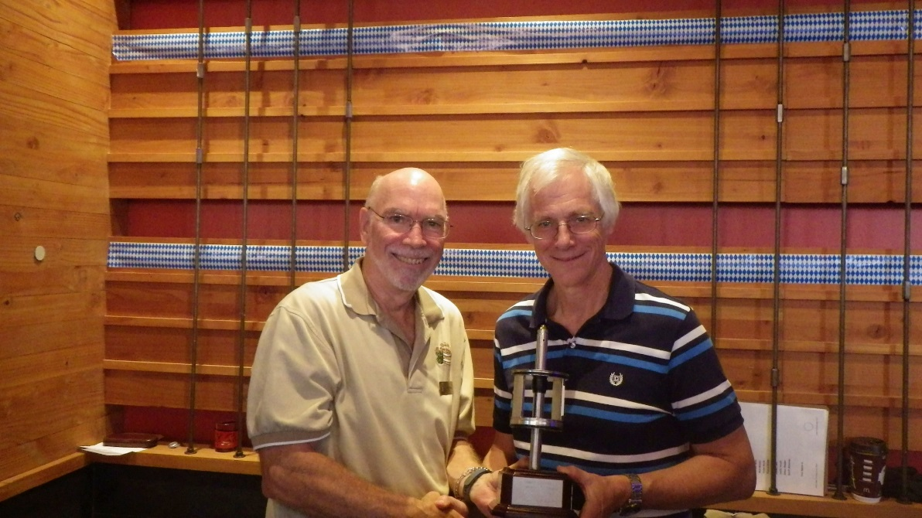
2015 Iron Brewer
The 2015 Iron Brewer
Ian Johnson

Slide 34
2015 Iron Brewer
2015 Iron Brewer
All net proceeds will be donated to
Breast Cancer & Prostate Cancer
This amounted to over $1,660

Slide 35
2016 Technical Conference
Beer Distribution in Ontario
Quality Systems
Traceability
Centrifuges
Automation Scale-Up
Energy Recovery
Dried Yeast

Slide 36
Join the Technical Committee!!!
We are looking for a new Technical Chairperson for 2016
New members to the committee are always welcome!

Slide 37
Board Of Governors Update
Chris Williams – BOG Representative

Slide 38
Board of Governors 2015 Update
Insurance Officer and Director insurance $1200 / year
Technical Directors Mark Sammartino, John Bryce
WBC 2016 Denver, April 13 to 17, 2016
District Boundaries With many more “small” breweries, becoming an issue
Brewing Guilds Every state in US, OCB
Volunteerism Drives the Association
Scholarship Opportunities Many at National Level not being distributed
MBAA Member Value Tech Resources, Communications/Networking, Discounts
Financial Report MBAA Central, 2014 – Email Chris Williams and he will get you a copy
Membership Equity ~$2.3M

Slide 39

Thank you!

